Slide 2
CONTRACEPTION
Prof Tallat Farkhanda
Dean & Head of Department Obs/Gynae
Rawalpindi Medical University
Rawalpindi

Slide 3
LEARNING OBJECTIVES
At the end of this lecture learner will be able to
Define contraception
Enlist different types on contraceptive methods
Describe how to start hormonal contraceptives
Enlist contraindications for different hormonal contraceptive
Understand the approach for missed pills
Understand male and female sterilization
Describe new development in contraception

Slide 4
PROF UMER MODEL OF INTEGRATED LECTURE

Slide 5
CONTRACEPTION
Is defined as avoidance of pregnancy by different methods other than avoiding coitus and hysterectomy.
The ideal method is one which is 100% effective ,acceptable, tolerable ,reversible and useable
No method is 100% effective

Slide 6
TYPES OF CONTRACEPTION
Temporary methods
Permanent methods
Emergency contraception
Within 72 hours
Hormonal
Intrauterine Contraception
Barrier Methods
Fertility Awareness methods
Female Sterilization
Male Sterilization
Within 5 days

Slide 7
HORMONAL
Combined hormonal contraception
Progesterone-only contraception
COCP
Vaginal ring
Transdermal patch
Combined injectable contraceptive
POP
Progesterone only injections
Subdermal implants

Slide 8
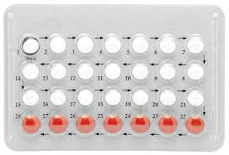
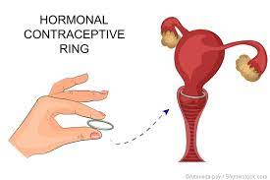
COMBINED HORMONAL CONTRACEPTION
COCP
Vaginal ring
Transdermal patch
Combined injectable contraceptive

Slide 9
COMBINED ORAL CONTRACEPTION
Monophasic
fixed amount of an oestrogen and a progestogen in each active tablet
Biphasic/Triphasic
varying amounts of the two hormones according to the stage of the cycle
ED (every day)
includes 7 days of placebo tablets

Slide 10
COMBINED ORAL CONTRACEPTION MODE OF ACTION
Ovulation suppression
Endometrial atrophy
Thickens cervical mucus

Slide 11
COCP
Mode of action
inhibit evolution
How to start
first day of menstrual cycle
Duration of use
no bar in its duration
Follow up
6 weeks ,6 monthly
Return of fertility
within 3 months

Slide 12
MISSED COC PILLS
Missed COC pill
Less than 12 hours elapsed
Take missed pill and continue regime as normal. No extra precautions required
More than 12 hours elapsed
Where in pill cycle?
1 pill missed from a pack in the cycle
Continue COC
2 or more pills missed at any time in the cycle
Continue COC to end of pack use extra precautions for 7 days
2 or more pills missed from days 15-21
Continue COC and use extra precautions for 7 days. GO straight on to next pack without a break

Slide 13
ADVERSE EFFECTS OF COCP
MINOR
(nausea, vomiting weight gain, mastalgia, breast enlargement ,mood swings and chloasma)
MAJOR
thromboembolism ,myocardial infarction ,stroke, gallstones, cancers

Slide 14
ABSOLUTE AND RELATIVE CONTRAINDICATION

Slide 15
PROGESTERONE-ONLY CONTRACEPTION
POP
Progesterone only injections
Subdermal implants

Slide 16
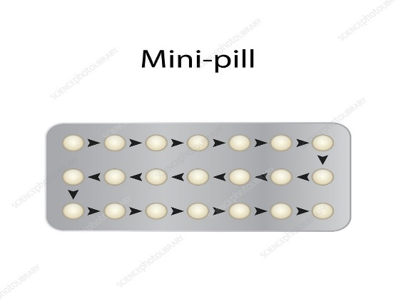
POP
Mini pills
Levonorgestrel pills 30ug
Mode of action ovulation inhibition cervical mucus changes, endometrial atrophy
Return of fertility rapidly after stopping
One pill every day preferably same time without break

Slide 17
ADVERSE EFFECTS
Menstrual irregularities
Weight gain
Follicular cyst
GIT symptoms
Skin changes
Depression ,irritability ,mood swings

Slide 18
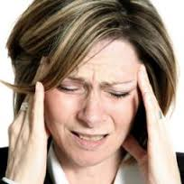
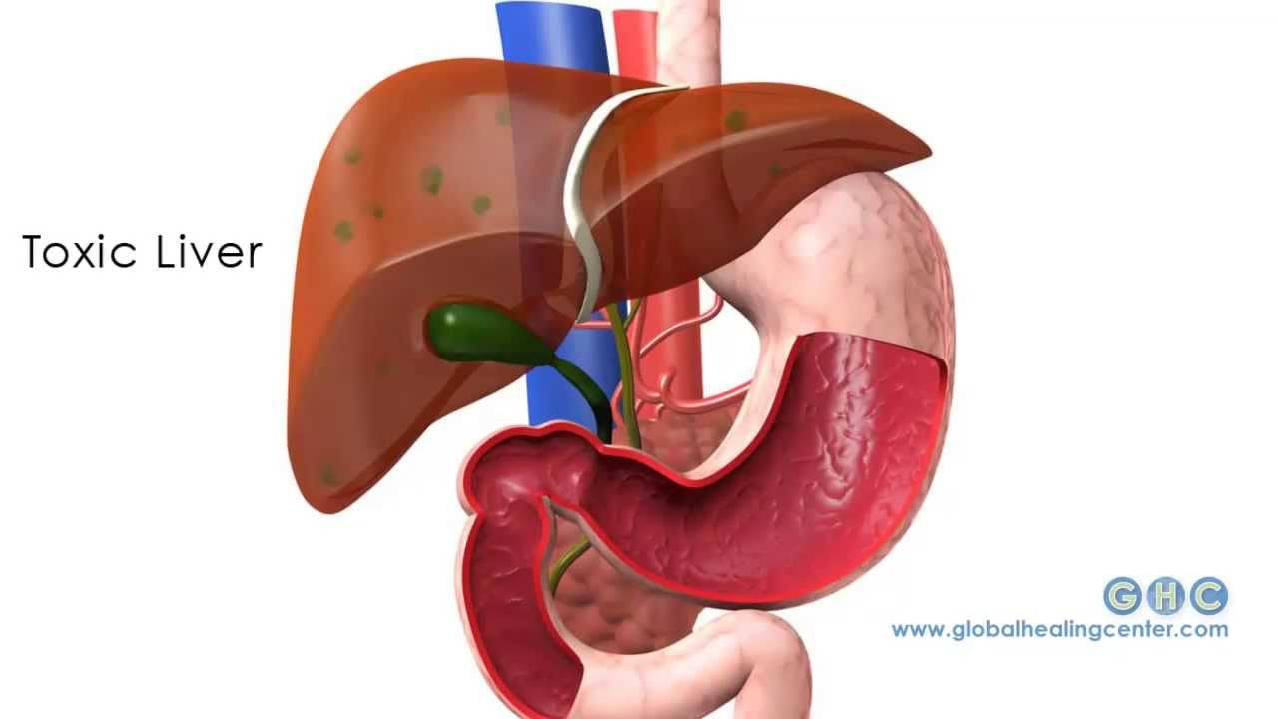
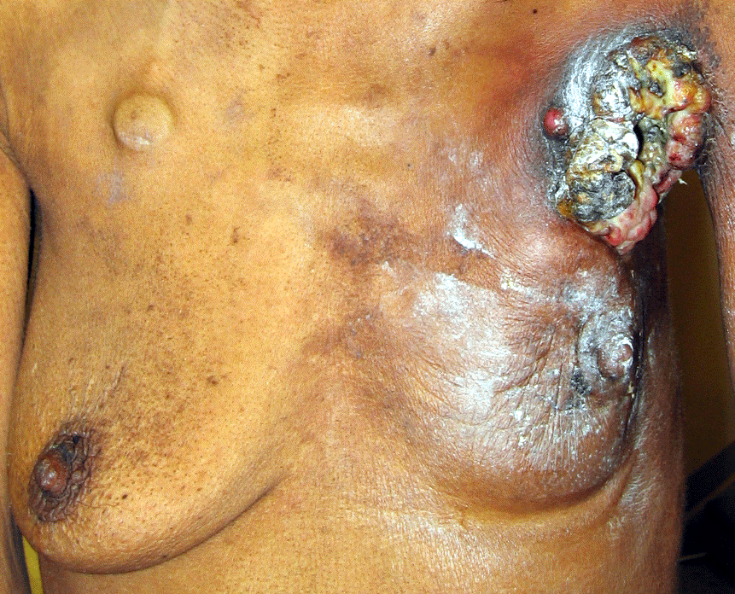
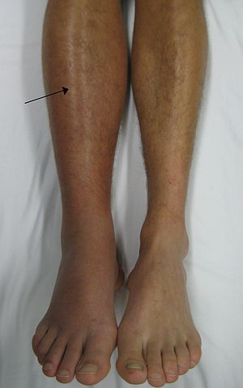
CONTRAINDICATIONS
Smoking Headaches/migraines
Liver / Gallbladder disease
Breast disease
Obesity Hypertension
DVT
Notes:
VTE in a first-degree relative under the age of 45 years who, having considered other contraceptive methods, still wish to use COC, then a thrombophilia screen should

Slide 19
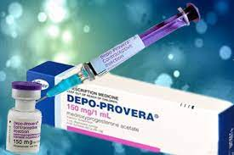
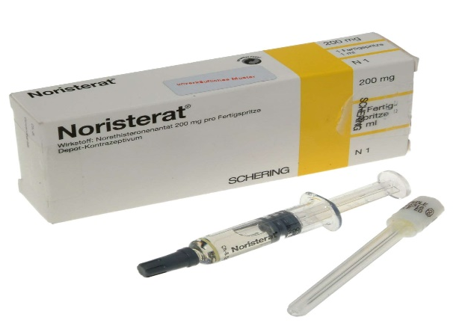
PROGERSTERONE ONLY INJECTIONS
Intramuscular DMPA
subcutaneous DMPA (SAYANA press)
Noresterat (norethisterone oenanthate NET-EN)

Slide 20
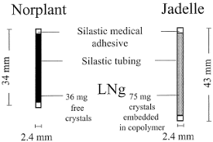
SUBDERMAL IMPLANTS (LARC)
Nexplanon
Norplant 6 rods
Jadelle 2 rods
Implanon single rod

Slide 21
SUBDERMAL IMPLANTS (LARC)

Slide 22
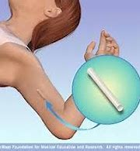
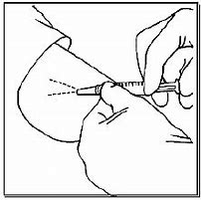
Implanon and jadelle

Slide 23
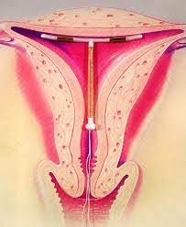
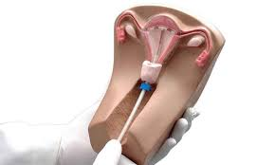
INTRAUTERINE CONTRACEPTION (LARC)

Slide 24
Contraindication to IUD,IUS

Slide 25
BARRIER METHODS
Male
Female
Condom
Condom
Cervical cap
Diaphragm
Sponge
Spermicide

Slide 26
BARRIER METHODS

Slide 27
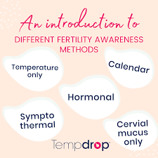
FERTILITY AWARENESS METHODS
Cycle or rhythm methods
Coitus interruptus
Temperature method
Billing methods
Lactational amenorrhea

Slide 28
PERMANENT METHODS

Slide 29
DIFFERENT METHODS OF TUBAL LIGATION

Slide 30
COMPLICATION
Anesthesia related
Surgery related
Long term morbidity abdominal pain, dyspareunia, failure rate 1 in 200,ectopic pregnancy
Request for reversal reversal is technically difficult but possible ,increase risk of ectopic pregnancy

Slide 31
EMERGENCY CONTRACETION

Slide 32
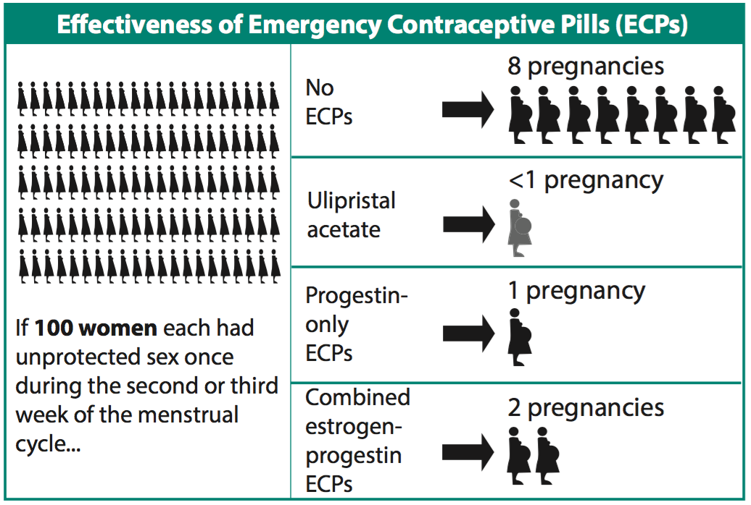
Effectiveness of ECP

Slide 33
NEW DEVELOPMENT
Vaccine against b hcg ,zona pellucida and sperm
GnRH analogues
Testosterone in combination with GnRH analogues

Slide 34
CONTRACEPTIVE PREVALENCE RATE (CPR)
Modern Method 26.1 %
Traditional Method 9.3%
Total 35.4%

Slide 35
UNMET NEED FOR
FAMILY PLANNING
Unmet need refers to women who’s last birth or current pregnancy was mistimed or unwanted, or who are not currently using contraception but do not want another child soon.

Slide 36
RESEARCH
https://www.n Contraception Selection, Effectiveness, and Adverse EffectsA ReviewStephanie Teal, MD, MPH¹; Alison Edelman, MD, MPH²
Author Affiliations Article Information
JAMA. 2021;326(24):2507-2518. doi:10.1001/jama.2021.21392

Slide 37
BIOMEDICAL ETHICS
Every women have right to get proper and unbiased information regarding contraceptive options.
health care provider choice should not not be imposed on patient.

Slide 38
FAMILY MEDICINE
each women who need contraception in her reproductive age group should be refereed to family planning services.
Basic education regarding hormonal contraception should be provided at first healthy care facility.

Slide 39
SCENARIO 1
A 32 years old p2,presents to for contraception advice, her last child birth is 1 years back and she developed DVT after 3 weeks of her child birth .what are the best contraceptive options for her ?

Slide 40
SCENARIO 2
A 28 years old p1 presents to you with complaints of excessive vaginal discharge after IUCD insertion .she wants to get it removed .what would be the best option for her ?

Slide 41
SCENARIO 3
A 38 years old p6 ,recently recovered from massive placental abruption ,she delivered a dead fetus at 38 weeks of gestation .she is known diabetic and hypertensive for last 10 years .what would be the best contraceptive advice to her

Slide 42
hope we all have a better tomorrow
Thank You

