Slide 1


Slide 2


Foundation Module
1st Year MBBS(LGIS)
Simple Epithelium
Presenter: Dr. Kashif Ashraf
APMO Anatomy Department Date: 03-03-2025

Slide 3
Motto, Vision, Dream
To impart evidence based research oriented medical education
To provide best possible patient care
To inculcate the values of mutual respect and ethical practice of medicine
Wisdom
Truth
Service

Slide 4
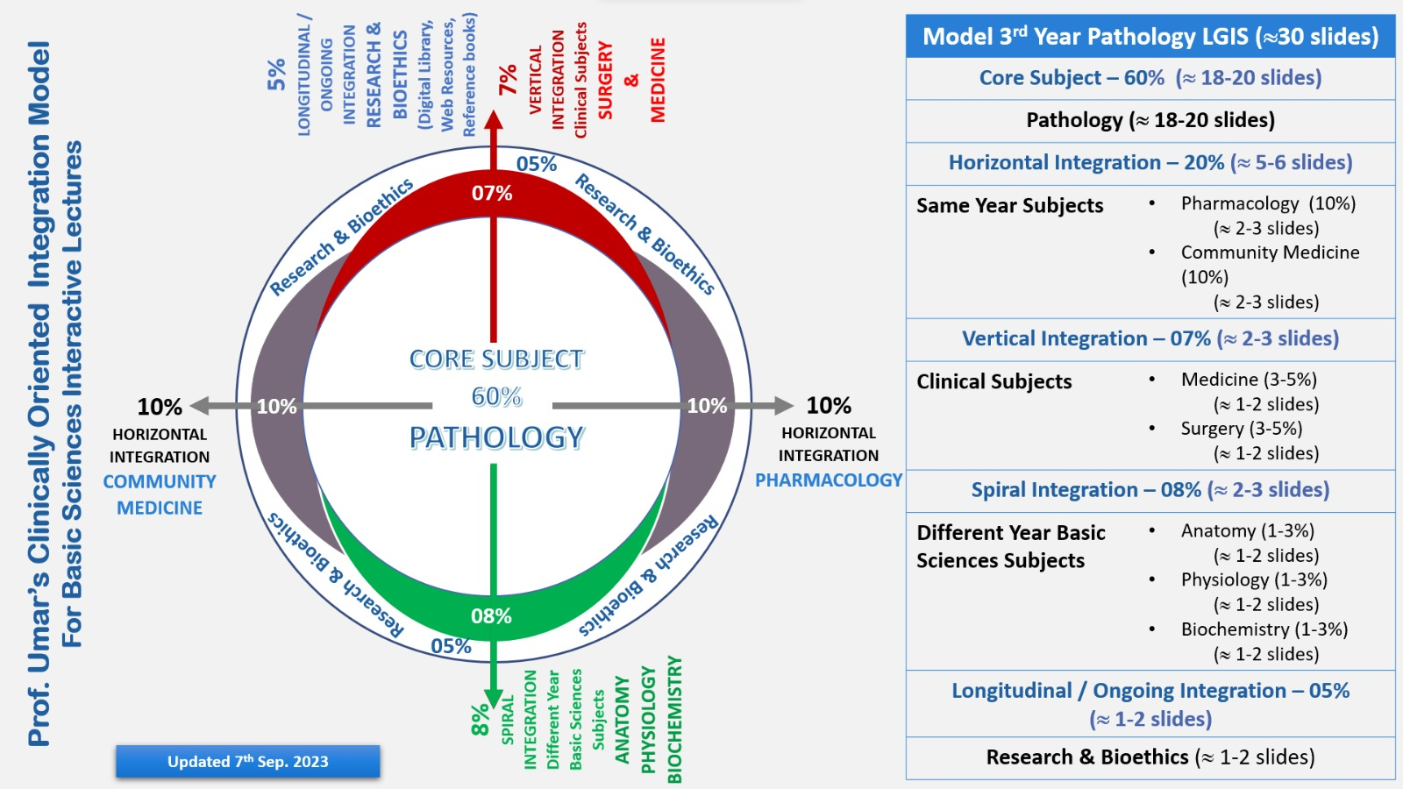
Professor Umar Model of Integrated Lecture

Slide 5
Learning Objectives
At the end of this session students should be able to
Classify epithelium.
Illustrate different types of simple epithelium
Identify type of simple epithelium under microscope
Write two points of identification

Slide 6
Core Concept

Slide 7
Classification Of Simple Epithelium
Core Concept

Slide 8
Core Concept

Slide 9
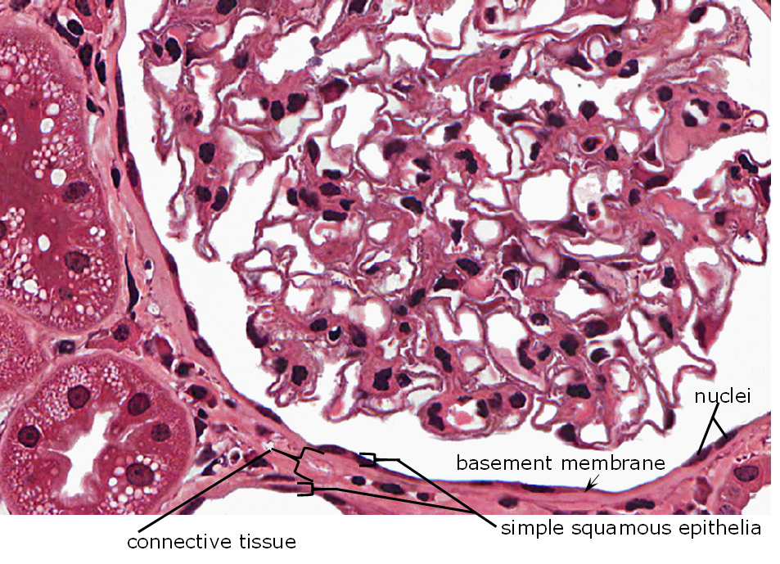
Simple Squamous Epithelium
Core Concept
Locations
inner lining of blood vessels
alveoli in the lungs
inner lining of lymphatic vessels
inner lining of the heart
inner lining of glomerular capsule in the kidneys
inner lining of some kidney tubules
serous membranes
Core Concept

Slide 10
Simple Squamous Epithelium(Surface View)
Core Concept

Slide 11
Simple Cuboidal Epithelium
Core Concept
Location
inner lining of some kidney tubules
inner lining of ducts

Slide 12
Simple Columnar Epithelium
Core Concept
Location
inner lining of the majority of the digestive tract
inner lining of ducts
lower respiratory tract

Slide 13
Pseudostratified Columnar Epithelium( Respiratory Epithelium)
Core Concept

Slide 14
Pseudostratified Columnar Epithelium
Core Concept

Slide 15
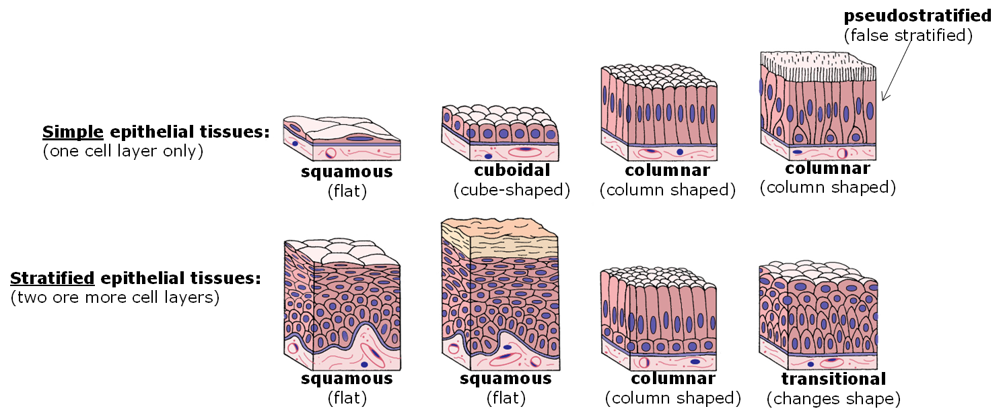
Core Concept

Slide 16
Horizontal Integration

Slide 17
Bio-Physiological Aspects
Horizontal Integration
Epithelium is an avascular tissue
cell junctions
free surface or apical domain, a lateral domain, and a basal domain
Epithelium creates a selective barrier between the external environment and the underlying connective tissue

Slide 18
Vertical Integration

Slide 19
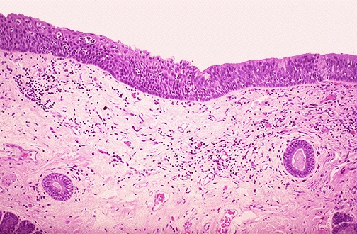
Clinical Scenario
Vertical Integration
A pathologist was studying a slide of respiratory epithelium but surprisingly he found stratified squamous epithelium instead of normal respiratory epithelium. Biopsy specimen was taken from a person that was a chain smoker for past 10 years.

Slide 20
Clinical Correlation
Vertical Integration
Epithelial metaplasia
  Squamous to columnar
      In respiratory epithelium in cigarette smokers
  Columnar to squamous
      Barrett’s esophagus

Slide 21
Skill Lab Assessment

Slide 22
Skill Lab Assessment
1. Psudostratifed columnar epithelium is made up of how many layers of cells?
a) one
b) two
c) three
d) four
e) five
2. In most respiratory passages (trachea and bronchi), psedostratified epithelium contains
goblet cells and ciliated cells
Goblet cells only
Penath cells
neuroglia
Olfactory cells
3. Simple squamous epithelium lines the lumen surface of
blood vessels
Intestine
large gut
rectum
e) Both b and c
4. Which of following lines the mesothelium
a) Simple squamous epithelium
b) simple columnar epithelium
c) pseudostratified coulmnar
d) both b and d
e) Both c & d
5. Pseudostratified columnar epithelium lines the
a.respiratory passages
b. Thyroid gland
c. Urinary bladder
d. Gall bladder
e. skin

Slide 23
MCQs Key
A
B
A
A
A

Slide 24
How To Access Digital Library
Go to the website of HEC National Digital Library.
On Home Page, click on the INSTITUTES.
A page will appear showing the universities from Public and Private Sector and other Institutes which have access to HEC National Digital Library HNDL.
Select your desired Institute.
A page will appear showing the resources of the institution
Journals and Researches will appear
You can find a Journal by clicking on JOURNALS AND DATABASE and enter a keyword to search for your desired journal.

Slide 25
Research Articles
https://www.sciencedirect.com/science/article/pii/S2352345X17300061
Celiac Disease: Role of the Epithelial Barrier
https://erj.ersjournals.com/content/7/12/2226.shor
Proinflammatory potential of the airway epithelium in bronchial asthma

Slide 26
Learning Resources
Junqueira's Basic Histology: Text and Atlas,Book by Anthony L. Mescher and L. Carlos Junqueira
d`ifiore’s Atlas Of Histology With Functional Correlations
Manual of Histology-I (General) by Tassaduq Hussain Shiekh
www.google.com for pictures

Slide 27
THANK YOU

