Slide 1
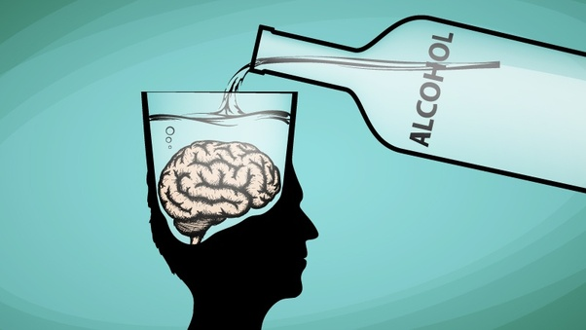
Alcohol
Dr. Filza Ali
Dr. Naila

Slide 2
VISION OF RMU THE DREAM/ TOMORROW
To impart evidence based research oriented medical education
To provide best possible patient care
To inculcate the values of mutual respect and ethical practice of medicine

Slide 3
PROF Dr. UMAR’s LGIS MODEL

Slide 4
SEQUENCE OF LGIS
Learning Objectives
Core concept 70 %
Horizontal integration related to Pathology and Pharmacology 15 %
Relevant clinical concepts and medico legal application of core knowledge / Vertical integration 10%
Research article relevant to the topic 3%
Ethics and family medicine 2%

Slide 5
Ethyl Alcohol / Ethanol Poisoning

Slide 6
Case 1
A 25 year old male was brought to the emergency department after being found unresponsive by his family. The family gave a history of the patient having consumed a drink at a wedding ceremony last night. He had a previous history of consuming 6 pints of beer per day since the age of 16 years.
According to his general physical examination:
Temperature – 98.3 °F
Respiratory rate – 10/min
Pulse – 90/min
Blood pressure – 110/70

Slide 7
Pupils contracted but dilate on pinching. (MacEwen's sign)
Initially his breathing was stertorous but later on depressed with no gag reflex and no response to pain. He was comatose with pinpoint (meiosis), but reactive pupils. He was in respiratory failure and was intubated later on in hospital. There was strong odour of spirit in the breath.
He did not have any needle track marks.
Questions :
What is the most probable diagnosis?
What is the differential diagnosis?
How would you differentiate clinically this type of coma with other comatose state?
What lab investigations should be necessary to confirm the diagnosis?
What precautions should be taken while sending the specimen fluid for chemical analysis.

Slide 8
Learning Objectives:
By the end of this session the students will be able to:
Enlist various types of alcohol.
Briefly describe the sign and symptoms of acute ethanol (ethyl alcohol) intoxication w.r.t. blood alcohol concentration (BAC).
Outline the management of an acute intoxication of ethanol (ethyl alcohol).
State the post mortem findings and medico legal aspects of ethanol (ethyl alcohol) intoxication.
Enumerate the clinical syndromes associated with chronic alcoholism.

Slide 9
Types of Alcohol
Core Concept
Ethyl alcohol / Ethanol
Methyl alcohol / Methanol
Isopropyl alcohol
Ethylene glycol

Slide 10
Types of Alcohol
Core Concept
Distillation and fermentation sum up the procedures and some of them are also aged.
Whisky, gin, vodka and rum fall in the category of spirits.
Beers are the most common type of alcohol. Beer is another class of alcoholic beverage that is almost as popular as tea.
Wines and Champagne are made from grapes

Slide 11
Ethyl Alcohol Most commonly ingested alcohol
Core Concept
Metabolism
Rapidly absorbed from GIT
Peak conc in blood in 1 hour to 90 minutes
Approx. 90% oxidised in liver
10% excreted by the kidneys and lungs
Half fluid ounce metabolized per hour
15 to 18 mg fall per 100ml of blood per hour
Conc in glomerular filtrate = conc in plasma
Notes:
Rate of absorption depends upon
1. Conc of alcohol
2. Food
3. Stomach wall
4. Quantity of alcohol
5. Rate of drinking
6. Weight of the person
7. Tolerence

Slide 12
Acute Ethanol Poisoning
Core Concept
Depression of CNS in descending order from cortex to medulla
Stage of excitement:- 30 to 100mg%
Higher centres which control judgement and behaviour
Presentation
Euphoria
Goofy smiles
Loss over emotions
Discloses secrets
Inappropiate language

Slide 13
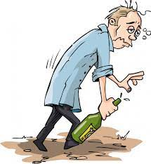
Acute Ethanol Poisoning
Core Concept
Stage of incoordination:- 100 to 300mg%
Motor centres (e.g. Broca’s area)
Presentation:
Slurred speech
Staggering gait
Confusion
Hiccups
Pupils dilated
Offences and violent

Slide 14
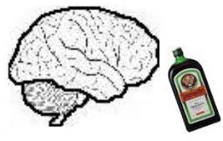
Acute Ethanol Poisoning
Core Concept
Stage of narcosis:- more than 300mg%
Medulla
Presentation:
Deep sleep
Rapid pulse
Stertorous breathing
Pupils constricted
Macewan’s sign

Slide 15
Acute Ethanol Poisoning
Core Concept
Hangover
Cerebral oedema
Presentation:
Headache
Acute depression
Gastrointestinal irritation

Slide 16
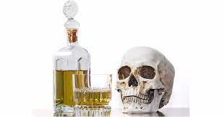
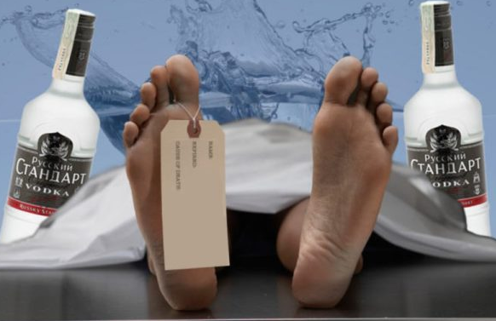
Acute Ethanol Poisoning
Core Concept
Death
Uncommon in acute alcoholism
If stage of narcosis persists for more than 12 hrs death can occur due to :
Cardiac centre paralysis
Respiratory centre paralysis
Pulmonary oedema

Slide 17
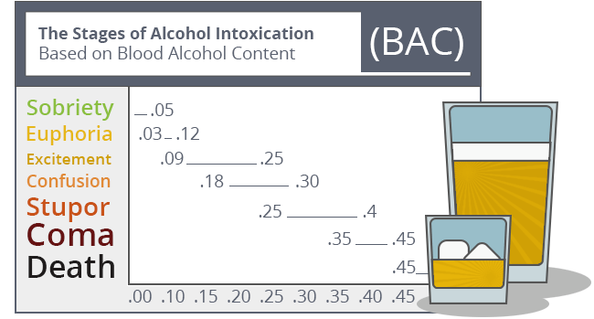
Acute Ethanol Poisoning
Core Concept
Fatal dose – depends upon
Patient’s age
Drinking habits
Strength of the liquid taken
350mg% and above
Fatal period
Usual is 12 -24 hrs
May be delayed to 5 – 6 days

Slide 18
Differential Diagnosis:
Vertical Integeration
Uremic coma
Hypoglcemic coma
Diabetic coma
Carbolic acid poisoning
Morphine / Opium poisoning
Lab Investigations:
BAC
Serum osmolality
Electrolytes
Blood sugar random
Blood urea nitrogen
LFTs
ABGs
Urine/ blood ketones
CXR-PA view

Slide 19
Treatment
Core Concept
Gastric lavage with 5% Sodium Bicarbonate
Keep the patient warm
Treatment is largely supportive and consists of
Identification and correction of hypovolemia
Identification and correction of hypoglycaemia
Close monitoring of respiratory status
Intravenous thiamine in patients at risk of Wernicke's encephalopathy.
Hemodialysis

Slide 20
Post-mortem appearance
Vertical Integeration
External appearance
Clothes
Stains
Rigor mortis
Injuries/bruises
Alcoholic odour

Slide 21
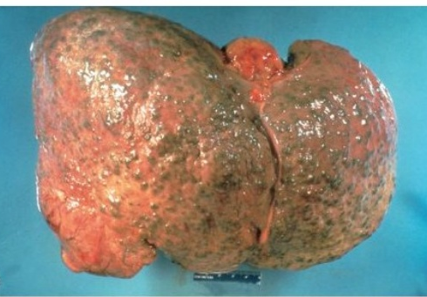
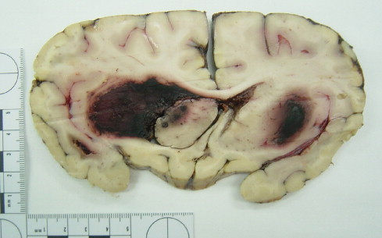
Post-mortem Findings
Core Concept
Internal appearance:
Odour of alcohol
Fluidity of blood
Brain may be oedematous and may have hematomas
Fatty liver
Pancreatitis
Alcoholic gastritis
Oedematous nonulcerated small intestine

Slide 22
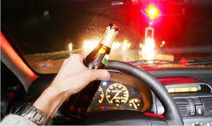
Medicolegal aspects
Core Concept
The prohibition (Enforcement of Hadd) Order (Sec-4 of 1979 Alcohol prohibition Act) extending to whole of Pakistan, imposes the total prohibition on the consumption, manufacture and selling of intoxicating liquor by the muslims.
Road traffic Act 1958 prohibits driving under the influence of alcohol – Reaction Time (0.3 Sec) in normal person.
Reaction time 0.5 sec or more if person is under the influence of alcohol.

Slide 23
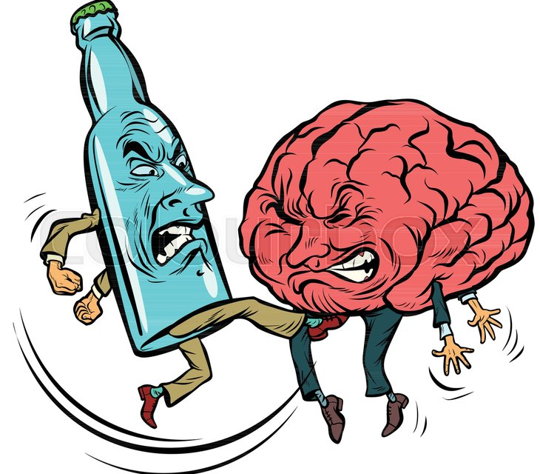
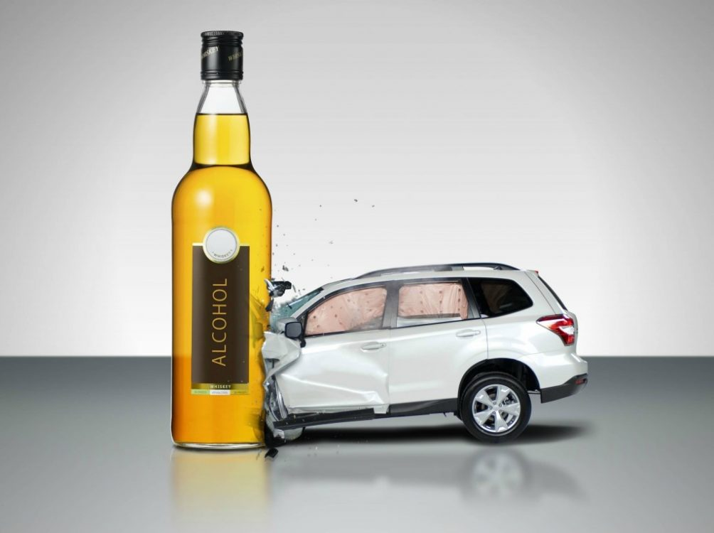
Core Concept
Direct death unlikely
Liable to cause fatal complications like head injuries, serious bleeding, suffocation, drowning
Chronic alcoholism – sexual jealousy crimes usually homicidal natures
Driving casualties

Slide 24
Chronic poisoning
Core Concept
Common clinical syndromes
Delirium tremens
Korsakoff’s psychosis
Wernicke’s encephalopathy
Acute hallucinosis

Slide 25
Core Concept

Slide 26
Core Concept
Delirium tremens
State of excitement with hallucinosis – last 3 to 4 days
Causes:
Unusual bout of drinking
Sudden withdrawal
Acute infection
Shock(fracture bone)
Exposure to cold

Slide 27
Core Concept
Treatment
Sedatives – chlorpromazine
IV hypertonic glucose
Treatment of infection
Korsakoff’s psychosis
Hallucinations, disorientation, multiple neuritis
Loss of recent memory
Confabulation
Lasts from about 1 month to a year

Slide 28
Core Concept

Slide 29
Core Concept
Acute hallucinosis
Auditory hallucinations with systemised delusion of persecution
Lasts weeks to months
Psychiatric emergency - homicidal or suicidal
Patient must be hospitalized, sedated closely observed
Treated as for delirium tremens
Choice of drug is Disulfiram – 0.5 gm OD

Slide 30
Post-mortem Findings in Chronic Alcoholism
Core Concept
Degenerative changes in liver, kidney and brain
Cirrhosis of liver
Atrophic gastritis
Cardiomyopathy

Slide 31
Treatment:
Core Concept
Sudden withdrawal of alcoholic drinks.
Antabuse (disulfiram) is given as an aversion technique.
Disulfiram blocks metabolism of alcohol at the acetaldehyde stage. Acetaldehyde accumulates in blood causing Disulfiram-ethanol reaction (Aldehyde syndrome)
Contraindications of Disulfiram:
Coronary artery disease, Liver failure, Chronic renal failure, Peripheral neuropathy, Muscular disease history of psychosis
and Pregnancy (1st trimester)

Slide 32
Treatment:
Core Concept
Citrated calcium carbimide (Temposil): 100 mg/ day in 2 divided doses instead of antabuse may be given.
Metronidazole, nitrfezole and methyltetrazolethiol are other alternatives.
Nutrients, vitamins and gradual return to a normal balanced diet.
Symptomatic treatment.

Slide 33
ALDEHYDE SYNDROME
Core Concept
Symptoms:
Sweating,
Throbbing headache,
Giddiness & sense of impending doom
Abdominal cramps appear due to which patient dislikes alcohol
Flushing
palpitation,
Nausea & vomiting,
Anxiety,
Tightness of chest,
Hypotension,

Slide 34
RESEARCH
Research
https://www.ncbi.nlm.nih.gov/books/NBK556147/
https://www.sciencedirect.com/topics/earth-and-planetary
https://en.wikipedia.org/wiki/Ethanol
https://scholar.google.com.pk/scholar?q=ethyl+alcohol+research&hl=en&as_sdt=0&as_vis=1&oi=scholart

Slide 35
BIOMEDICAL ETHICS
ETHICS
SOCIAL AND ENVIRONMENTAL JUSTICE CONCERNS: Research work to determine the practicality and feasibility of carrying out remedial work to reduce, limit, or eliminate exposures harmful to the public.
LOOKING AHEAD TO WHAT MUST BE DONE: In the case of lead, preventing exposure is the only method known to be effective in reducing the risk of adverse health outcomes.
HUMAN PROTECTION: Work place protection and prevention should be made to avoid unnecessary exposure.

Slide 36
FAMILY MEDICINE
Family medicine
Treatment will depend on the underlying cause.
If victim received with lead poisoning , remove the source of poison
Health education and awareness
Screening of family members
Involving high authorities

Slide 37
How To Access Digital Library
1. Go to the website of HEC National Digital Library.
2. On Home Page, click on the INSTITUTES.
3. A page will appear showing the universities from Public and Private Sector and other Institutes which have access to HEC National Digital Library HNDL.
4. Select your desired Institute.
5. A page will appear showing the resources of the institution
6. Journals and Researches will appear
7. You can find a Journal by clicking on JOURNALS AND DATABASE and enter a keyword to search for your desired journal.

Slide 38
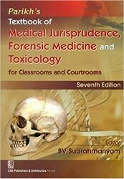
TEXT BOOKS & PRACTICAL NOTEBOOK:
Principles & Practice of Forensic Medicine.
by Nasib R. Awan
Parikh’s Textbook of Medical Jurisprudence,
Forensic Medicine & Toxicology.
Practical Manual Of Forensic Medicine
& Toxicology

Slide 39
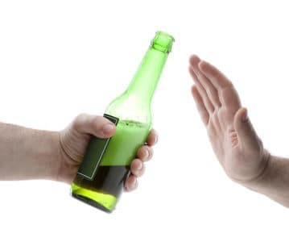
Thank you

