Slide 1
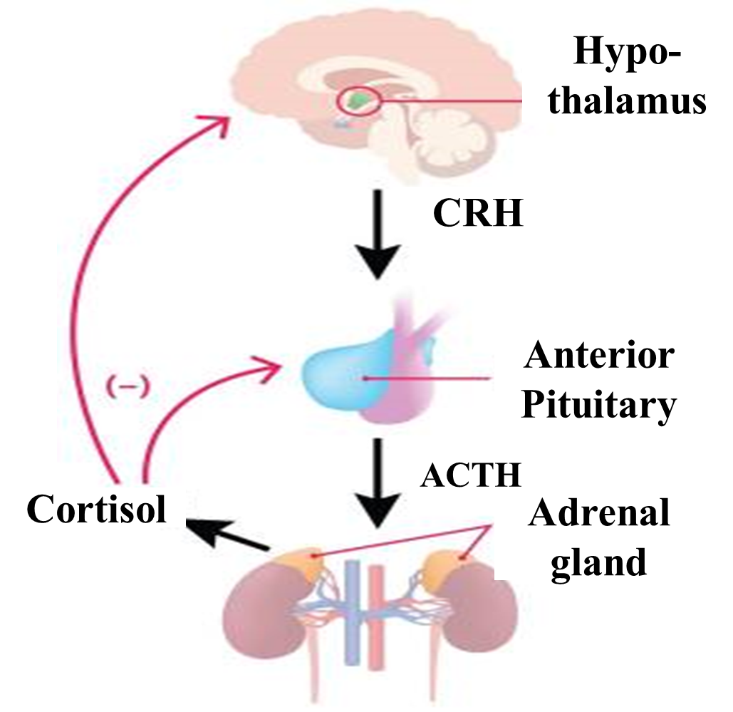
Neonatal Cushing’s
Mostly by exogenous use of glucocorticoids (Prednisone, prednisolone, betamethasone, dexamethasone, etc.).
Rarely by endogenous hypercortisolemia.
Due to Adrenocortical tumor.
Compensatory hyperplasia
Because of suppression of CRH & ACTH secretion
In fetus by maternal steroid use.
In neonates by exogenous steroid use.
Hypertension hyperglycemia (Cushing synd)

Slide 2
Ethical Considerations
Professionalism & Professional Competence.
Physician must know:
When & when not, to give steroids in Pregnancy.
When and when not, to give steroids in Neonates.
Generally should be avoided.
If indicated, should be given in smallest dose and for shortest period of time as possible.
Prophet Mohammad (Peace &blessings be upon him) said, “Whoever practices medicine without any prior knowledge of medicine will be held responsible.”
Abu Ali Ibn Sina in his famous book, Qanoon Fi Al-Tib, stressed regarding professional competency of the physician.

