Slide 2
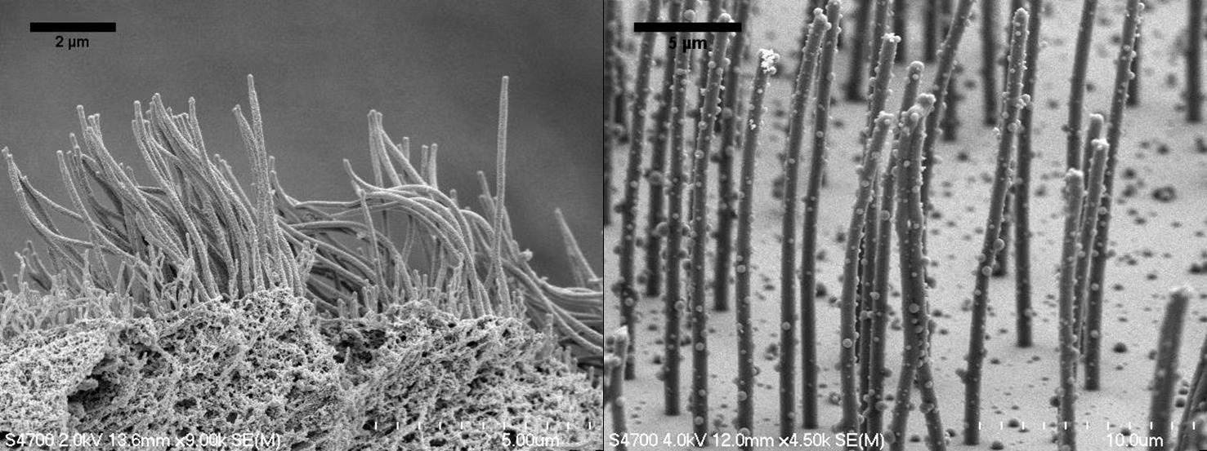
FOUNDATION MODULE(LGIS)
Apical Cell Surface Specializations
Presenter:
Dr. Mohtasham Hina 06-03-23

Slide 3
Vision; The Dream/Tomorrow
Motto
To impart evidence based research oriented medical education
To provide best possible patient care
To inculcate the values of mutual respect and ethical practice of medicine
Wisdom
Truth
Service

Slide 4
Learning Objectives
At the end of lecture 1st year students should be able to
Different types of apical cell surface domains
Explain histological structure of apical cell surface modifications
Location and functions of modifications
correlate clinical aspects of modifications
To understand bio-physiological aspect of different types of modifications
Read a research article
Use digital library

Slide 5
A 45 years male patient came to medical OPD with chest infection. He gave history of recurrent episodes of such infection since childhood. He also gave history of treatment failure for infertility as he was married for past 13 years.

Slide 6
Core Concept

Slide 7
Apical cell surface modifications
Microvilli
Cilia
sterocilia

Slide 8
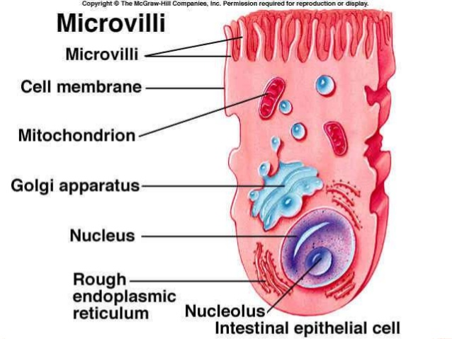
Microvilli

Slide 9
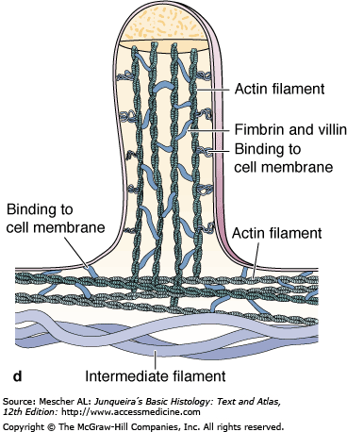
Microvilli
0.1μm
0.08 μm wide
Myosine-I
Terminal web

Slide 10
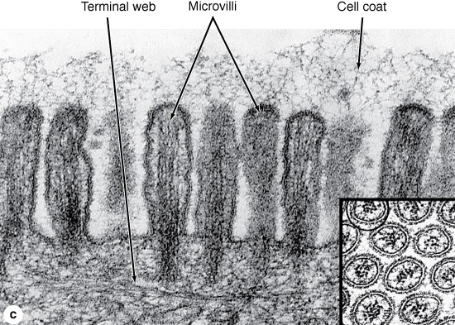
Microvilli

Slide 11
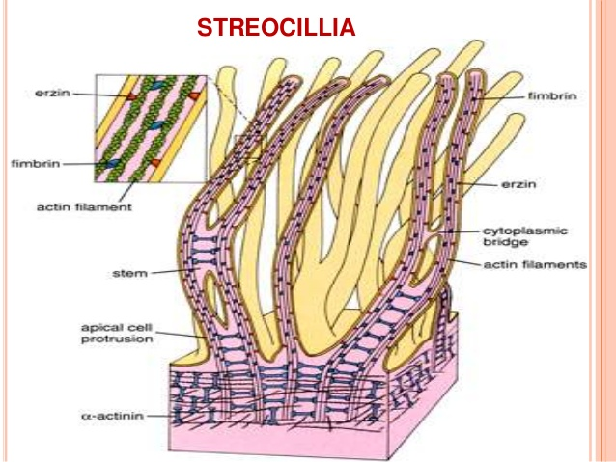

Slide 12
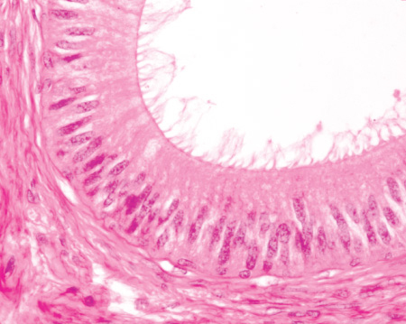
Sterocilia

Slide 13
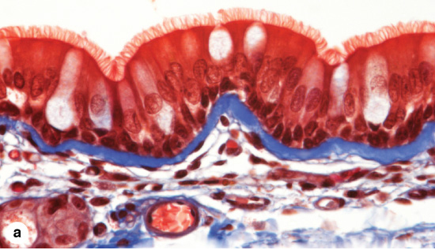
Cilia
5–10 μm long and 0.2 μm in diameter

Slide 14
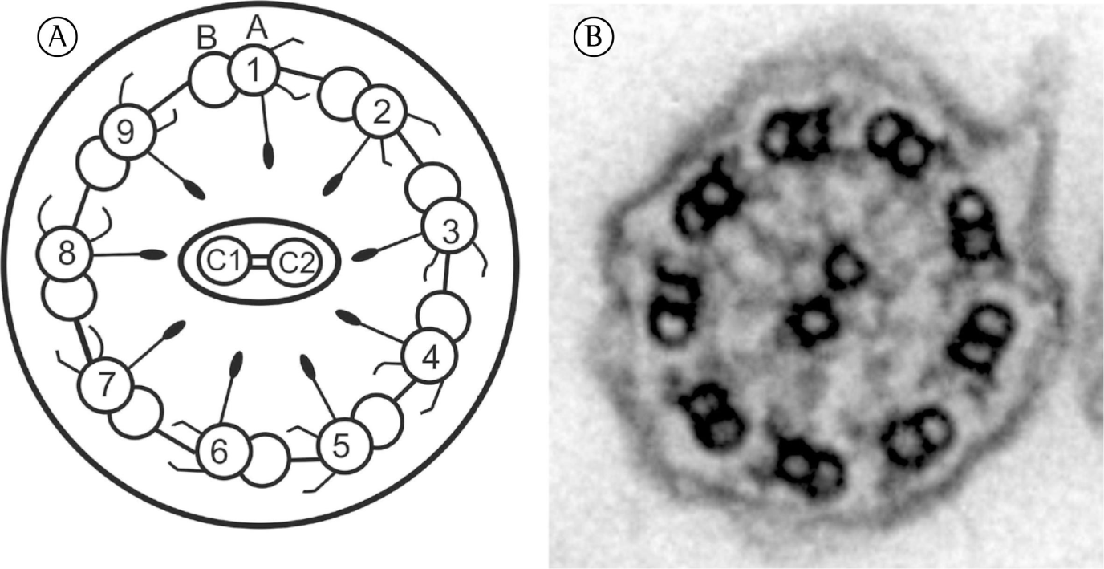
Cilia And Basal Body

Slide 15
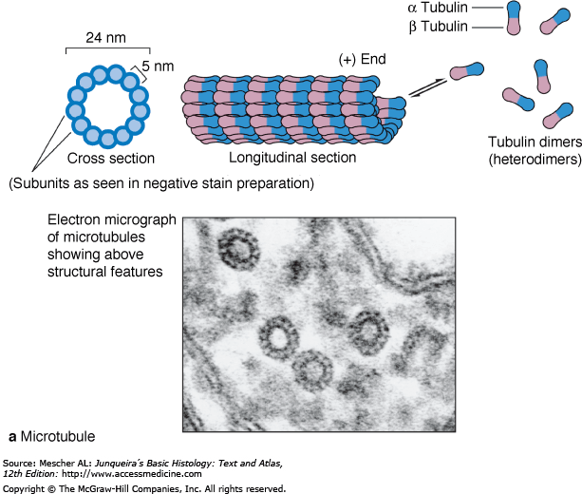
Microtubule structure

Slide 16
Microtubule structure

Slide 17
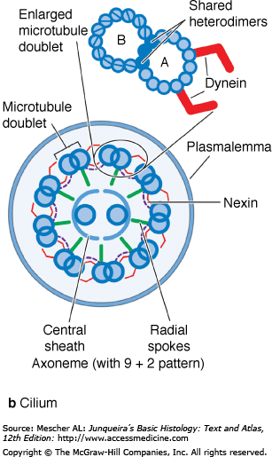

Slide 18
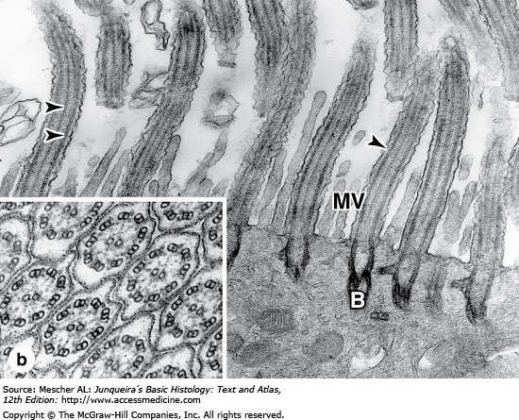
Cilia

Slide 19
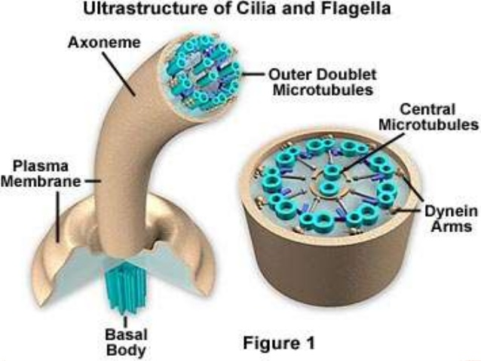
CILIA

Slide 20
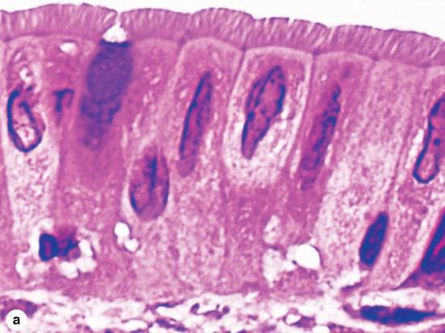
CILIA

Slide 21
Apical domain of cell
Cilia | Microvilli
Narrow,long, hair like structure | Finger like membrane protrousions
Cylindrical with tapering ends | Cylindrical with blunt ends
Longer than microvilli | Shorter than cilia
Thinner | Thicker than cilia
Not covered with glycocalyx | Covered with glycocalyx
Motile | Non motile
9+2 axonem | absent
Non absorptive | absorptive
Do not increase surface area | Increase surface area
Dr Mohtasham Hina

Slide 22
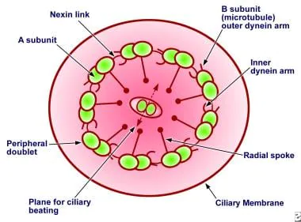
Primary ciliary Dyskinesia
Horizontal Integration
Physiological Anatomy

Slide 23
Clinical Correlation
Several mutations have been described in the proteins of the cilia and flagella. They are responsible for the immotile cilia syndrome, the symptoms of which are immotile spermatozoa, male infertility, and chronic respiratory infections caused by the lack of the cleansing action of cilia in the respiratory tract

Slide 24
kartagener Syndrome
Vertical Integration
Specific Kartagener syndrome treatment includes:
Regular sinus washes.
Regular ear canal washes.
Steroids.
Mucus thinners, called mucolytics.
Antibiotics.
Bronchodilators to relax lung muscles for easier breathing.
Ear tubes.
Speech therapy

Slide 25
Kartagener syndrome (primary ciliary dyskinesia)
Bio Ethics
Ethical considerations surrounding genetic testing for PCD are important. Patients and their families may need counselling.
Individuals with PCD may face challenges related to infertility. Ethical questions may arise concerning assisted reproductive technologies, such as in vitro fertilization (IVF)
Privacy and Genetic Information:
Patient Autonomy
Stigmatization and Discrimination

Slide 26
Research Article
The immotile cilia syndrome: radiological manifestations
H R Nadel, D A Stringer, H Levison, J A Turner, J M Sturgess
https://pubs.rsna.org/author/Nadel%2C+H+R

Slide 27
How To Access Digital Library
Go to the website of HEC National Digital Library.
On Home Page, click on the INSTITUTES.
A page will appear showing the universities from Public and Private Sector and other Institutes which have access to HEC National Digital Library HNDL.
Select your desired Institute.
5. A page will appear showing the resources of the institution
6. Journals and Researches will appear
7. You can find a Journal by clicking on JOURNALS AND DATABASE and enter a keyword to search for your desired journal.

Slide 28
Learning Resources
Junqueira’s Basic Histology 12th Edition, Chapter 4
Histology , A text and Atlas by Michael H.Ross 7th Edition, Chapter 5
DiFiore's Atlas of Histology with Functional Correlations 11th Edition, Chapter 2
Google scholar

