Slide 1


Slide 2


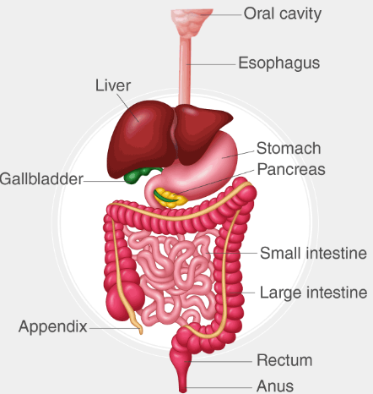
Gastrointestinal Tract (GIT) Module
2nd Year MBBS(SGD)
Topography Organization of GIT & Tongue
Presenter: Dr. Minahil Haq Date: 24-02-25
(Demonstrator)

Slide 3
Prof. Umar’s Model of Teaching Strategy
Self Directed Learning Assessment Program
Objectives :To cultivate critical thinking, analytical reasoning, and problem-solving competencies.
To instill a culture of self-directed learning, fostering lifelong learning habits and autonomy.
How to Assess?
➢Ten randomly selected students will be evaluated within the first 10
minutes of the lecture through 10 multiple-choice questions (MCQs)
based on the PowerPoint presentation shared on Students Official
WhatsApp group, one day before the teaching session.
➢The number of MCQs from the components of the lecture will follow
the guidelines outlined in the Prof. Umar model of Integrated Lecture.
Component of LGIS | Core Knowledge | Horizontal Integration | Vertical Integration | Spiral Integration
No. of MCQs | 6-7 | 1-2 | 1 | 1

Slide 4
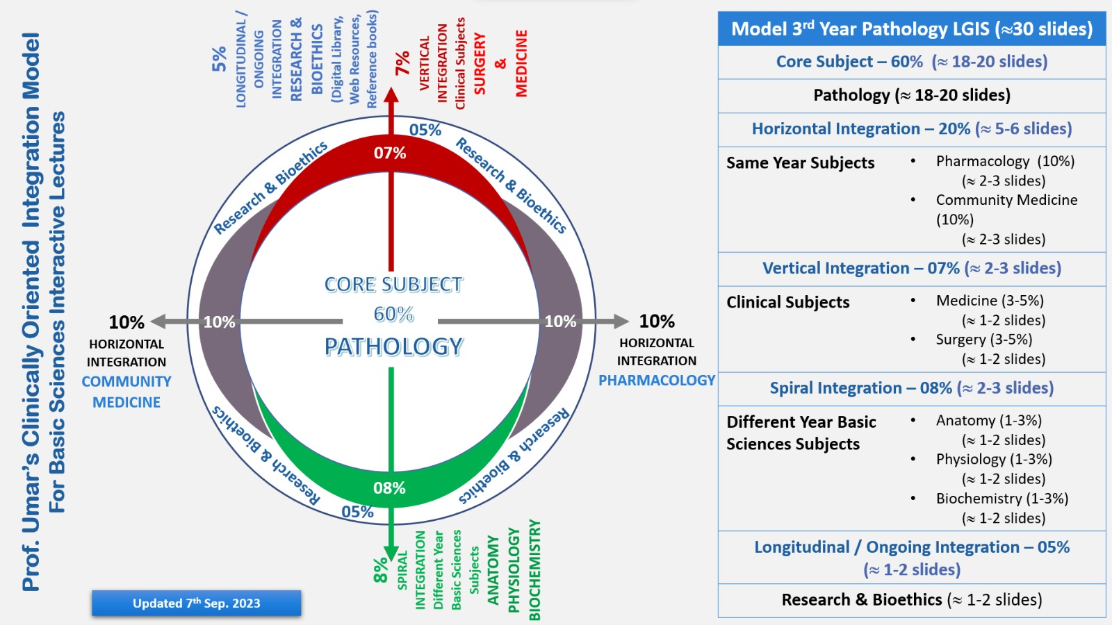
Professor Umar Model of Integrated Lecture

Slide 5
Learning Objectives
At the end of this session students should be able to
Enlist components of gastrointestinal tract
Mark the planes dividing the abdomen into nine quadrants
Enumerate the parts of GIT lying in various quadrants
Tabulate the extrinsic & intrinsic muscles of tongue
Correlate Physiology and Biochemistry
Correlate clinical aspects
Practice principles of Bioethics with professionalism/ communication skills
Apply strategic use of AI in health care
Able to read relevant research article

Slide 6
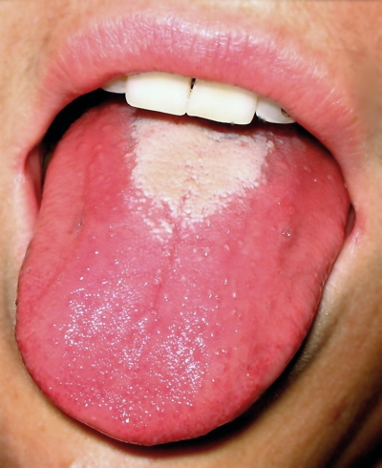
Interactive Session
A 45-year-old female presents to the outpatient department with complaints of a burning sensation on her tongue for the past two months. She also reports difficulty in swallowing, fatigue, and occasional tingling in her hands and feet. On examination, her tongue appears
smooth, erythematous, and atrophic.

Slide 7
Digestive System
Core Knowledge
Muscular tube lined by mucous membrane continuous with outer skin at mouth & anus
Functions : Ingestion, mastication, digestion, absorption of food and elimination of wastes.
Elements : Alimentary canal & Accessory organs ( tongue, teeth, salivary glands, liver & pancreas)
Other relevant structures : Abdominal cavity, peritoneum & spleen

Slide 8
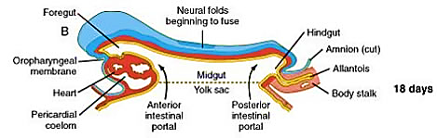
Core Knowledge
18-day embryo GIT components

Slide 9
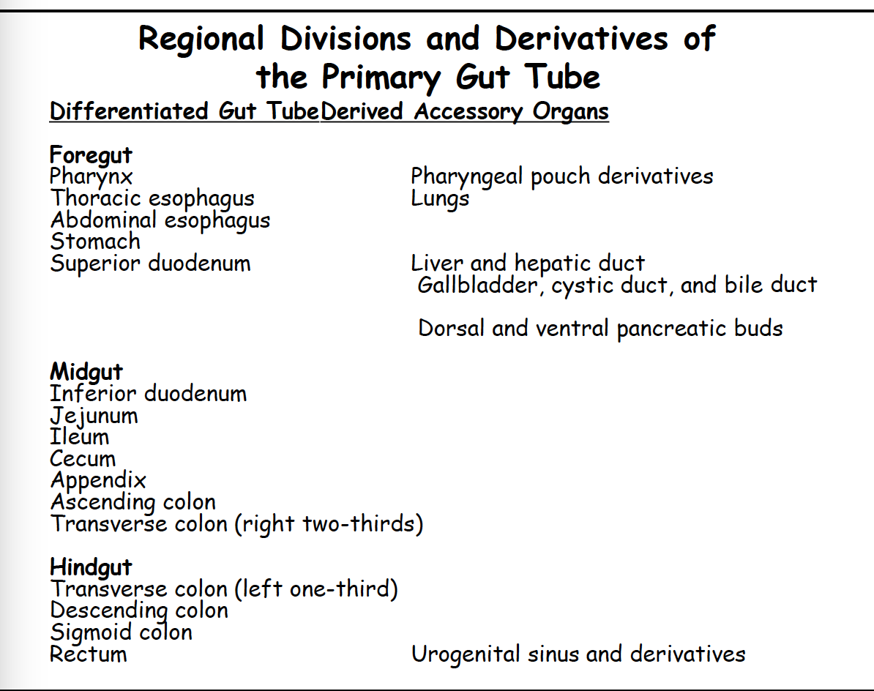
Core Knowledge

Slide 10
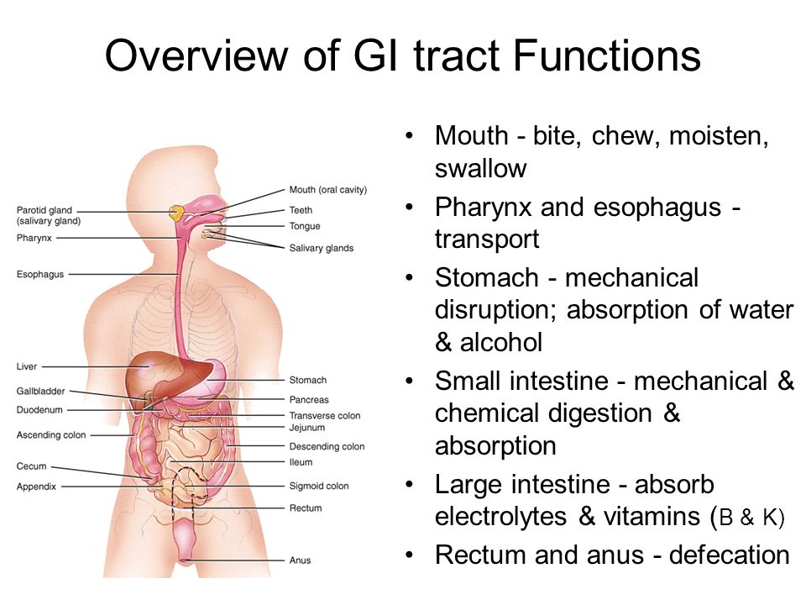
Core Knowledge

Slide 11
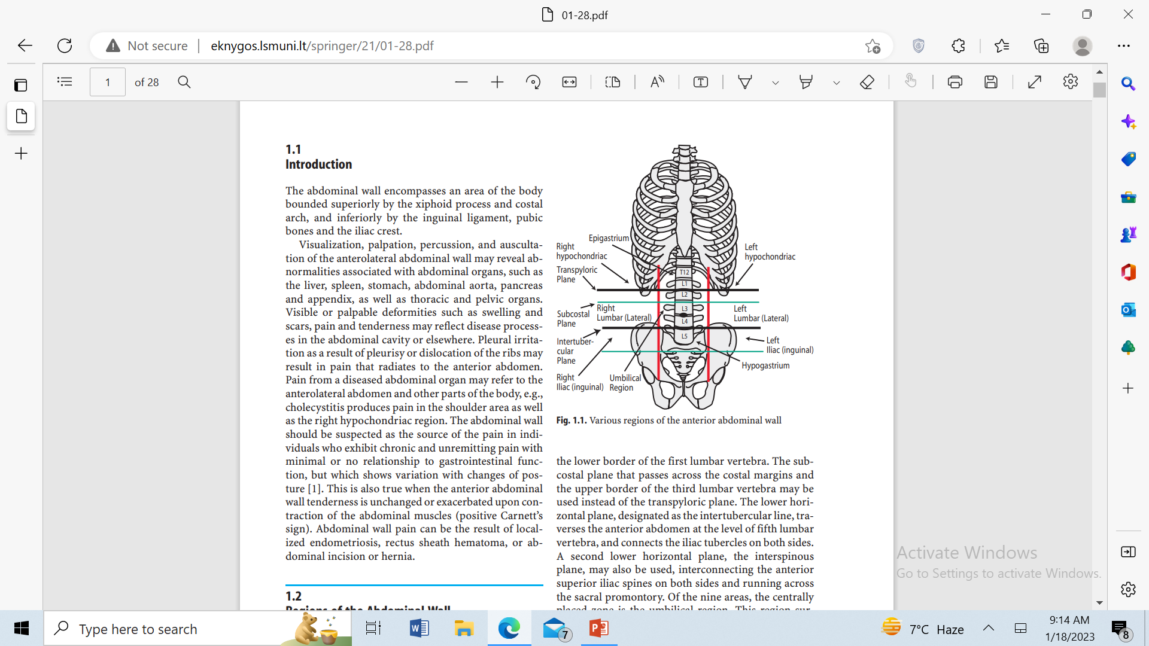
9 Regions of the abdomino-pelvic wall
Core Knowledge
Sagittal planes (Vertical planes)
1. Mid-clavicular plane .
Transverse / Horizontal planes
1- Trans-pyloric plane
2- Inter-tubercular plane
3- Subcostal plane
4- Interspinous plane
5- Trans-umbilical plane

Slide 12
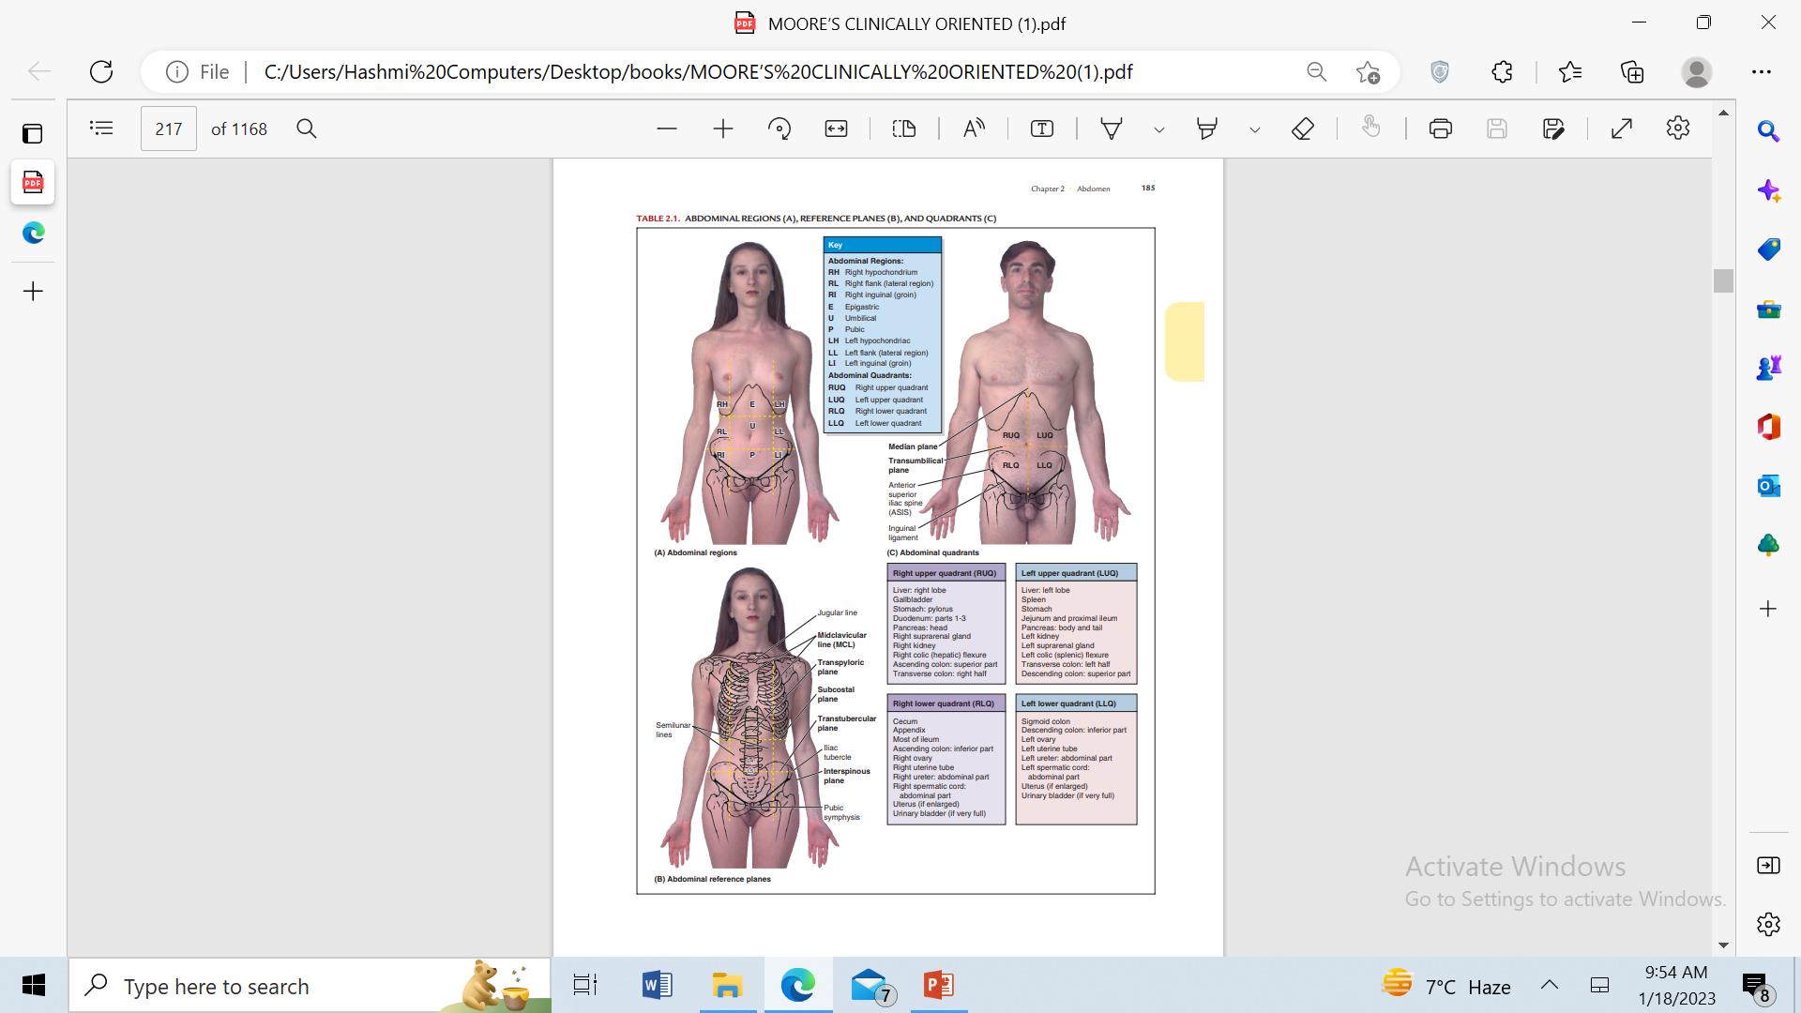
Midclavicular plane
Core Knowledge
2 sagittal planes are Midclavicular planes
Passes through the middle part of the clavicle & mid inguinal point.

Slide 13
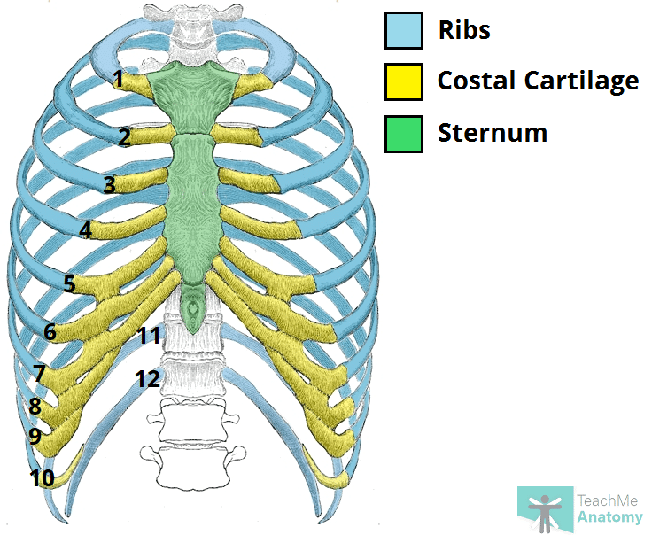
Subcostal plane.
Core Knowledge
horizontal planes,through upper border of L3
Passing through inferior border of 10th costal cartilage on each side.

Slide 14
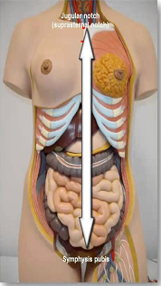
Transpyloric plane
Core Knowledge
Midway b/w the superior border of manubrium sterni (suprasternal notch) & superior border of pubic symphysis
Midway b/w umblicus & sternal body
Intersects at L1 body lower border, meeting tip of 9th costal cartilage

Slide 15
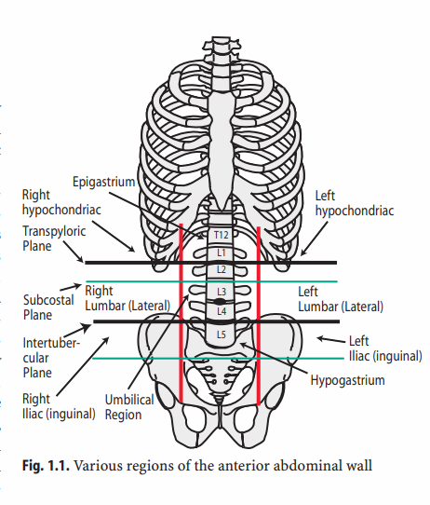
Core Knowledge
Structures lying at this plane.
1- Pylorus in lying down position.
2- Fundus of gall bladder
3- Neck of the pancreas.
4- The origin of the superior mesenteric artery
5- Hepatic portal vein.
6- Root of the transverse mesocolon.
7- Duodenojejunal junction
8- Hila of the kidney.

Slide 16

Trans tubercular plane
Core Knowledge
Passing through iliac tubercles.(5 cm post. To ASIS).
It cuts the front of L5 vertebral body near it’s upper border.

Slide 17
Interspinous plane.
Core Knowledge
Passes through Easily palpated ASIS on each side.
L4

Slide 18
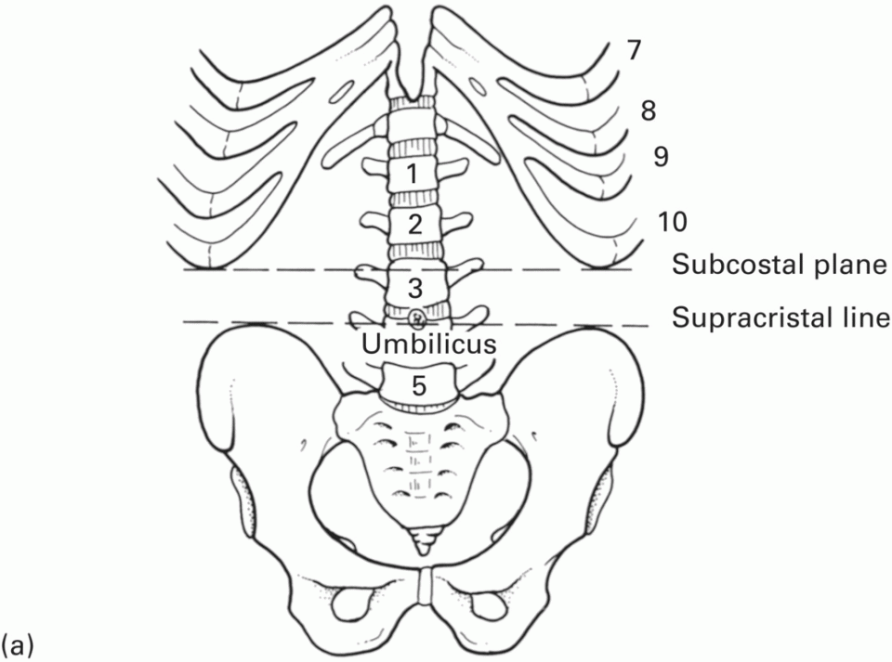
Supra-cristal Plane
Core Knowledge
Present on posterior /dorsal surface of body
Transverse line b/w highest point of iliac crest
At level of L4 spinous process

Slide 19
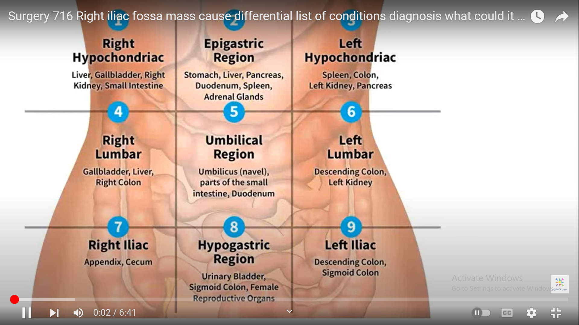
.
Core Knowledge

Slide 20
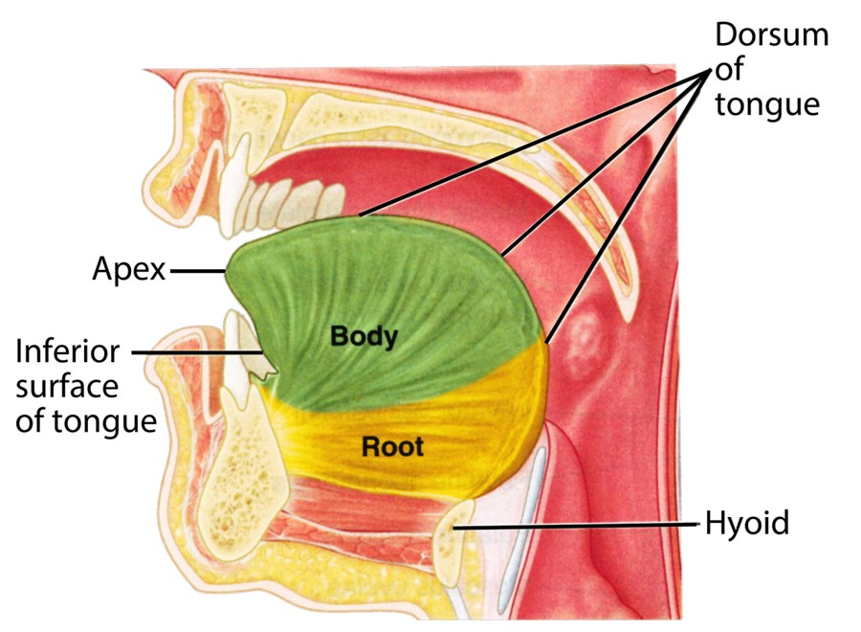
Core Knowledge
Tongue

Slide 21
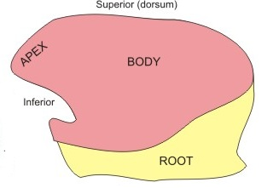
Core Knowledge
Tongue
A mass of striated muscle covered mucous membrane.
Forms part of floor of oral cavity and part of anterior wall oropharynx.
Its anterior part is in the oral cavity and is somewhat triangular in shape with a blunt apex of tongue.
The apex is directed anteriorly .
The root of tongue is attached to mandible and the hyoid bone.

Slide 22
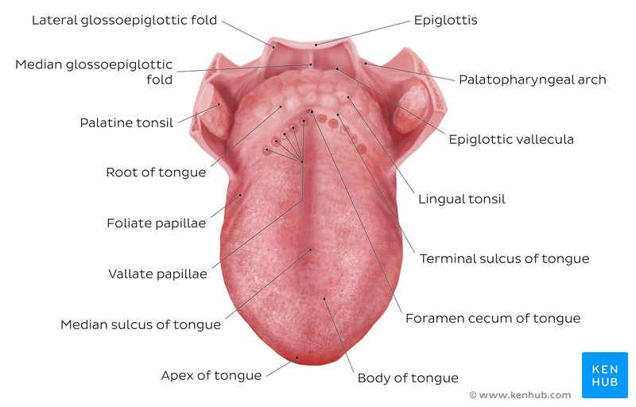
Core Knowledge

Slide 23
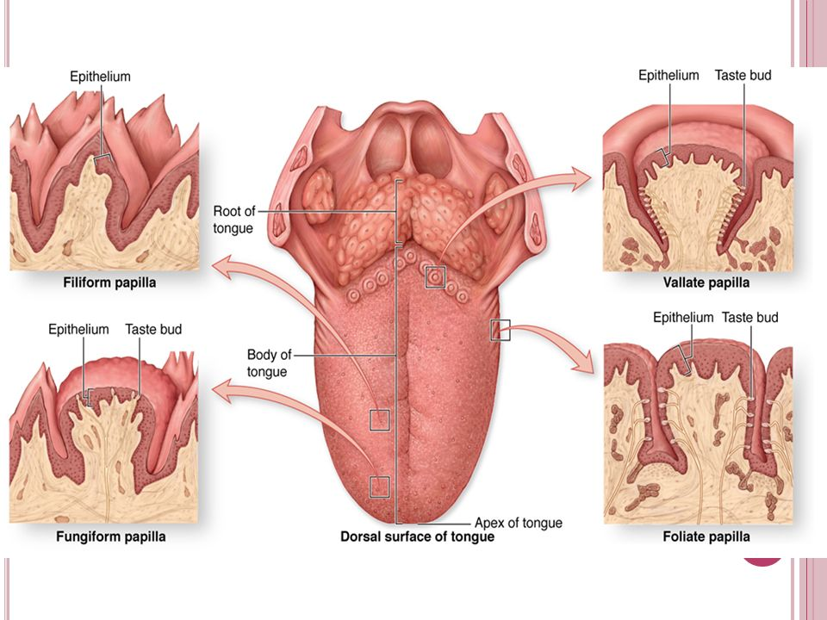
Core Knowledge

Slide 24
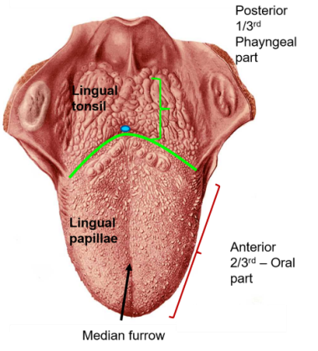
Gross Features of Tongue
Core Knowledge

Slide 25
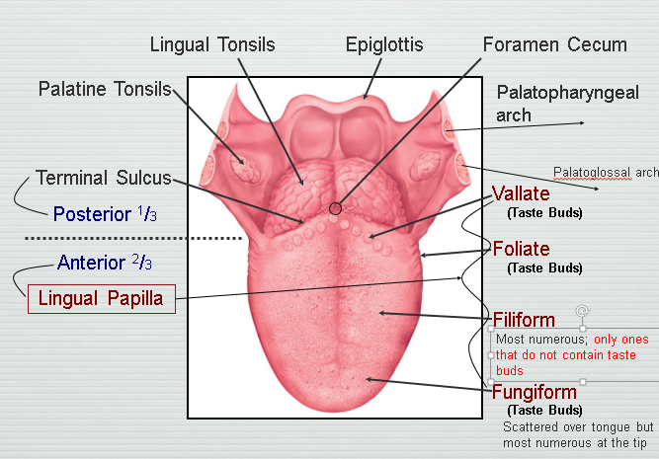
Core Knowledge

Slide 26
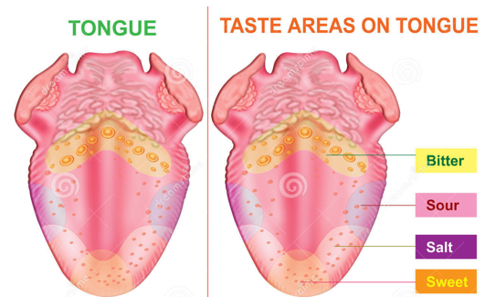
Core Knowledge

Slide 27
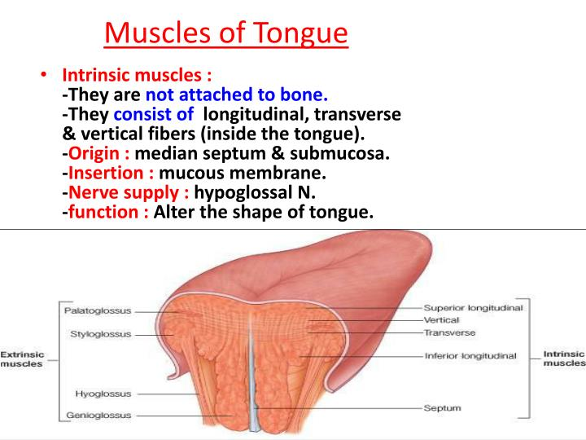
Core Knowledge

Slide 28
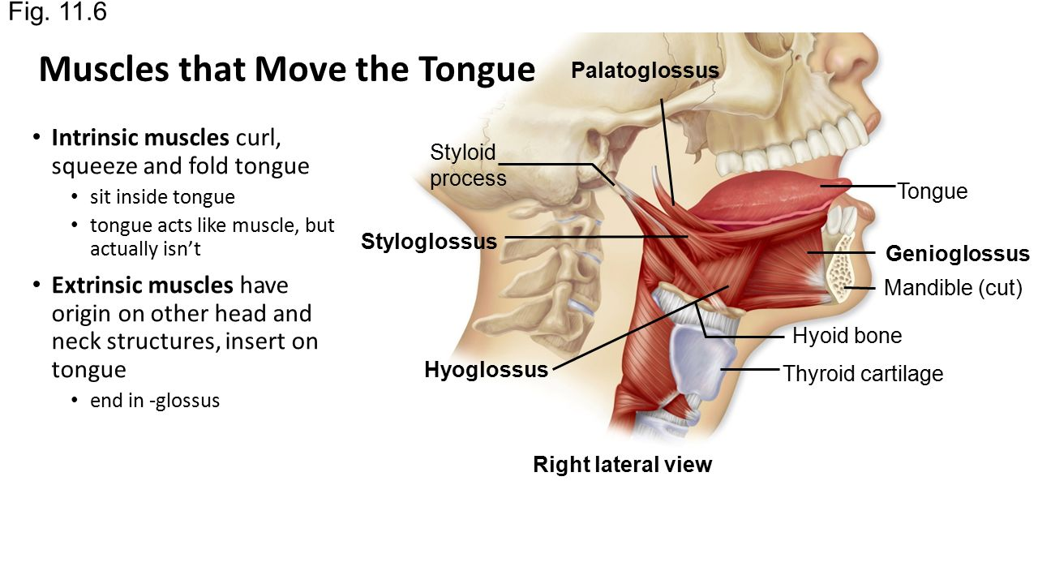
Core Knowledge

Slide 29
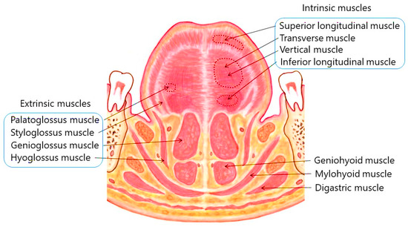
Intrinsic muscles confined to the tongue, are not attached to bone.
Extrinsic muscles attached to bones and the soft palate.

Slide 30
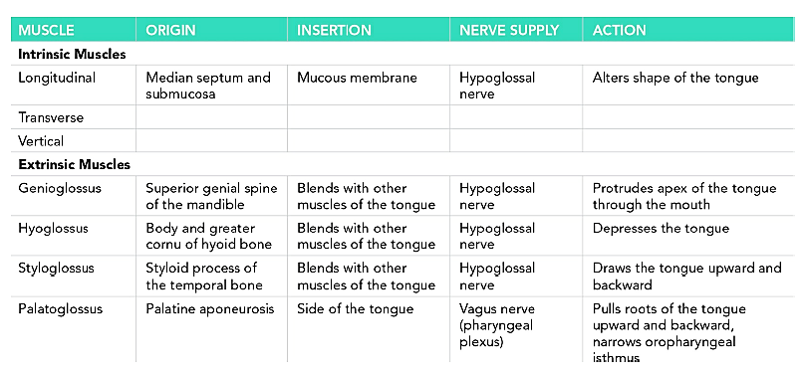
Core Knowledge

Slide 31
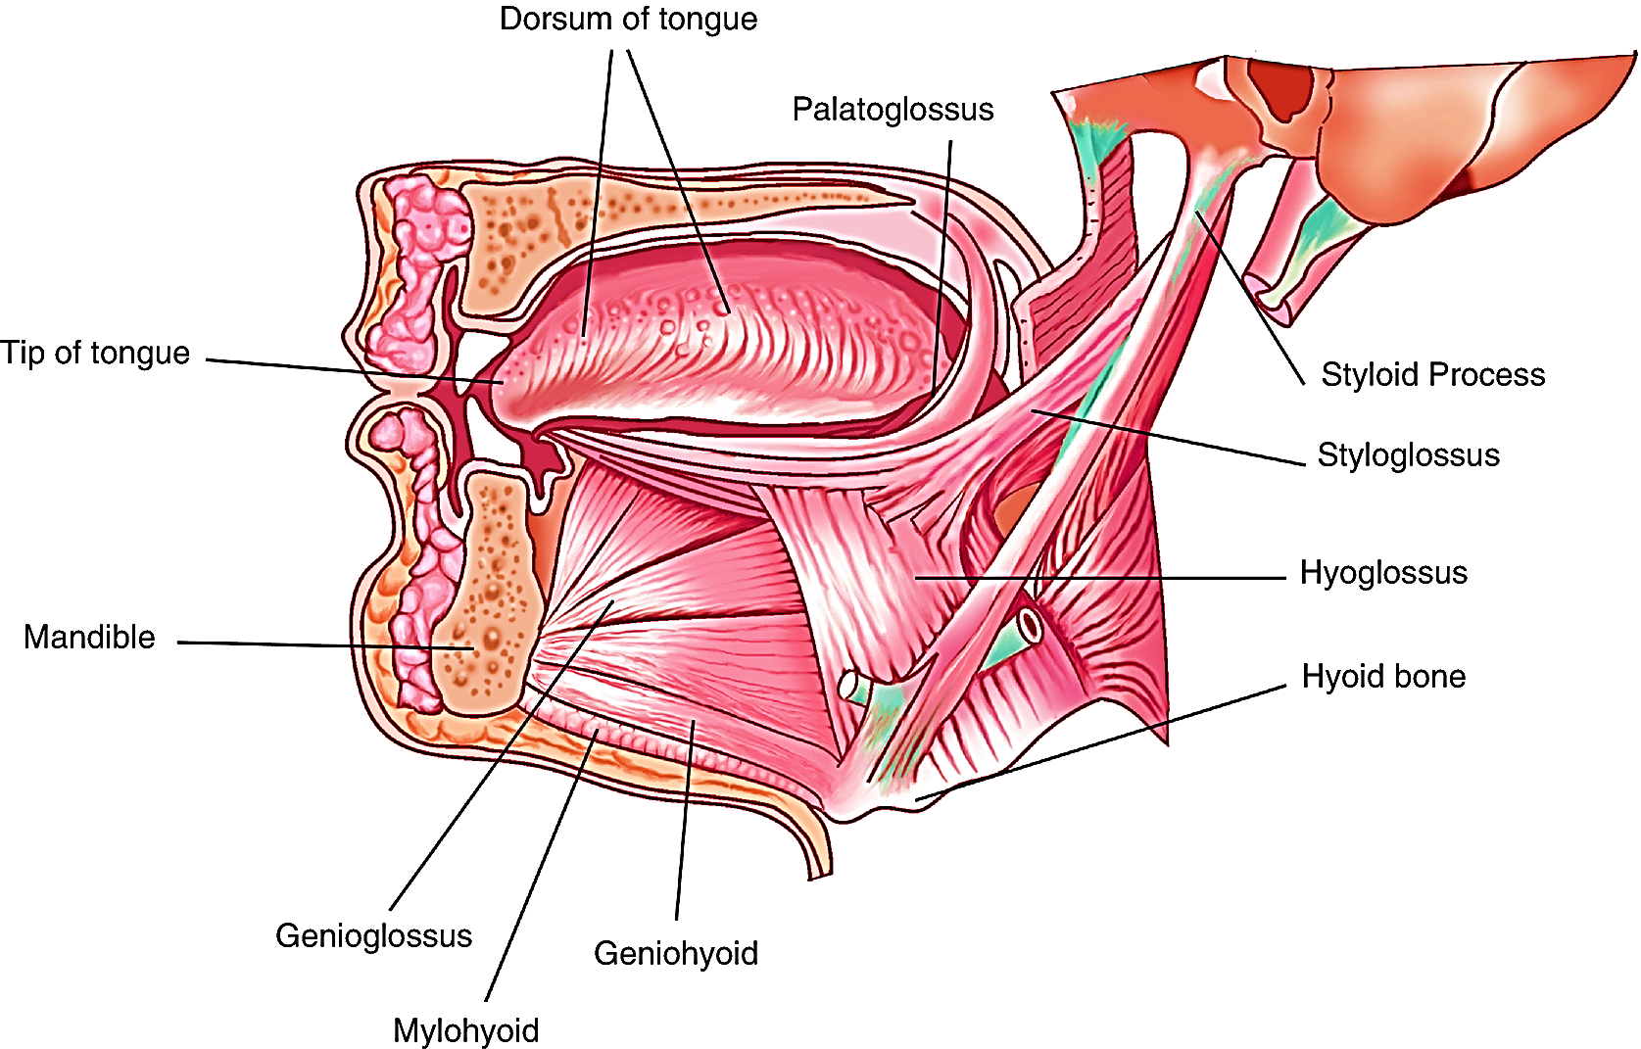
Muscle of Tongue

Slide 32
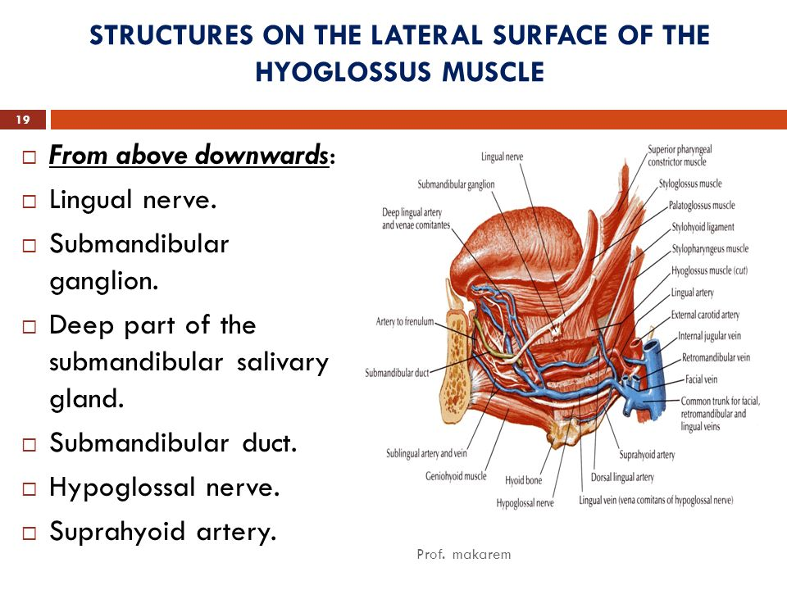
Core Knowledge

Slide 33
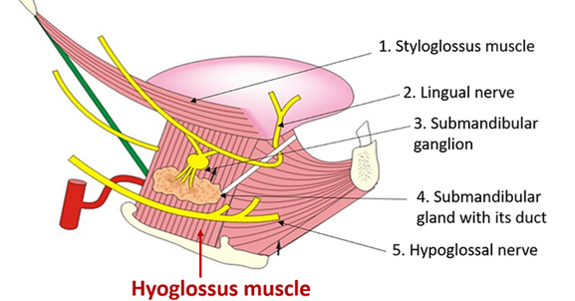
Core Knowledge

Slide 34
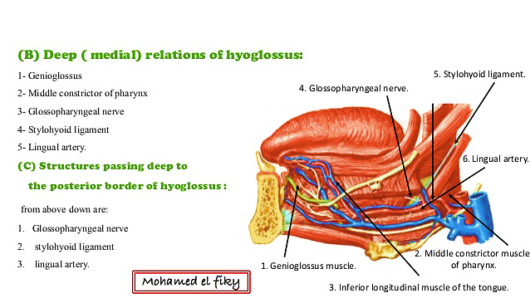
Core Knowledge

Slide 35
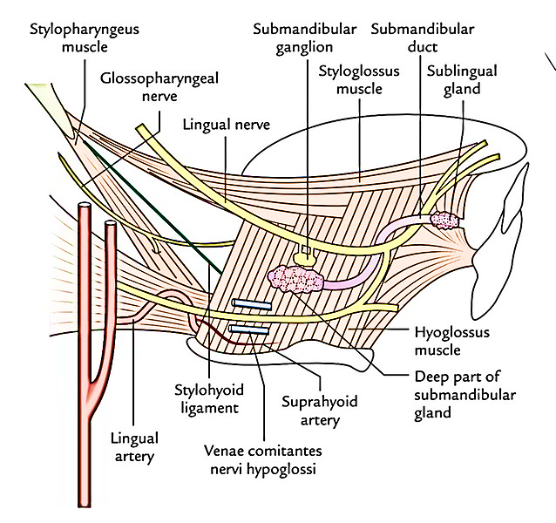
Core Knowledge

Slide 36
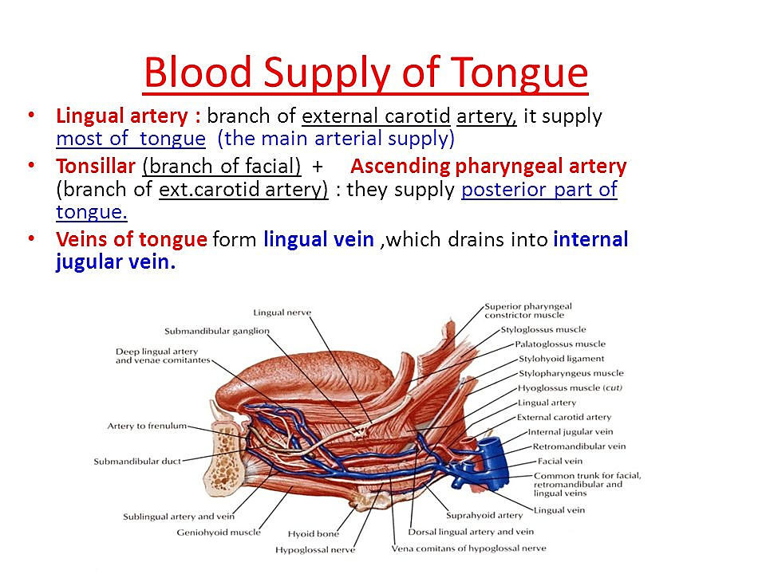
Core Knowledge

Slide 37
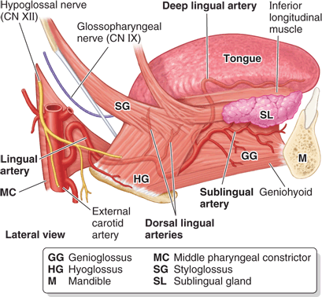
Core Knowledge

Slide 38
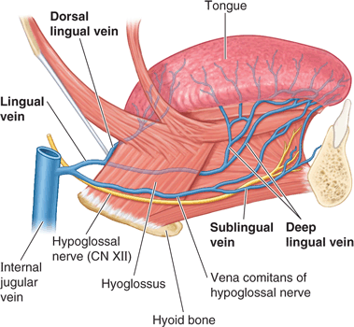
Core Knowledge
Venous Drainage

Slide 39
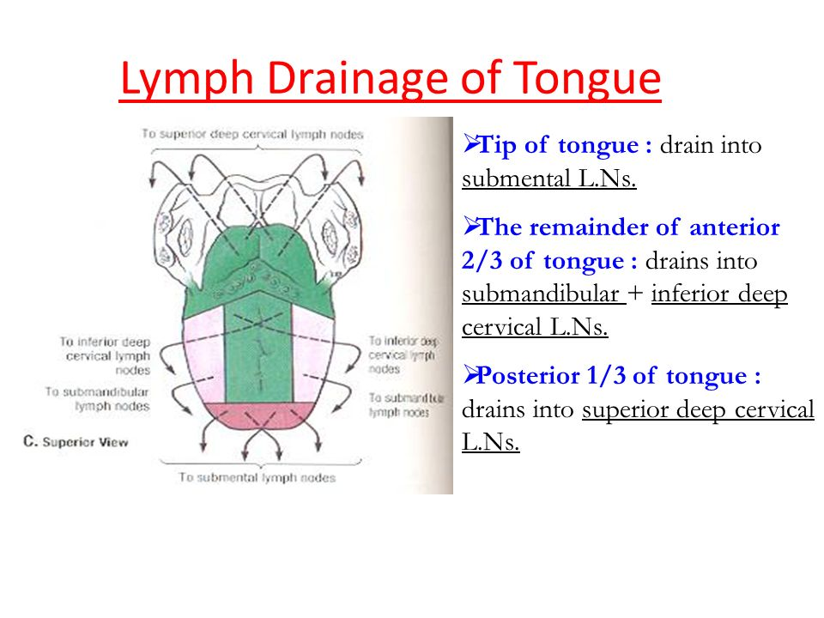
Core Knowledge

Slide 40
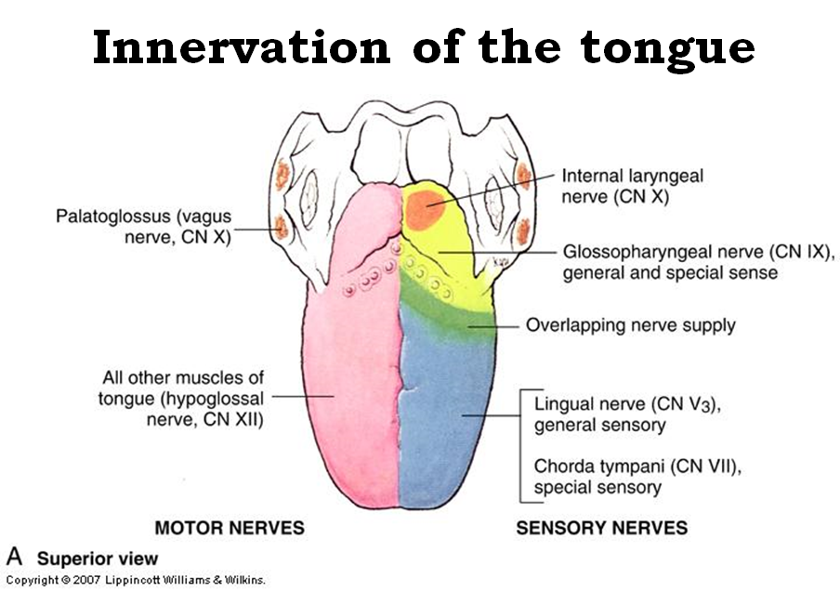
Core Knowledge

Slide 41
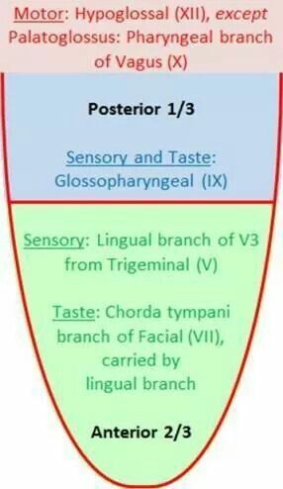
Core Knowledge

Slide 42
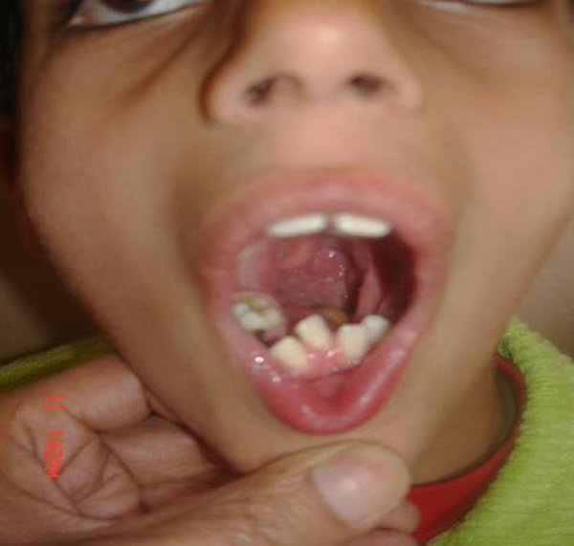
Aglossia Congenita
Vertical IntegrationIntegration

Slide 43
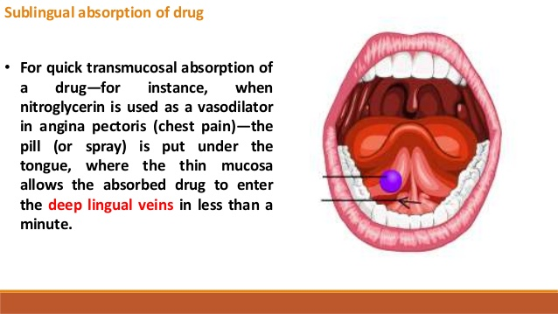
Core Knowledge

Slide 44
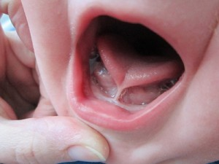
Tongue tie
Vertical IntegrationIntegration

Slide 45
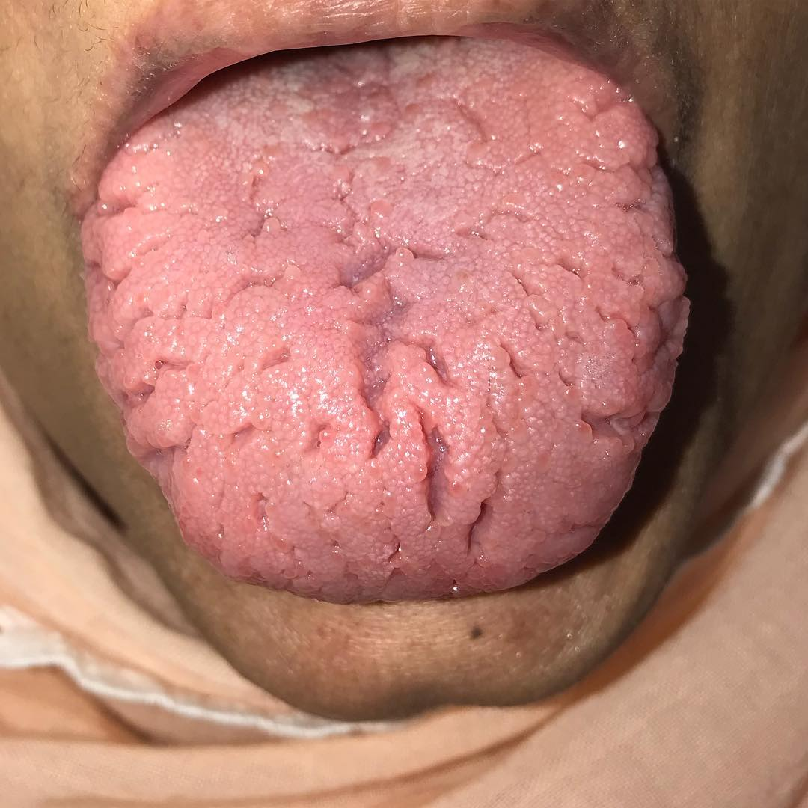
FISSURED TONGUE(Fe def. anaemia)
Vertical IntegrationIntegration

Slide 46
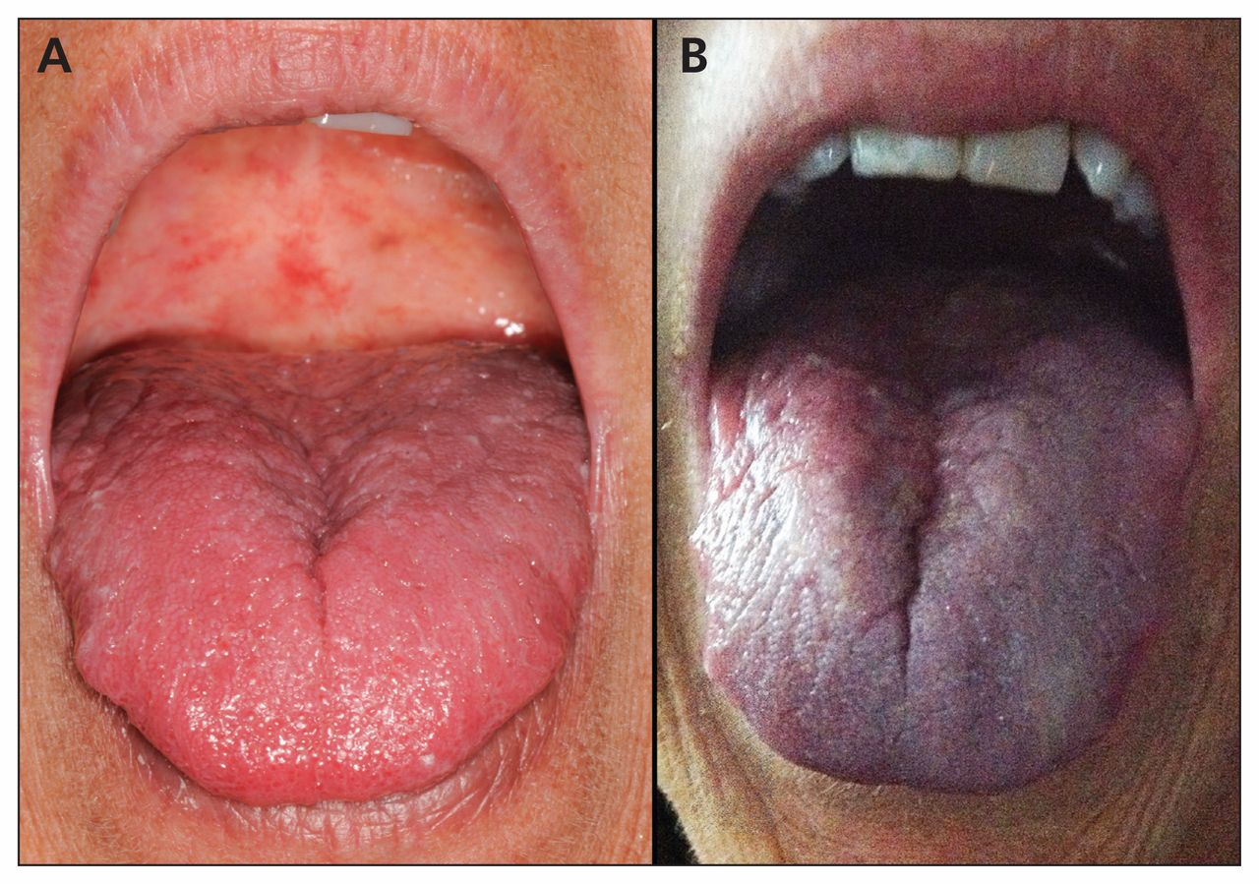
Central cynosis
Vertical IntegrationIntegration

Slide 47
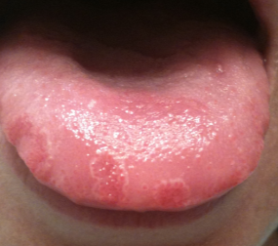
Tongue ulcer
Vertical IntegrationIntegration

Slide 48
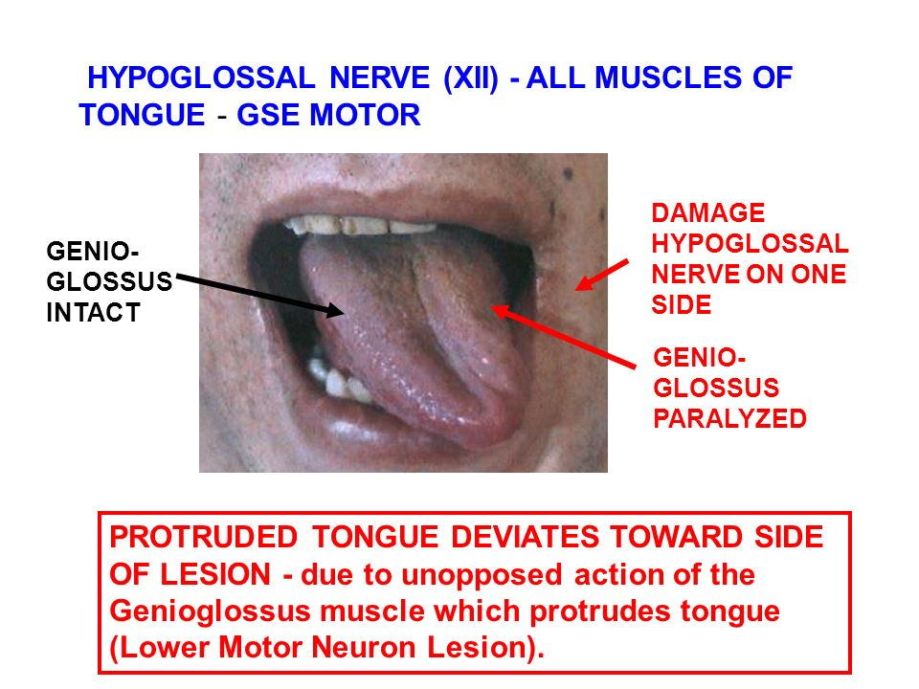
Core Knowledge

Slide 49
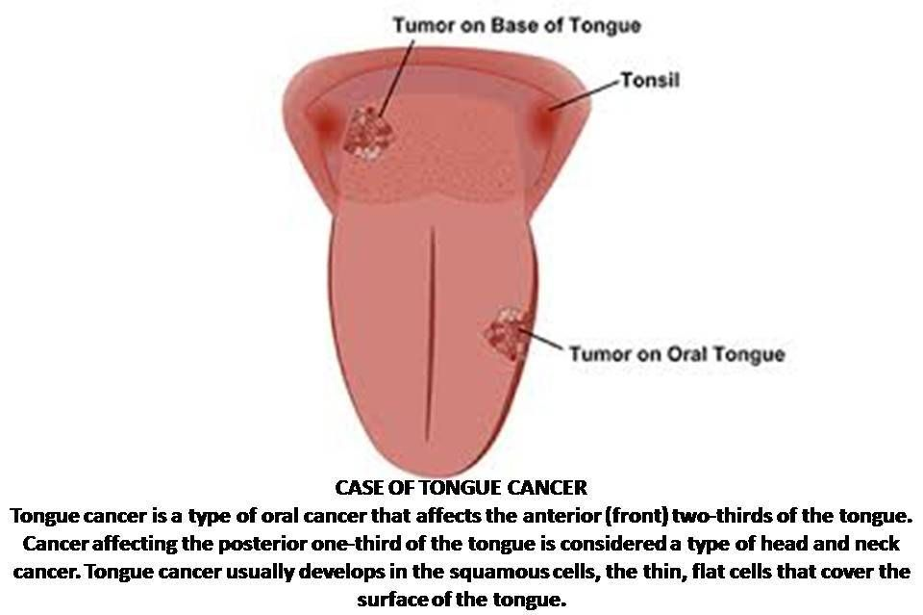
Core Knowledge

Slide 50
Spiral Integration
Bioethics
Ethical Considerations
From an ethical standpoint, the scenario raises considerations regarding patient autonomy, informed consent, and confidentiality
The physician must ensure that patient fully understands her diagnosis, treatment options, and potential implications
Discuss the necessity of a tongue biopsy for confirmation of oral thrush and obtaining informed consent for the procedure
Additionally, the physician must respect patient’s privacy and confidentiality throughout the diagnostic and treatment process

Slide 51
.
Family Medicine
Spiral Integration
Management of Glossitis
Conduct a thorough medical history, including inquiries about recent antibiotic use, immunocompromised status
Perform a physical examination, focusing on the oral cavity to assess the extent and severity of oral thrush lesions
Vitamin B12 supplementation (oral or intramuscular depending on severity).Dietary modifications (increase intake of animal products like meat, eggs, dairy).Monitor neurological symptoms, as recovery may be slow if nerve damage is extensive.

Slide 52

Spiral Integration
Artificial Intelligence
Role of AI in Glossitis
AI can potentially aid in enhancing diagnostic accuracy and efficiency.
AI-powered decision support systems can also help clinicians in selecting appropriate treatment modalities
AI-driven predictive models may help anticipate the risk of recurrence in susceptible populations

Slide 53
Research Article
Spiral Integration
Treatment of symptomatic benign migratory glossitis: a systematic review
Wladimir Gushiken de Campos1 & Camila Vieira Esteves1 & Lígia Gonzaga Fernandes1 & Carina Domaneschi1 & Celso Augusto Lemos Júnior1
Received: 2 May 2018 /Accepted: 28 June 2018 /Published online: 7 July 2018 # Springer-Verlag GmbH Germany, part of Springer Nature 2018
Benign migratory glossitis (geographic tongue) is a common clinical finding in routine pediatric dentistry. The condition usually is discovered on routine clinical examination, appearing as an asymptomatic, ulcer-like region on the dorsum of the tongue. The lesion may recur at different sites on the tongue, creating a migratory appearance, and in many cases, will resolve completely.

Slide 54
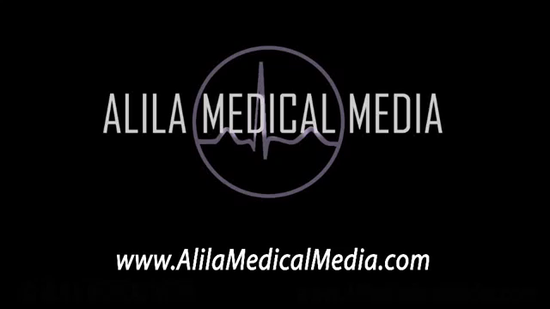

Slide 55
THANKS

