Slide 1
CVS &Respiration MODULE _VII Rheumatic fever
Dr. Mudassira Zahid
Dr. Fatima-tuz-Zahra
MBBS, M.Phil. (Chem), FCPS(Chem), CHPE
Pathology Department, RMU
Assistant Professor Pathology
LGIS

Slide 2
LEARNING OUTCOMES
At the end of the lecture the students should be able to:
Describe the etiology and pathogenesis of rheumatic fever.
Summarize the presenting features of the disease.
Enlist various tests which may be done for the diagnosis of the disease.

Slide 3
ETIOLOGY
• Rheumatic fever is an immunologically mediated inflammatory disorder, which occurs as a sequel to group A streptococcal pharyngeal infection.
• Multisystem disease affecting the heart, joints, brain, cutaneous and subcutaneous tissues
• acute rheumatic fever remains an important preventable cause of cardiac disease.
• It is most common in children 6 to 15 years old.
• A family history of rheumatic fever and lower socioeconomic status are additional factors.

Slide 4
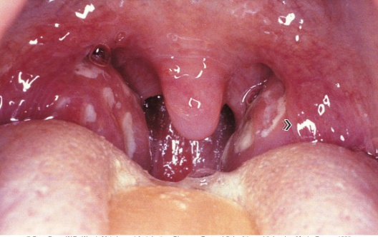
pharyngitis

Slide 5
Rheumatic fever-pathogenesis
There is no direct invasion to the tissue by the microorganism but its an autoimmune disease that involves Ag-Ab interaction.
It is due to an immunologic reaction that is a delayed sequela of group A beta hemolytic streptococcal infections of the pharynx.
It must be pharyngeal infection not skin infection.

Slide 6
Group A streptococcal(GAS) pharyngeal infection
verticle
Body produce antibodies against streptococci
These antibodies cross react with human tissues because of the antigenic similarity between streptococcal components and human connective tissues (molecular mimicry)[there is certain amino acid sequence that is similar between GAS and human tissue]-
Immunologically mediated inflammation & damage (autoimmune) to human tissues which have antigenic similarity with streptococcal components- like heart, joint, brain connective tissues.

Slide 7
Clinical Features
verticle
Presents suddenly with fever, joint pain and malaise
Cardiac Manifestation
- heart murmur , cardiac enlargement or cardiac failure
- Pericardial effusion, ECG changes of pericarditis, myocarditis
Skin Manifestation verticle
Erythema marginatum(transient pink rashes edges, occurs in 20% of cases)
- Erythematous area found mainly on trunk and limbs
- Subcutaneous nodules which are painless, pea-sized, hard

Slide 8
verticle
Arthritis
- Fleeting migratory polyarthritis
- Affects large joints i.e. knee, elbows, ankle and wrist
Sydenham’s chorea
- Occurs late after Streptococcal infection
- CNS involvement
- presents long after infection has resolved, more common in females,
- Spasmodic, unintentional, jerky choreiform movements, speech affected.

Slide 9
Modified Jones Criteria(for diagnosis)
Core
Evidence of antecedent streptococcal infection
Positive throat culture for group A streptococcus
History of (e.g. of scarlet fever)
Elevated anti-streptolysin O titer (or other serological assay for streptococci)
Major criteria
Carditis
Polyarthritis
Chorea , Erythema marginatum/Subcutaneous nodules

Slide 10
Modified Jones Criteria(for diagnosis)
Core
Minor criteria
Fever
Arthralgia (unless arthritis counted as major criterion)
Previous rheumatic fever
Raised ESR/C-reactive protein
Leukocytosis
[Diagnostic: if 2 or more major criteria or 1 major and 2 or more minor criteria; along with evidence of current streptococcal infection]

Slide 11
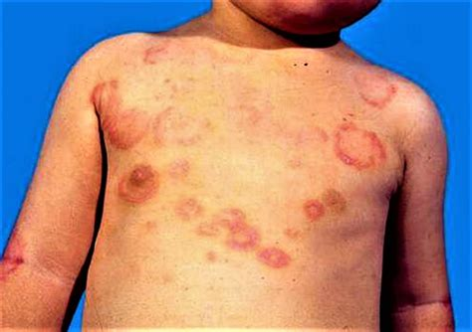
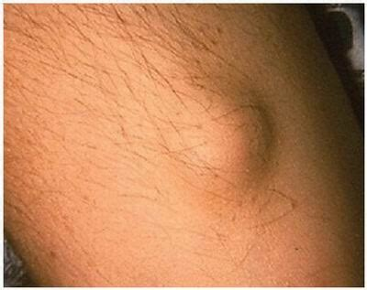
RHEUMATIC FEVER
Verticle

Slide 12
S. PYOGENES
Verticle
Pyogenic diseases
Toxigenic diseases , toxic shock syndrome, scarlet fever
Immunologic diseases- Rheumatic fever, acute glomerulonephritis

Slide 13
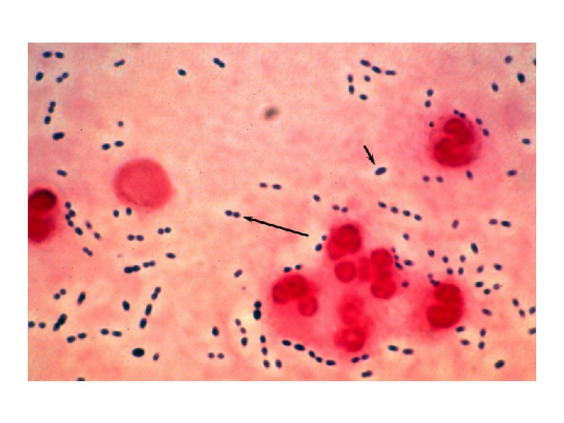
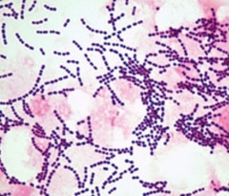
STREPTOCOCCUs PYOGENES
Verticle
Gram Positive spherical bacteria- form pairs
or chains.
Members of normal human flora
Associated with important human diseases

Slide 14
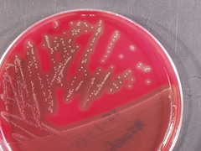
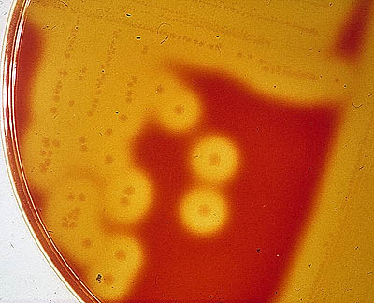
CLASSIFICATION OF STREPTOCOCCI- HEMOLYSIS
Verticle

Slide 15
CLASSIFICATION OF STREPTOCOCCI
Verticle
Group-specific carbohydrate(Lancefield grouping)
A-U.
Human pathogens- A, B, C, D, F and G.
Gp A -S.pyogenes.
Gp B- S. agalactiae.
Gp D- Enterococcus

Slide 16
Virulence factors
Core
Capsule.
M protein- major virulence factor, promotes adherence, antiphagocytic, anticomplement.
C- carbohydrates- protect against lysozyme.
Fimbriae- adherence.
Hyaluronic acid capsule- provokes no immune response.
C5a protease hinders complement and neutrophil response.
Exoenzymes- Streptokinase, streptodornase, hyaluronidase.

Slide 17
Infections caused by S. pyogenes
Core
Superficial
-Pharyngitis, skin and soft tissue inf.,erysipelas, impetigo, vaginitis, post partum infections, stomatitis.
Deep
-Cellulitis, myositis, deep soft tissue inf., puerperal sepsis, pericarditis, meningitis, pneumonia.
Toxin mediated
-Scarlet fever, toxic shock syndrome
Immunologically mediated- Glomeruloneph., Rheumatic fever

Slide 18
Diagnosis
Core
Specimens- throat swab, pus, blood.
Microscopy.
Culture- bacitracin disc.
Catalase negative.
Antigen detection.
Antibody detection
-ASO titer- for throat infection.
-anti DNAase, antihyaluronidase- for skin infections.

Slide 19
Treatment
Horizontal Pharmacology
Bed rest 2-6 weeks(till inflammation subsided)
Supportive therapy- treatment of heart failure
Eradication of organism anti-streptococcal therapy- Benzathine penicillin(long acting) 1.2 million units once(IM injection) or oral penicillin 10 days, if allergic to penicillin erythromycin 10 days
Anti-inflammatory agents-
a. for Polyarthritis & mild carditis; anti-inflammatory therapy with salicylates: Aspirin 100 mg/kg per day for arthritis and in the absence of carditis- for 4-6 weeks to be tapered off
b. For severe carditis with cardiomegaly: Corticosteroid 1-2 mg/kg per day – for 4-6 wks

Slide 20
Prevention
Community Medicine
Secondary prevention
Prevention of recurrent attacks
Benzathine penicillin G 1.2 million units IM every 4 weeks
Or Penicillin V 250 mg twice daily orally
• If allergic– Erythromycin 250 mg twice daily orally
Duration of secondary rheumatic fever prophylaxis
• Rheumatic fever + carditis - life long.
• Rheumatic fever without carditis- 5 years or until 21 years whichever is longer.
• (Continuous prophylaxis is important since patient may have asymptomatic GAS infection)

Slide 21
Prognosis
Core
R.F. may cause permanent damage to the heart.
The prognosis of acute rheumatic fever depends on the degree of permanent cardiac damage.
Cardiac involvement may resolve completely, especially if it is the first episode and the prophylactic regimen is followed.
The severity of cardiac involvement worsens with each recurrence of rheumatic fever.

Slide 22
SUMMARY
Rheumatic fever is an immunologically mediated inflammatory disorder, which occurs as a sequel to group A streptococcal pharyngeal infection.
• Multisystem disease affecting the heart, joints, brain, cutaneous and subcutaneous tissues
• Acute rheumatic fever remains an important preventable cause of cardiac disease.
• It is most common in children 6 to 15 years old.
Cardiac involvement may resolve completely, especially if it is the first episode and the prophylactic regimen is followed.

Slide 23
Research
Longitudinal
Recent modifications to the Jones Criteria include echocardiographic diagnosis of carditis and different criteria based on underlying population risk,⁴ but there have been no other substantive recent changes to diagnostic approach. I

Slide 24
bioethics
Longitudinal
Informed Consent: Patients, especially minors, should be informed about diagnostic tests and possible implications.
Non-Maleficence: Avoid unnecessary tests or misdiagnosis that may lead to undue anxiety or harm.
Beneficence: Early and accurate diagnosis ensures timely treatment, preventing complications like rheumatic heart disease.
Justice: Equitable access to diagnostic tools and treatment, regardless of socioeconomic status, is essential.
Autonomy: Patients and guardians should be involved in decision-making regarding investigations and treatment plans.

Slide 25
EOLA
A 12-year- boy presents with fever, joint pain, and shortness of breath. His mother reports that he had a sore throat three weeks ago that resolved without treatment. On examination, he has a temperature of 38.5°C (101.3°F), a new holosystolic murmur at the apex, and swelling with tenderness in his knees and elbows. Laboratory tests show elevated ESR and CRP. An echocardiogram reveals mitral regurgitation.
Which of the following is the most likely diagnosis?
A) Reactive arthritis B) Infective endocarditis C) Juvenile idiopathic arthritis D) Acute rheumatic fever E) Viral myocarditis

Slide 26
Longitudinal

