Slide 2
CVS &Respiration MODULE _VII Infective Endocarditis
LGIS
Dr. Mudassira Zahid
Dr. Fatima-tuz-Zahra
MBBS, M.Phil. (Chem), FCPS(Chem), CHPE
Pathology Department, RMU
Assistant Professor Pathology

Slide 4
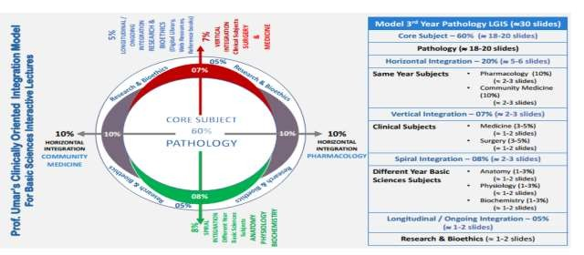

Slide 5
How to use HEC Digital Library
Steps to Access HEC Digital Library
Go to the website of HEC National Digital Library.
On Home Page, click on the INSTITUTES.
A page will appear showing the universities from Public and Private Sector and
other Institutes which have access to HEC National Digital Library (HNDL).
Select your desired Institute.
A page will appear showing the resources of the institution
Journals and Researches will appear
You can find a Journal by clicking on JOURNALS AND DATABASE and enter a keyword to search for your desired journal.
5.

Slide 6
Learning Outcomes
Define infective endocarditis.
Describe the pathogenesis, clinical manifestations, and diagnosis of infective endocarditis.
Outline the management principles of infective endocarditis.

Slide 7
Endocarditis: Definition
Spiral
pathology
Infective Endocarditis:
a microbial infection of the endocardial surface of the heart or mural endocardium
It is bacterial, fungal, rickettsial, chlamydial & viral
Common site: heart valve, but may occur at septal defect, on chordae tendinae or in the mural endocardium

Slide 8
Endocarditis: Classification
pathology
Core
▶ According to severity of presentation and progression
Acute Infective endocarditis
Follow a fulminant course
If untreated death within < 6 weeks
Healthy heart involved
Sub acute Infective Endocarditis
If untreated death from 6 weeks to 3 months
Damaged heart is involved
Chronic Infective endocarditis
If untreated death from 3 months to 2 years
Prior valvular disease present

Slide 9
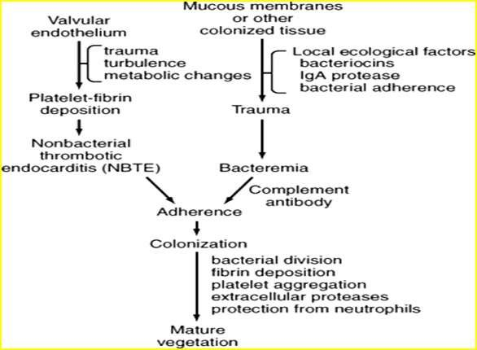
Spiral
pathology
Pathogenesis

Slide 10
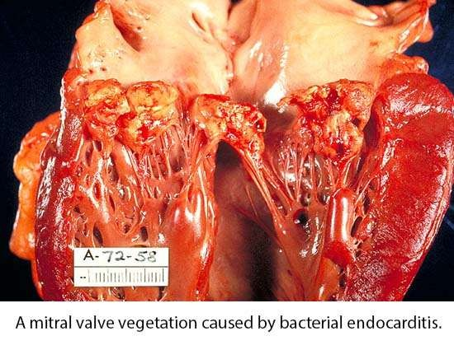
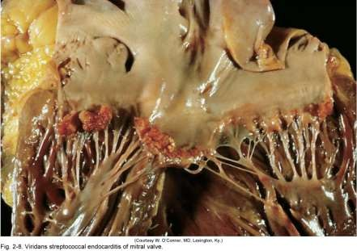
Characteristic Pathological lesion
Spiral
pathology
Vegetation, composed of platelets, fibrin, microorganisms and inflammatory cells.

Slide 11
Core
pathology

Slide 12
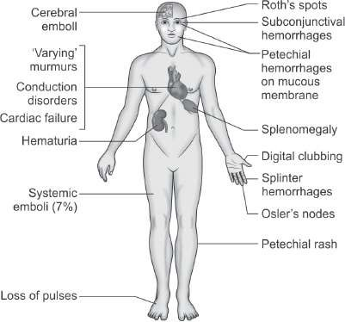
Signs and Symptoms
Vertical
pathology

Slide 13
Clinical Manifestations
Vertical
pathology
▶ Four processes contribute to the clinical picture
The infectious process on the valve, including the local intracardiac complications
bland or septic embolization to virtually any organ
constant bacteremia, often with metastatic foci of infection
circulating immune complexes and other
immunopathologic factors

Slide 14
Clinical Manifestations
Vertical
pathology
▶ CONSTITUTIONAL SYMPTOMS:
Fever, most common symptom, sign (but may be absent),
Anorexia, weight-loss, malaise, night sweats
▶ CONSEQUENCE OF DESTRUCTION OF THE HEART VALVES:
Heart murmur, heart failure, AV block (PR prolongation on ECG)

Slide 15
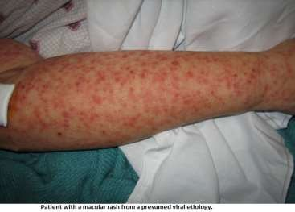
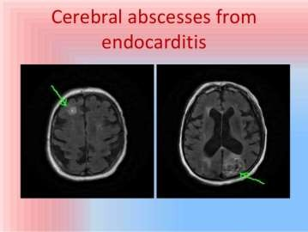
Clinical Manifestations
Vertical
▶ EMBOLIC PHENOMENA:
Lt sided endocarditis; CVAs or brain abscess, spleen or renal infarcts and emboli to other sites manifesting as petechiae on the skin, conjunctivae, oral mucosa, retinal hemorrhages, splinter hemorrhages, janeway lesions
Splenomegaly, Arthralgia, Myalgia, clubbing

Slide 16
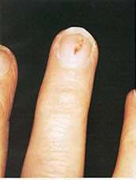
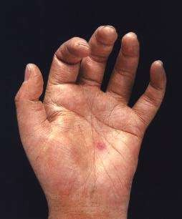
Clinical Manifestations
Vertical
▶ Splinter hemorrhages: are linear, red-to-brown streaks in the fingernails or toenails found commonly in IE, nonspecific and also seen in elderly patients
▶ Janeway lesions: are hemorrhagic, macular, painless plaques with a predilection for the palms or soles, are thought to be embolic in origin they occur with greater frequency in staphylococcal IE

Slide 17
Clinical Manifestations
Vertical
Medicine
Right-sided endocarditis; is not associated with peripheral emboli/phenomena but pulmonary findings predominate (cough, SOB, chest pain, hemoptysis)
▶ ANTIGEN ANTIBODY DEPOSITION:
Osler’s node, Roth spots, glomerulonephritis (hematuria) and arthritis
Osler nodes: painful, nodular lesion,10% to 25% cases, not specific for IE
Roth spots are oval, pale, retinal lesions surrounded by hemorrhage and usually are located near the optic disk, occur in < 5% of patients of IE

Slide 18
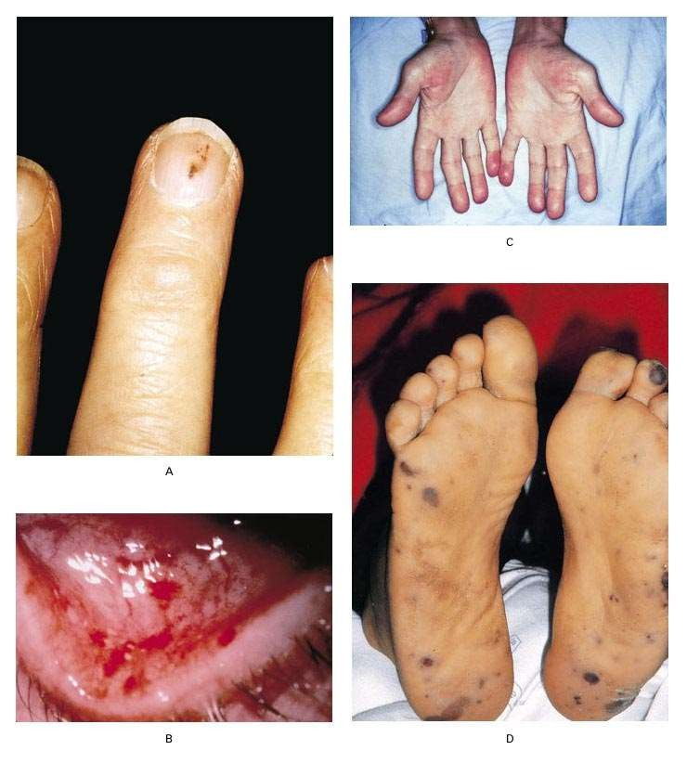
Vertical
Oslers’ nodes Tender, s/c nodules
Janeway lesions Nontender erythematous, haemorrhagic, or pustular lesions often on palms or soles.

Slide 19
Lab Diagnosis
Core
Non-Specific
ESR increased, Anemia, Leukocytosis, Thrombocytopenia,
RA + in 40-50%
C-Reactive Protein
Haematuria, Proteinuria
Specific
Blood Culture (3-4 times-1 hr apart) -> prolonged incubation
Serological diagnosis (e.g. Q-fever, chlamydia, etc)
CSF Culture
Molecular diagnosis
Echocardiography: TTE, TOE
ECG

Slide 20
Diagnosis: Duke Criteria
Core
▶ In 1994 a group at Duke University standardised criteria for assessing patients with suspected endocarditis
▶ Include
-Predisposing Factors
-Blood culture isolates or persistence of bacteremia
-Echocardiogram findings with other clinical, laboratory findings

Slide 21
Duke Criteria
Core
(Two major, or one major & three minor or five minor)
Major criteria
Microbiologic criteria:
Positive blood culture (Two separate positive culture)
Persistent positive blood culture(from >12 hr apart)
Serology for Q-fever positive
Clinical criteria:
Endocardiographic findings:
Oscillating intracardiac vegetation or periannular abscess or a
dehiscence of prosthetic valve
New valvular regurgitations

Slide 22
Duke Criteria
(Two major, or one major & three minor or five minor)
Core
Minor criteria
A predisposing cardiac condition or IV drug use
Fever >38C (>100.4 F)
Vascular phenomenon (emboli etc.)
Immunologic phenomenon like glomerulonephritis,osler
node, Roth’s spot, rheumatoid factors
Microbiologic evidence (not meeting the major criteria)
Endocardiographic findings (not meeting the major
criteria)

Slide 23
Core

Slide 24
Complications Of Endocarditis
Vertical
▶ Prolonged Fever: usually fever associated with endocarditis resolves in 2-3 days after commencing appropriate antimicrobial therapy with less virulent organisms and 90% by the end of the second week
▶ Recurrent fever
▶ Mycotic aneurysm
▶ Renal → Focal & diffuse glomerulonephritis
▶ Treatment failure

Slide 25
Therapy for Infective Endocarditis
Horizontal pharmacology
Antimicrobial therapy general principles:
▶ Appropriate diagnosis of causative agent
▶ Determination of appropriate antibiotic – MIC
▶ Intravenous therapy
▶ Prolonged therapy – at least for 6 weeks
▶ Continuous monitoring
▶ Use a bactericidal regimen
▶ Use a recommended regimen for the organism isolated
▶ Repeat blood cultures until blood is demonstrated to be
sterile

Slide 26
Therapy
Horizontal
pharmacology
▶ Streptococci/Enterococci
▶ Determine MIC of Penicillin
▶ Penicillin +/- aminoglycoside
▶ Ceftriaxone alone
▶ Vancomycin +/- aminoglycoside
HACEK group
▶ Cefotaxime/ceftriaxone

Slide 27
Therapy
Horizontal
pharmacology
▶ Staphylococci
▶ Native valve
▶ Flucloxacillin +/- aminoglycoside
▶ Vancomycin +/- aminoglycoside/ rifampicin
▶ Prosthetic valve
▶ Flucloxacillin + aminoglycoside + rifampicin
▶ Vancomycin + aminoglycoside + rifampicin

Slide 28
Causes of Treatment Failure
Core
▶ Failure to control infection
▶ Highly resistant organism/wrong therapy
▶ Constant shedding of organisms from the diseased tissue or valve
▶ I/V related phlebitis
▶ Metastatic abscess formation
▶ Recurrent emboli from endocardium or deep venous thrombosis
▶ Superimposed infection at other sites like UTI, RTI

Slide 29
Prophylaxis
Pharmacology Horizontal
▶ Prophylactic antibiotic (Penicillin) is recommended for individuals at risks (Rheumatic heart disease or heart valve lesions or prosthetic heart valve)
Just before & short time after dental manipulation or extraction
▶ Aminoglycoside or other is added to penicillin if GIT or
genitourinary invasive procedures
▶ Long acting penicillin/Erythromycin is recommended - 5 years or more to all individuals with Rheumatic heart disease

Slide 30
Surgical Therapy
Verticle
pharmacology
▶ Get cardiothoracic teams involved early
▶ Indications:
▶ Congestive cardiac failure
▶ Peri valvular invasive disease
▶ Uncontrolled infection despite maximal antimicrobial
therapy
▶ Pseudomonas aeruginosa, Brucella species, Coxiella burnetti, Candida and fungi
▶ Presence of prosthetic valve endocarditis unless late
infection
▶ Large vegetation
▶ Major embolus
▶ Heart block

Slide 31
FAMILY MEDICINE
Longitudinal
▶ A 65-year-old male with a history of rheumatic heart disease presents with fever, chills, and a new heart murmur. Blood cultures are positive for Streptococcus viridans. What is the most likely diagnosis?
A. Acute pericarditis
B. Myocardial infarction
C. Infective endocarditis
D. Aortic dissection
E. Pulmonary embolism

Slide 32
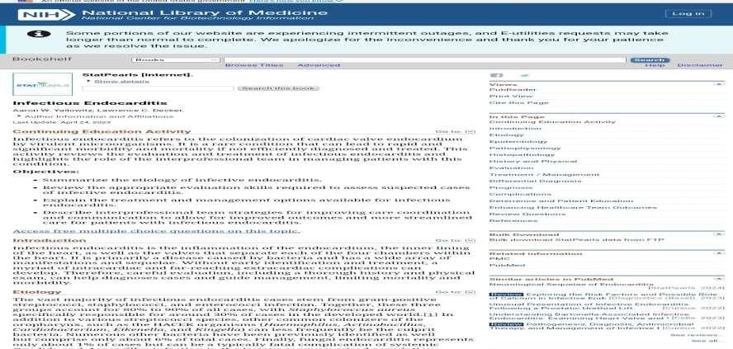
RESEARCH
Longitudinal
https://www.ncbi.nlm.nih.gov/books/NBK557641/

Slide 33
TAKE HOME MESSAGE
Infective endocarditis is a serious heart infection. Bacteria or fungi enter the bloodstream and form vegetations on heart valves. Symptoms include fever, chills, heart murmur, and fatigue. Early diagnosis and treatment are crucial to prevent complications.

Slide 34
EOLA
A 45-years male with a history of intravenous drug use presents to the emergency department with fever, fatigue, and weight loss for the past two weeks. He also reports shortness of breath and pleuritic chest pain. On examination, his temperature is 38.7°C (101.7°F), and a new systolic murmur is auscultated over the tricuspid area. Blood cultures grow Staphylococcus aureus. Transthoracic echocardiography reveals vegetations on the tricuspid valve.
Which of the following is the most likely complication of his condition?
A) Stroke due to embolization to the middle cerebral artery B) Septic pulmonary embolism C) Rupture of the mitral chordae tendineae D) Aortic root abscess E) Acute pericarditis

