Slide 1
CVS &Respiration MODULE _VII Asthma & Emphysema
LGIS
Dr. Mudassira Zahid
Dr. Fatima-tuz-Zahra
MBBS, M.Phil. (Chem), FCPS(Chem), CHPE
Pathology Department, RMU
Assistant Professor Pathology

Slide 2
Revision
Core Pathology
EMPHYSEMA
Emphysema is a chronic obstructive airway disease characterized by permanent enlargement of air spaces distal to terminal bronchioles.
Subtypes include
centriacinar (most common; smoking related),
panacinar (seen in α1-antitrypsin deficiency)
distal acinar
irregular

Slide 3
Revision
CHRONIC BRONCHITIS
Chronic bronchitis is defined as persistent productive cough for at least 3 consecutive months in at least 2 consecutive years
Cigarette smoking is the most important underlying risk factor; air pollutants also contribute

Slide 4
Aims of my lecture
To develop an understanding of the:
Types of asthma
Etiology of asthma
Pathogenesis of asthma
Genetic associations of asthma
Morphological changes in lungs in a patient with asthma
Pathogenesis of bronchiectasis
Gross and microscopic changes in bronchiectatic lung

Slide 5
Asthma
Core Pathology
Chronic inflammatory disorder of the airways that causes
Recurrent episodes of wheezing
Breathlessness
Chest tightness
Cough
These symptoms are
Particularly at night and/or in the early morning
Associated with widespread but variable bronchoconstriction and
airflow limitation

Slide 6
Asthma
Core Pathology
The hallmarks of the disease are
Increased airway responsiveness to a variety of stimuli
Resulting in episodic bronchoconstriction
Inflammation of the bronchial walls
Increased mucus secretion

Slide 7
Asthma
Core Pathology
Many cells play a role in the inflammatory response
Lymphocytes
Eosinophils
Mast cells
Macrophages
Neutrophils
Epithelial cells

Slide 8
Classification based on pathogenesis
Core Pathology
Asthma may be categorized into
Atopic
Evidence of allergen sensitization
In a patient with a history of
Allergic rhinitis
Eczema
Non-atopic
Without evidence of allergen sensitization

Slide 9
Classification based on triggering agents
Asthma may also be classified according to the agents or events that trigger bronchoconstriction
These include
Seasonal
Exercise-induced
Drug-induced e.g.
Aspirin
Occupational asthma
Asthmatic bronchitis in smokers

Slide 10
Triggers
Episodes of bronchospasm can be triggered by diverse mechanisms
Respiratory infections
Especially viral infections
Environmental exposure to irritants e.g.
Smoke
Fumes
Cold air
Stress
Exercise

Slide 11
Atopic Asthma
Most common type of asthma
Classic example of type I IgE-mediated hypersensitivity reaction
Disease usually begins in childhood
Triggered by environmental allergens such as
Dusts
Pollens
animal dander
Foods

Slide 12
Non-Atopic Asthma
Does not have evidence of allergen sensitization
Skin test results are usually negative
A positive family history of asthma is less common in these patients
Respiratory infections due to viruses are common triggers e.g.
Rhinovirus
Parainfluenza virus
Hyperirritability of the bronchial tree probably underlies their asthma

Slide 13
Non-Atopic Asthma
Core Pathology
Pathogenesis
It is thought that virus-induced inflammation of the respiratory mucosa lowers the threshold of the subepithelial vagal receptors to irritants
Inhaled air pollutants, such as sulfur dioxide, ozone, and nitrogen dioxide, may also contribute to the chronic airway inflammation and hyperreactivity

Slide 14
Pathogenesis
Core Pathology
Non- Atopic Asthma
Exact mechanism of bronchial hyperactivity in intrinsic asthma is
unknown .Following is the suggested mechanism:
Bronchial smooth muscles and bronchial secretions are controlled by autonomic nervous system ; Cholinergic and alpha- adrenergic stimulation causes broncho-constriction while beta- adrenergic stimulation causes relaxation
It is theorized that exposure to cold, exercise , air pollution , emotion and aspirin stimulate cholinergic and alpha – adrenergic system resulting in bronchial constriction and increased bronchial mucus secretion

Slide 15
Drug-Induced Asthma
Core Pathology
Several pharmacologic agents provoke asthma
Aspirin-sensitive asthma
Nonsteroidal anti-inflammatory medications
Occur in individuals with
Recurrent rhinitis
Nasal polyps
Clinical features
Asthmatic attacks
Urticaria

Slide 16
Drug-Induced Asthma
Core Pathology
Pathogenesis
Aspirin triggers asthma in these patients by
Inhibiting the cyclooxygenase pathway of arachidonic acid metabolism
Without affecting the lipoxygenase route
Tipping the balance toward elaboration of the bronchoconstrictor
leukotrienes

Slide 17
Pathogenesis
Core Pathology
The major etiologic factors in atopic asthma are a
Genetic predisposition to type I hypersensitivity (“atopy”)
Exposure to environmental triggers that remain poorly defined
It is postulated that inheritance of susceptibility genes makes individuals prone to develop strong TH2 reactions against environmental antigens (allergens) that are ignored or elicit harmless responses in most individuals. In the airways the scene for the reaction is set by initial sensitization to inhaled allergens, which stimulate induction of TH2 cells

Slide 18
Pathogenesis
Core Pathology
TH2 cells secrete cytokines that
promote allergic inflammation
stimulate B cells to produce IgE and other antibodies
Cytokines include
IL-4
Stimulates the production of IgE
IL-5
Which activates locally recruited eosinophils
IL-13
Which stimulates mucus secretion from bronchial submucosal glands
Promotes IgE production by B cells

Slide 19
Core
Pathology
Pathogenesis
Repeat exposure to the
allergen
Triggers IgE coats submucosal
mast cells
Release granule contents
Produce cytokines and
other mediators
Late-phase
reaction
Early-phase (immediate hypersensitivity) reaction

Slide 20
Pathogenesis
Core Pathology
The early reaction
Bronchoconstriction
Bronchoconstriction is triggered by direct stimulation of subepithelial vagal (parasympathetic) receptors through both central and local reflexes (including those mediated by unmyelinated sensory C fibers)
Increased mucus production
Variable degrees of vasodilation
Increased vascular permeability

Slide 21
Pathogenesis
Core Pathology
The late-phase reaction
Inflammation
Recruitment of leukocytes, notably eosinophils, neutrophils, and more T cells
Leukocyte recruitment is stimulated by chemokines produced by
Mast cells
Epithelial cells
T cells

Slide 22
Pathogenesis
This second wave of mediators stimulates the late reaction e.g
Eotaxin
Produced by airway epithelial cells
Potent chemoattractant
Activator of eosinophils
The major basic protein of eosinophils
Epithelial damage
Airway constriction

Slide 23
Core
Pathology
Multiple mediators contribute to the acute asthmatic response
Composition of this mediator combo might differ among different individuals or types of asthma
The appreciation of the importance of inflammatory cells and mediators in asthma has led to greater emphasis on anti-inflammatory drugs, such as corticosteroids, in the treatment of asthma

Slide 24
Core
Pathology
The complex interactions are poorly understood between
Immune system
Airway epithelium
Mesenchymal tissues in the airways
Infections with common respiratory pathogens can exacerbate the chronic changes and cause serious worsening of the clinical manifestations of the disease e.g
Respiratory syncytial virus
Influenza.

Slide 25
“Hygiene Hypothesis”
Core Pathology
states that eradication of infections may promote allergic and other harmful immune responses
Although infections are often
triggers for asthma
paradoxically, some infections may be protective
Despite a fascination with this idea, there is no plausible explanation for the inverse relationship between infections and asthma

Slide 26
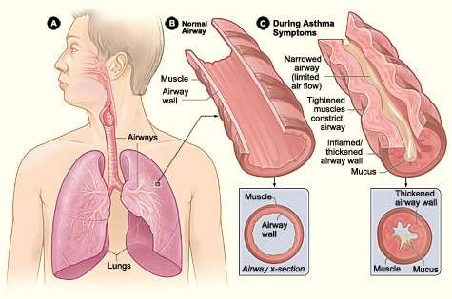
Air Way Morphology

Slide 27
Morphology
Core Pathology
Status asthmaticus
Histologically
Curschmann spirals
Well-known spiral shaped mucus plugs
Mucus plugs contain whorls of shed epithelium
These result from
Mucus plugging in subepithelial mucous gland ducts which later become extruded
Plugs in bronchioles
Eosinophils
Charcot-Leyden crystals
Collections of crystalloid made up of an eosinophil lysophospholipase binding protein called galectin

Slide 28
“Airway remodeling”
Core Pathology
The other characteristic histologic findings of asthma
Overall thickening of airway wall
Sub-basement membrane fibrosis
Due to deposition of type I and III collagen beneath the classic basement membrane composed of type IV collagen and laminin
Increased vascularity

Slide 29
“Airway remodeling”
An increase in size of the submucosal glands and mucous metaplasia of airway epithelial cells
Hypertrophy and/or hyperplasia of the bronchial wall muscle
This has led to the novel therapy of bronchial thermoplasty
Radiofrequency current is applied to the walls of the central airways through a bronchoscopically placed probe
Reduces airway hyper-responsiveness for up to at least a year
•

Slide 30
Clinical Course
Classic acute asthmatic attack
Lasts up to several hours
Symptoms persist at a low level constantly
Chest tightness
Dyspnea
Wheezing
Cough with or without sputum production
Status asthmaticus
Severe acute paroxysm persists for days and even weeks
Airflow obstruction might be so extreme as to cause severe cyanosis and even death

Slide 31
Clinical Course
Medicine Vertical Integration
Clinical diagnosis is aided by the
Demonstration of an increase in airflow obstruction (from baseline
levels)
Difficulty with exhalation
Prolonged expiration
Wheeze
Peripheral blood
Elevated eosinophil count
Finding of sputum, particularly in patients with atopic asthma
Eosinophils
curschmann spirals
charcot-leyden crystals

Slide 32
Clinical Course
Medicine Vertical Integration
Disease is more discouraging and disabling than lethal
Clinical course
Most individuals with asthma are able to maintain a productive life
With appropriate therapy to relieve the attacks
Up to 50% of childhood asthma remits in adolescence only to
return in adulthood
Variable decline in baseline lung function

Slide 34
Pathology
Core

Slide 35
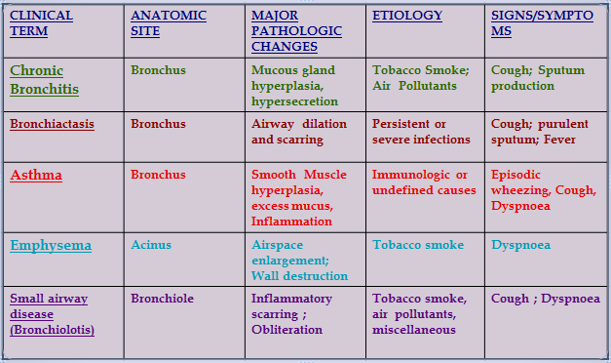
Medicine Vertical Integration
DISORDERS ASSOCIATED WITH AIRFLOW OBSTRUCTION : THE SPECTRUM OF CHRONIC OBSTRUCTIVE PULMONARY DISEASE

Slide 36
Patient Education & Counselling
Evidence shows that teaching patients about this disorder and the importance of compliance are critical for good outcomes.
The patient should be taught about monitoring techniques, inhaler use, and modifying the environment.
A social worker should be involved in the care to ensure that the patient has adequate home support and facilities.

Slide 37
RESEARCH
Busse WW, Castro M, Casale TB. Asthma Management in Adults. J Allergy Clin Immunol Pract. 2023 Jan;11(1):21-
33. doi: 10.1016/j.jaip.2022.10.015. Epub 2022 Oct 22.
PMID: 36283607.
Five new biologics, mepolizumab, benralizumab, reslizumab, dupilumab, and tezepelumab, were approved to join omalizumab and revolutionize severe asthma treatment.
These biologics significantly prevent exacerbations to spare systemic corticosteroids use and their side effects. Guidelines attest to the effectiveness of inhaled corticosteroids/long-acting β-agonists (formoterol) for both maintenance and rescue therapy.

