Slide 1
CVS &Respiration MODULE _VII Tuberculosis
Dr. Mudassira Zahid
Dr. Fatima-tuz-Zahra
MBBS, M.Phil. (Chem), FCPS(Chem), CHPE
Pathology Department, RMU
Assistant Professor Pathology
LGIS

Slide 3
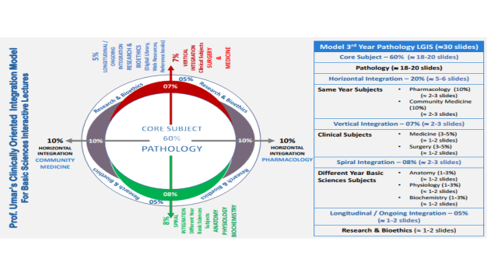

Slide 4
How to use HEC Digital Library
Steps to Access HEC Digital Library
Go to the website of HEC National Digital Library.
On Home Page, click on the INSTITUTES.
A page will appear showing the universities from Public and Private Sector and other Institutes which have access to HEC National Digital Library (HNDL).
Select your desired Institute.
A page will appear showing the resources of the institution
Journals and Researches will appear
You can find a Journal by clicking on JOURNALS AND DATABASE and enter a keyword to search for your desired journal.

Slide 5
LEARNING OUTCOMES
Understand the basic characteristics of Mycobacterium tuberculosis, including its unique cell wall structure and slow growth rate.
Describe the transmission and pathogenesis of tuberculosis, including the formation of granulomas and the latent and active phases of infection.
Explain the immune response to M. tuberculosis, including the roles of cell-mediated immunity and the importance of specific cytokines.
Discuss the diagnosis of tuberculosis, including various diagnostic tests such as acid-fast bacilli smear, culture, and molecular tests.
Understand the treatment of tuberculosis, including the use of multi-drug therapy and the challenges of drug resistance.

Slide 6
Mycobacterium Tuberculosis complex
Core pathology
INCLUDES: M. tuberculosis, M. bovis and M. africanum.
M. bovis is found mainly as a pathogen in cattle and occasionally in other animals. Humans become infected by close contact with infected cattle or by ingesting the organisms in raw untreated milk..
M. africanum consists of several strains midway between M. tuberculosis and M. bovis and is found in equatorial Africa.

Slide 7
Core pathology
MYCOBACTERIUM TUBERCULOSIS
DISEASE
Tuberculosis.
EPIDEMIOLOGY
Worldwide, M. tuberculosis causes more deaths than any other single microbial agent.
1.7 million people die of tuberculosis
9 million new cases occur.
An estimated 500,000 people are infected with a multidrug-resistant strain of M. tuberculosis

Slide 8
IMPORTANT PROPERTIES
Core pathology
Grows slowly (i.e., it has a doubling time of 18 hours, in contrast to most bacteria, which can double in number in 1 hour or less).
Cultures of clinical specimens must be held for 6 to 8 weeks before being recorded as negative.
Mycobacterium tuberculosis can be cultured on bacteriologic media, whereas M. leprae cannot.
Media used for its growth (e.g., Löwenstein-Jensen medium) contain complex nutrients (e.g., egg yolk) and dyes (e.g., malachite green).
The dyes inhibit the unwanted normal flora present in sputum samples.

Slide 9
Core pathology

Slide 10
Core pathology

Slide 11
TRANSMISSION
Core pathology
Person to person by respiratory aerosols produced by coughing.
The source of the organism is a cavity in the lung that has eroded into a bronchus.
The portal of entry is the respiratory tract, and the initial site of infection is the lung.
In tissue, it resides within reticuloendothelial cells (e.g., macrophages).
Macrophages kill most, but not all, of the infecting organisms.
Can disseminate to other organs.
RESERVOIR: Humans natural reservoir of M. tuberculosis.
cattle, can be infected, they are not the main reservoir for human infection.

Slide 12
Core pathology

Slide 13
PATHOGENESIS
Core pathology
Primary tuberculosis, which typically results in a Ghon focus in the lower lung
Primary tuberculosis can heal by fibrosis, can lead to progressive lung disease, can cause bacteremia and miliary tuberculosis, or can cause hematogenous dissemination.
If the primary infection heals without causing disease, it is called a latent infection.
90% develop latent infection and approximately 10% develop disease.

Slide 14
Core pathology
The organism preferentially infects macrophages and other reticuloendothelial cells.
Mycobacterium tuberculosis survives and multiplies within a cellular vacuole called a phagosome.
The organism produces a protein called exported repetitive protein that prevents the phagosome from fusing with the lysosome, thereby allowing the organism to escape the degradative enzymes in the lysosome.

Slide 15
Core pathology
LESION:
Dependent on the presence of the organism and the host response.
Two types of lesions:
Exudative lesions,
which consist of an acute inflammatory response and occur chiefly in the lungs at the initial site of infection.
Granulomatous lesions
consist of a central area of giant cells containing tubercle bacilli surrounded by a zone of epithelioid cells.
These giant cells, called Langhans’ giant cells
A tubercle is a granuloma surrounded by fibrous tissue that has undergone central caseation necrosis.
Tubercles heal by fibrosis and calcification.

Slide 16
Core pathology
Primary lesion --lungs.
Ghon complex--The parenchymal exudative lesion and the draining lymph nodes.
Primary lesions --occur in the lower lobes, whereas reactivation lesions --apices.
Reactivation lesions---other well-oxygenated sites such as the kidneys, brain, and bone.
Reactivation is seen primarily in immunocompromised or debilitated patients.

Slide 17
Core pathology
SPREAD OF ORGANISM:
two mechanisms:
A tubercle can erode into a bronchus, empty its caseous contents, and thereby spread the organism to other parts of the lungs, to the gastrointestinal tract if swallowed, and to other persons if expectorated.
It can disseminate via the bloodstream to many internal organs.
Dissemination can occur at an early stage if cell-mediated immunity fails to contain the initial infection or at a late stage if a person becomes immunocompromised.

Slide 18
IMMUNITY AND HYPERSENSITIVITY
Core pathology
After recovery from the primary infection, resistance to the organism is mediated by cellular immunity (i.e., by CD4-positive T cells and macrophages).
Circulating antibodies are formed but has no role in resistance
Deficient in cellular immunity, such as patients with acquired immunodeficiency syndrome (AIDS), are at much higher risk for disseminated, life-threatening tuberculosis.
Mutations in the interferon-γ receptor gene are another cause of defective cellular immunity that predisposes to severe tuberculosis.
This emphasizes the importance of activation of macrophages by interferon-γ in the host defense against M. tuberculosis.

Slide 19
CLINICAL FINDINGS
Vertical medicine
Many organs
lungs --main site of infection.
Constitutional symptoms --fever, fatigue, night sweats, and weight loss.
Pulmonary tuberculosis--cough and hemoptysis.
Chest X-ray findings-- Reactivation tuberculosis of the lung include an infiltrate in the upper lobe with or without a cavity.

Slide 20
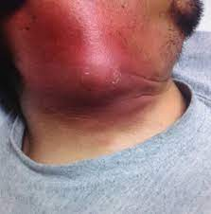
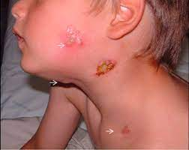
Vertical medicine
Scrofula
is mycobacterial cervical lymphadenitis
presents as swollen, nontender lymph nodes, usually unilaterally.
Lymphadenitis is the most common extrapulmonary manifestation of tuberculosis.
Patients infected with human immunodeficiency virus (HIV) are more likely to have multifocal lymphadenitis than those not infected with HIV.

Slide 21
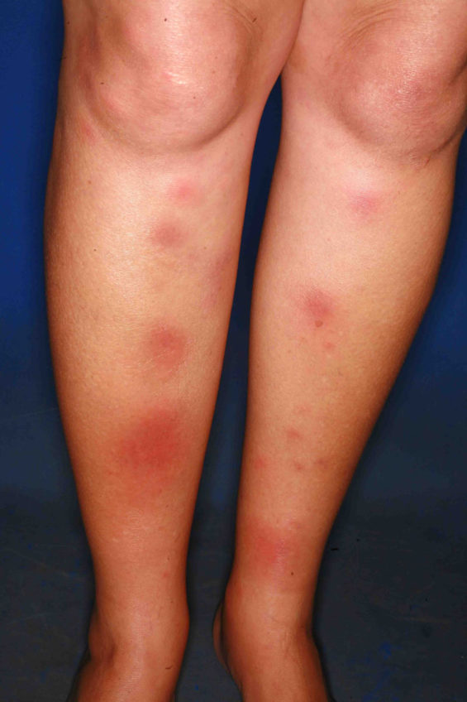
Vertical pathology
Erythema nodosum
characterized by tender nodules along the extensor surfaces of the tibia and ulna

Slide 22
Vertical medicine

Slide 23
Core pathology
Tuberculous meningitis and tuberculous osteomyelitis,
especially vertebral osteomyelitis (Pott’s disease)
Gastrointestinal tuberculosis
characterized by abdominal pain and diarrhea .
fever and weight loss.
Intestinal obstruction or hemorrhage may occur.
The ileocecal region is the site most often involved.
Caused--either M. tuberculosis when it is swallowed after being coughed up from a lung lesion or by M. bovis when it is ingested in unpasteurized milk products.
Oropharyngeal tuberculosis --painless ulcer accompanied by local adenopathy.

Slide 24
Core pathology
Renal tuberculosis
dysuria, hematuria, and flank pain occur.
“Sterile pyuria” is a characteristic finding.
The urine contains white blood cells, but cultures for the common urinary tract bacterial pathogens show no growth. However, mycobacterial cultures are often positive.

Slide 25
Investigations
Core pathology
Chest X-ray (CXR)
Sputum Smear Microscopy (Ziehl-Neelsen stain)
Sputum Culture (Löwenstein-Jensen, Middlebrook agar)
GeneXpert (Xpert MTB/RIF) Test
Nucleic Acid Amplification Tests (NAATs) (e.g., PCR)
Interferon-Gamma Release Assays (IGRAs) (e.g., QuantiFERON-TB, T-SPOT.TB)
Bronchoscopy (for difficult-to-obtain samples)
Histopathological Examination (biopsy of affected tissues)
Drug Susceptibility Testing (DST)

Slide 26
Chest X ray
Core pathology

Slide 27
ZN STAIN
Core pathology

Slide 28
TREATMENT AND RESISTANCE
Horizontal pharmacology
Multidrug therapy is used to prevent the emergence of drug-resistant mutants during the long (6- to 9-month) duration of treatment. (Organisms that become resistant to one drug will be inhibited by the other.)
Isoniazid (INH), a bactericidal drug, is the mainstay of treatment.
Pulmonary tuberculosis --three drugs: INH, rifampin, and pyrazinamide.
INH and rifampin-- 6 months, but pyrazinamide treatment is stopped after 2 months.
Different regimen can also be used.
convenient way --four drugs (isoniazid, rifampin, pyrazinamide, and ethambutol) for 2 months and two drugs (isoniazid and rifampin) for 4 months.

Slide 29
Immunocompromised
AIDS +disseminated disease or who are likely to have INH-resistant organisms, a fourth drug, ethambutol, is added, and all four drugs are given for 9 to 12 months.
Patient’s sputum becomes noninfectious within 2 to 3 weeks.
The necessity for protracted therapy is attributed to
Intracellular location of the organism
Caseous material, which blocks penetration by the drug;
Slow growth of the organism
Metabolically inactive “persisters” within the lesion. Because metabolically inactive organisms may not be killed by antitubercular drugs.
Horizontal pathology

Slide 30
core pathology
Lymphadenitis,
Scrofula caused by M. tuberculosis---treated with the drug regimens described earlier for disseminated disease.
Scrofula caused by M. scrofulaceum ---surgical excision of the single cervical lymph node
latent (asymptomatic) infections
Consists Of Inh Taken For 6 To 9 Months Or Inh Plus Rifapentine For 3 Months.
Resistant To Multiple Drugs (Mdr Strains) Have Emerged--aids Patients.
The Most Common Pattern Is Resistance To Both INH And Rifampin, But Some Isolates Are Resistant To Three Or More Drugs.
The Treatment Of MDR Organisms Usually Involves The Use Of Four Or Five Drugs, Including Ciprofloxacin, Amikacin, Ethionamide, And Cycloserine.

Slide 31
Horizontal pathology
Noncompliance (i.e., the failure of patients to complete the full course of therapy) is a major factor in allowing the resistant organisms to survive. One approach to the problem of noncompliance is directly observed therapy (DOT), in which health-care workers observe the patient taking the medication.

Slide 32
Horizontal Pharmacology

Slide 33
PREVENTION
Horizontal Community medicine
Better housing and nutrition, which have improved host resistance.
prompt identification and adequate treatment of patients who are coughing up the organism.
The use of masks and other respiratory isolation procedures to prevent spread to medical personnel is also important.
PPD skin test ---Groups screened --HIV infection, close contacts of patients with active tuberculosis, low-income populations, alcoholics and intravenous drug users, prison inmates.
This test, called QuantiFERON-TB Gold (QFT-G), measures the amount of interferon-γ released from the patient’s lymphocytes after exposure to antigens from M. tuberculosis in cell culture.
QFT-G requires only a single blood specimen and determines the amount of interferon-γ by an enzyme-linked immunosorbent assay (ELISA) test.

Slide 34
Horizontal Community medicine
The vaccine contains a strain of live, attenuated M. bovis called bacillus Calmette-Guérin(BCG).
The vaccine is effective in preventing the appearance of tuberculosis as a clinical disease, especially in children, although it does not prevent infection by M. tuberculosis.
BCG vaccine is also used to treat bladder cancer. The vaccine is instilled into the bladder and serves to nonspecifically stimulate cell-mediated immunity, which can inhibit the growth of the carcinoma cells.
Pasteurization of milk and destruction of infected cattle are important in preventing intestinal tuberculosis.

Slide 35
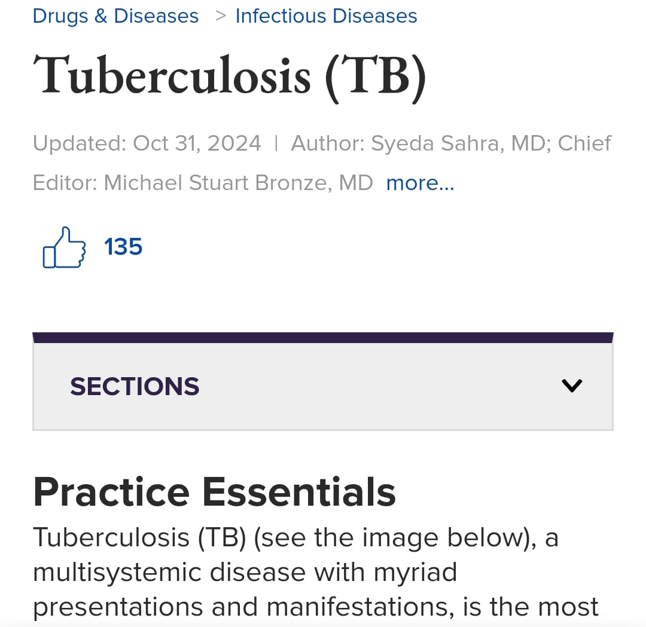
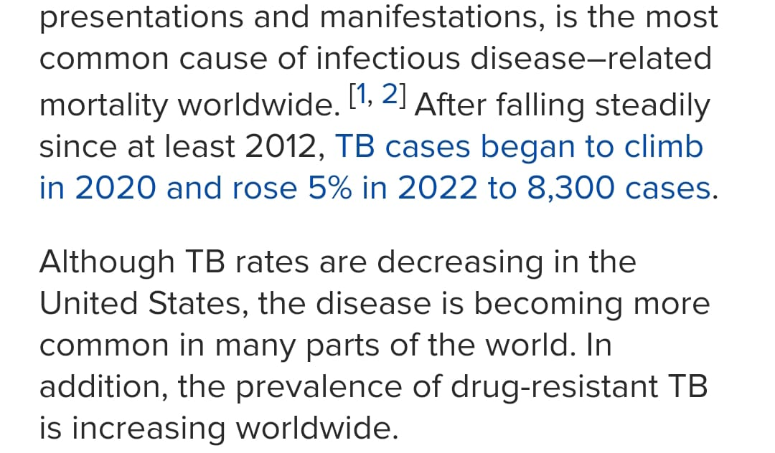
Research
longitudinal
https://emedicine.medscape.com/article/230802-overview?form=fpf

Slide 36
Family Medicine
longitudinal
A 35-year-old patient presents with a persistent cough, fever, night sweats, and weight loss. A chest X-ray reveals multiple nodular lesions in both lungs. Acid-fast bacilli smear is positive.
What is the most likely diagnosis?
a) Pneumonia
b) Tuberculosis
c) Bronchitis
d) Lung cancer
Answer: b) Tuberculosis

Slide 37
Take Home Message
Mycobacterium tuberculosis is a slow-growing bacterium. It is transmitted through airborne droplets. The primary infection often leads to latent tuberculosis.

