Slide 2
FOUNDATION MODULE _III Tumor Suppressor Genes In Cancer
Dr. Fatima-tuz-Zahra
MBBS, M.Phil. (Chem), FCPS(Chem), CHPE
Pathology Department, RMU
Assistant Professor Pathology
LGIS

Slide 3
LEARNING OBJECTIVES
At the end of the session the students will be able to:
Explain carcinogenesis by tumor suppressor genes Rb gene P53 gene. C2
Explain role of ApC – b catenin pathway in carcinogenesis . C2

Slide 4
Resource
ROBBINS AND COTRAN PATHOLOGIC BASIS OF DISEASE
Tenth edition
Chapter 5 : Neoplasia

Slide 5
SUMMARY
NO single tumor suppressor gene causes cancer
BOTH several oncogenes AND several tumor suppressor genes must be involved
Gatekeeper/Caretaker concept
Gatekeepers: ONCOGENES and TUMOR SUPPRESSOR GENES
Caretakers: DNA REPAIR GENES
Tumor “PROGRESSION”
ANGIOGENESIS
HETEROGENEITY from original single cell

Slide 6
Tumor suppression genes
Vertical Integration
PROTEINS- THAT APPLY BRAKES TO CELL PROLIFERATION
TGF-B receptor e.g ca lung & stomach
E-Cadherin e.g ca stomach
NF-1, NF-2 e.g neuroblastomas, schwannomas
APC/B-catenin e.g ca stomach , colon, pancreas
PTEN e.g endometrial and prostate ca
SMAD2, SMAD4 e.g ca colon
RB e.g retinoblastoma, osteosarcoma, ca breast, colon
P53 e.g bladder,brain,breast,colon,esophagus,liver, lung
WT-1 e.g Wilms tumor
BRCA-1, BRCA-2 e.g ca breast, ovary

Slide 7
Tumor suppressor genes
MODE OF INACTIVATION
Point Mutations
Insertion /Deletion
Loss of heterozygosity
DNA methylation- hypermethylation

Slide 8
Knudson’s Two Hits Theory and retinoblastoma
In hereditary cases:
First hit is inherited from an affected parent and present in all cells Second hit occurs in one of the many of retinal cells, which already carry the first hit.
Carriers of a mutant Rb gene have a 10,000-fold increased risk, children develop retinoblastoma at much younger age than sporadic cases, usually bilateral .
In sporadic cases:
Both hits occur somatically within a single retinal cells, whose progeny then form the tumor.

Slide 9
Retinoblastoma- Knudson two hit hypothesis of oncogenesis

Slide 10
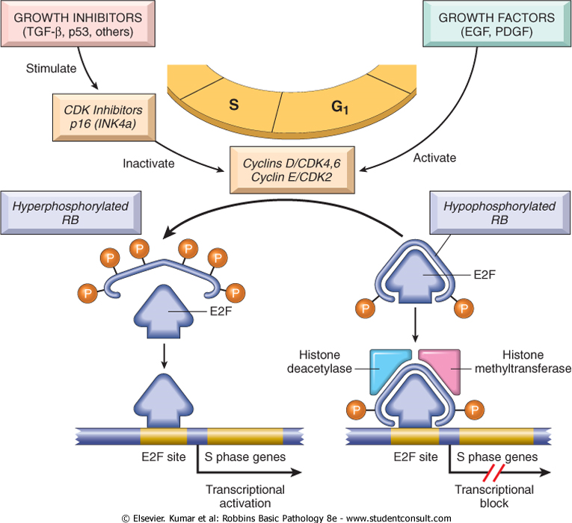
TUMOR SUPPRESSOR GENES IN CANCER

Slide 11
p53 Gene: Guardian of the Genome
The p53 tumor suppressor gene is one of the most commonly mutated genes in human cancers.
P53 induces neoplastic transformation by three interlocking mechanisms:
1-activation of temporary cell cycle arrest (termed quiescence),
2-induction of permanent cell cycle arrest (termed senescence),
3-triggering of programmed cell death (termed apoptosis).

Slide 12
P53 Guardian of genome

Slide 13
Gate Keeper Genes
Vertical Integration
Tissue specific cancer genes: APC mutations > colon cancers! BRCA1 mutations> breast cancer
Familial Adenomatous Polyposis
Normal
Affects ~1 in 7,000 individuals
Inherited in an autosomal dominant manner
Multiple benign tumors (adenomas) of the colon and rectum
APC germline mutation

Slide 14
Normal Colorectal Epithelial Cells
X
Transcription of Growth Promoting Genes
Tcf-4
β-catenin
Gene
APC

Slide 15
APC/B-Catenin pathway

Slide 17
Multi-step carcinogenesis
MOLECULAR CHANGE
Loss / mutation of APC
Mutation of RAS
Loss of SMAD
Loss of P53
MORPHOLOGIC APPERANCE
Normal epithelium-
hyperproliferative-
Early adenoma
-late adenoma
carcinoma

Slide 19
Caretaker genes
Maintain genomic stability by DNA repair or whole chromosome stability.
Caretaker genes are not oncogenic, but their loss of function increases the risk of mutations in other genes, including oncogenes and tumor suppressor genes.

Slide 20
.
Care taker-DNA repair;
BRCA1, BRCA2, hMSH2
Gate keeper-Tumor suppressor gene;
P53, RB, APC, NF-1

Slide 21
DNA REPAIR GENE DEFECTS
Vertical Integration
DNA repair is like a spell checker
HNPCC (Hereditary Non-Polyposis Colon Cancer [Lynch]): TGF-β, β-catenin, BAX
Xeroderma Pigmentosum: UV fixing gene
Ataxia Telangiectasia: ATM gene
Bloom Syndrome: defective helicase
Fanconi anemia

Slide 22
Evasion of APOPTOSIS
BCL-2
p53
MYC
Notes:
Mutations of genes resulting in EVASION of APOPTOSIS would also be a factor in carcinogenesis, wouldn’t it?

Slide 23
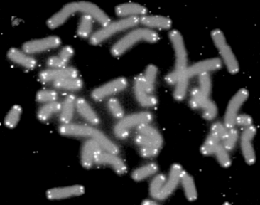
LIMITLESS REPLICATIVE POTENTIAL
TELOMERES determine the limited number of duplications a cell will have.
TELOMERASE, present in >90% of human cancers, changes telomeres so they will have UNLIMITED replicative potential
Notes:
Telomeres are a sequence of repetitive bases at the ends of linear chromosomes that prevent adjacent chromosomes from attaching to each other.
Think about this? If a telomere is interfered with, perhaps by telomerase, it LOSES its ability to limit mitoses!

Slide 24
Limitless replicative potential: Telomerase

Slide 25
.
ONCOGENES
Mutation in one of the two alleles sufficient for activity; act dominant to wild type
Gain of function of protein that signal cell division
Mutation arises in somatic tissue not inherited
*Gene regulating apoptosis
may be dominant or
recessive
TUMOR SUPPRESSOR GENES
Mutation in both alleles or mutation in one followed by loss of or reduction to homozygosity in second
Loss of function of a protein
Mutation present in germ cell (can be inherited) or somatic cell

Slide 26
Research: Cancers 2020, 12(1), 223; https://doi.org/10.3390/cancers12010223
longitudinal Integration

Slide 27
Cancer screening &target therapy
Horizontal Integration
Genetic counseling for high-risk individuals (BRCA1/2, APC mutation carriers).
Cancer screening programs: Mammography, colonoscopy, and pap smears.
Lifestyle interventions: Reducing carcinogen exposure, vaccination (HPV for cervical cancer), and dietary modifications.
Pharmacology (Targeted Therapy & Treatment Implications)Therapies aimed at restoring tumor suppressor function or compensating for its loss.
Gene therapy approaches (e.g., reintroducing functional p53 in certain tumors)/

Slide 28
SUMMARY
NO single tumor suppressor gene causes cancer
BOTH several oncogenes AND several tumor suppressor genes must be involved
Gatekeeper/Caretaker concept
Gatekeepers: ONCOGENES and TUMOR SUPPRESSOR GENES
Caretakers: DNA REPAIR GENES
Tumor “PROGRESSION”
ANGIOGENESIS
HETEROGENEITY from original single cell

Slide 29
EOLA
A 45-year-old woman presents with a palpable breast lump and a family history of early-onset breast and ovarian cancer. Genetic testing confirms a BRCA1 mutation. A biopsy of the mass shows high-grade invasive ductal carcinoma, ER-negative, PR-negative, and HER2-negative (triple-negative breast cancer).
Which of the following is the most appropriate next step in management for this patient?
A. Neoadjuvant chemotherapy followed by bilateral mastectomy B. Tamoxifen therapy for five years C. Trastuzumab-based therapy D. Prophylactic bilateral salpingo-oophorectomy only E. Active surveillance with yearly MRI and mammograms

