Slide 1
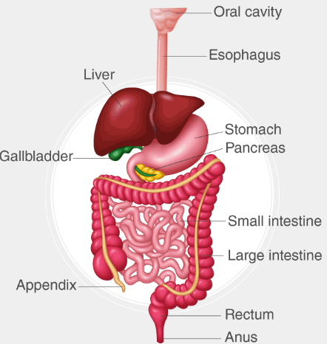
Gastrointestinal Tract (GIT) Module 2nd Year MBBS(SGD) Gall Bladder
Presenter: Dr. Minahil Haq Date: -25

Slide 2
Prof. Umar’s Model of Teaching Strategy Self Directed Learning Assessment Program
Objectives :To cultivate critical thinking, analytical reasoning, and problem-solving competencies.
To instill a culture of self-directed learning, fostering lifelong learning habits and autonomy.
How to Assess?
➢Ten randomly selected students will be evaluated within the first 10
minutes of the lecture through 10 multiple-choice questions (MCQs)
based on the PowerPoint presentation shared on Students Official
WhatsApp group, one day before the teaching session.
➢The number of MCQs from the components of the lecture will follow
the guidelines outlined in the Prof. Umar model of Integrated Lecture.
Component of LGIS | Core Knowledge | Horizontal Integration | Vertical Integration | Spiral Integration
No. of MCQs | 6-7 | 1-2 | 1 | 1

Slide 3
Professor Umar Model of Integrated Lecture

Slide 4
Learning Objectives
Describe location & size of gall bladder
Enumerate relations of gallbladder.
Describe clinical conditions related to gallbladder
Enlist different components of Extra-hepatic biliary System
Discuss the right & left hepatic ducts, common hepatic duct, cystic ducts, bile duct
Explain differences between Intra & Extra Hepatic Biliary Systems.
Discuss clinicals related with biliary apparatus
Discuss accessory hepatic ducts
Map outline of gallbladder & Bile duct on simulated patient /model

Slide 5
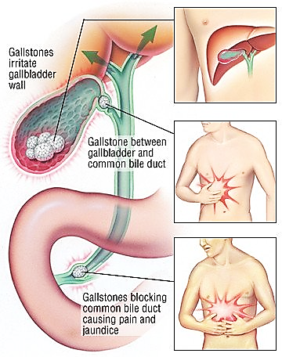
Interactive Session
A 45-year-old obese woman presents to the emergency department with severe right upper quadrant (RUQ) abdominal pain for the past 12 hours. The pain started after eating a fatty meal and has progressively worsened. She also reports nausea, vomiting, and fever.
On examination:
Temp101.3°F)
RUQ tenderness with Murphy’s sign positive (sharp pain and inspiratory arrest upon deep palpation of RUQ)

Slide 6
EXTRAHEPATIC BILIARY APPARATUS
Core Concept
The extrahepatic biliary apparatus receives the bile from the liver,
stores and concentrates it in the gallbladder,
and transmits it to the second part of the duodenum when required.

Slide 7
Core Concept

Slide 8
components
Core Concept
It consists of five components :
1. Right and left hepatic ducts.
2. Common hepatic duct.
3. Gallbladder.
4. Cystic duct.
5. Bile duct (formerly, common bile duct)

Slide 9
HEPATIC DUCTS
Core Concept
The right and left hepatic ducts from the right and left lobes of the liver emerge through porta hepatis
and unite near its right end to form the common hepatic duct,
which passes downward for about 2.5 cm (1 inch) and then joined on its right side by the cystic duct to form the CBD.

Slide 10
The accessory hepatic ducts
Core Concept
are seen in about 15% of cases.
They usually emerge from right lobe of the liver and may open in one of the following sites:
(a) common hepatic duct,
(b) cystic duct,
(c) bile duct, and
(d) gallbladder

Slide 11
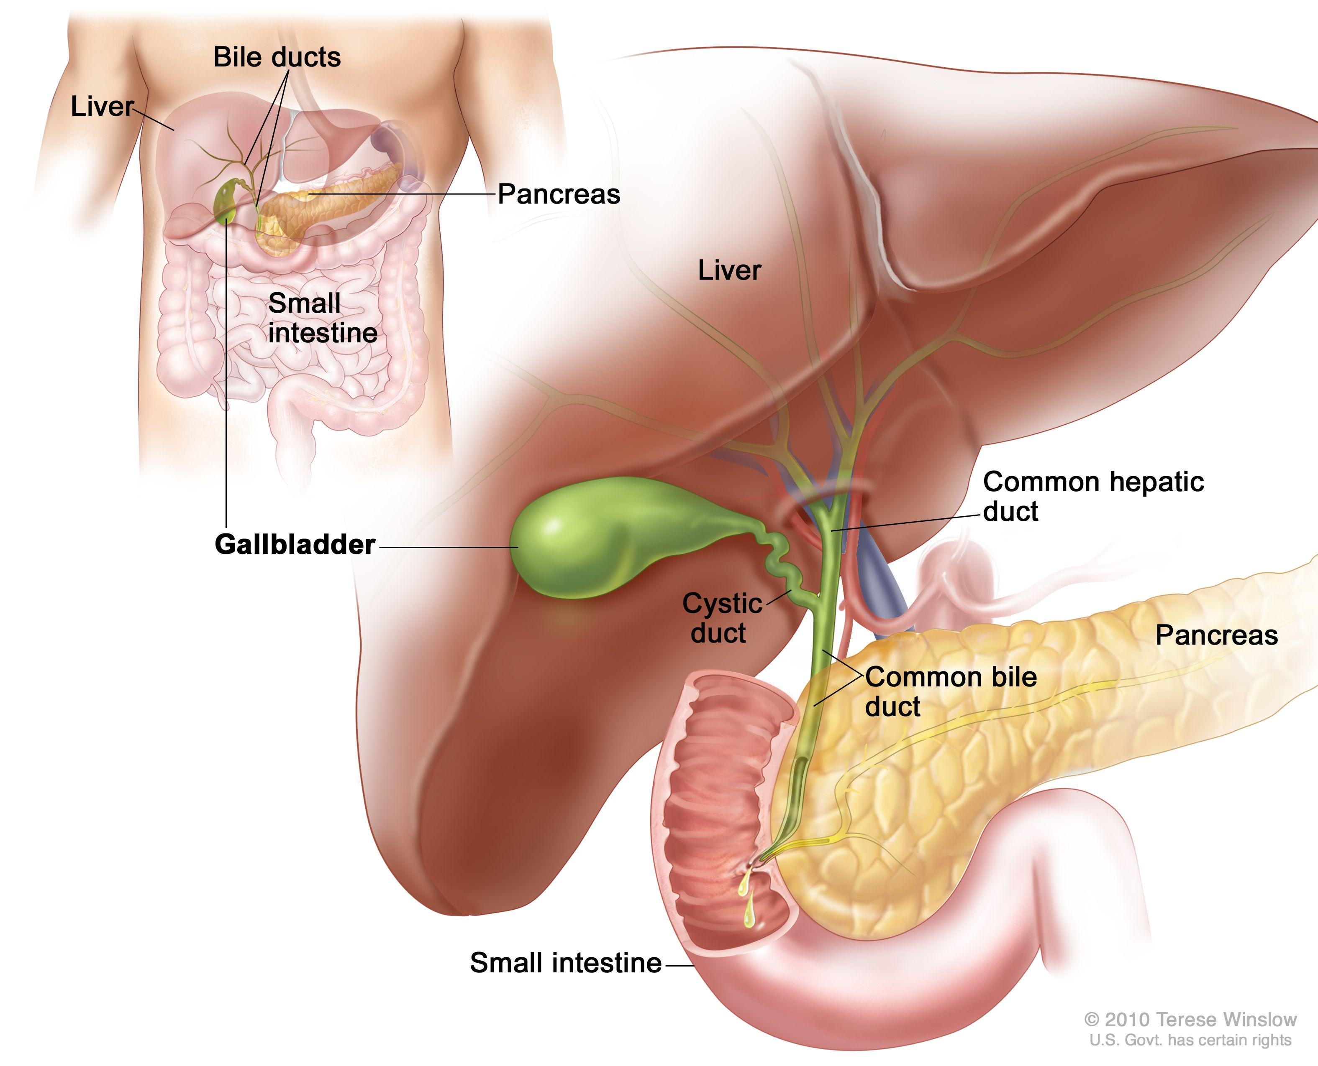
GALLBLADDER
Core Concept
The gallbladder is an elongated pear-shaped sac of about 30–50 ml capacity.
It stores and concentrates the bile and discharges it into the duodenum by its muscular contraction.

Slide 12
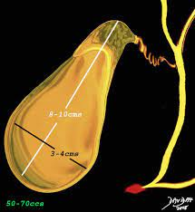
Dimensions
Core Concept
Pear shaped
Length: 10 cm.
Width: 3 cm (at its widest part).
Capacity :30-50 ml
When obstructed:300ml

Slide 13
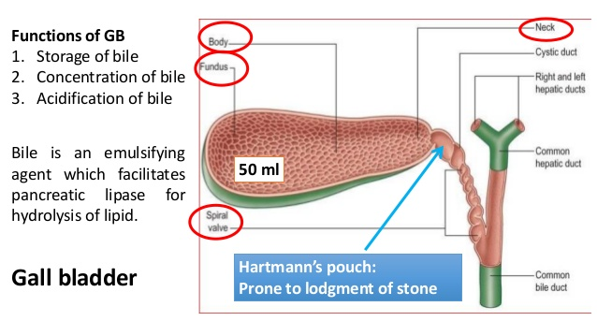
Parts and Relations
Core Concept
The gallbladder is divided into the following three parts:
fundus,
body,
neck.

Slide 14
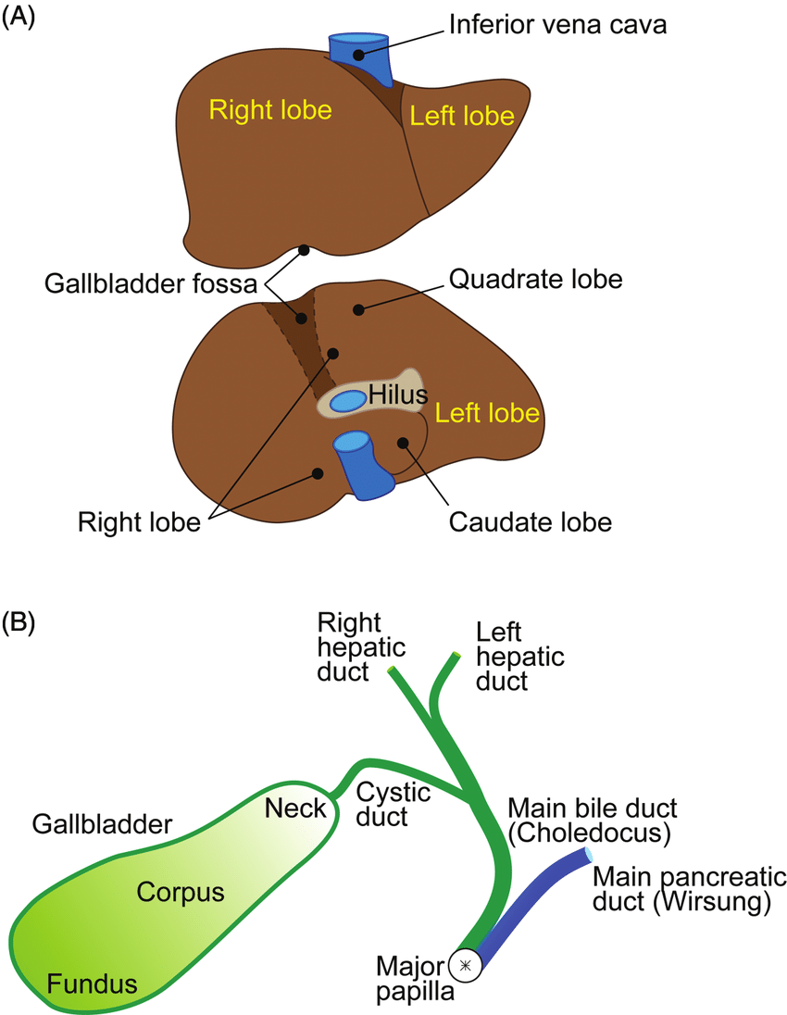
Fundus
Core Concept
Location
It is the expanded blind end of the organ.
It projects from the inferior border liver
and touches the anterior abdominal wall at the tip of the right 9th costal cartilage,
deep to the point where the right linea semilunaris meets the costal margin.
Relations It is surrounded by the peritoneum.
Anteriorly = anterior abdominal wall
Posteriorly = transverse colon
It is continuous through the body of gallbladder with the narrow neck

Slide 15
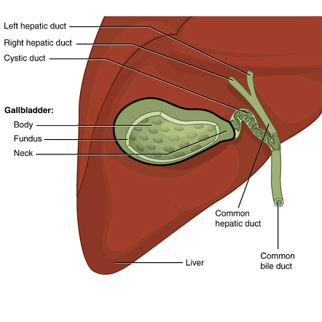
Body
Core Concept
1. It is directed upward, backward, and to left to join neck at right end of porta hepatis.
2. Its upper surface is related directly to the liver and is devoid of peritoneum.
3. Its undersurface is covered by the peritoneum and is related to second part of duodenum

Slide 16
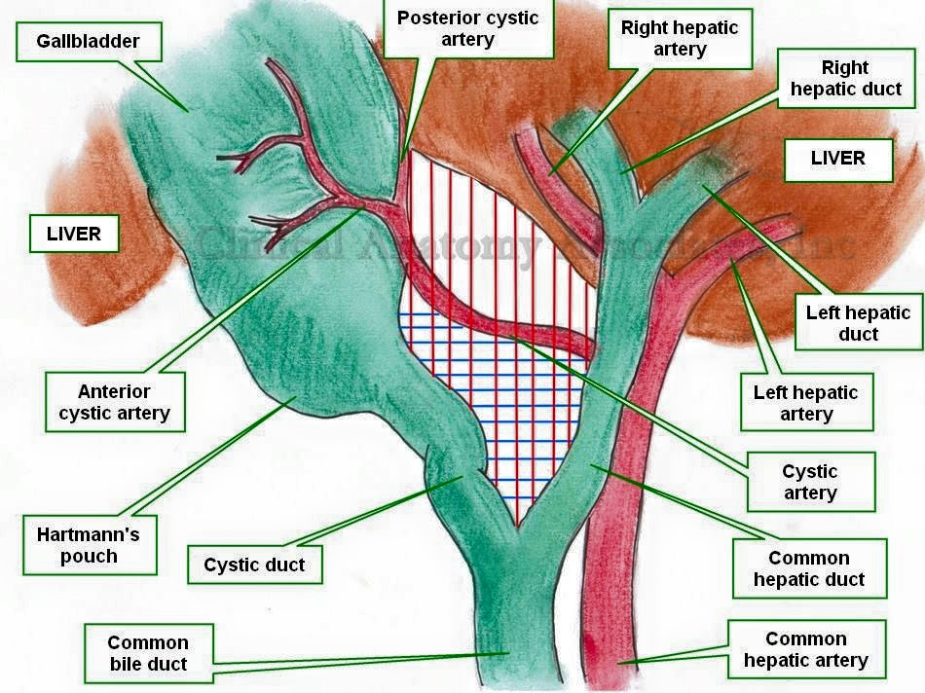
NECK
Core Concept
1. It is narrow upper end of gallbladder lying near right end of the porta hepatis.
2. A constriction is marked where neck, joins with cystic duct.
3. It is attached to the liver by loose areolar tissue in which cystic artery is embedded
.

Slide 17
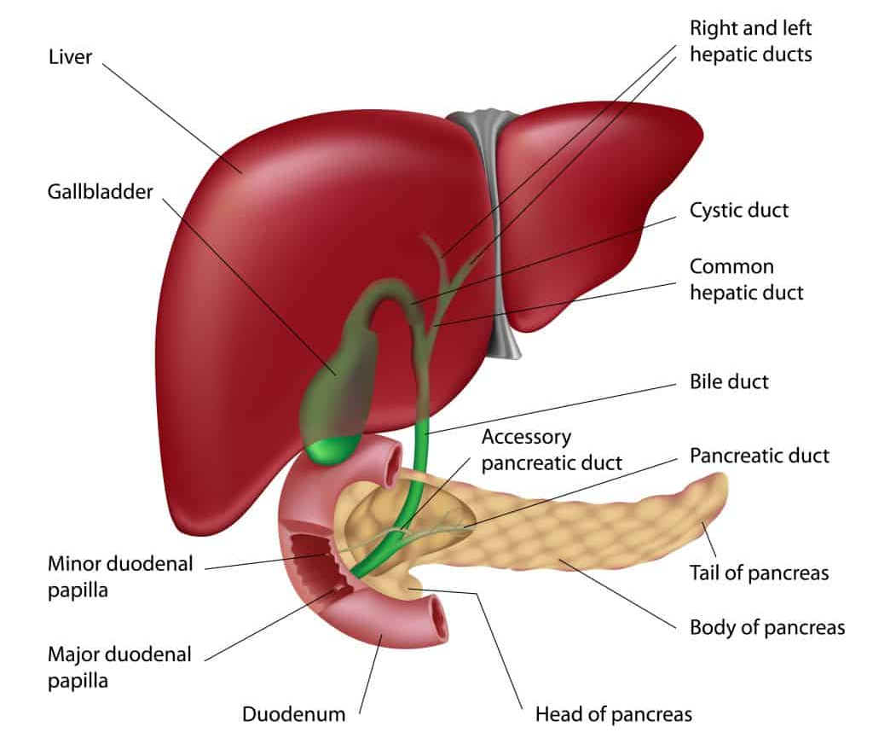
Cont’d
Core Concept
4-. Neck is related inferiorly to the first part of duodenum
5. Its posteromedial wall shows a pouch-like dilatation (Hartmann’s pouch) directed downward and backward.
6. The gall stones lodged in this pouch may cause adhesion with the first part of the duodenum and may perforate it.
7. The neck turns sharply downward to become continuous with the cystic duct

Slide 18
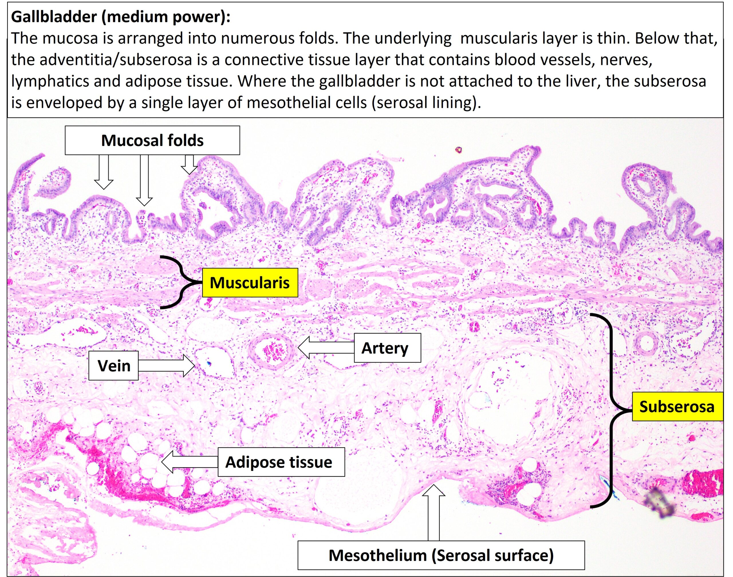
Structure of the Gallbladder
Core Concept
The wall of the gallbladder consists of the following layers:
1. Serous layer of the peritoneum.
2. Subserous layer of the loose areolar tissue.
3. Fibromuscular layer of the fibrous tissue mixed with smooth muscle fibres, which are arranged in loose bundles disposed in longitudinal, circular, and oblique directions.
4. Mucous membrane is loosely connected with the fibrous layer and is elevated into minute rugae which give it a honeycomb appearance.
The epithelium lining consists of a single layer of tall columnar cells

Slide 19
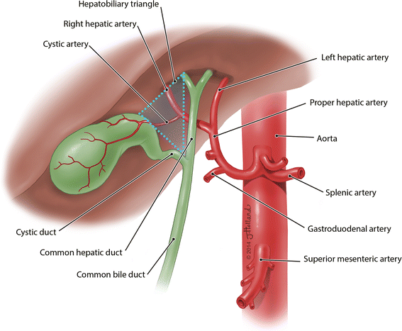
Arterial Supply
Core Concept
The gallbladder is supplied by the cystic artery
(a branch of right hepatic artery).
It may arise from the main trunk of hepatic artery,
from the left hepatic artery,
or from the gastroduodenal artery.

Slide 20
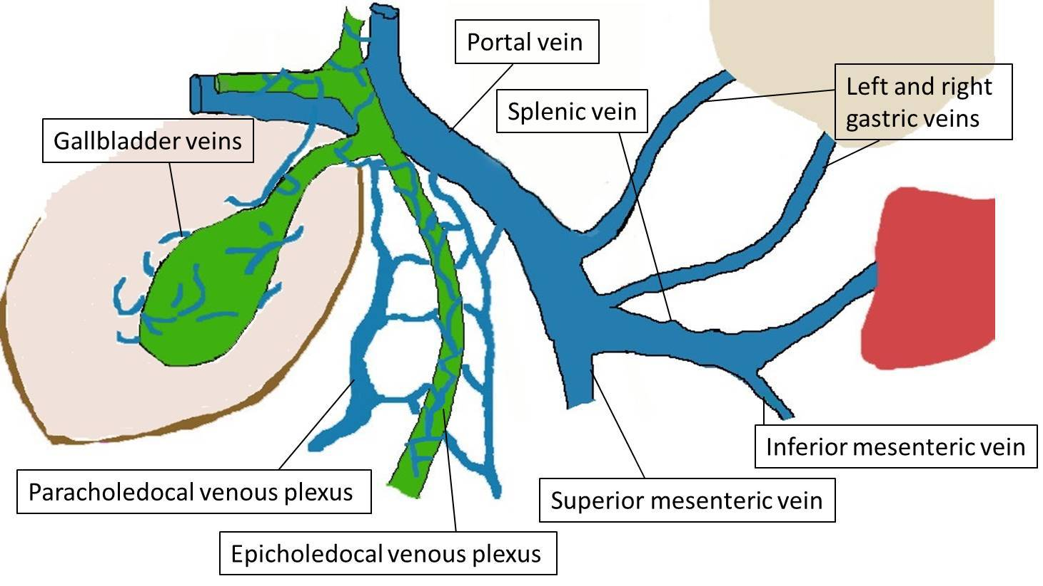
Venous Drainage
Core Concept
The venous drainage of gallbladder is 2 fold
(a) by the cystic vein, which drains into the portal vein and
(b) by a number of small veins, which pass from the superior surface of the gallbladder to the liver through the gallbladder bed to drain into the hepatic veins.

Slide 21
Lymphatic Drainage
Core Concept
1. The majority of lymph vessels from the gallbladder drain into
(a) the cystic lymph node of Lund, located in the Calot’s triangle
(b) the node alongside the upper part of the bile duct (node at anterior border of epiploic foramen),
which finally drains into the coeliac group of lymph nodes.
2. Few lymph vessels from the upper surface of gallbladder directly communicate with subscapular lymph vessels of the liver.
N.B. Cystic node is constantly enlarged in cholecystitis.

Slide 22
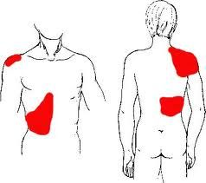
Nerve Supply
Core Concept
The gallbladder receives its nerve supply via the cystic plexus formed by
Clinically, gallbladder pain is referred accordindly..
1) Sympathetic fibers (T7–T9)
Pain to inferior angle of right scapula by sympathetic fibers
2) Parasympathetic fibers (right & left vagus nerve)
Pain to stomach by vagus
3) fibers of right phrenic nerve.
Pain to tip of right shoulder via right phrenic nerve

Slide 23
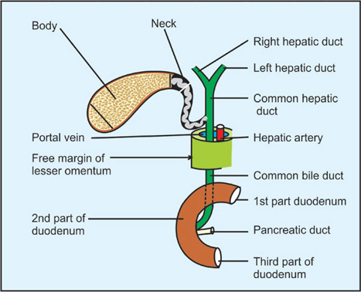
CYSTIC DUCT
Core Concept
about 3–5 cm long
runs backward & downward from neck of gallbladder to run in the lesser omentum
.
Its junction with the common hepatic duct is usually situated immediately below the porta hepatis.

Slide 24
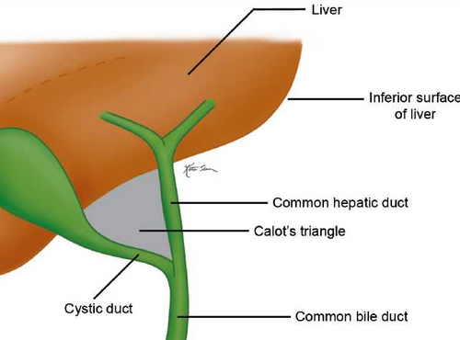
cystohepatic angle
Core Concept
The angle between the cystic duct and the common hepatic duct is acute and is called cystohepatic angle.

Slide 25
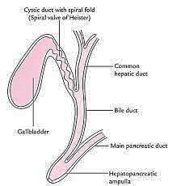
Core Concept
Mucous membrane lining interior of cystic duct is thrown into a series of crescentic folds (5–10 in number)
They project into lumen in a spiral fashion forming a spiral fold called “spiral valve of Heister

Slide 26
Cystohepatic triangle of calot
Core Concept
The cystohepatic triangle is bounded:
on the right side by the cystic duct,
on the left side by common hepatic duct
above by inferior surface of the liver
The apex of the triangle faces downward between the cystic and common hepatic ducts.

Slide 27
The contents of the triangle
Core Concept
Are:
right hepatic artery,
cystic artery,
and cystic lymph node of Lund.
It is in this triangle that most of aberrant segmental right hepatic ducts and arteries are usually encountered.
The accessory hepatic ducts terminate either into the gallbladder or into the common hepatic duct or even into the bile duct,
and are responsible for oozing of bile from the wound after cholecystectomy.

Slide 28
Importance of cystohepatic triangle
Core Concept
The identification of the cystohepatic triangle and its contents helps the surgeon to locate the pedicle of the gallbladder and its ligation in cholecystectomy.
The errors in gallbladder surgery often occur from failure to appreciate the common variations of the extrahepatic biliary system.
This occurs especially when the right hepatic artery in this triangle presents a caterpillar-like loop called Moynihan’s hump which may be inadvertently clamped, ligated along with cystic pedicle, and cut leading to profuse bleeding

Slide 29
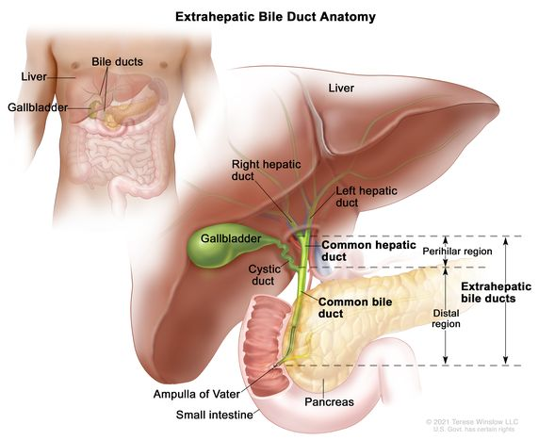
BILE DUCT/COMMON BILE DUCT (CBD)
Core Concept
Formation
It is formed near the porta hepatis.
by the union of cystic and common hepatic ducts.
It is usually 7.5 cm (3 inches) long.
and about 6 mm in diameter.

Slide 30
Parts
Core Concept
It is divided into four parts
1. Supraduodenal
2. Retroduodenal
3. Infraduodenal (pancreatic)
4. Intraduodenal

Slide 31
Supraduodenal Part
Core Concept
is about 2.5 cm long
descends in right free margin of the lesser omentum
to right of hepatic artery proper
anterior to portal vein

Slide 32
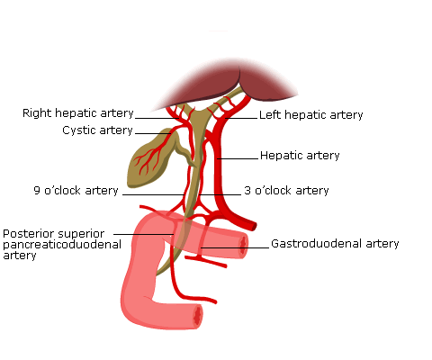
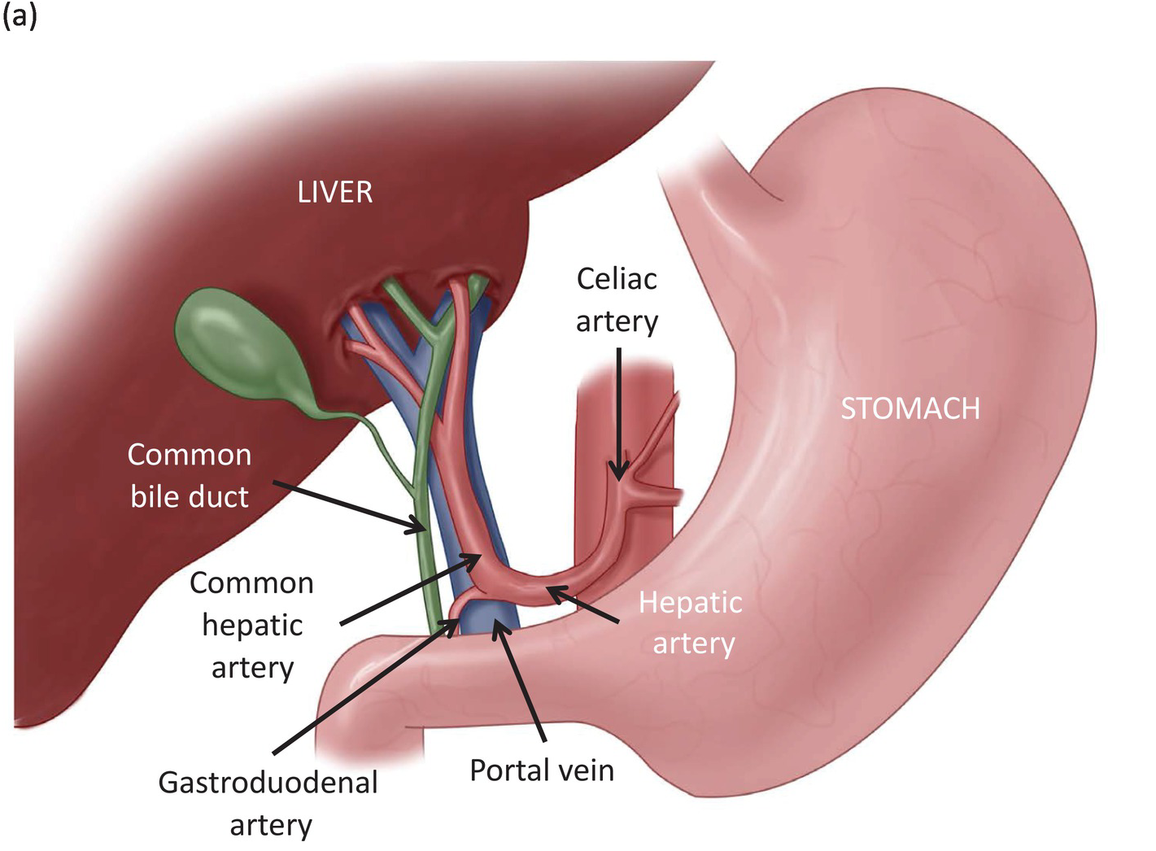
Retroduodenal Part
Core Concept
It descends behind first part of duodenum
Being t right of gastroduodenal artery
and IVC on its posterior aspect

Slide 33
Core Concept
Infra duodenal (Pancreatic) Part
It runs in groove on upper lateral parts of posterior surface of pancreas
and is sometimes completely embedded in the pancreatic tissue.

Slide 34
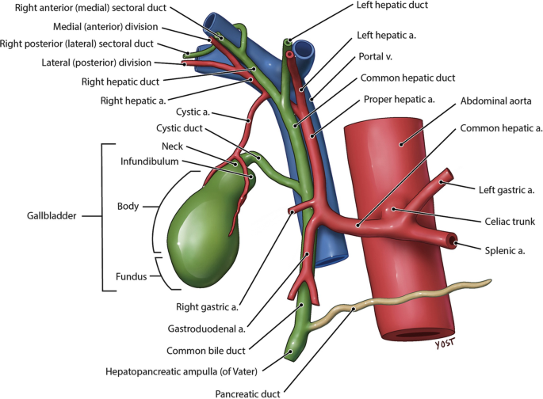
Core Concept
Clinically
it is a source of hemorrhage in the exposure of intraduodenal part of the bile duct.
Near middle 2nd part of duodenum, it comes in contact with the pancreatic duct.

Slide 35
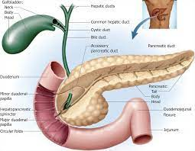
Intra duodenal (or Intramural) Part of CBD
Core Concept
It enters the posteromedial surface of the descending (second) part of the duodenum a little below its middle.
The main pancreatic duct also enters the wall of the duodenum at the same site.
The two ducts run obliquely in the wall of the duodenum and unite to form an expansion, the hepatopancreatic ampulla (or ampulla of Vater),

Slide 36
Core Concept
The intramural parts (terminal parts) of bile and pancreatic ducts as well as the ampulla are surrounded by smooth muscle sphincters

Slide 37
Sphincters Around the Terminal Parts of Bile and Pancreatic Ducts and Ampulla
Core Concept
The sphincter around the bile duct is called sphincter choledochus (of Boyden),
the sphincter around the pancreatic duct is called sphincter pancreaticus,
.

Slide 38
Mechanism of sphincters.
Core Concept
The three sphincters are independent of duodenal musculature.
The sphincters remain closed until the gastric contents enter the duodenum, stimulating its mucosa to release a hormone called cholecystokinin.
This hormone in addition to causing contraction of the gallbladder relaxes these sphincters allowing bile and pancreatic secretions to enter the duodenum.

Slide 39
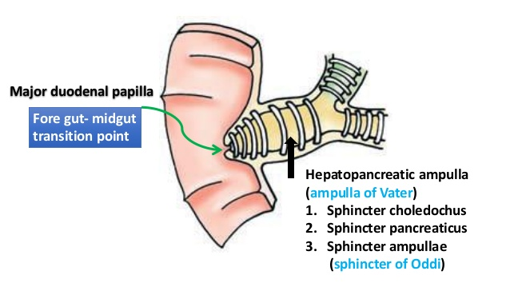
Core Concept

Slide 40
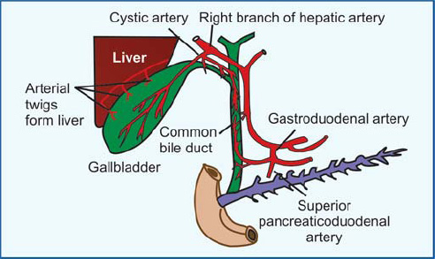
Arterial Supply of the Bile Duct/Common Bile Duct
Core Concept
The upper part of the bile duct is supplied by a twig from the
descending branch of the cystic artery
while its lower part is supplied by the ascending branch of the superior pancreaticoduodenal artery

Slide 41
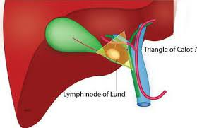
The cystic node of Lund
Core Concept
N.B. The cystic node of Lund (a solitary node) present in the apical part of this triangle receives most of the lymph from the gallbladder and is constantly found enlarged in cholecystitis

Slide 42
Hormonal control of gallbladder emptying:
Horizontal integration
When the food rich in fat enters the duodenum, the duodenal cells liberate a hormone called cholecystokinin (CCK).
This hormone is carried to the gallbladder and causes its contraction.
There is a reflex mediation, when the gallbladder contracts, the sphincter of Oddi relaxes.
Thus concentrated bile is emptied into the gallbladder.

Slide 43
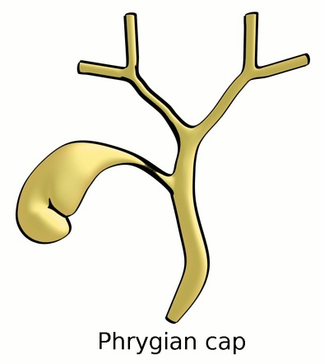
Phrygian cap
Vertical integration

Slide 44
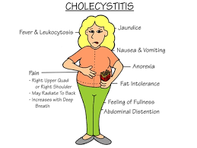
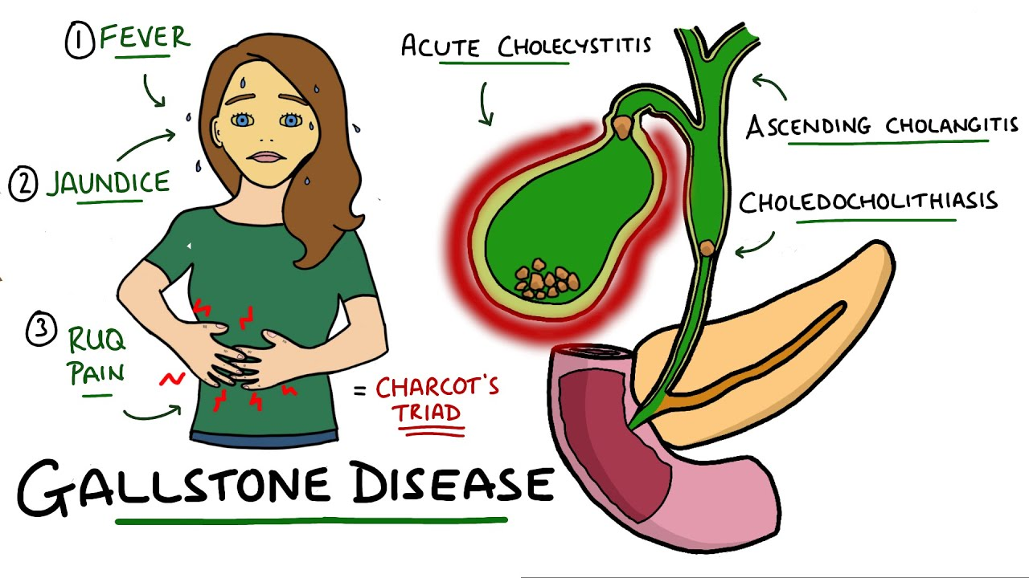
Cholecystitis
Vertical integration
The cholecystitis is the inflammation of the gallbladder. It may be acute or chronic.
Acute cholecystitis: It occurs usually in adult women and is characterized by
(i) sudden pain in the hypochondrium referred to the inferior angle of the right scapula or to the tip of the right shoulder,
(ii) vomiting, and
(iii) positive Murphy’s sign—if the finger is pressed under the right costal margin at the tip of the 9th costal cartilage.

Slide 45
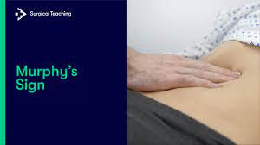
Vertical integration
(iii) positive Murphy’s sign—if the finger is pressed under the right costal margin at the tip of the 9th costal cartilage
when the patient is asked to take a deep breath, she/he feels sharp pain and winces with a “catch” in the breath as the diseased gallbladder meets the examining finger

Slide 46
(b) Chronic cholecystitis
Vertical integration
usually leads to formation of stones in the gallbladder (cholelithiasis):
It usually occurs typically in5F
fat,
fertile,
flatulous
female of
forty

Slide 47
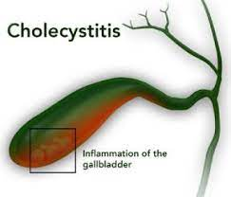
• Referred pain of gallbladder: In acute cholecystitis
Vertical integration
the inflammation of the gallbladder may irritate the subdiaphragmatic parietal peritoneum,
which is supplied in part by the phrenic nerve (C3, C4, and C5 spinal segments).
This may lead to referred pain over the tip of the right shoulder
for being supplied by the supraclavicular nerves (C3 and C4 spinal segments).

Slide 48
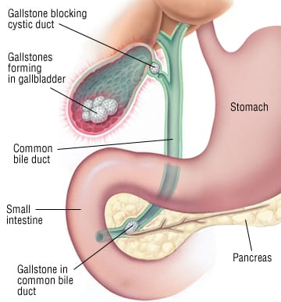
• Biliary colic
Vertical integration
It is usually caused by spasm of smooth muscle of gallbladder wall in an attempt to expel gallstone.
It is intermittent and is most intense when stone (calculus) is impacted either at the terminal end of the cystic duct or at the lower end of the because the smooth musbile duct cle everywhere in the biliary duct system is sparse except at the terminal portions of the cystic and bile ducts.

Slide 49
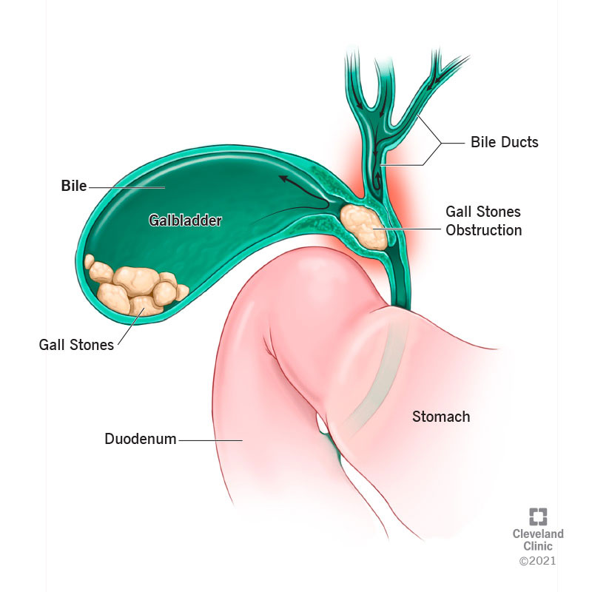
Obstruction of CBD
Vertical integration
The obstruction of CBD usually occurs due to gallstones, pancreatic carcinoma, or enlarged neoplastic hepatic lymph nodes.
It causes obstruction to bile flow, which leads to jaundice.

Slide 50
Courvoisier’s law:
Vertical integration
This law states that obstructive jaundice with distended and palpable gallbladder is most likely due to extrinsic obstruction of CBD (e.g., carcinoma of the head of the pancreas).

Slide 51
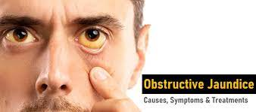
Vertical integration
On the contrary, obstructive jaundice with non-distended, non-palpable gallbladder is due to an intrinsic obstruction of CBD (e.g., impaction by gallstones) because in this case, previous cholecystitis makes the gallbladder fibrotic and contracted.

Slide 52
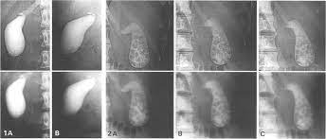
IMAGING OF THE BILIARY TRACT
Vertical integration
CHOLECYSTOGRAPHY
Gallbladder is not opaque to X-ray, but when certain radiopaque dyes are given by either mouth or intravenous injection they are excreted by the liver from blood into bile and reach the gallbladder.
In the gallbladder, the dye is concentrated and thus the gallbladder becomes opaque to X-rays
.

Slide 53
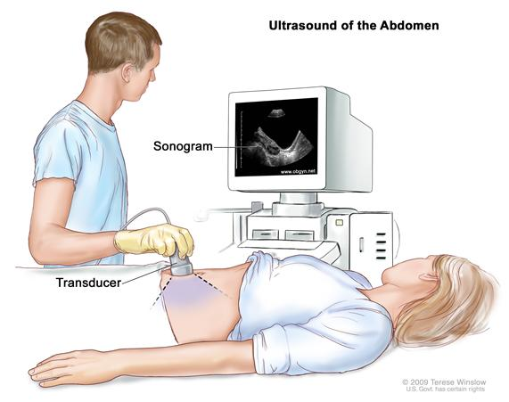
ULTRASOUND
Vertical integration
The ultrasonography is a noninvasive imaging technique to visualize the gallbladder and other components of the biliary apparatus.
This technique has largely replaced the cholecystograph

Slide 54
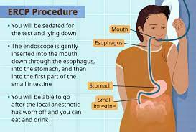
ENDOSCOPIC RETROGRADE CHOLANGIOPANCREATOGRAPHY (ERCP)
Vertical integration
In this technique,
under direct vision through a fiber-optic endoscope,
a catheter is inserted into the hepatopancreatic ampulla
and radiopaque contrast medium is injected
, and bile and pancreatic ducts are visualized

Slide 55
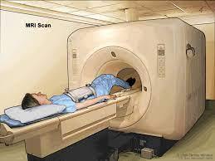
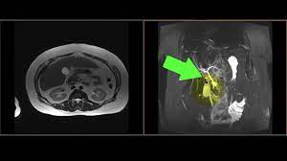
MRI
Vertical integration
The bile and pancreatic ducts can now also be visualized by the noninvasive magnetic resonance imaging (MRI) technique

Slide 57
Spiral Integration
Bioethics
Ethical Considerations
From an ethical standpoint, the scenario raises considerations regarding patient autonomy, informed consent, and confidentiality
The physician must ensure that patient fully understands her diagnosis, treatment options, and potential implications
Discuss the necessity of a tongue biopsy for confirmation of oral cancers and obtaining informed consent for the procedure
Additionally, the physician must respect patient’s privacy and confidentiality throughout the diagnostic and treatment process

Slide 58
Family medicine
Spiral integration
Cholecystitis
When a patient comes to a GP he will take history about and make diagnosis on the basis of it :
Acute cholecystitis –it is a sudden inflammation of the gall bladder that causes marked abdominal pain, often with nausea, vomiting, and fever.
Chronic cholecystitis – it is low-intensity inflammation of the gall bladder that lasts a long time.
It may be caused by repeat attacks of acute cholecystitis.
Chronic cholecystitis may cause intermittent mild abdominal pain or no symptoms at all.
Depending on the condition of the patient he is referred to surgery outdoors or emergency.

Slide 59
Spiral integration
Spiral integration
Management
NPO, IV fluids, IV antibiotics (ceftriaxone + metronidazole)
Pain management (NSAIDs/opioids)
Early cholecystectomy (laparoscopic preferred, within 72 hours)
If not fit for surgery: Percutaneous cholecystostomy

Slide 60
Artificial intelligence
Spiral integration
AI can potentially aid in enhancing diagnostic accuracy and efficiency of cholecystitis.
AI-powered decision support system can also help clinicians in selecting appropriate treatment modalities
AI-driven predictive models may help anticipate the risk of complications and recurrence in susceptible populations

Slide 61
Research Article March 8, 2022 Acute Cholecystitis A Review Jared R. Gallaher, MD, MPH¹; Anthony Charles, MD, MPH¹ Author Affiliations JAMA. 2022;327(10):965-975. doi:10.1001/jama.2022.2350
Spiral integration
Research
Gallstone-associated cystic duct obstruction is responsible for 90% to 95% of the cases of acute cholecystitis. Approximately 5% to 10% of patients with acute cholecystitis have acalculous cholecystitis, defined as acute inflammation of the gallbladder without gallstones, typically in the setting of severe critical illness. The typical presentation of acute cholecystitis consists of acute right upper quadrant pain, fever, and nausea that may be associated with eating and physical examination findings of right upper quadrant tenderness. Ultrasonography of the right upper quadrant has a sensitivity of approximately 81% and a specificity of approximately 83% for the diagnosis of acute cholecystitis

Slide 62
TKANKU

