Slide 1


Slide 2

FOUNDATION MODULE _1
Reversible and Irreversible Cell Injury
Dr. Mudassira zahid
. Fatima-tuz-Zahra
MBBS, M.Phil. (Chem), FCPS(Chem), CHPE
Pathology Department, RMU
Assistant Professor Pathology
LGIS

Slide 3
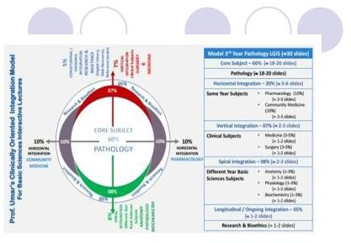

Slide 4
LEARNING OUTCOMES
By the end of this session you should be able to:
Describe mechanism of cell injury
Explain etiology and pathogenesis of different types of cell injury
Correlate morphological features of various types of injury with their clinical manifestations

Slide 5
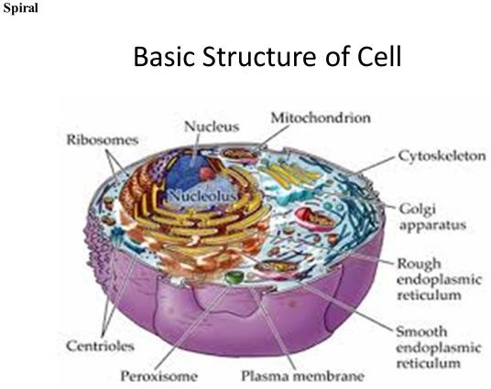

Slide 6
CAUSES OF CELL INJURY
CORE SUBJECT
  Alcohol and Narcotic Drugs
Insecticides and herbicides
Oxygen Deprivation (Hypoxia)
  Ischemia: Loss of blood supply to a tissue
  Anaemia: Decreased haemoglobin,
Physical Agents
Mechanical trauma.
Extremes of temperature (burns and deep cold)
Chemical Agents and Drugs
  Poisons such as Arsenic and Cyanide

Slide 7
CORE SUBJECT
Infectious Agents:
Viruses, Bacteria, Fungi, Parasites
Immunologic Reactions:
Serves as defense against biologic agents Autoimmune diseases,
Anaphylactic Reactions
Genetic Derangements: Genetic defects may result in pathologic changes as down syndrome
Nutritional Imbalances:
  Protein Calorie Deficiencies
  Vitamin Deficiency
Aging:

Slide 8
Point of No Return
CORE SUBJECT
Two phenomena consistently characterize irreversibility :
The inability to reverse mitochondrial dysfunction (lack of oxidative phosphorylation and ATP generation) even after resolution of original injury
Profound disturbances in membrane function

Slide 9
Reversible Cell Injury: Morphologic Changes
CORE SUBJECT
The two main morphologic correlates of reversible
cell injury are:
Cellular Swelling: It is the result of failure of energy dependent ion pumps in the plasma membrane, leading to an inability to maintain ionic and fluid homeostasis.
Fatty Change: It occurs in hypoxic injury and various forms of toxic or metabolic injury.
It is manifested by the appearance of small or large lipid vacuoles in the cytoplasm.

Slide 10
Ultra structural changes of Reversible Cell Injury
CORE SUBJECT
Blebbing of plasma membrane Blunting or distortion of microvilli Loosening of intercellular attachments
Swelling and appearance of phospholipid – rich amorphous sdensities in mitochondria
Dilation of endoplasmic reticulum
Detachment of ribosomes
Nuclear alterations with clumping of chromatin

Slide 11
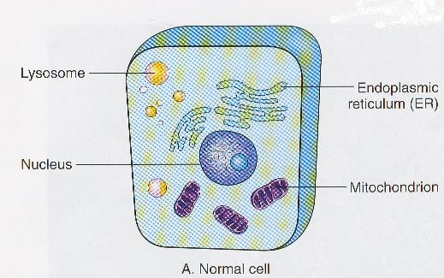
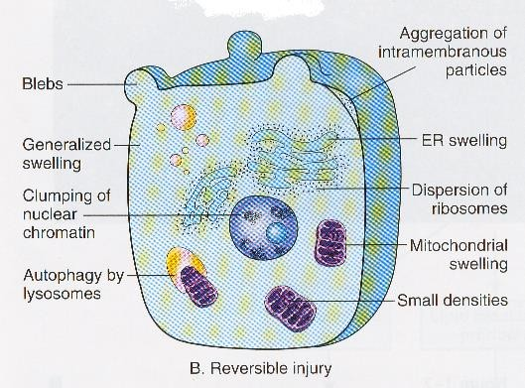
CORE SUBJECT
NORMAL CELL
REVERSIBLE CELL INJURY

Slide 12
Necrosis
CORE SUBJECT
Sum of the morphologic changes that follow cell death in a living tissue or organism’.
Two mechanisms are involved in necrosis:
Enzymatic digestion of cells by catalytic enzymes
  Autolysis: Catalytic enzymes derived from the lysosomes of dead cells.
  Heterolysis: Catalytic enzyme derived from lysosomes of immigrant leucocytes.
Denaturation of Proteins

Slide 13
Types of Necrosis
CORE SUBJECT
Several distinct types of necrosis are recognized:
Coagulative Necrosis
Liquefactive Necrosis
Caseous Necrosis
Gangrenous Necrosis
Fibrinoid Necrosis
Fat Necrosis

Slide 14
Morphologic Changes in Necrosis
Changes in Cytoplasm
Increased Eosinophilia: It is due to:
Loss of normal basophilia imparted by RNA
Cell will assume a glassy homogenous appearance . Due to digestion of cytoplasmic organelles by enzymes, the cytoplasm will appear vacuolated and appear moth- eaten
Calcification of dead cell may occur
Changes in Nucleus
Pyknosis: Shrinkage of nucleus
Karyolysis: Dissolution of nucleus
Karyorrhexis: Fragmentation of nucleus

Slide 15
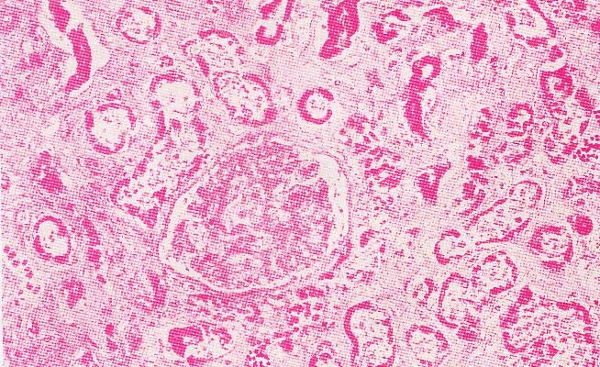
Caogulative Necrosis
Vertical integration
Coagulative Necrosis is the most common type of necrosis. The process of coagulative necrosis, with preservation of the general tissue architecture is characteristic of hypoxic death of cells ( due to lack of blood supply) in all tissues except brain
The pathogenesis of coagulative necrosis is denaturation of proteins.
Part of kidney deprived of its blood supply. caogulative necrosis Cellular and nuclear detail has been Lost. The ghost outline of a glomerulus can be seen in the centre, with remnants of tubule elsewhere

Slide 16
Liquefactive Necrosis
CORE SUBJECT
Liquefactive Necrosis is characteristically seen in:
Hypoxic death of cells within the central nervous system
,Bacterial or occasionally fungal infections.
Liquefaction completely digests the dead cells.
The end result is transformation of the tissue into a liquid viscous mass.
If the process had been initiated by acute inflammation, the material is frequently creamy yellow because of the presence of dead white cells and is called pus.

Slide 17
Caseous Necrosis
CORE SUBJECT
The term caseous is derived from gross appearance of tissue (white and cheesy)
Microscopic Appearance: The necrotic focus appears as amorphous granular debris composed of fragmented, coagulated cells and granular debris enclosed within a inflammatory border known as Granulomatous Reaction”

Slide 18
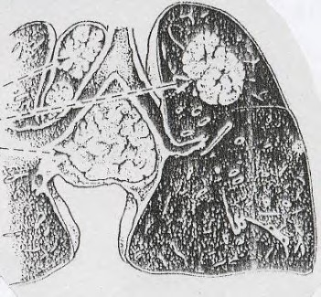
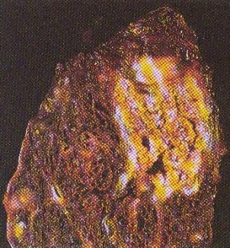
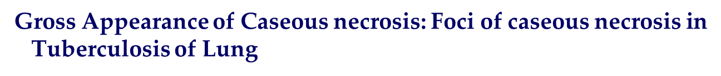
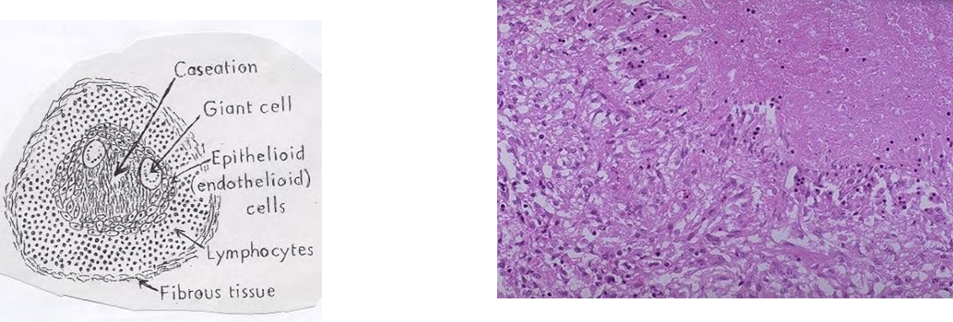
Vertical integration
Microscopic Appearance of Caseation Necrosis: Characteristic Tubercle showing central necrosis, along with epithelioid cells, multinucleated Giant cells and lymphocytes

Slide 19
Gangrenous Necrosis
CORE SUBJECT
Gangrene is massive necrosis (Caused by acute ischemia or severe bacterial infection) followed by putrefaction
  Gangrene is a special type of necrosis, in which bacterial infection is superimposed on coagulative necrosis and coagulative necrosis is modified by the liquefactive action of the bacteria

Slide 20
Fat necrosis
CORE SUBJECT
Fat Necrosis may be due to:
Direct Trauma to adipose tissue and extracellular liberation of fat. The result may be a palpable mass, particularly at a superficial site such as the breast
Enzymatic lysis of fat due to release of Lipases In Acute Pancreatitis there is release of pancreatic lipase. As a result, fat cells have their stored fat split into fatty acids, which then combine with calcium to precipitate out as white soaps.

Slide 21
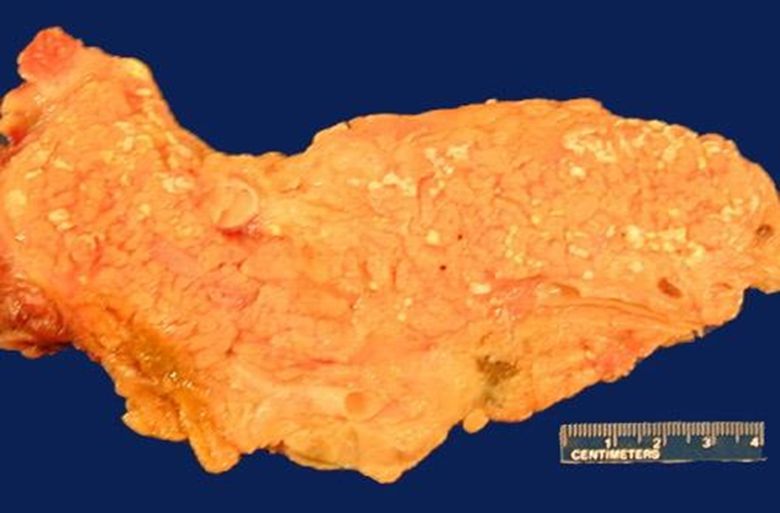
Fat Necrosis Pancreas
Vertical integration
Cellular injury to the pancreatic acini leads to release of powerful enzymes which damage fat by the production of soaps (combination of calcium salts with fat’ ;fat saponification), and these appear grossly as the soft Chalky white areas seen in this cut surface

Slide 22
Fibrinoid Necrosis
CORE SUBJECT
Fibrinoid Necrosis is a type of Connective Tissue Necrosis
It is seen particularly in conditions where there is Deposition of Antigen – Antibody Complexes .
The important examples are Autoimmune Disorders like Systemic Lupus Erythematosus, Rheumatic Fever and Polyartirtis Nodosa.
In these conditions the media and smooth muscles of vessel wall are involved

Slide 23
Differences Between Different Types of Necrosis
COAGULATIVE NECROSIS | LIQUEFACT- IVE NECROSIS | CASEOUS NECROSIS | FAT NECROSIS | FIBRINOID NECROSIS
Occurs due to ischemia | Occurs due to ischemia | Occurs due to granuloma- tous disease | Occurs due to trauma or enzymatic fat injury | Due to vascular inflammation
In various tissues | In Brain | In any tissue | In Pancreas and Breast | Around Blood Vessels
Tissue architecture preserved | Architecture destroyed | Cheesy material; Architecture disturbed | Architecture distorted | Architecture not much affected
Involves denaturation of protein & lysosomal enzymes | Denaturation of Proteins & Autolysis | Caseation | Rupture of Fat cells | Accumulation of Fibrinoid material
COAGULATIVE NECROSIS | LIQUEFACT- IVE NECROSIS | CASEOUS NECROSIS | FAT NECROSIS | FIBRINOID NECROSS

Slide 24
Apoptosis
CORE SUBJECT
Designed to eliminate unwanted host cells through activation of coordinated, internally programmed series of events
Affected by a dedicated set of gene products.
It is a disassembly of cellular components
to eliminate unwanted cells, during embryogenesis and in various physiologic processes.

Slide 25
.
Stage 1 (Dying Process):
Active metabolic changes in the cell cause cytoplasmic and nuclear condensation and nuclear membrane is intact.
Cell disintegrates into multiple Apoptotic Bodies each surrounded by a part of plasma membrane.
Stage 2 (Elimination Process):
Apoptotic bodies are phagocytosed by surrounding cells ,e.g., liver cells, tumour cells.
This is followed by rapid digestion.
The surrounding cells move together to fill the vacant space leaving virtually no evidence of the process.

Slide 26
Pathogenesis of Apoptosis
CORE SUBJECT
Results from action of “caspases” which are activated ,lead to endonuclease digestion of DNA and disintegration of the cell skeleton.
Activation through Death Factor (Fas Ligand): The is by signaling through membrane proteins such as Fas or TNF receptor intracellular death domain.
Release of Cytochrome – C from the Mitochondria:
The second pathway is via the release of Cytochrome – C from mitochondria .
Cytochrome – C binds to Apaf – 1 which then activates caspases.

Slide 27
Apoptosis specific Gene
CORE SUBJECT
Gene that stimulates Apoptosis e.g, bax – gene
APOPTOSIS INHIBITING GENE
Gene that blocks apoptosis
e.g, bcl - gene

Slide 28
Physiologic and Pathologic
Apoptosis conditons
CORE SUBJECT
The programmed destruction of cells during embryogenesis.
Hormone dependent involution in the adults
Cell depletion in proliferating cell population
Cell death in tumours.
Death of neutrophils during an acute inflammatory response.
Deletion of B and T lymphocytes after cytokine depletion

Slide 29
Morphologic changes in Apoptosis
CORE SUBJECT
MORPHOLOGIC CHANGES IN APOPTOSIS
Cell Shrinkage:
Cell is smaller in size;
Cytoplasm is dense; organelles are tightly packed.
Chromatin Condensation:
Chromatin aggregates peripherally, under the nuclear membrane;nucleusmay break in fragments
Formation of cytoplasmic blebs and apoptotic bodies.
Phagocytosis of apoptotic bodies by adjacent healthy cells.

Slide 30
Comparison of cell death by Apoptosis & Necrosis
FEATURE | APOPTOSIS Cell Suicide | NECROSIS Cell Homicide
Induction | May be induced by physiological or pathological stimuli | Invariably due to pathological injury
Extent | Single cells | Cell groups
Biochemical events | (I) Energy- dependent fragmentation of DNA by endogenous endonucleases (ii) Lysosomes intact | (i) Impairment or cessation of ion homeostasis (ii) Lysosomes leak lytic enzymes
Cell membrane integrity | Maintained | Lost
Morphology | Cell fragmentation to form apoptotic bodies | Cell swelling and lysis
Inflammatory response | None | Usual

Slide 31
Pharmacological Agents
Horizontal integration
Role of Drugs in Cell Injury
Direct toxic effects: e.g., acetaminophen overdose causing liver cell necrosis
Free Radical Generation
Certain drugs (e.g., doxorubicin) generate free radicals, leading to oxidative stress and cell damage
Drug-Induced Apoptosis
Example: Chemotherapeutic agents inducing apoptosis in cancer cells
Protective Drugs Against Cell Injury
Antioxidants: Prevent damage caused by free radicals (e.g., Vitamin C, Vitamin E)

Slide 32
AI in diagnosis of Cell Injury
longitudinal integration
Digital Pathology with AI Algorithms
  AI-powered software analyzes histopathological slides for cellular injury.
  Example: Identifying necrosis or apoptosis in liver biopsy samples for hepatitis. Eg PathAI
Predictive Toxicology Models
  AI tools predict drug-induced liver injury (DILI) using patient data and drug profiles.
  .
AI in Laboratory Medicine
  Automated detection of cellular injury markers in blood or urine tests.
  Example: AI-assisted analysis of troponin levels for myocardial injury detection.

Slide 33
Bioethics
longitudinal integration
Informed Consent Ensures the patient understands the nature of MI, potential risks, and available diagnostic and treatment options.
Beneficence (Acting in the Patient’s Best Interest)Prompt diagnosis via ECG, cardiac biomarkers, and imaging reduces complications and improves survival.
Non-Maleficence (Do No Harm)Avoiding unnecessary delays, misdiagnosis, or incorrect treatments minimizes harm.
Justice (Fairness in Healthcare)Equal access to diagnostic tools and timely intervention ensures ethical and equitable patient care.

Slide 34
Cellular and molecular mechanisms of cell damage and cell death in ischemia–reperfusion injury in organ transplantation Molecular Biology Reports
Review
Published: 29 March 2024
Volume 51, article number 473, (2024)
Key Mechanisms:and summary of article
Ischemia: Hypoxia disrupts mitochondrial function, causing edema.
Reperfusion: Excess oxygen produces ROS, leading to oxidative damage and inflammation.
Outcomes:
Moderate IRI: Reversible cell dysfunction.
Severe IRI: Cell death via pathways like apoptosis, necrosis, ferroptosis, and pyroptosis.
Clinical Relevance: Targeting these mechanisms can enhance transplant success

Slide 35
EOLA
A 45-year- male with chronic alcohol use presents with severe epigastric pain radiating to the back, nausea, and vomiting. Vitals: BP 90/60 mmHg. Labs: Amylase 980 U/L, Lipase 1400 U/L, ALT 210 U/L, Calcium 7.8 mg/dL, BUN 32 mg/dL. CT shows pancreatic edema and peripancreatic fat stranding. What confirms the diagnosis of acute pancreatitis?
A) CT scan findings
B) Lipase/amylase elevation + typical symptoms
C) Serum calcium and BUN levels
D) Right upper quadrant ultrasound
E) MRCP for biliary obstruction

