Slide 1




Slide 2
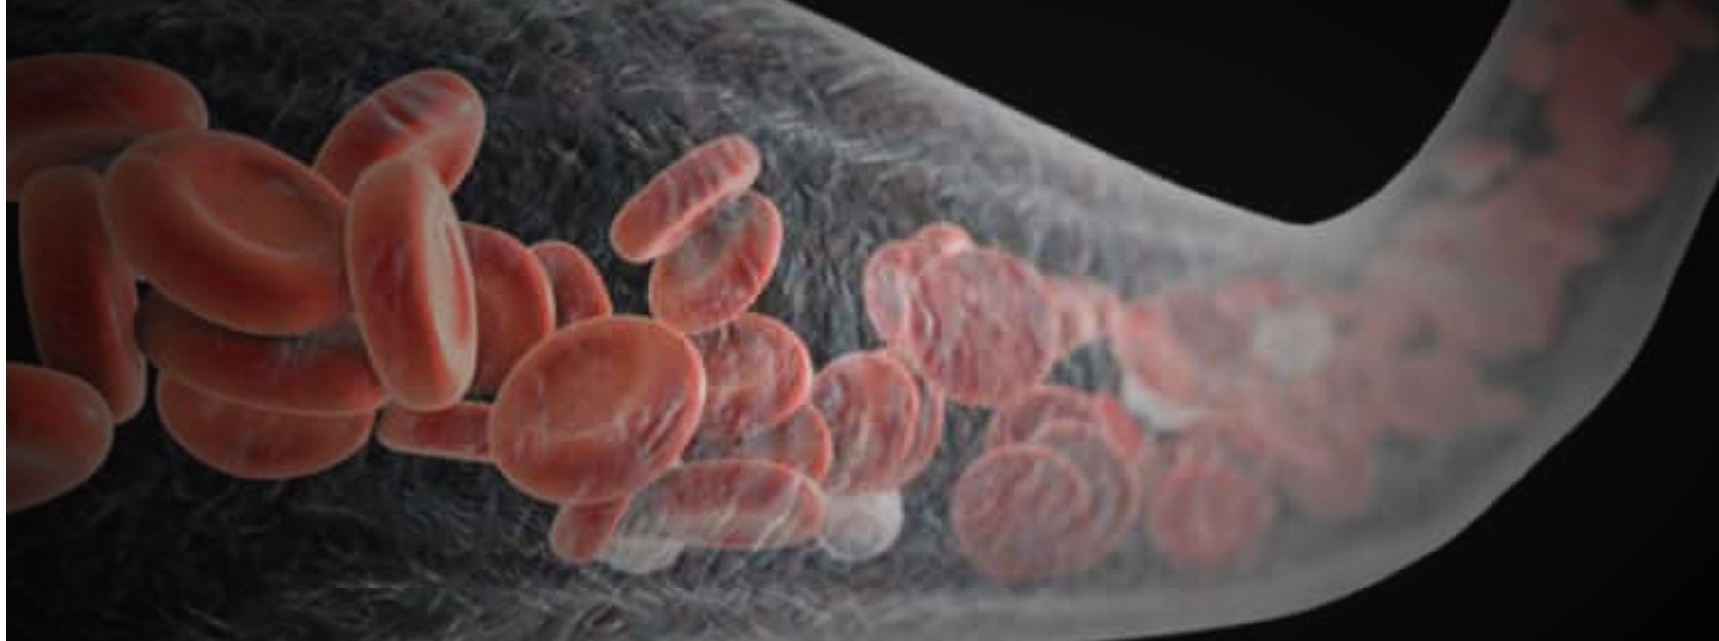
ANEMIA IN PREGNANCY
Dr Sobia Nawaz Malik
Associate Prof gynae
HFH,RWP

Slide 3
University Motto, Vision, Values & Goals
Mission Statement
To impart evidence-based research-oriented health professional education
Best possible patient care
Mutual respect, ethical practice of healthcare and social accountability.
Vision and Values
Highly recognized and accredited centre of excellence in Medical Education, using evidence-based training techniques for development of highly competent health professionals, who are lifelong experiential learner and are socially accountable.
Goals
The Undergraduate Integrated Learning Program is geared to provide you with quality medical education in an environment designed to.

Slide 4
SEQUENCE OF LGIS
Learning objectives
core concept = 70%)
Related anatomy (horizontal integration 15%)
Related clinical findings (vertical integration – 10%)
Research article related to topic (3%)
Ethics (2%)

Slide 5
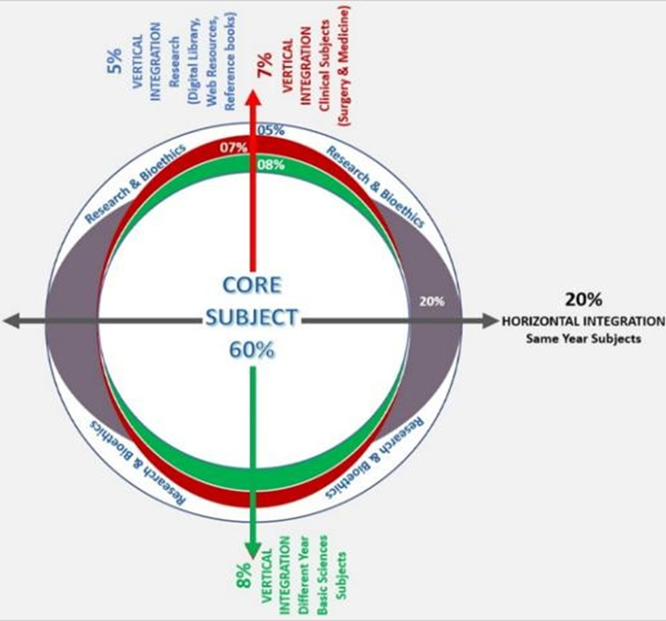
PROF UMER MODEL OF INTEGRATED LECTURE

Slide 6
Learning Objectives
At the end of this presentation, you will be able to
Define Anemia
Enlist causes of microcytic, macrocytic, and normocytic anemia
Diagnose different types of anemia
Formulate a management plan for the correction of anemia

Slide 7
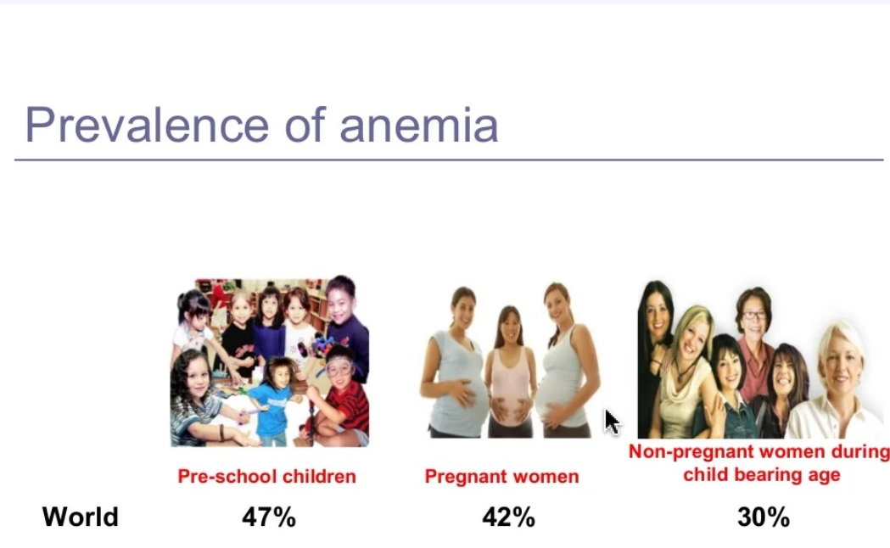
INTRODUCTION
Commonest medical disorder in pregnancy
  Developed countries 18-20%
  Developing countries 40-70%
Prevalence in PAKISTAN is 35.5% (unicef 2018)
Nutritional anemia (Fe deficiency) is commonest 46.9%
It is important contributor to maternal & perinatal morbidity & mortality
as a direct or indirect cause
Caption

Slide 8
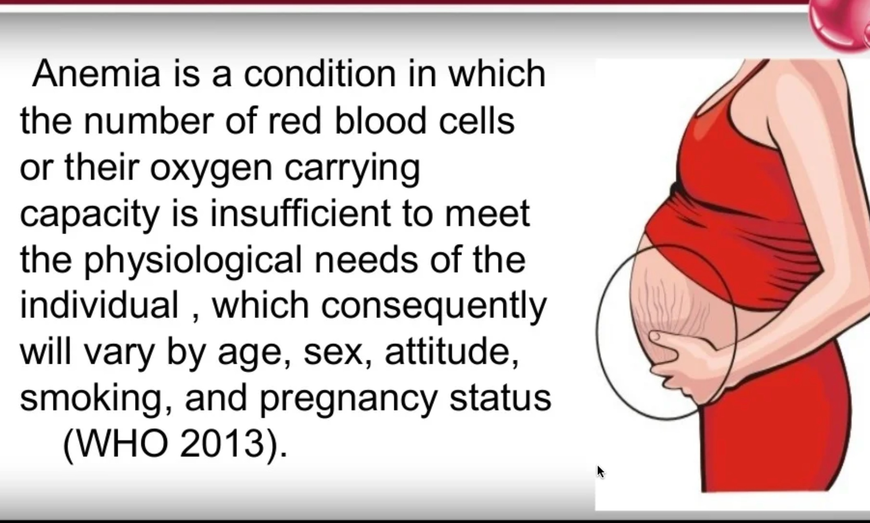
DEFINITION
Caption

Slide 9
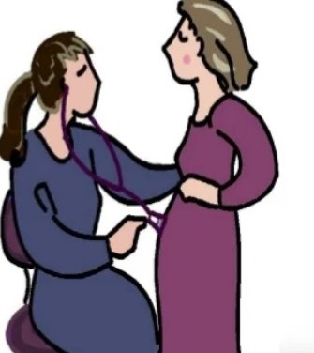
ANEMIA IN PREGNANCY
WHO defines it as
  Hemoglobin below 11gm/dl
  Hematocrit of less than 33%.
Centre for Disease Control (CDC) defines as
  Hb conc < 11gm % in 1st and 3rd trimesters and
  Hb conc < 10.5 gm% in 2nd trimester.
Caption

Slide 10
CLASSIFICATION
Degree of anemia is graded acc. to ICMR
Mild 10-10.9gm/dl
Moderate 7.0-9.9gm/dl
Severe 4- 6.9 gm/dl
Very severe <4gm/dl

Slide 11
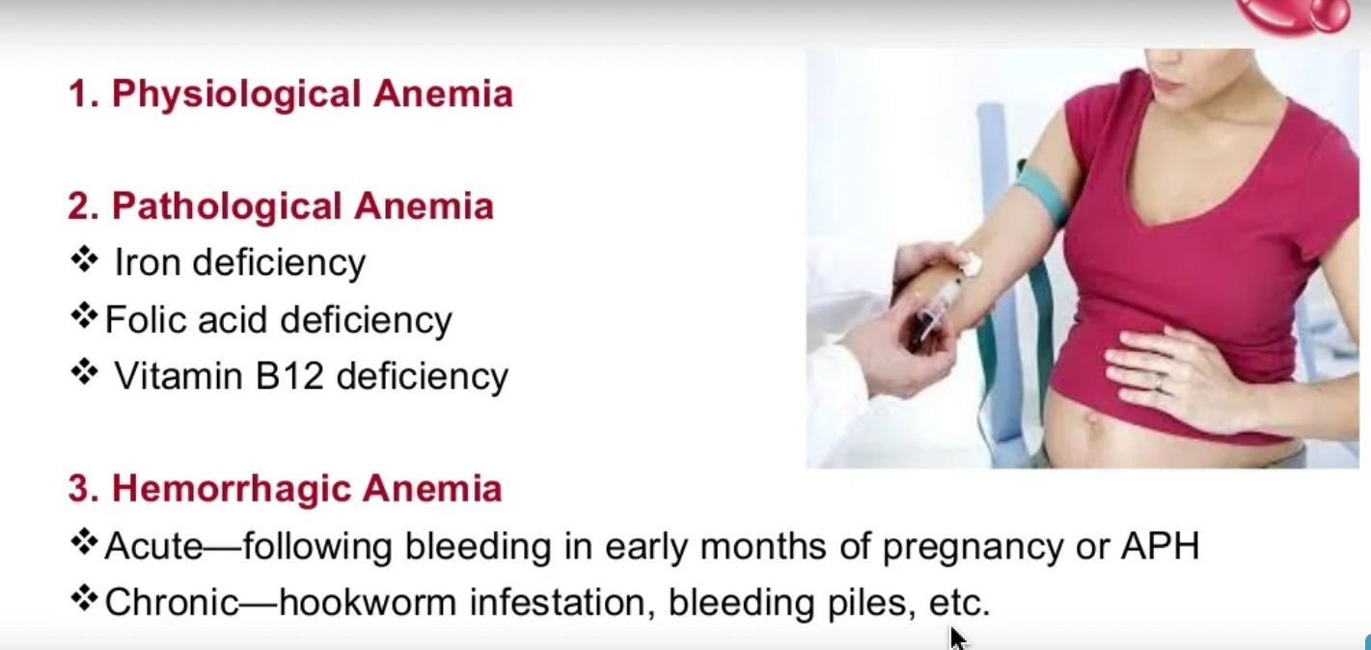
TYPES OF ANEMIA
Caption

Slide 12
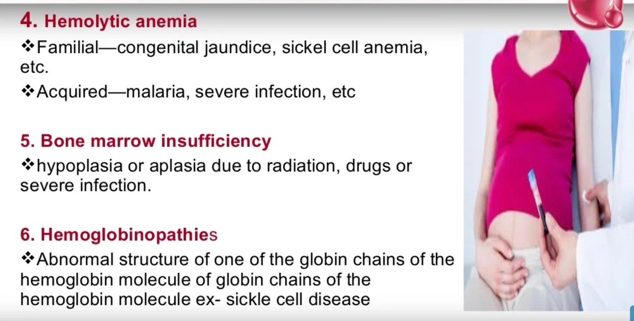
Caption

Slide 13
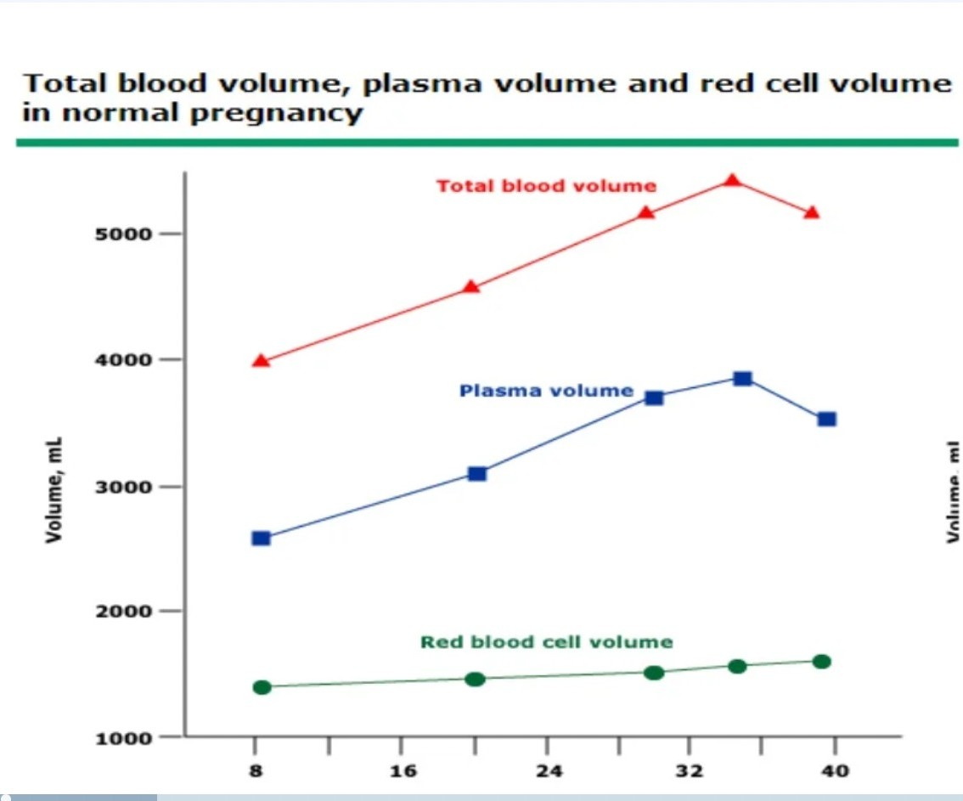
PHYSIOLOGICAL ANEMIA
The RBC mass increases by 25-30%
Plasma volume increases by 40 to50%,
Resulting in erythrocyte dilution by 5 to 15%
Decrease in hemoglobin concentration by approximately 2g/dl
Most rise takes between 32-35weeks of gestation
•
Caption

Slide 14
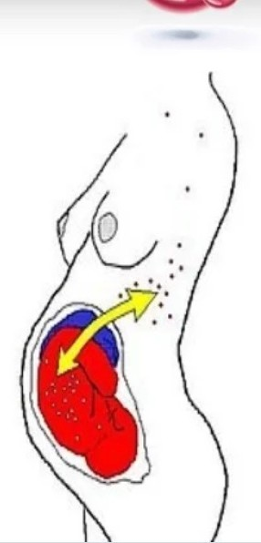
The picture on peripheral smear remain normocytic and normochromic.
The decrease in blood viscosity facilitate better blood flow through placenta
.
The increased blood volume also offers a protective benefit against blood loss in the third stage of labor.
Resolves by 6weeks postpartum as plasma volume returns to normal
Caption

Slide 15
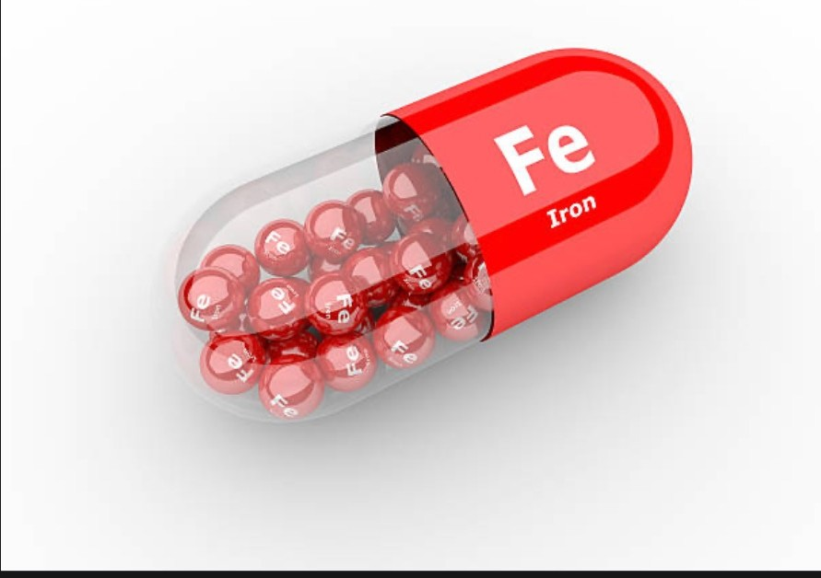
IRON REQUIREMENT IN PREGNANCY
Total iron demand in pregnancy – 900mg ( 700-1400 mg)
uterus ( fetus + placenta) – 500 - 600 mg
blood loss during delivery – 150 – 200 mg
increase in Hb mass - 500 mg
225 mg of iron is saved as a result of amenorrhoea of 9 months.
Average elemental iron required is 30-60mg/day

Slide 16
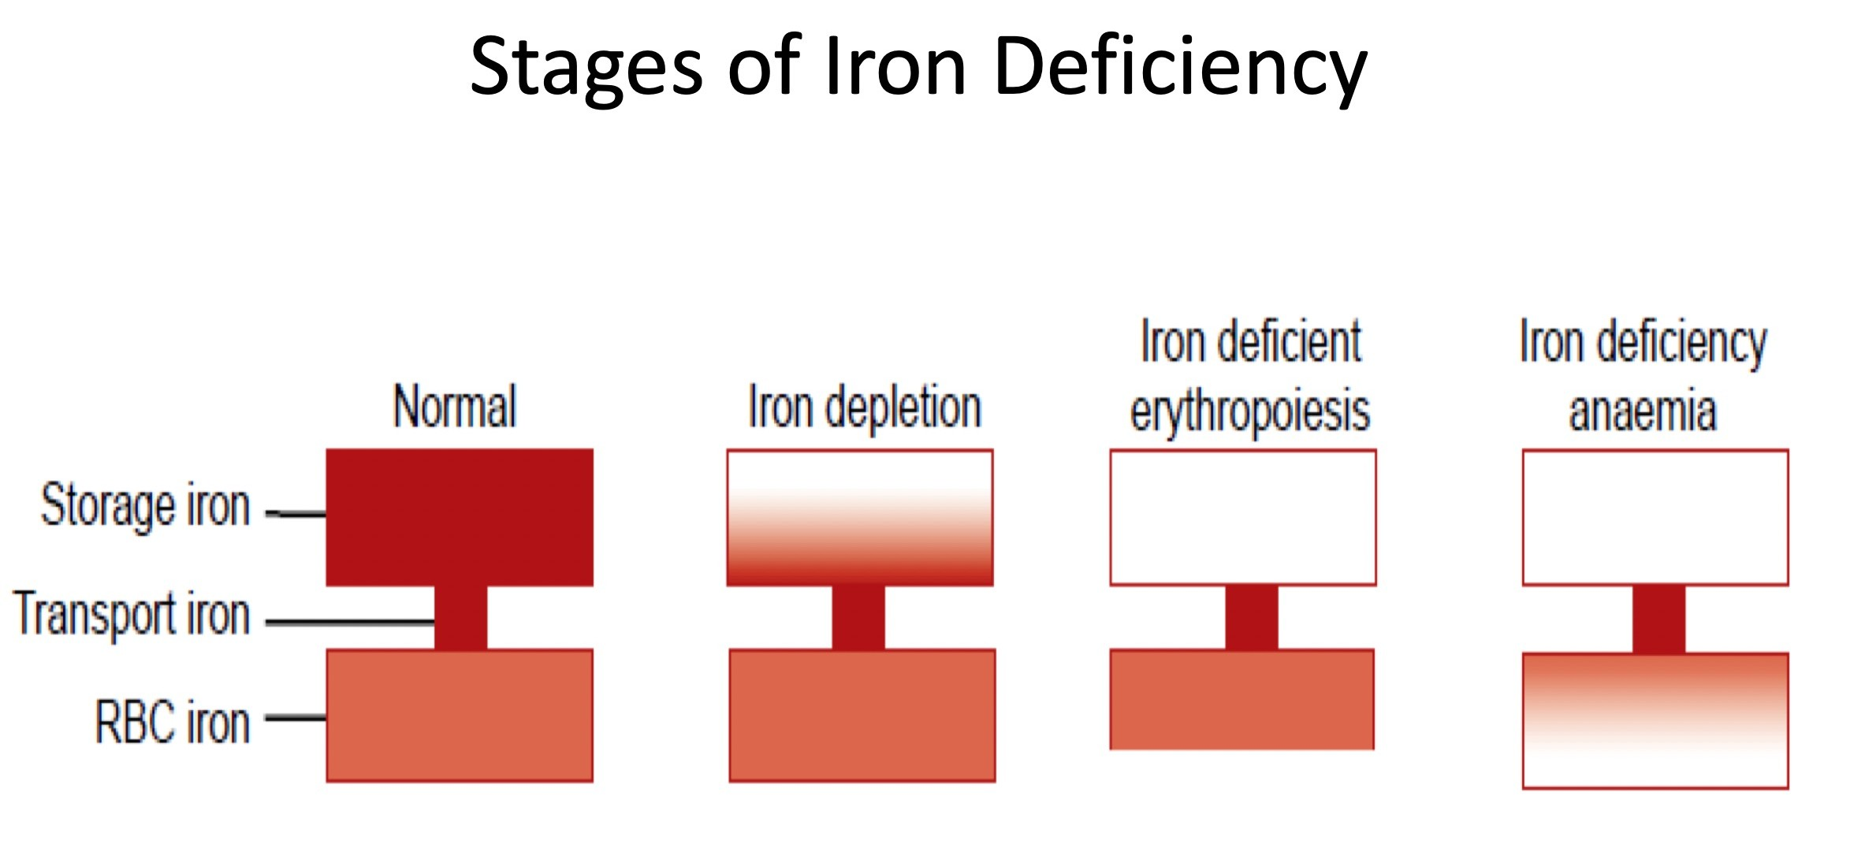
IRON DEFICIENCY ANEMIA
MOST COMMON TYPE OF ANEMIA IN PREGNANCY
RESULTS from increase in demand and depletion of iron stores in pregnant women

Slide 17
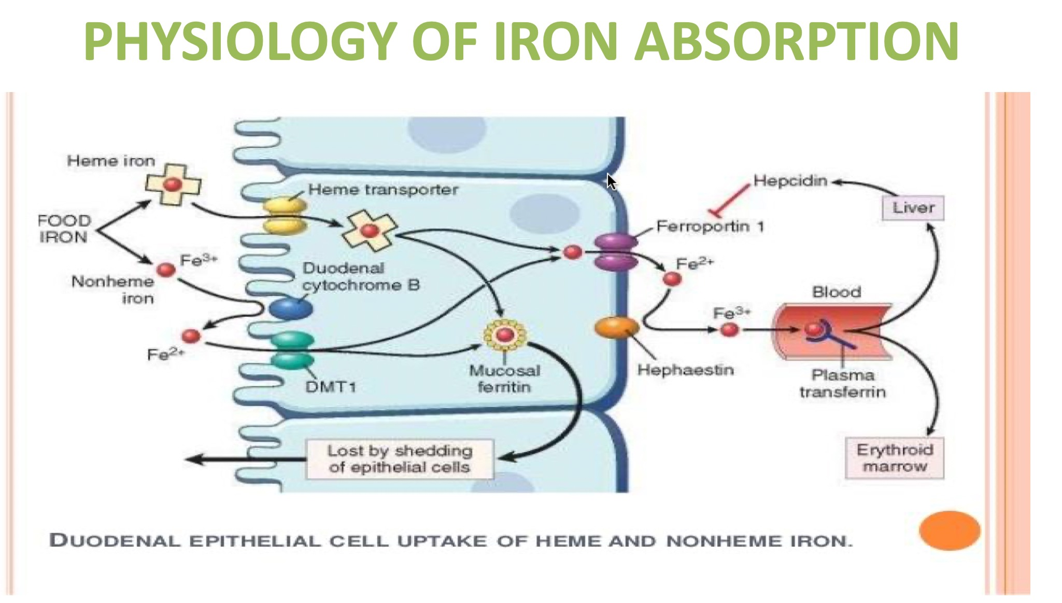

Slide 18

CAUSES
Increased demand~1000 mg
(growing fetus + placenta + blood loss during labor)
Decreased intake:
  Faulty eating habits
  Loss of appetite , Vomiting
Disturbed metabolism-low erythropoiesis
Pre pregnancy iron status/ Anemia
Repeated/ Multiple pregnancies
Hookworm infestations.
Hemmorhoids
Caption

Slide 19
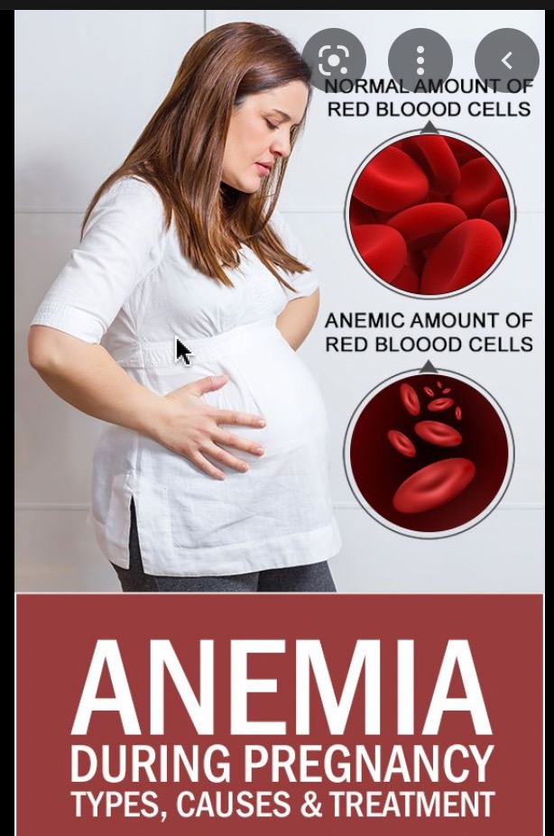
EFFECT OF ANEMIA ON THE MOTHER
Antepartum | INTRAPARTUM | POSTPARTUM
Rercurrent infection Preeclampsia APH Preterm labour Cardiac failure | Uterine inertia Dysfunctional labour patterns ncreased risk of instrumental deliveries Fetal distress Cardiac failure Shock | Puerperal sepsis Subinvolution of uterus Failing lactation Puerperal venous thrombosis Pulmonary embolism Cardiac failure Delayed wound healing

Slide 20
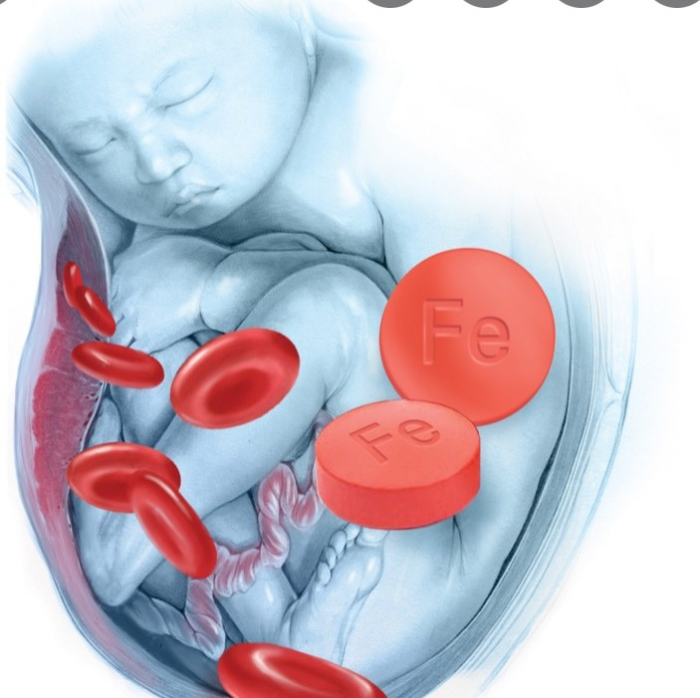
EFFECTS ON FETUS
IUGR
Prematurity
Still birth
Anemia in early infancy
Inc perinatal morbidity

Slide 21

SYMPTOMS OF ANEMIA
Lack of concentration
Infection
Palpitation
Dizziness
Light headedness
Irritability
PICA
Fatigue
Weakness
Dyspnoea on exertion

Slide 22
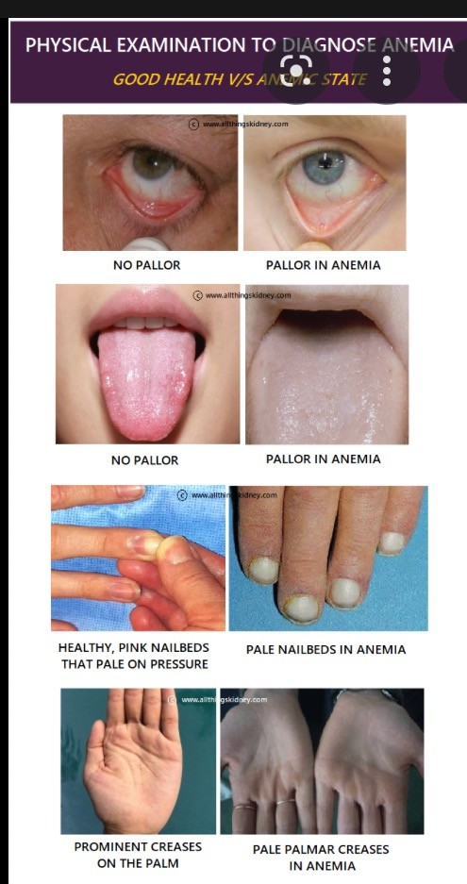
SIGNS OF ANEMIA
Pallor of mucus membrane or nail bed
Glossitis and Stomatitis
Koilonychia
Tachycardia , tachypnea
Ejection systolic murmur
Ankle Edema
Increased juglar venous pressure
Postural hypotension

Slide 23
DIAGNOSIS
Tests | Iron def | Thalasemia | Megaloblastic anemia
Hb | Dec | Dec | Dec
Ferritin | Dec | N/INC | Inc/N
MCV | Dec | Dec | Inc
Retics | Dec | Inc | Dec
Hb electrophresis | Normal | High HbF, HbA2 | Normal

Slide 24
Mentzer index
An index used to differentiate IDA from thalessemias.
Formula is MCV/RBC count Value for IDA>13 Value for thalessemia<13

Slide 25
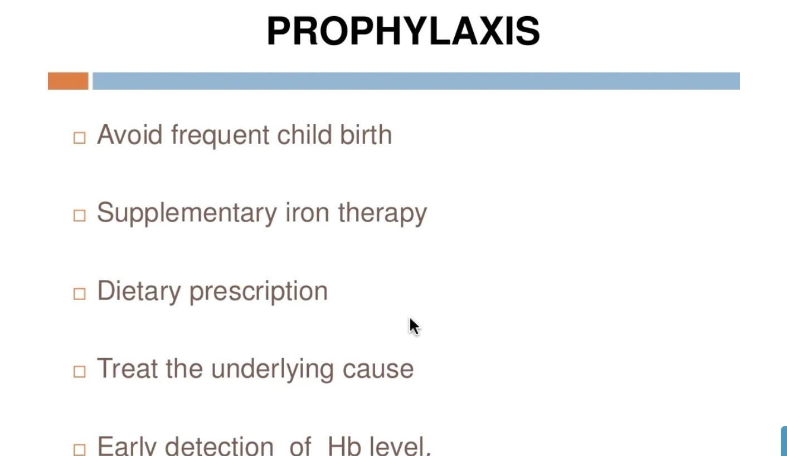
PREVENTION
Caption

Slide 26
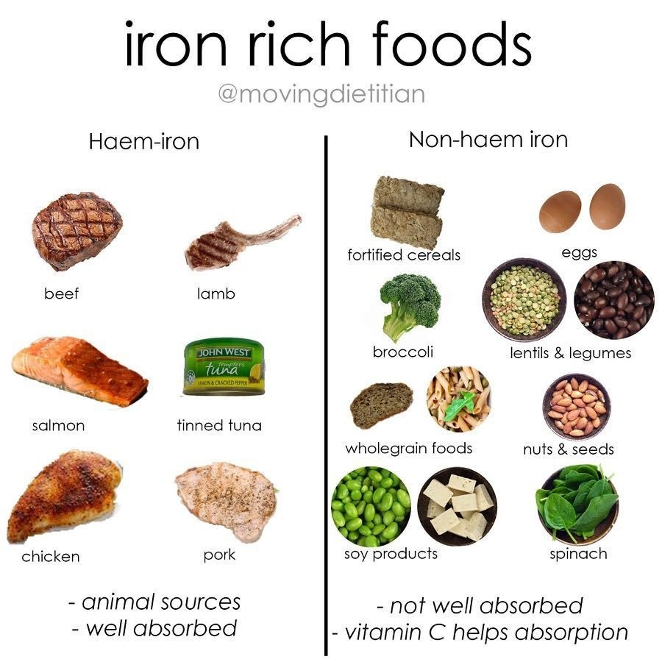
PREVENTIVE MEASURES!
Prepreganancy counselling and dietary advice
Heme iron
Using cast iron utensils
Take vit C rich food
Avoid food that inhibit its absorption
  Tanins (tea)
  Phytates in bran
  Calcium (dairy products)

Slide 27
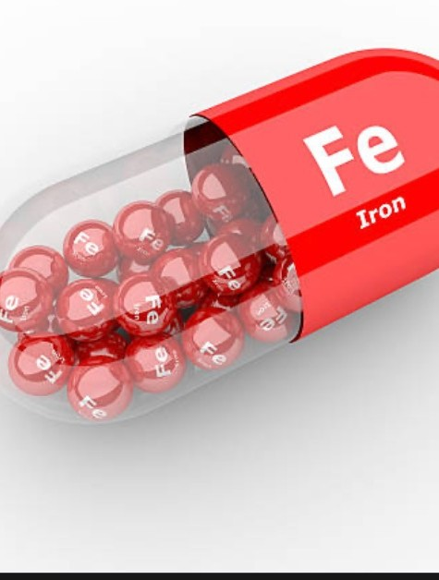
ORAL IRON SUPPLEMENTATION
Daily iron 60mg and folic acid 400ug should be started and continued unto 3 months post party
Therapeutic dosage of iron is 100-200mg daily
Oral ferrous salt are treatment of choice
Caption

Slide 28
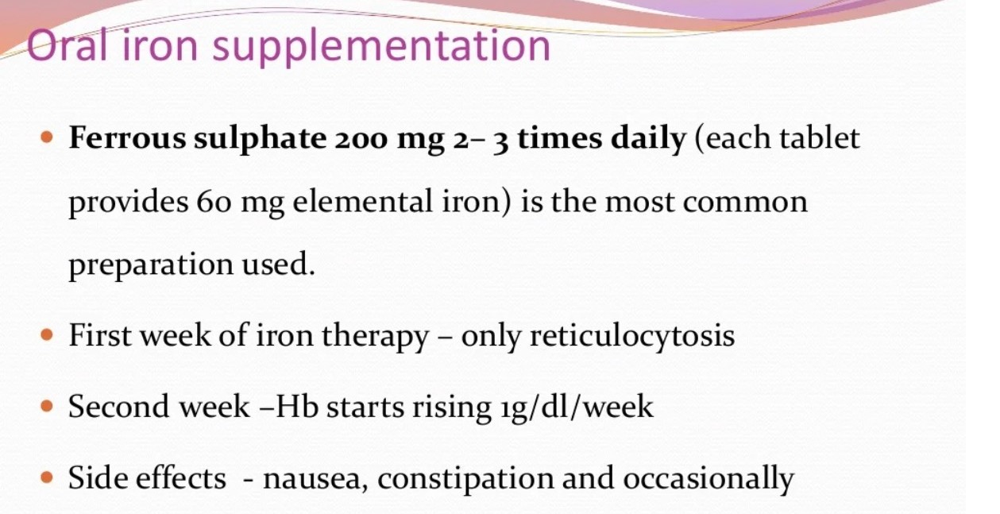
Caption

Slide 29
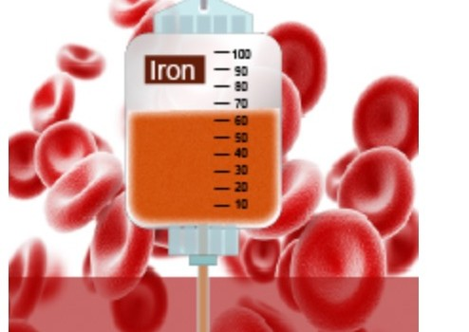
Parentral Iron
Indication
  Intolerance to oral iron
  Moderate anemia
  Failure of oral therapy
Route: IM / IV
Caption
IM route causes pain, staining of skin , myalgia, injection abscess
IV route : anaphylaxis can occur
Iron dextran and polymaltose preparation can be used by both routes.

Slide 30
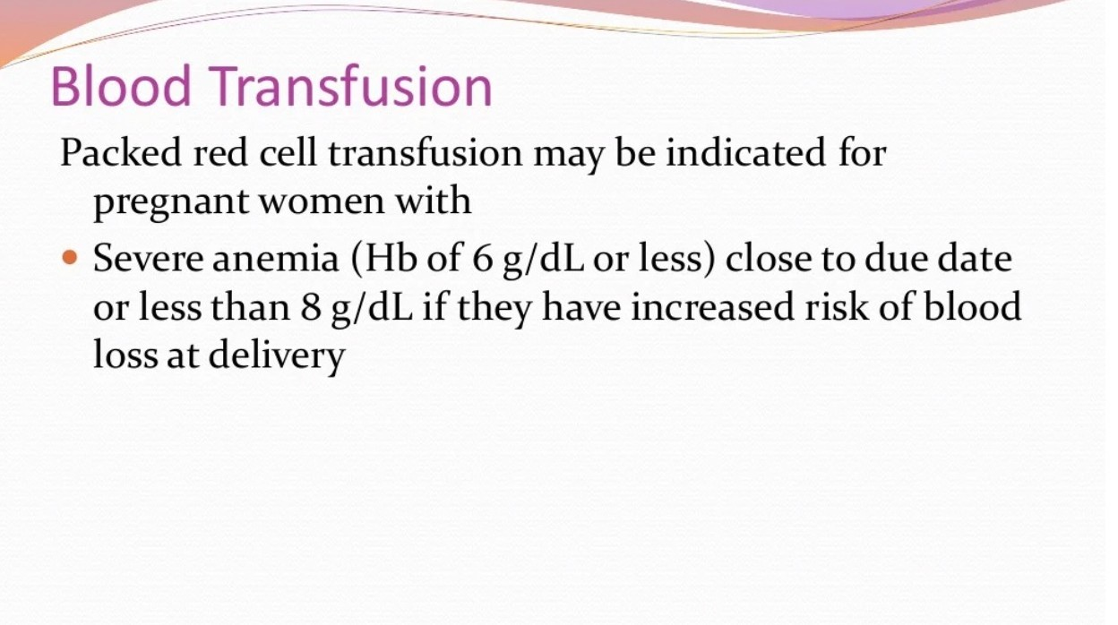

Caption
Caption

Slide 31
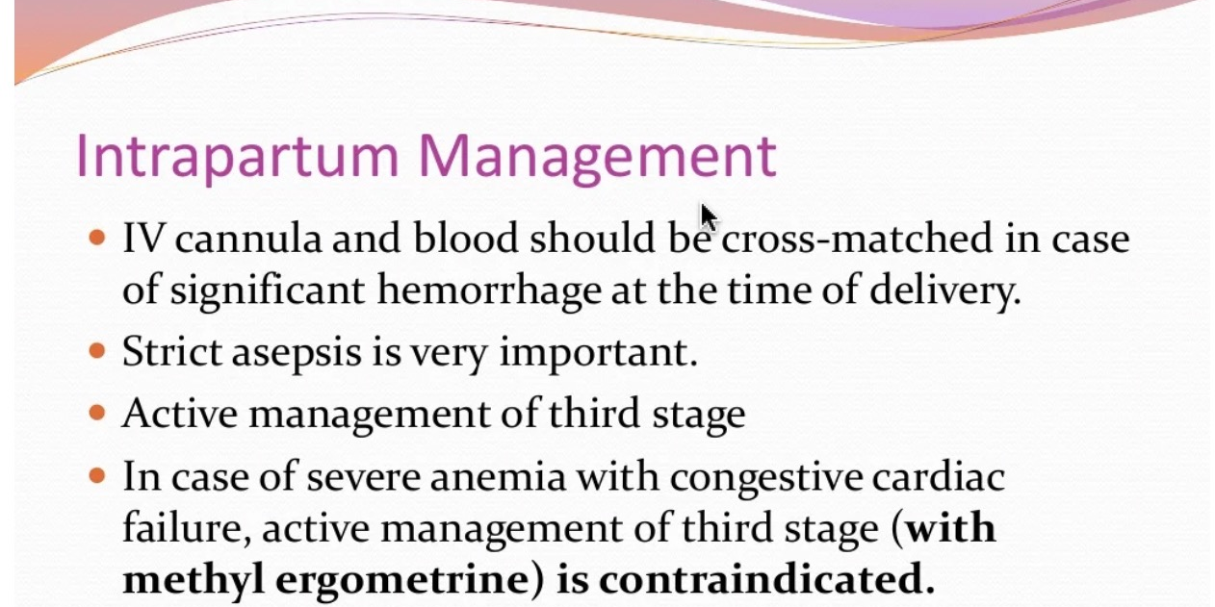

Caption

Slide 32
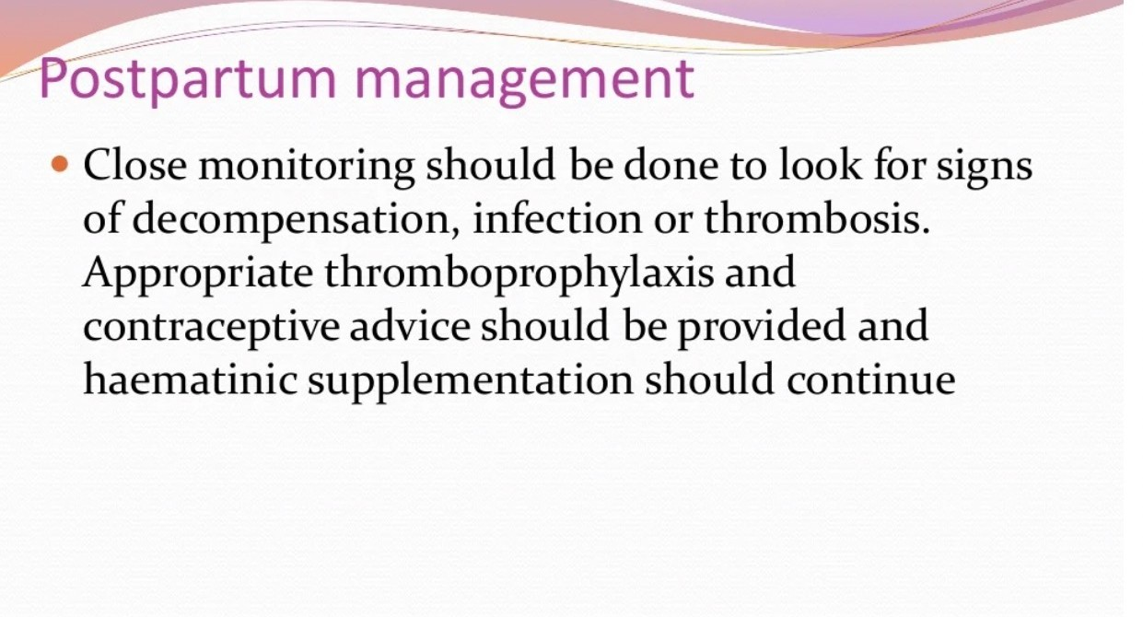
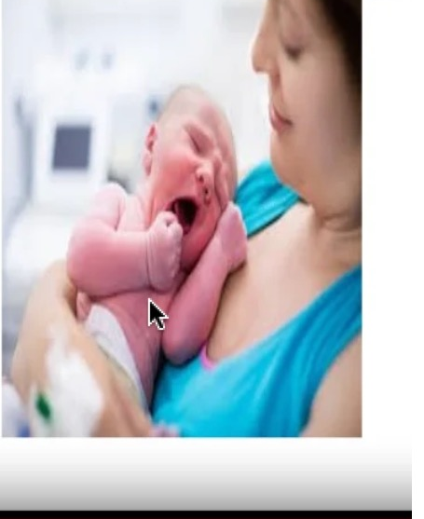
Caption
Caption

Slide 33
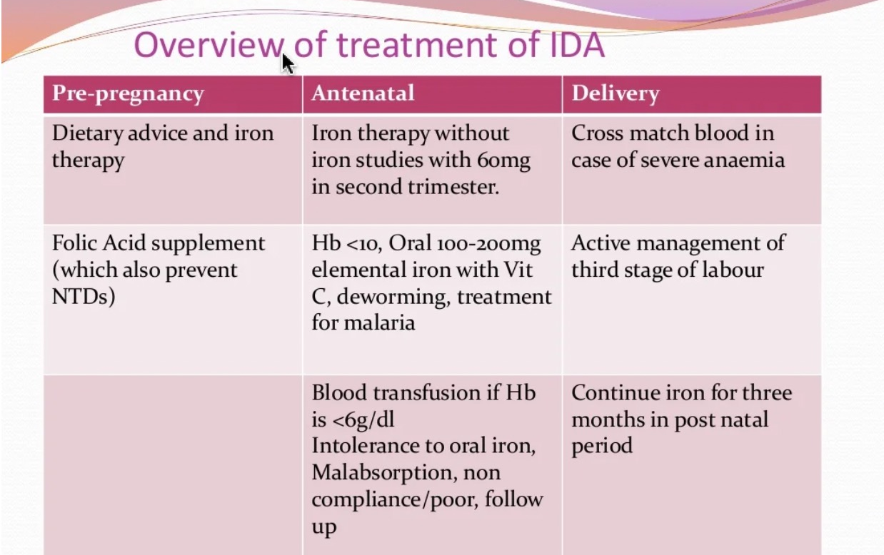

Slide 34
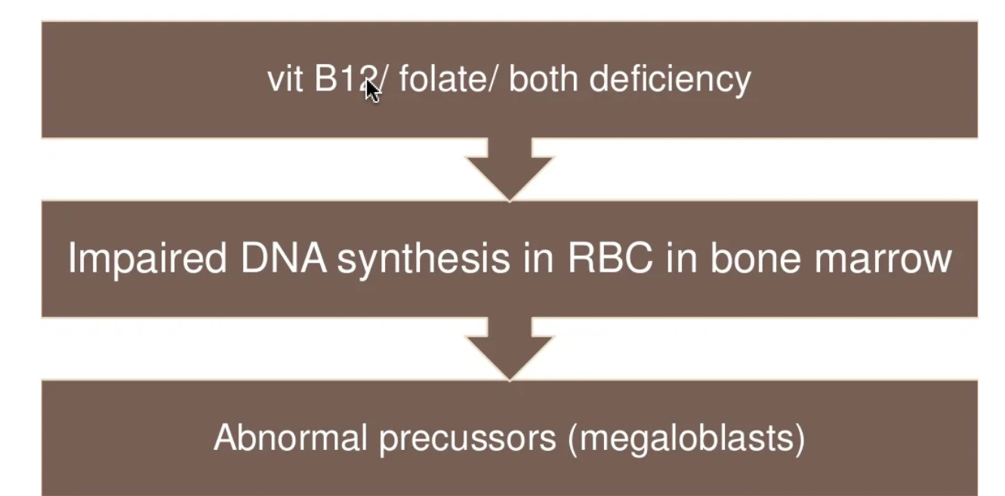
MEGALOBALSTIC ANEMIA
Caption

Slide 35
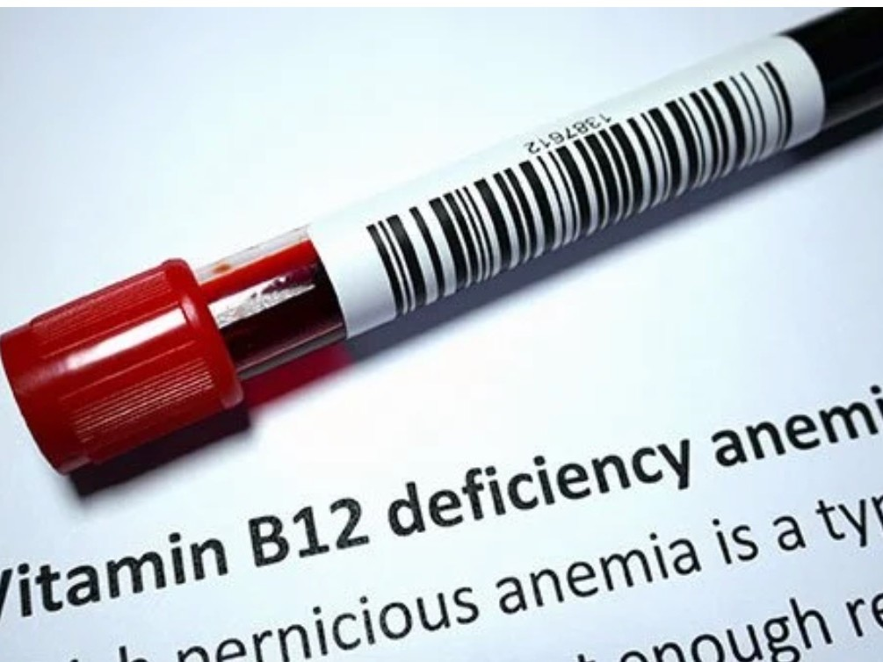
CAUSES
B12 DEFICIENCY | FOLATE DEFICIENCY
Vegetarian diet | Inadequate intake
Ileal bypass/ gaterectomy | Inc demand (Infection,Haemorrage)
Gastritis | Dec storage VitCdef, liver disorders
Crohns disease | Dec Absorption
Drugs: metformin ,PPI | Drugs Anti epilepetics
Caption

Slide 36
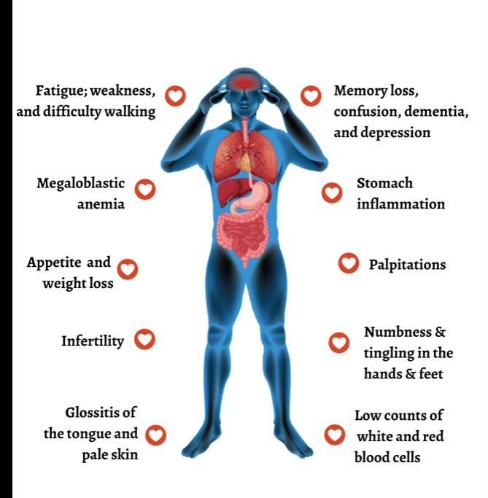
CLINICAL FEATURES
Insidious onset
First detected in last trimester/ puerperium
Diahrea/ vomiting
Anorexia

Slide 37
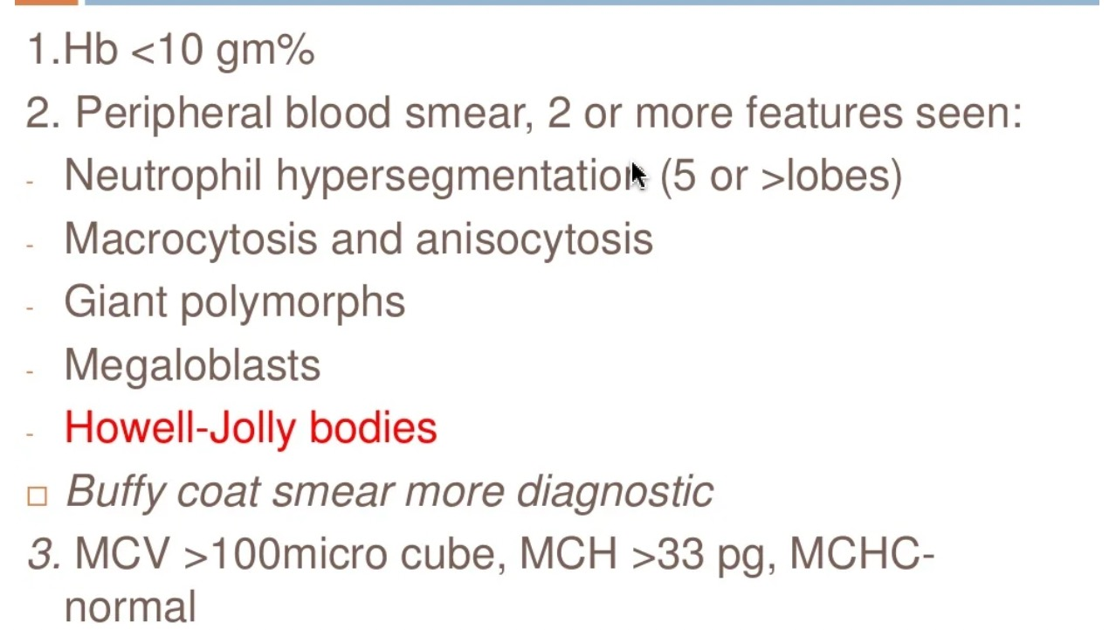
Diagnosis

Slide 38
Serum folate levels <50mg/ml
Serum B12 levels < 90 pg/ml
Thrombocytopenia and decreased TLC may also be present

Slide 39
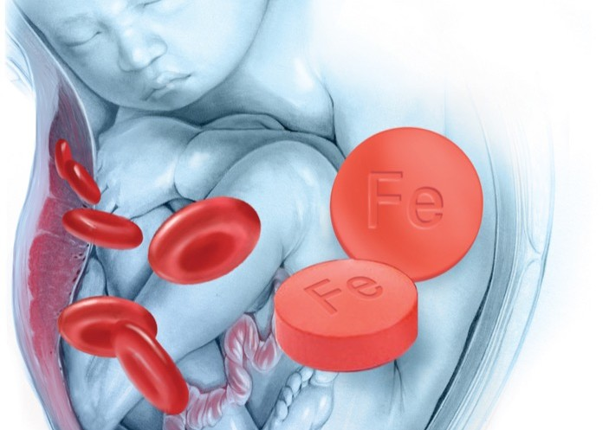
Effect on pregnancy
Congenital defects (cleft palate, NTD)
IUGR
Preterm labour
Placental abruption
Caption

Slide 40
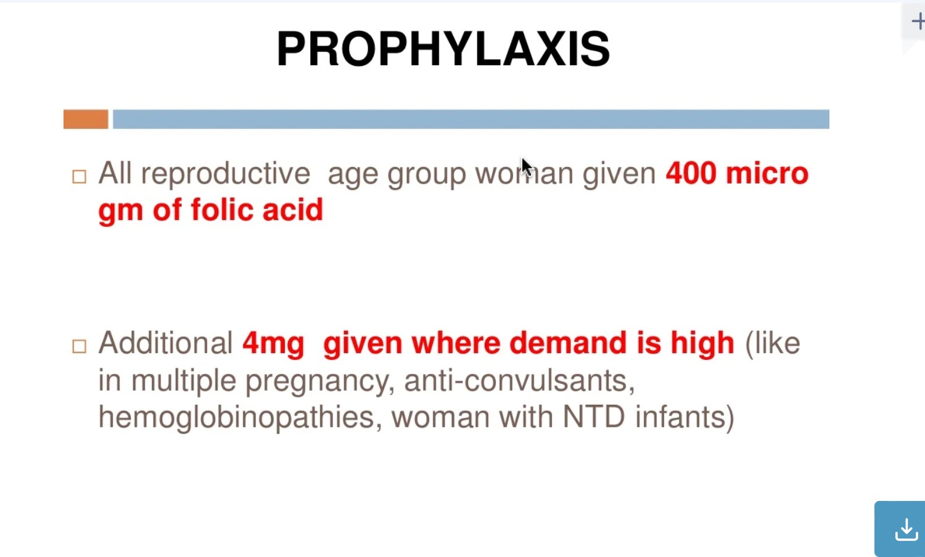
Caption

Slide 41
MANAGEMENT
Daily administration of folic acid 5mg
Continued until 4weeks postpartum
Recommended daily intake of B12 is 2.6ug/day
Parental cynocobalamin 1mg three times a week for 2 weeks with once every three weekly

Slide 42
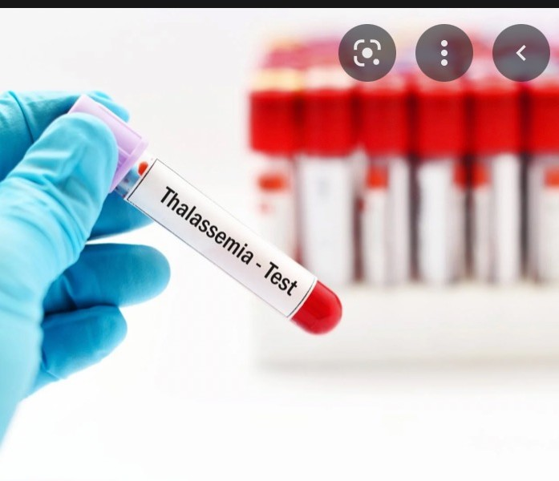
HEMOGLOBINOPATHIES
Structural disorders(sickle cells disease)
Thalassemia: quantitative disorder of globin chain synthesis @-thalassemia: reduced @globin chain
Beta-thalassemia: reduced B chain
Caption

Slide 43
B-thalassemia
Two copies of B globin genes.
Clinical manisfestations of B thalassemia depends on the inherited genetic mutation and is classified into
B thalassemia minor/trait
B thalassemia intermedia B thalassemia major

Slide 44
CLINICAL FEATURES
Minor: usually asymptomatic or iron deficiency anemia
Intermedia: iron deficiency anemia or sometimes blood transfusions
Major: unable to produce normal hemoglobin. Lifelong red cell transfusions

Slide 45
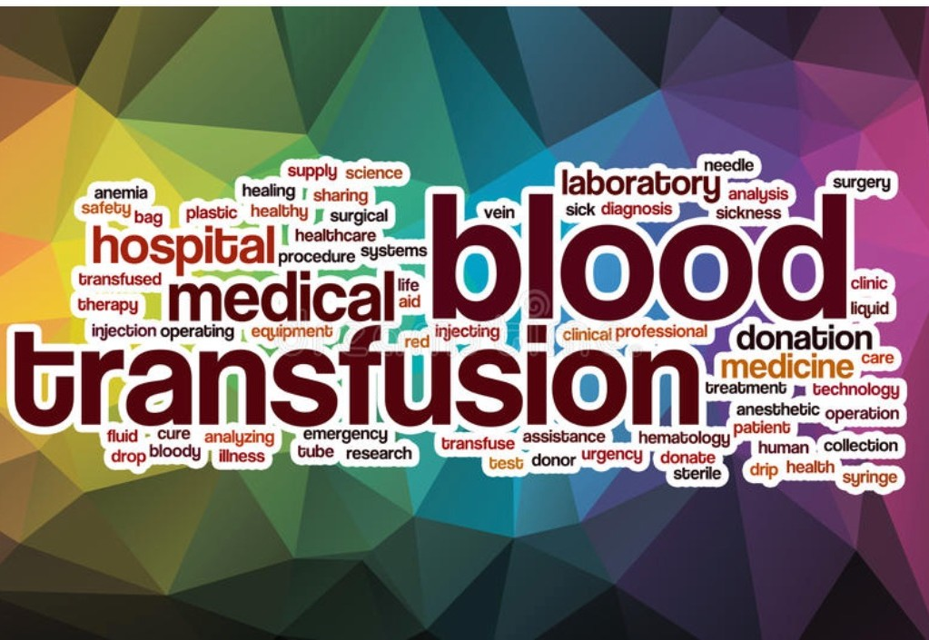
Diagnosis and Management
Patient education
Partner testing
Blood complete picture
Hemoglobin electrophoresis
Folic acid 5mg daily
Blood transfusions( aim is 10g/dl)
Iron therapy only if iron studies show iron deficiency
Iron chelation if iron overload
Splenectomy rarely required during pregnancy

Slide 46
Recent advances
Georgieff MK. Iron deficiency in pregnancy. Am J Obstet Gynecol. 2020 Oct;223(4):516-524. doi: 10.1016/j.ajog.2020.03.006. Epub 2020 Mar 14. PMID: 32184147; PMCID: PMC7492370
James AH. Iron Deficiency Anemia in Pregnancy. Obstet Gynecol. 2021 Oct 1;138(4):663-674. doi: 10.1097/AOG.0000000000004559. PMID: 34623079.

Slide 47
BIOMEDICAL ETHICS
Check compliance with Iron and calcium on every antenatal visit
Anemia should be treated prepregnancy.
High risk patients should be referred timely to tertiary care facilities

Slide 48
FAMILY MEDICINE
Family Physicians and lady health visitors should know
Signs and symptoms of anemia.
Diagnosis and treatment of anemia.
Timely referral of high-risk cases can prevent maternal,and perinatal mortality and morbidity

Slide 49
THANK YOU

