Slide 1
Vibrio cholera, klebsiela and shigella Microbe Module 3rd Year MBBS
Dr Kiran Fatima
Pathology Department
Rawalpindi Medical University

Slide 2
Motto of RMU

Slide 3
Vision of RMU
The Dream/ Tomorrow
To impart evidence based research oriented medical education
To provide best possible patient care
To inculcate the values of mutual respect and ethical practice of
medicine

Slide 4
Learning objectives
At the end of this session, a student should be able to
Understand;
Pathogenesis, lab diagnosis and treatment of of vibrio cholera
Pathogenesis and lab diagnosis of klebsiela
Pathogenesis and lab diagnosis of shigela

Slide 5
Study questions
How will you classify vibrio cholera?
How do you make laboratory diagnosis of cholera?
How will you treat a patient of cholera?
What are the characteristics of Klebsiella pneumonia?
How will you diagnose Klebsiella pneumonia?
How will you treat Klebsiella pneuomonia?
What is the pathogenesis of Shiegela infection?
How will you make lab diagnosis of Shiegela infection?
How will you treat Shiegela infection?
How will you prevenet Shiegela infection?

Slide 6
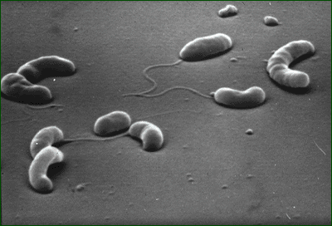
Identification
Core
Vibrios are highly motile, gram-negative, curved or comma-shaped rods with a single polar flagellum

Slide 7
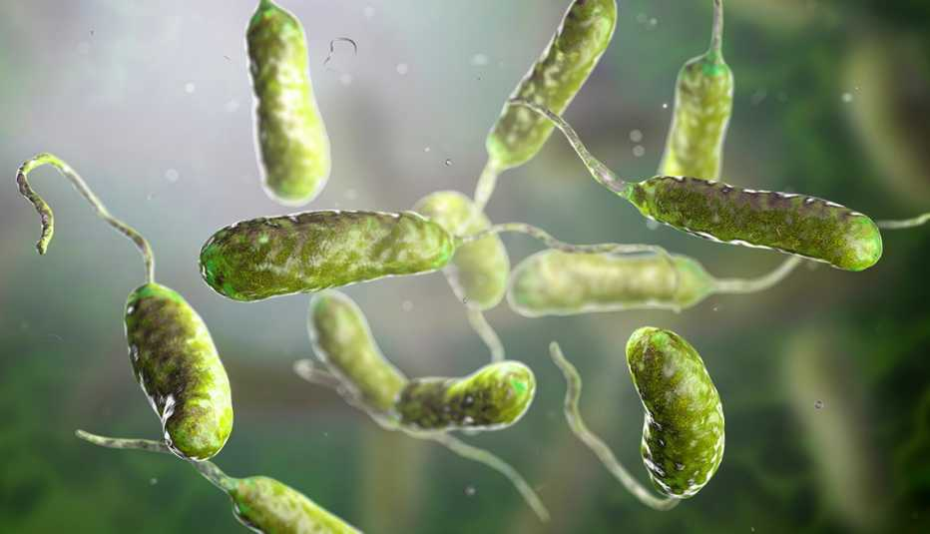
spiral

Slide 8
Cholerae serological
Classification
Core
Toxigeaic: V. choleme
Division into 1 e idemid sero
0139
inaba ogawa h|kojima
A6 C-” |  | (x.Ittle C)”Aritige»s |  | A, B, C
11

Slide 9
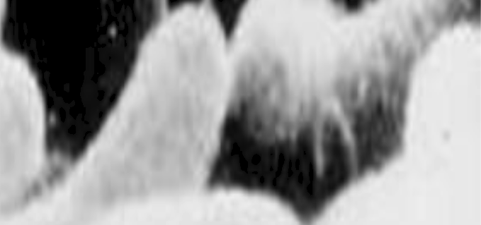
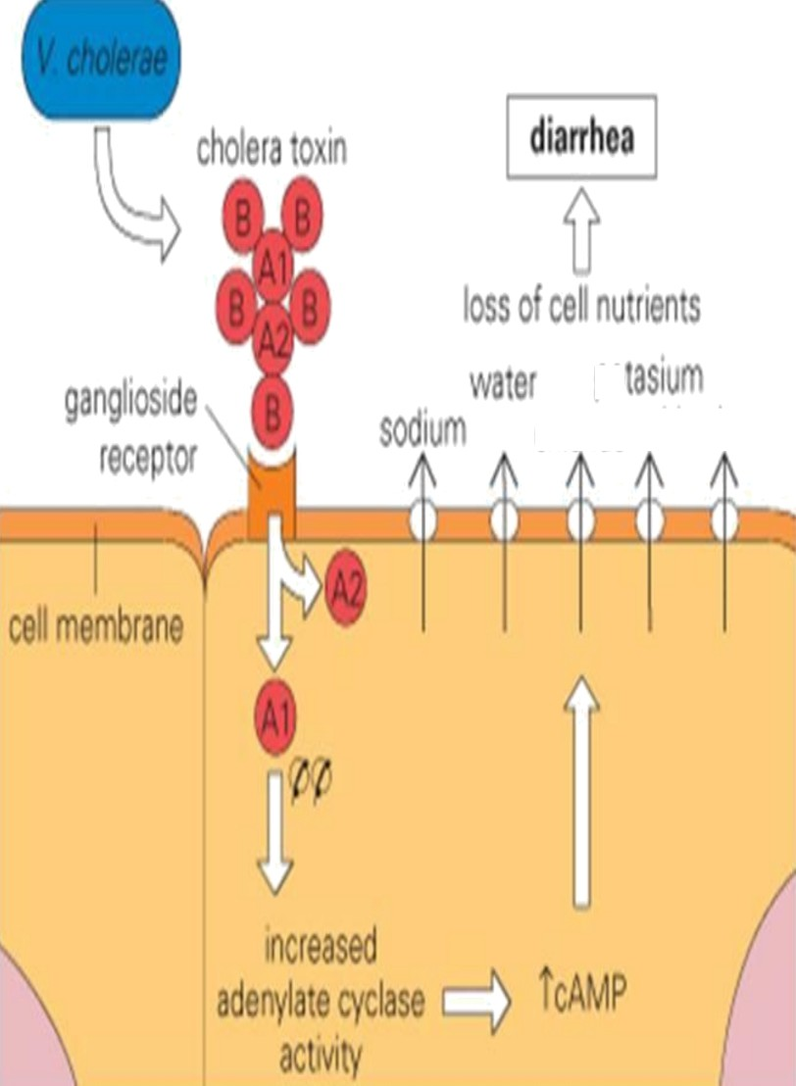
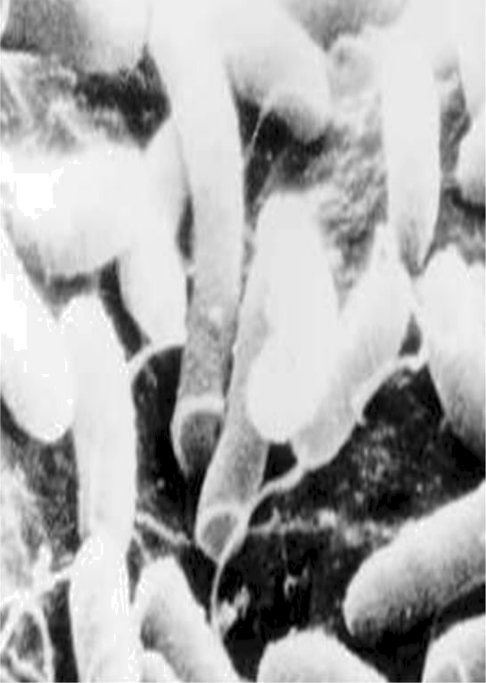
chlgriğę
Core
ğO
tiCâit0 ât8

Slide 10
Lab diagnosis

Slide 11
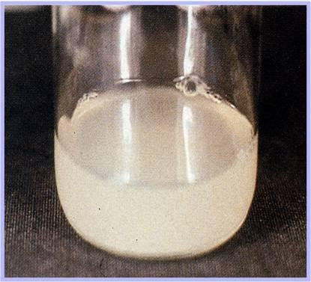
SPECIMEN: Rice water Stool
Core

Slide 12
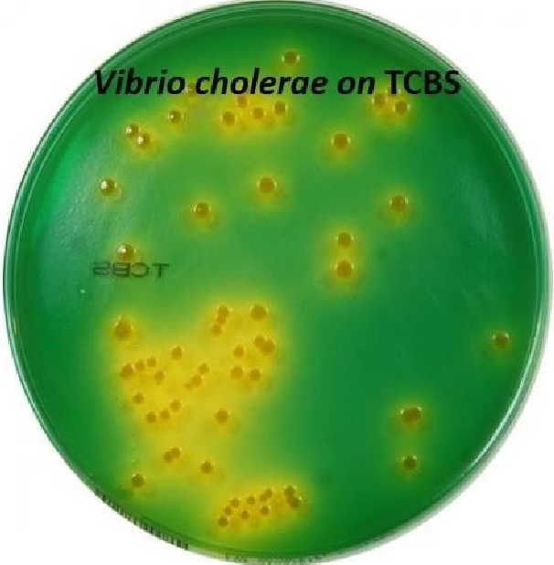

Slide 13
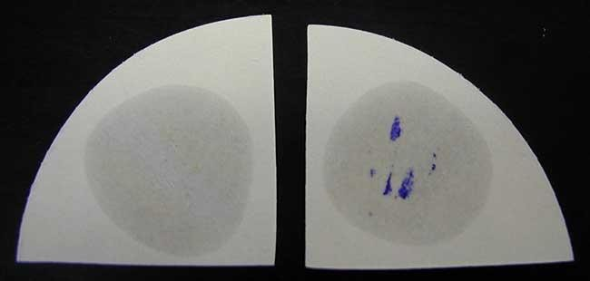
OXIDASE TEST : POSITIVE

Slide 14
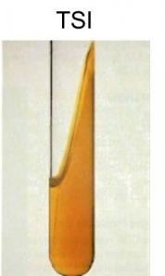
TSI

Slide 15
Treatment
Vertical
Even before identifying cause of disease, rehydration therapy must begin Immediately because death can occur within hours
Oral rehydration Intravenous rehydration

Slide 16
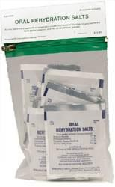
Treatment:continued
Core
ORS Reduces mortality from over 50% to less than 1%
Packets of Oral Rehydration Salts Distributed by WHO, UNICEF Dissolve in 1 L water
NaCl, KCl, NaHCO₃, glucose
Use of antibiotics such as vibramycin

Slide 17
Klebsiella pneumoniae

Slide 18
Characteristics
Core
Facultative aerobes
Gram-negative rods
Large polysaccharide capsule
Lactose fermenter
Mucoid colonies on Mac conkey's agar

Slide 19
Diseases
Core
Pneumonia
UTI
Sepsis
wound infections
VAP

Slide 20
Habitat
Core
Colonize the human upper respiratory and enteric tracts

Slide 21
Transmission
Core
Inhalation of respiratory droplets/ colonization of
upper respiratory tract
Direct transmission
IV or Urinary catheters

Slide 22
Virulence factors/ pathogenesis
Core
Capsule
Antiphagoctic properties
Fimbria
Attachment to mucosal surfaces and biofilm formation
Biofilm formation
Resistant to killing by host and antibiotics

Slide 23
Core
Siderophores
Iron scanvengers, deplete essential iron from body. Helps in colonization
Urease
Precipitation of inorganic salts on catheter surfaces (encrustation)

Slide 24
Core
Antibiotic resistance
Limits to a few options for treatment

Slide 25
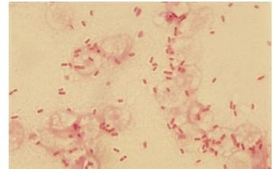
Laboratory Diagnosis
Core
Specimens:
Blood, CSF, Urine, BAL, Sputum (Current jelly sputum), Pus, Pus swab, Pleural fluid
Gram Staining
Gram positive bacilli

Slide 26
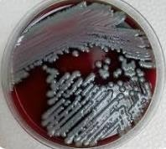
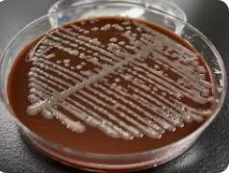
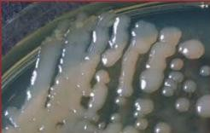
Core
Culture Media
Non selective media
Chocolate agar
Blood agar
Nutrient agar

Slide 27
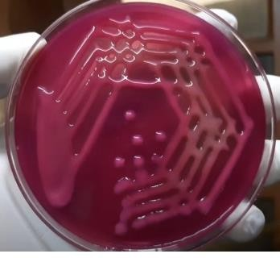
Core
Selective media
Mac Conkey agar

Slide 28
Core
TSI

Slide 29
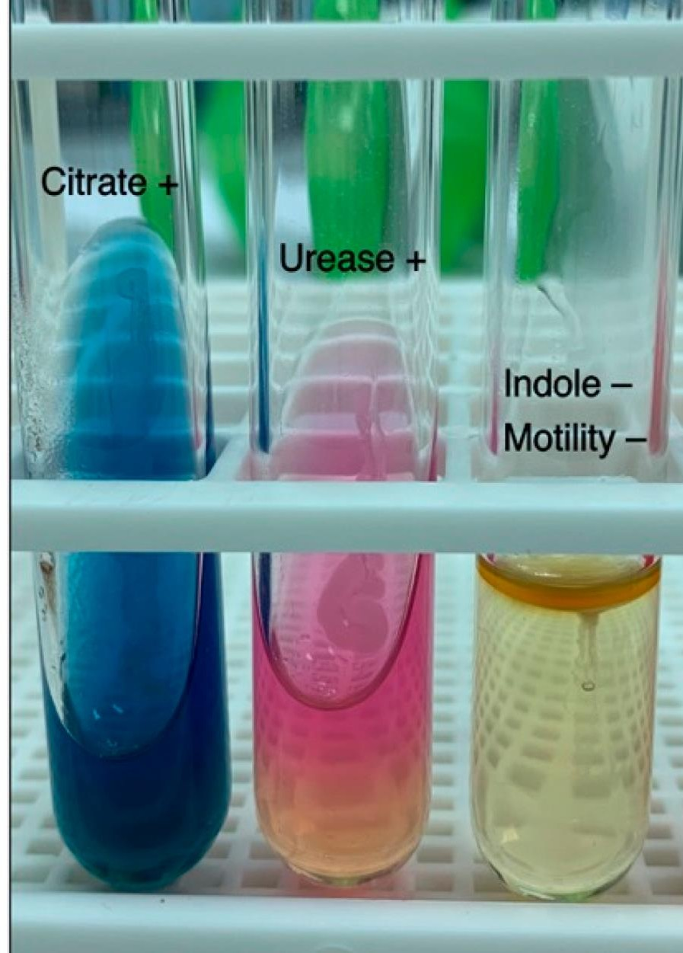
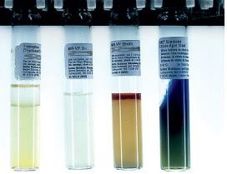
Core
• Biochemical tests
IMViC

Slide 30
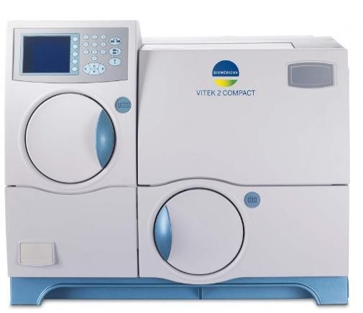
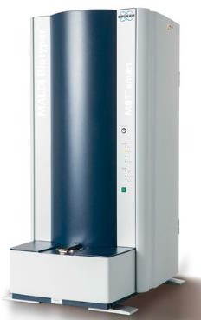
Core
Automated systems
Vitek-2
Maldi tof

Slide 31
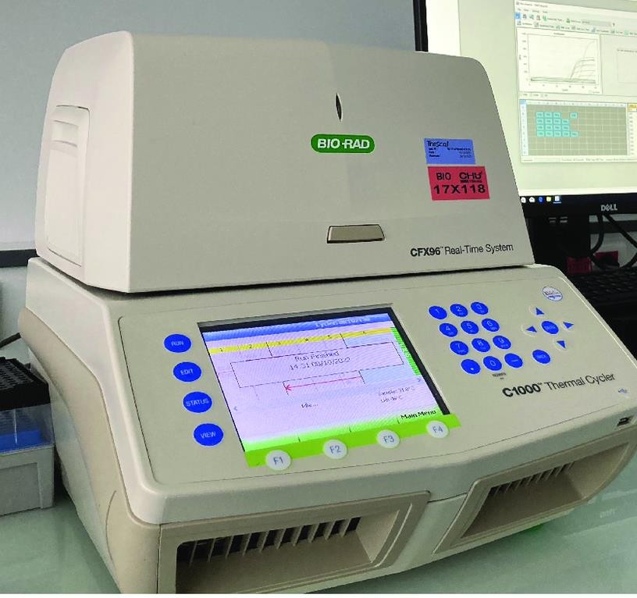
Core
Molecular methods
PCR
NAAT
WGS

Slide 32
Treatment
vertical
Do antibiotic sensitivity testing
Resistance is mediated by plasmid-encoded
Enzymes, especially β-lactamase

Slide 33
Prevention
longitudinal
No vaccine or drug is available
Urinary and intravenous catheters should be removed promptly
Good hygiene
Health education and training of staff and patients

Slide 34
longitudinal
Hand hygiene/washing
Before preparing or eating food
Before touching their eyes, nose, or mouth
Before and after changing wound dressings or bandages
After using the restroom

Slide 35
longitudinal
After blowing their nose, coughing, or sneezing
After touching hospital surfaces such as bed rails, bedside tables, doorknobs, remote controls, or the cell phone

Slide 36
Shigella

Slide 37
Characteristics
Core
Enterobacteriaciae
Gram – negative bacilli
Non – motile
Non – lactose fermenter
H2s – negative
Capsule (k-antigen)
O – somatic antigen
Can cause bacillary dysentery and shigellosis

Slide 38
Epidemiology
Core
Human
Fecal – oral route
( Water , food , feces , flies )
Person – person contact
Childhood
Id : 10 - 100 organisms
High infectivity
Ip - 1– 4 days
Source - cases , carriers
Daycare centers, mental inst. Travel , homosexeual

Slide 39
Pathogenesis
Core
Enteroinvasive
Colonic mucosa
Tissue damage
ULCERS
Exotoxin (shiga toxin ) – sh. Dysenteriae
Enterotoxin (absorption)
Cytotoxin ( a – 5 b)
Neurotoxin (nerve damage)
B - Subunit
A – subunit
Glycolipids
60s ribosomal
Subunit. Inactivation inhibition of protein synthesis . – cell death

Slide 40
Diagnosis
Core
1 - Culture stool rectal swbs
Macconkey agar
Dca , xld
Selenite f broth
NLF
Microscopy : leucocytes , rbc
Biochemical : tsi - no gas, h2s , acid
Non motile
Serology test : slid

Slide 41
Core
øn nfatc•ñ
control
ftfgØłfø 9onnei
ASM MicrobeLibrary.org@CŁ\amber!ain

Slide 42
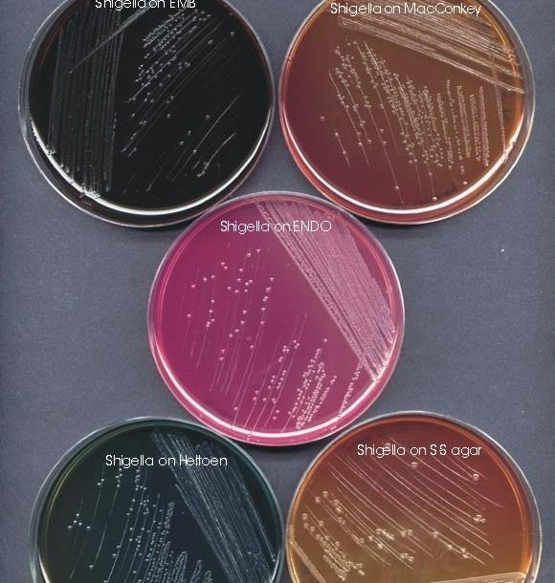

Slide 43
Treatment
vertical
Mild illness
Short ( 48 – 72 h)
Sh . sonnei
Bacillary dysentery
Antimicrobial therapy ( shorten the duration ,
Prevent spread)
Ampicillin (plasmid resistance)
Cotrimoxazole (res.)
Ciprofloxacin
Ceftriaxone
REHYDRATION

Slide 44
Prevention
longitudinal
Supply of pure water
Personal hygiene ( hands)
Sewage disposal
Food hygiene
Insect control (flies)
Vaccine (oral) - 6 months

Slide 45
Take home message
Vibrio: Gram-negative, comma-shaped bacteria, often found in aquatic environments. Some species are halophilic (require salt). V. cholerae is the causative agent of cholera.
Cholera: An acute diarrheal illness caused by V. cholerae that produces a potent enterotoxin. Characterized by profuse watery diarrhea, dehydration, and electrolyte imbalance. Treatment includes rehydration therapy.
Klebsiella: Gram-negative, encapsulated bacteria, commonly found in the environment and as part of the normal human flora. K. pneumoniae is an opportunistic pathogen that can cause pneumonia, UTIs, and other infections, often exhibiting antibiotic resistance.

Slide 46
Family medicine
A 35-year-old male presents to the emergency department with profuse watery diarrhea, vomiting, and severe dehydration after attending a seafood festival. He reports consuming raw oysters. Stool cultures are positive for a gram-negative, comma-shaped bacterium that is oxidase-positive and grows on thiosulfate-citrate-bile-sucrose (TCBS) agar. Which of the following is the most likely causative organism?
A. Escherichia coli B. Salmonella typhi C. Vibrio cholerae D. Klebsiella pneumoniae
Answer: C. Vibrio cholerae

Slide 47
Research
https://www.sciencedirect.com/topics/food-science/vibrio
VIBRIO | Introduction, Including Vibrio parahaemolyticus, Vibrio vulnificus, and Other Vibrio Species
J.L. Jones, in Encyclopedia of Food Microbiology (Second Edition), 2014
Overview of the Genus Vibrio
The genus Vibrio is a large group of ubiquitous aquatic bacteria, with nearly 100 individual species currently identified. They can be found as planktonic, free-living organisms but frequently are associated with plankton or aquatic animals, particularly invertebrates. This suggests that most of the members of the genus commonly can be found in or on most seafood products. Fortunately, only a few vibrios have been associated with human illness; most notably Vibrio parahaemolyticus, Vibrio vulnificus, and the type strain of the genus, Vibrio cholerae.

Slide 48
Thank You!!!

