Slide 1
CRYPTOrCHIDisM
Dr ali raza Chaudhry
Senior registrar
Paediatric surgery
Rmu hfh Rawalpiundi

Slide 2
Learning Objectives
At The End Of This Lecture Students Shall Be Able To Learn The:
Anatomy Of Testis
Embryology
Classification of undescended testis
Examination
Investigations
Risks
Medical And Surgical Management
Recent Advances

Slide 3
Anatomy

Slide 4
Blood Supply of testis

Slide 5
Embryology

Slide 7
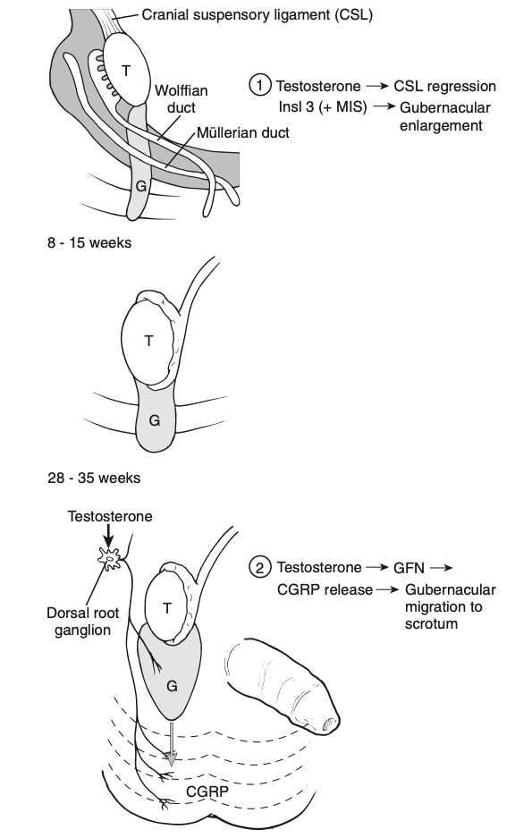
Descent of testis
Abdominal testicular descent
Migratory inguinoscrotal phase
Major Hormones ( INSL3, Testosterone)
Major Anatomical players ( CSL , Gubernaculum)

Slide 8
Animation
https://youtu.be/6PcerMP9bFM

Slide 9
Classification
Undescended Testis
Ectopic Testis
Retractile Testis
Ascending Testis

Slide 10
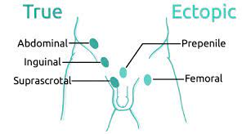
CRYPTOCHIDISM / UNDESCENDED TESTES
“Cryptorchidism is a congenital absence of one or both testes in the scrotum
due to a failure of the testes to descend during development.”

Slide 11
Types
Cryptorchidism can broadly be Classified as :
True undescended testis: where testis is absent from the scrotum but lies along the line of testicular descent /Ectopic testis: where the testis is found away from the normal path of decent.
OR
Palpable/Non Palpable
OR
Congenital/Acquired

Slide 12
Points to ponder
Why testis are anatomicaly placed out side the body?
What will happen if testis is maldescended?
What is the significance of testis in sexual life?
What will happen if one testis is undescended and what if bilateral are undescended?

Slide 13
INcidence
Premature with LBW(<2.5KG) 33% to 45%
Mature (full term , Normal weight) 3%
Falls to 1% at 6-12 months.
Descent after 12 months is unlikely.
Other risk factors are:
Familial , Maternal , Iatrogenic , idiopathic.

Slide 14
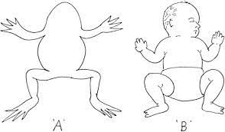
Diagnosis
History
Term/premature ?
Was the testis in scrotum at birth?
Has the parent ever noticed the testis in scrotum at any point?
Examination
Warm room and hands, Supine or Frog legged.
Inspection (Scrotum development)
Palpation (80% are palpable, high scrotal, canalicular, ectopic)

Slide 15
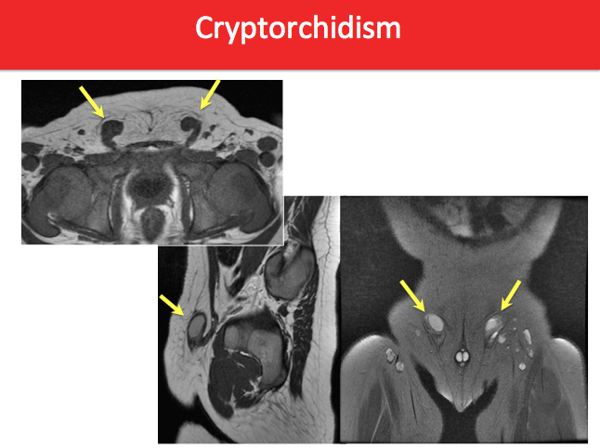
IMAGING
Rarely Helpful
USG
MRI

Slide 16
RISKS
Fertility
Infertility in men with Hx of UDT (U/L) similar to normal men.
With B/L UDT + Early correction (50% to 65% paternity rate)
Causes include
Sertoli/Lydig cells under developed/nonfunctional
Wolffian abnormalities (Vasal/Epididymal)
Temperature

Slide 17
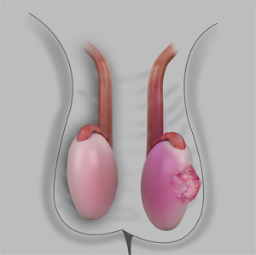
RISKS
Malignancy:
10% of all adults with testicular cancer have h/o UDT.
2 to 8 fold increase in risk of malignancy
Intra abdominal > Inguinal.

Slide 18
Management Alogrithm:
UNILATERALY PALPABLE
UNILATERAL NON PALPABLE
DARTOS POUCH ORCHIDOPEXY
LAPROSCOPY
ABORT
BLIND VESSELS
INTRA ABDOMINAL TESTIS
VESSELS EXITING RING
STAGED ORCHIDOPEXY
ORCHIDOPEXY
ORCHRCHIDECTOMY
INGUINAL EXPLORATION

Slide 19
Recent Advances
https://www.ncbi.nlm.nih.gov/pmc/articles/PMC9363670/
https://www.auanet.org/guidelines-and-quality/guidelines/cryptorchidism-guideline

Slide 20
Biomedical ethics
Therapy for an undescended testicle should begin between six months of age and may consist of hormone or surgical treatment.
By six months of age, patients with undescended testicles should be evaluated by a pediatric surgeon.
Earlier referral may be warranted for bilateral nonpalpable testes.

Slide 21
Family medicine
At birth of a male child external genitalia should be examined and referred to paediatric surgeon if the testis is/are not palpable
Early diagnosis and management of the undescended testicle is needed

Slide 22
Thank you

