Slide 1
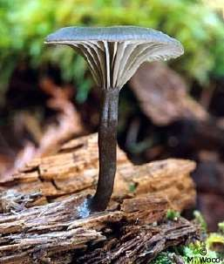
Mycology Microbe Module 3rd Year MBBS
BY:
Dr. Kiran Fatima
Pathology Department
Rawalpindi Medical University

Slide 5
Learning outcomes
By the end of this lecture, you will be able to:
Identify different types of mycosis.
Explain the symptoms commonly associated infections.
Explain the importance of early diagnosis
Discuss treatment options for mycosis, including topical and oral antifungal medications.
Different type of antifungal drugs, their mechanism of action, resistance and their uses.

Slide 6
Learning resources
Robbins & cotran pathologic basis of disease 10th edition

Slide 7
Pathology Spiral
Fungi are eukaryotic organisms, do not contain chlorophyll, have cell walls, filamentous structures, and produce spores.
Grow as saprophytes and decompose dead organic matter. Between 100,000 to 200,000 species depending on how they are classified.
About 300 species are presently known to be pathogenic for man.

Slide 8
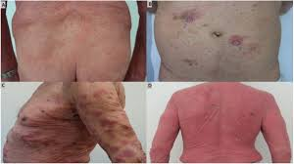
spiral

Slide 9
Features | Pathology Fungi | Spiral Bacteria
Nucleus | eukaryotic | prokaryotic
Cell membrane | Sterols present | absent
Cytoplasm | Mitochondria and ER present | Absent
Cell wall content | Chitin | Peptidoglycan
Spores | Sexual asexual | Endospores

Slide 10
Types
Core
Yeasts 2. Molds.
Yeasts grow as single cells , reproduce by budding.
Molds grow by filamentous hyphae, and form a mat ( mycelium). Form septate and aseptate hyphae.

Slide 11
Pathology
Core
Several medically imp. Fungi are thermally
Diamorphic.
i.e, different structures at different temperatures.
Molds in environment at ambient temperatures and as yeasts at body temperature.

Slide 12
There are four types of Mycotic diseases:
Pathology
Core
Hypersensitivity - allergic reaction to molds and spores.
Mycotoxicoses - poisoning of man and animals by feeds and food products contaminated by fungi producing toxins from the grain substrate.
Mycetismus- ingestion of preformed toxin (mushroom poisoning).
Infections.
In this lecture , we shall be concerned only with the last type.

Slide 13
. Clinical classification of the mycoses
Pathology Core
Superficial mycoses
Subcutaneous mycoses
Systemic mycoses
Opportunistic mycoses

Slide 14
Pathology
Core
a. Superficial mycoses
(or cutaneous mycoses) are fungal diseases that are confined to the outer layers of the skin, nail, or hair, (keratinized layers) rarely invading the deeper tissue or viscera. The fungi involved are called dermatophytes

Slide 15
b. Subcutaneous mycoses are confined to the subcutaneous tissue rarely spread systemically.
Pathology Core
Form deep, ulcerated skin lesions or fungating masses, most commonly involving the lower extremities.
Causative organisms are soil saprophytes which are introduced through trauma to the feet or legs.

Slide 16
c. Systemic mycoses may involve deep viscera and become widely disseminated.
Pathology
Core
Each fungus type has its own predilection for various organs.

Slide 17
d. Opportunistic mycoses
Pathology
Core
Are infections due to fungi with low inherent virulence.
The etiologic agents are organisms which are common in all environments.

Slide 18
Systemic Mycosis
Pathology
Core
Cocciodioides immitis.
Histoplasma
Blastomyces
Paracoccidiodes

Slide 19
Pathology
Core

Slide 20
Pathology
Core

Slide 21
Pathology
Core

Slide 22
Pathology
Core

Slide 23
Pathology
Core

Slide 24
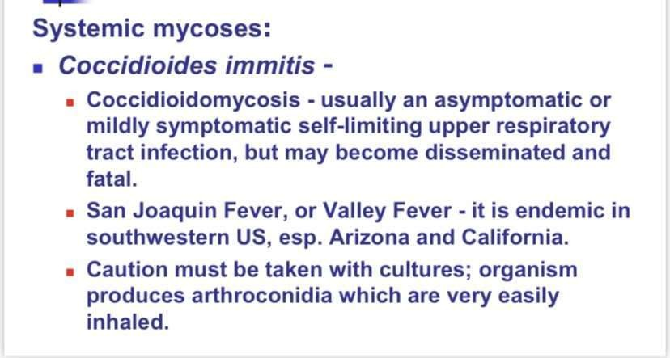
Pathology
Core

Slide 25
Pathology
Core

Slide 26
B. Cryptococcosis (cryptococcus neoformans)
Core
Meningitis or pulmonary disease.
Portal of entry is the respiratory system.
Infection subacute or chronic.. symptoms begin with vision problems and headache, then progress to delirium, nuchal rigidity leading to coma and death .
CSF is examined for chemistry (elevated protein and decreased glucose), cells (usually monocytes), and evidence of the organism.
Visual demonstration of the organism (India Ink preparation) The India Ink test, which demonstrates the capsule of this yeast

Slide 27
Pathology
Core
Cryptococcosis of lung in patient with AIDS.

Slide 28
A. Candidiasis (candida albicans)
Pathology Core
Candidiasis. Candida albicans , endogenous organism.found in 40-80% of normal human beings.
Present in the mouth, gut, and vagina,
Commensal or a pathogenic organism.
Usually some alteration in cellular immunity, normal flora or normal physiology. Although it most frequently infects the skin and mucosae, Candida can cause pneumonia, septicemia or endocarditis in the immuno-compromised patient

Slide 29
Pathology
Core
Gram-stain of vaginal smear showing Candida albicans epithelial cells and many gram-negative rods. (1,000X oil)

Slide 30
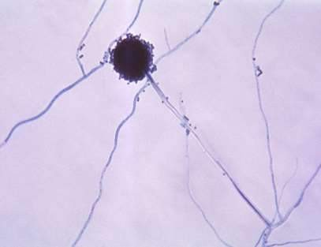
Aspergillus:
Pathology
Core
Aspergillus (is a genus consisting of several hundred mold species found in various climates worldwide

Slide 31
The most common pathogenic species
Pathology
Core
The most common causing pathogenic species are
Aspergillus fumigatus : causing allergic disease
Aspergillus flavus.,produces aflatoxin which is both a toxin and a carcinogen, and which can potentially contaminate foods such as nuts.
Other species are important as agricultural pathogens.
Aspergillus spp. cause disease on many grain crops, especially maize, and synthesize mycotoxins including aflatoxin.

Slide 32
Pathology
Core
Aspergillosis
Pulmonary aspergillosis.
Aspergillosis is the group of diseases caused by Aspergillus. The most common subtype among paranasal sinus infections associated with aspergillosis is Aspergillus fumigatus.
symptoms: include fever, cough, chest pain or breathlessness, Usually, only patients with already weakened immune systems or who suffer other lung conditions are susceptible.

Slide 33
Major forms of disease
Pathology Core
Allergic bronchopulmonary aspergillosis or ABPA, which affects patients with respiratory diseases like asthma, cystic fibrosis, and sinusitis).
Acute invasive aspergillosis, a form that grows into surrounding tissue, more common in those with weakened immune systems such as AIDS or chemotherapy patients.
Disseminated invasive aspergillosis, an infection spread widely through the body.
Aspergilloma, a "fungus ball" that can form within cavities such as the lung

Slide 34
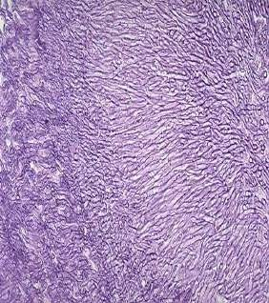
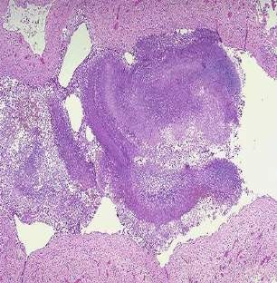
Fungus ball of aspergillus
Pathology
Core

Slide 35
Diagnosis
Pathology
vertical
Skin scrapings suspected to contain dermatophytes or pus from a lesion can be mounted in KOH on a slide and examined directly under the microscope.
Skin testing (dermal hypersensitivity).
Serology may be helpful when it is applied to a specific fungal disease.
Direct fluorescent microscopy may be used for identification.
Biopsy and histopathology.
Culture: Sabouraud dextrose agar.

Slide 36
Treatment
Pathology
Horizontal
The primary antifungal agents are:
Amphotericin B. drug of choice for most systemic fungal infection, administered I.V. (patient usually needs to be hospitalized), often for 2-3 months. The drug is rather toxic; thrombo- phlebitis, nephrotoxicity, fever, chills and anemia frequently occur during administration
Azoles: ketoconazole, fluconazole, oral.
Griseofulvin: slow-acting drug which is used for severe skin and nail infections, oral.
5-fluorocytosine:inhibits RNA synthesis, oral.

Slide 37
Pathology
core

Slide 38
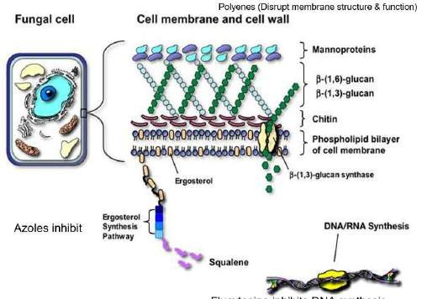
Pathology
core

Slide 39
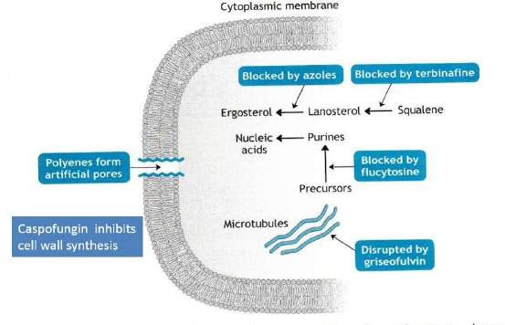
Pathology
core

Slide 40
Pathology
core

Slide 41
Pathology
core

Slide 42
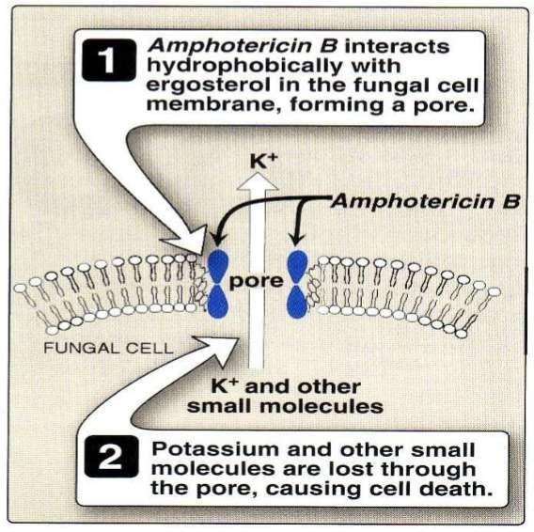
Mechanism of action
Pathology
core

Slide 43
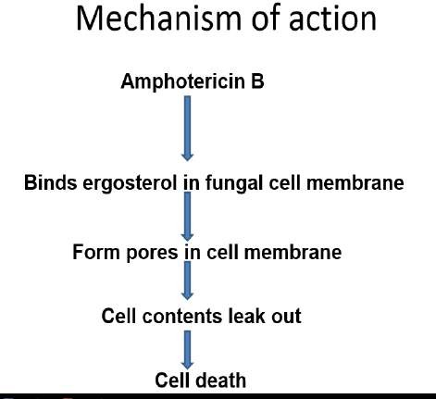
Pathology
core

Slide 44
Pathology
core

Slide 45
Pathology
core

Slide 46
Uses
Pathology
core

Slide 47
Pathology
core

Slide 48
Pathology
core

Slide 49
Pathology
core

Slide 50
Pathology
core

Slide 51
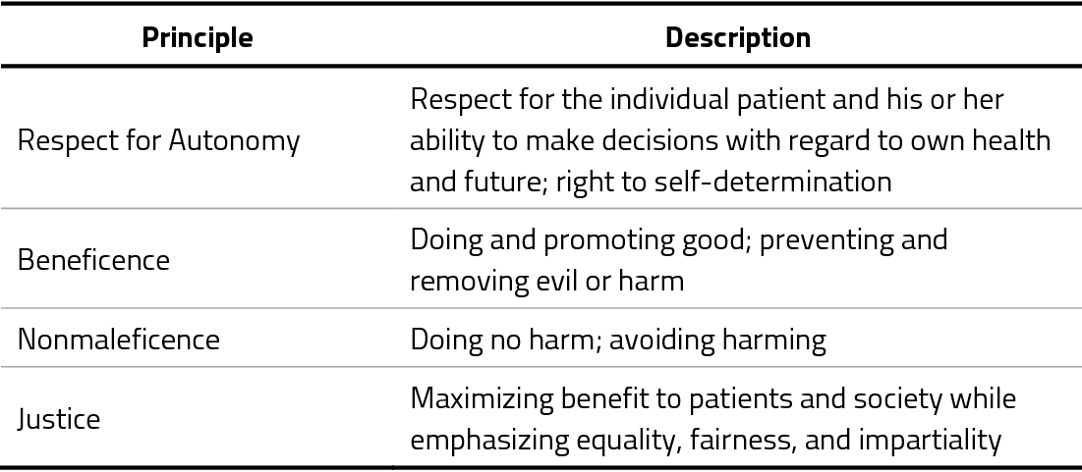
Bioethics
Longitudinal

Slide 52
Artificial intelligence
Longitudinal

Slide 53
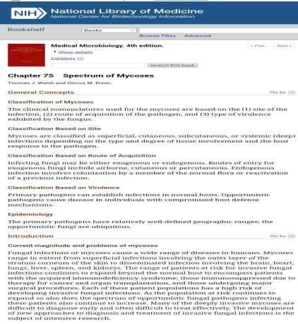
Longitudinal
Research
https://www.ncbi.nlm.nih.gov/books/NBK7902/

Slide 54
Family medicine
Longitudinal
Scenario-based MCQ
Maria notices white, flaky patches appearing between her toes, accompanied by itching and burning.
MCQ:
What type of mycosis is Maria most likely experiencing?
a) Aspergillosis (affects the lungs)
b) Athlete's foot (fungal infection of the feet) CORRECT
c) Vaginal yeast infection (specific to the genital area)

Slide 55
Take home message
Fungi can cause infections called mycoses, invading our skin, nails (think athlete's foot!), lungs, or even genitals (yeast infections!). Itchy, red, and uncomfortable symptoms can arise. Antifungal meds, topical or oral, fight back. Keeping clean and a healthy immune system are your best defense against these fungal foes!

