Slide 1
STURUCTURE OF BACTERIA
Microbe Module 3rd Year MBBS
By: Dr. Kiran Fatima
Pathology Department
Rawalpindi Medical University

Slide 4
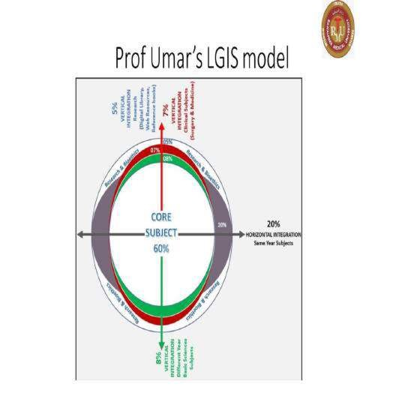

Slide 5
learning outcomes
After this lecture student will be able to understand;
What are the structural components of bacteria.
Difference between cell wall of gram
negative and gram positive bacteria.
Difference between eukaryotic cell and prokaryotic cell.
What are antibacterial drugs and bacterial
vaccines.

Slide 6
Learning resources
Levinson, W. Review of Medical Microbiology and Immunology. 15th ed. McGraw-Hill Education / Medical; 2020

Slide 7
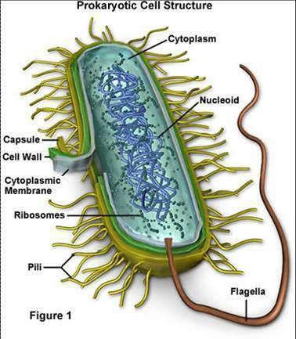
spiral

Slide 8
STRUCTURE OF BACTERIAL CELL(PROKARYOTE)
Pathology
core
CELL WALL
inner layer of peptidoglycan which provides support and maintains shape,found only in bacterial cell wall,except for mycoplasma which has cell membrane,good target for antibacterial drugs.Penicillins,cephalosporins,va ncomycin and lyzozymes cleave PPG
outer layer is variable

Slide 9
Gram positive cell wall
Pathology
core
Has thick layer of peptidoglycans
Techoic acid fibres protrude outside PPG,major surface antigens,induce septic shock

Slide 10
Gram negative cell wall
Pathology
core
Inner thin PPG layer
Complex outer layer of Lipopolysaccharides(endotoxin) Lipoproteins
Phospholipids
Periplasmic space contains B- lactamases that degrade penicillins and other B-lactam drugs

Slide 11
Cytoplasmic membrane
Pathology
core
Phospholipid bilayer
FUNCTIONS Active transport Energy generation Synthesis of cell wall
Secretion of enzymes and toxins

Slide 12
Mesosomes
Pathology
core
Invaginations of cell membrane
Imp in cell division

Slide 13
Ribosomes
Pathology
core
Related with protein synthesis
Bacterial ribosome is 70S in size,imp for antibiotic action

Slide 14
Granules
Pathology
core
Store nutrients
Stain characteristically with certain dyes

Slide 15
Nucleoid
Pathology
core
Area where DNA is located
DNA of prokaryote is single,circular molecule
Bacteria have no proper nucleus,no mitotic apparatus and no nucleolus

Slide 16
Plasmids
Pathology
core
Extrachromosomal,double stranded ,circular DNA molecules,replicate independently
Functions
Carry genes for pilli,exotoxin and resistance to antibiotics,heavy metals,uv light

Slide 17
Structures outside cell wall
Pathology
core
Capsule
Composed of polysaccharides
Determines serotype,used as antigen in lab diagnosis,prevents action of antibiotics on cell

Slide 18
Flagella
Pathology
core
Organ of locomotion
Antibiotics act against flagella
Many rods have flagella

Slide 19
Pilli
Pathology
core
Hair-like filaments extending from cell surface
Shorter than flagella
Many gram negatives have pilli
FUNCTIONS 1.Attatchment of bacteria to
human cell surface
2.Sex pilus

Slide 20
Spores
Pathology
core
Highly resistant structures
Mean of survival and not multiplication
Their formation occurs in unfavourable circumstances
Bacillus and clostridium

Slide 21
Prokaryotic cell (versus
Pathology
core
eukaryotic cell)
Not compartmentalized
Cell membranes lack sterols
(e.g. cholesterol)
Single circular chromosome
Ribosomal are 70S
subunits
30S (16S rRNA)
50S (5S & 23S rRNA)

Slide 22
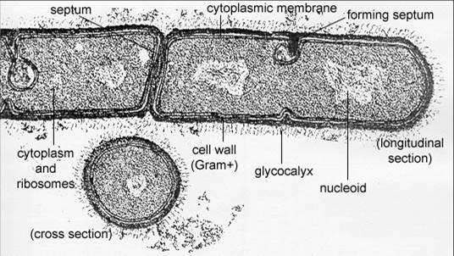
Structure of gram positive bacteria
Pathology
spiral

Slide 23
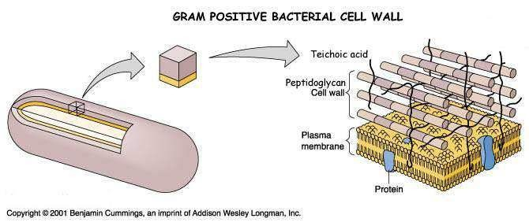
Pathology
spiral

Slide 24
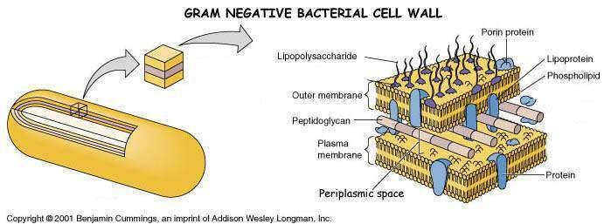
Pathology
spiral

Slide 25
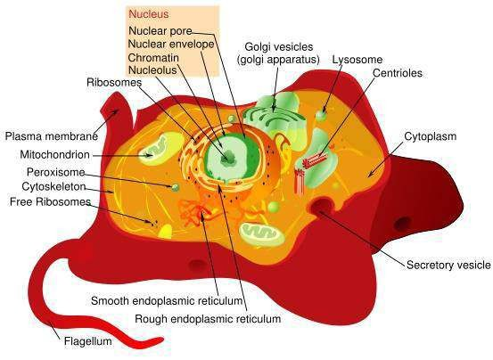
EUKAYOTES
Pathology
spiral

Slide 26
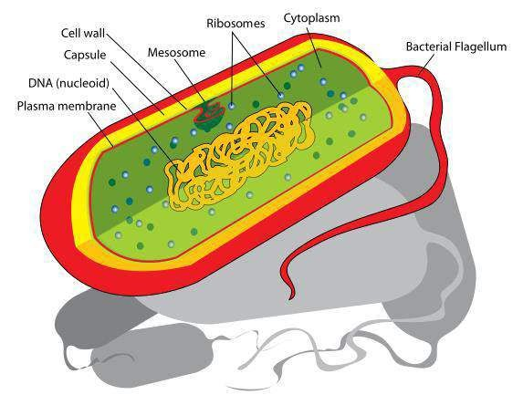
Pathology
spiral

Slide 27
ANTIMICROBIAL DRUGS
Pathology vertical
Inhibition of cell wall synthesis
Penicillins
Cephalosporins
Imipenem
Inhibition of protein synthesis
Chloramphenicol
Tetracyclines
Aminoglycosides
Erythromycin

Slide 28
Pathology
vertical
Inhibition of nucleic acid synthesis
Sulfonamides
Quinolones
Alteration of cell membrane
1. Polymyxin

Slide 29
Bacterial vaccines
Pathology vertical
Corynebacterium diphtheriae
Clostridium tetani
Bordetella
H.influenzae
Streptococcus pneumoniae
Neisseria meningitidis
Salmonella typhi
Vibrio cholera
Yersinia
Bacillus anthracis
Mycobacterium bovis

Slide 30
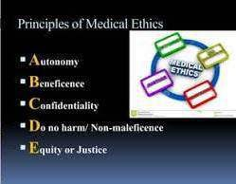
Bioethics
Longitudinal

Slide 31
Research
Longitudinal
https://www.ncbi.nlm.nih.gov/books/NBK8477/
General Concepts
Gross Morphology
Bacteria have characteristic shapes (cocci, rods, spirals, etc.) and often occur in characteristic aggregates (pairs, chains, tetrads, clusters, etc.). These traits are usually typical for a genus and are diagnostically useful.
Cell Structure
Prokaryotes have a nucleoid (nuclear body) rather than an enveloped nucleus and lack membrane-bound cytoplasmic organelles. The plasma membrane in prokaryotes performs many of the functions carried out by membranous organelles in eukaryotes. Multiplication is by binary fission.

Slide 32
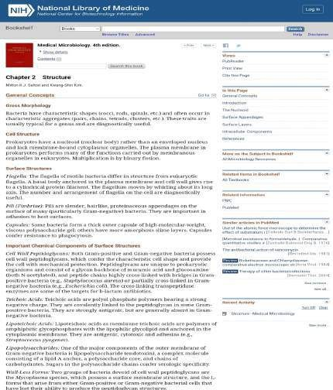

Slide 33
Family medicine
Longitudinal
A patient arrives at the emergency department with a suspected urinary tract infection (UTI). You perform a urinalysis and Gram stain to identify the causative bacteria.Under the microscope, you see cocci in chains that stain Gram-positive.What is the MOST likely cell wall component responsible for the Gram-positive staining reaction in this bacteria?
A) Lipopolysaccharide (LPS)
B) Teichoic Acid
C) Peptidoglycan (This is the most likely answer
)D) Phosphatidylcholine
E) Capsule

Slide 34
AI in lab
Longitudinal

