Slide 2
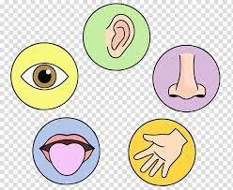
SPECIAL SENSES- GENERAL RADIOLOGY CONCEPTS OVERVIEW
DR SABA
SR HFH RADIOLOGY
DR MADIHA
SR BBH RADIOLOGY

Slide 3
 | Mission Statement To impart evidence-based research-oriented health professional education in order to provide best possible patient care and inculcate the values of mutual respect, ethical practice of healthcare and social accountability. Vision and Values Highly recognized and accredited center of excellence in Medical Education, using evidence-based training techniques for development of highly competent health professionals, who are lifelong experiential learner and are socially accountable. Goals of the Undergraduate Integrated Modular Curriculum To provide you with quality medical education in environment designed to: Provide thorough grounding in the basic theoretical concepts underpinning the practice of medicine. Develop and polish the skills required for providing medical services at all levels of the Health care delivery system. Help you attain and maintain the highest possible levels of ethical and professional conduct in your future life.
TRUTH, WISDOM & SERVICE
“OUT MOTTO”

Slide 4
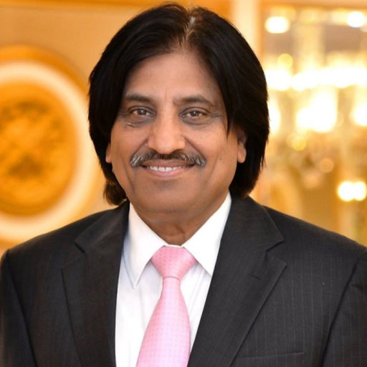
NUMBER OF SLIDES ACCORDING TO DR UMAR LGIS MODEL
Introductory slides
Bismillah 1
Introduction 1
Mission vision 1
Dr. Umar model of LGIS 1
Gain attention slides 2
Learning objectives 1
Core Concept 7
Horizontal Integration 10
Vertical integration 16
Recent Articles 2
Assessment 5
Take home message 1

Slide 5
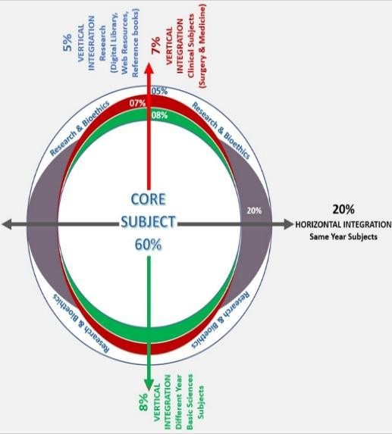
PROF.UMER MODEL OF INTEGRATED LECTUREROF UMER MODEL OF INTEGRATED LECTURE

Slide 6
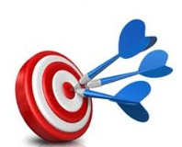
LEARNING OBJECTIVES
At the end of this lecture, students should be able to;
Understand the concept of role of medical imaging regarding special senses
Understand and identify basic radiological anatomy
Introduction to Various imaging modalities and their specific role
Approach to imaging
Introduction to some common pathologies
Read relevant research article

Slide 7
What are special senses? CORE CONCEPT

Slide 8
VISUAL PATHWAY HORIZONTAL INTEGRATION

Slide 9
VISUAL PATHWAY

Slide 10
IMAGING MODALITIES:
Ultrasound (B Scan)
X ray orbit (occiptomental view)
CT orbit
MRI orbit

Slide 11
B SCAN

Slide 12
VERTICAL INTEGRATIONVV

Slide 13
INDICATIONS OF X RAY AND CT ORBITS
Abscess (infection) of the eye area.
Broken eye socket bone.
Foreign object in the eye socket.
OCCIPOMENTAL VIEW

Slide 14
ORBITAL BLOW OUT FRACTURE

Slide 15
ORBITAL FOREIGN BODY

Slide 19
OPTIC NERVES

Slide 20
OPTIC CHIASM

Slide 21
OPTIC RADIATION

Slide 22
OPTIC NERVE GLIOMA

Slide 23
AUDITORY PATHWAY

Slide 24
AUDITORY PATHWAY

Slide 25
IMAGING MODALITIES
X RAY
CT TEMPORAL BONE
MRI

Slide 26
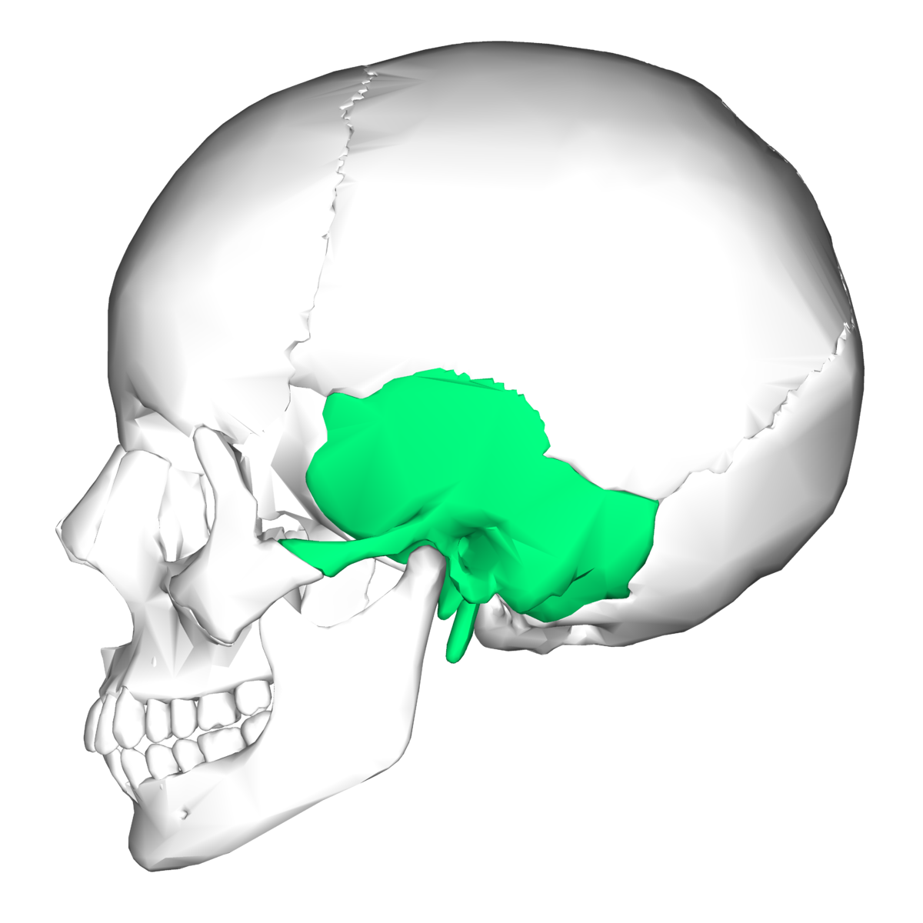
ANATOMY OF TEMPORAL BONE
The temporal bone is located on the sides and base of cranium and lateral to temporal lobe of cerebrum.

Slide 27
TEMPORAL BONE IMAGING TECHNIQUES
CT and MRI are currently the most widely used imaging techniques
Each imaging modality has its own advantages and disadvantages, and often more than one investigation is necessary for a complete evaluation.

Slide 28
CT:
Excellent for assessing the osseous structures.
Not ideal for assessing the soft tissue contents of the otic capsule, brain or vessels.
MRI:
Characterizing brain, CSF and cranial nerves.

Slide 29
MIDDLE EAR CAVITY
MIDDLE EAR CAVITY
Air space within the petrous part of temporal bone between eustachian canal anteriorly and mastoid air cells posteriorly
Laterally- tympanic membrane
Medially- otic capsule and cochlear promontory
Superiorly- tegmen tympani
Inferiorly- jugular floor
Subdivided into;
Epitympanum
Mesotympanum
hypotympanum

Slide 32
MIDDLE EAR OSSICLES

Slide 34
VESTIBULOCOCHLEAR NERVE

Slide 36
OLFACTORY PATHWAY

Slide 38
IMAGING MODALITIES
X RAY
CT PNS
MRI

Slide 39
X RAY AND CT PNS

Slide 40
OLFACTORY NERVES IN OLFACTORY GROOVE

Slide 41
OLFACTORY GROOVE MENINGIOMA

Slide 42
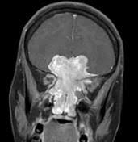
OLFACTORY NEUROBLASTOMA

Slide 43
RELEVANT JOURNAL ARTICLE
Biousse V, Danesh-Meyer HV, Saindane AM, Lamirel C, Newman NJ. Imaging of the optic nerve: technological advances and future prospects. The Lancet Neurology. 2022 Dec 1;21(12):1135-50.
Benson JC, Lane JI. Temporal Bone Anatomy. Neuroimaging Clinics. 2022 Nov 1;32(4):763-75.

Slide 45
Identify the study: Identify labelled structures:
A
C
B

Slide 47
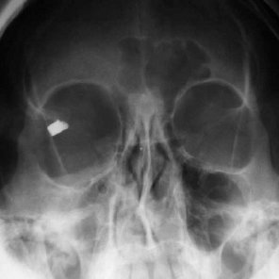
Case scenario:
50-year-old man whose face was injured on the right side while he was working with an agricultural machine. On admission, he was fully conscious and did not have any neurological deficits. He had tearing, photophobia and "foreign body" sensation on right side with no loss of vision or ocular motility, but had a laceration of the lateral side of his right upper eyelid.
Identify the study
Describe the findings
Further imaging if required

Slide 48
ANSWER KEY
IDENTIFY THE STUDY?
X RAY ORBIT
DESCRIBE THE FINDINGS?
Orbital x ray reveals a metallic density intraocular foreign body in superolateral part of right orbit
No fracture noted
FURTHER IMAGING IF REQUIRED?
CT orbits, as it provides superior localization of small foreign bodies, the anatomy of the surrounding structures, and any associated injuries.

Slide 49
TAKE HOME MESSAGE
“Each imaging modality has its own indications, advantages and disadvantages, and often more than one investigation is necessary for a complete evaluation.”

