Slide 2
GIT MODULE SKILL LAB /Physiology Practical 2nd Year MBBS 2025 SENSE OF SMELL
Dr. Ali Zain
Date : 00-00-0000

Slide 3
Table of Contents
Sr # | Content | Slide #
1 | Motto, Vision | 4
2 | Professor Umar Model of Integrated Lecture | 5
3 | Bloom’s Taxonomy(Domains of learning) | 6
4 | Diagrammatic Representation of Blooms Taxonomy | 7
5 | Learning Objectives | 8
6 | Horizontal Integration | 10,11,12
7 | Core Concept | 9,13-29
8 | Vertical Integration | 9,13-29
9 | Biomedical Ethics(lesson of the day) | 30-32
10 | Suggested Research Article | 33
11 | Brainstorming(question relevant with lecture) | 35-39
12 | Promoting IT and research culture(Digital Library) | 30
13 | References of this lecture | 40

Slide 4
Motto Vision; The Dream/Tomorrow
To impart evidence based research oriented medical education
To provide best possible patient care
To inculcate the values of mutual respect and ethical practice of medicine
Wisdom
Truth
Service

Slide 5
Professor Umar Model of Integrated Lecture
60%
CORE SUBJECT
20%
HORIZONTAL
INTEGRATION
Physiology
biochemistry
8%
VERTICAL INTEGRATION
Pathology
pharmacology
7%
VERTICAL INTEGRATION
Clinical integration
5%
VERTICAL INTEGRATION
Research, professionalism
Ethics
Digital library

Slide 6
BLOOM'S TAXONOMY : DOMAINS OF LEARNING
Sr. # | Domain of learning | Abbreviation | Levels of the domain | Meaning
1 | cognition | C | C1 | Recall / Remembering
2 |  |  | C2 | Understanding
3 |  |  | C3 | Applying / Problem solving
4 | Psychomotor | P | P1 | Imitation / copying
5 |  |  | P2 | Manipulation / Follows instructions
6 |  |  | P3 | Precision / Can perform accurately
7 | Attitude | A | A1 | Receiving / Learning
8 |  |  | A2 | Respond / Starts responding to the learned attitude
9 |  |  | A3 | Valuing / starts behaving according to the learned attitude

Slide 7
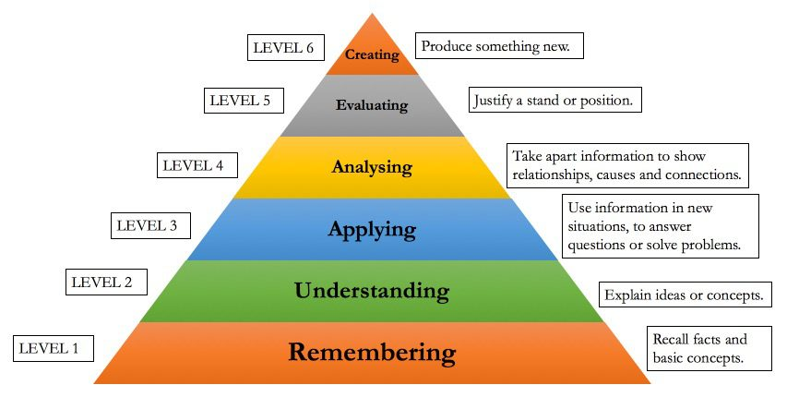
Diagrammatic Representation of Blooms Taxonomy

Slide 8
LEARNING OBJECTIVES
Sr. # | Learning Objectives | Domain of Learning
1 | To understand the relationship between taste and smell | C2
2 | To describe olfactory pathway and primary sensations of smell | C2
3 | To know the different abnormalities of smell | C2
4 | To perform practical for sense of smell | C1/P3/A3

Slide 9
Vertical integration
Horizontal Integration

Slide 10
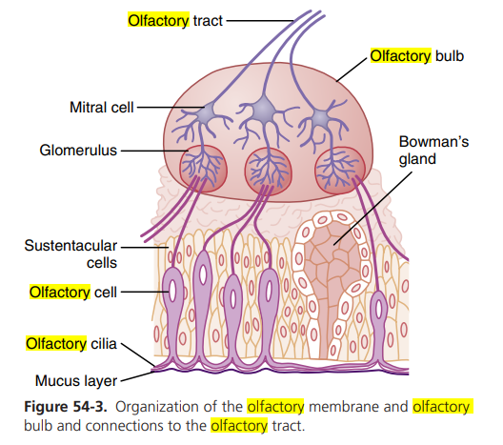
Horizontal integration with anatomy
Reference : Guyton and Hall textbook of physiology page 679

Slide 11
Core Knowledge

Slide 12
Relationship between smell and taste
Core knowledge
Both smell and taste receptors are chemoreceptors that are stimulated by molecules in solution in mucus in the nose and saliva in the mouth

Slide 13
Primary sensations of smell
Core knowledge
Camphoraceous
Musky
Floral
Pepperminty
Ethereal
Pungent
putrid

Slide 14
Olfactory adaptation
Core knowledge
Also known as olfactory fatigue
It means that the olfactory sensation decreases with continued exposure to an odorant

Slide 15
Horizontal integration with anatomy
Refernece from Sherwood 9th Edition Pg# 228

Slide 16
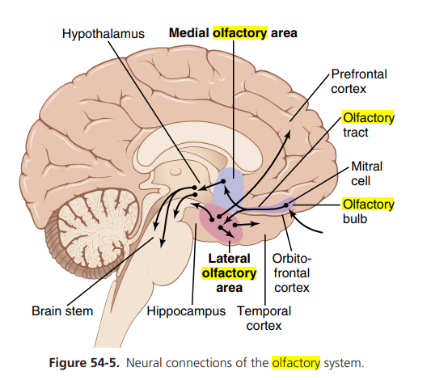
Core knowledge
Reference : Guyton and Hall textbook of physiology page 681

Slide 17
Core knowledge
Refernece from Sherwood 9th Edition Pg# 227

Slide 18
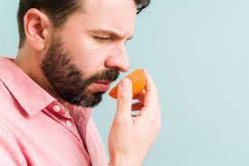
Apparatus
Core knowledge
Aromatic substances like clove oil, orange extract,fresh instant coffee and peppermint extract
Image from google

Slide 19
Procedure
Core knowledge
Ask the subject to sit and close his eyes
Ask the subject to occlude one of his/her nostrils
Then, ask the subject to smell and distinguish the odors of each of the test substances one by one
Repeat the same procedure for the other nostril

Slide 20
Precautions
Core knowledge
Ensure that the subject’s nasal passages are intact
Use the less irritating odor first
Use the most irritating odor at the end
Test each nostril separately

Slide 21
Vertical integration
Vertical integration

Slide 22
Vertical Integration with ENT
Anosmia : complete absence of sense of smell
Parosmia : alteration of small sensation
Hyposmia : decreased sense of smell

Slide 23
Brain storming

Slide 24
Question
Brainstorming/
recall
A 35-year-old patient presents with symptoms of fever,sore throat and productive cough. On examination, his temperature was 102F. He also complains of loss of sense of smell . What is the term used for loss of sense of smell?

Slide 25
Question
Brainstorming/
recall
A 35-year-old patient presents with symptoms of fever,sore throat and productive cough. On examination, his temperature was 102F. He also complains of loss of sense of smell . What is the term used for loss of sense of smell?
Answer : Anosmia

Slide 26
Bioethics

Slide 27
The four principles of Beauchamp and Childress
Bioethics
The four principles of Beauchamp and Childress have been extremely influential in the field of medical ethics, and are fundamental for understanding the current approach to ethical assessment in health care.

Slide 28
Lesson Of the Day Autonomy
Bioethics
Autonomy means that the patients are able to make independent decisions. This means that doctors & nurses should be sure patients have all of the needed information that is required to make a decision about their medical care and are educated. They do not influence the patient's choice.
The Right of Self-Determination or Autonomy would include the right to refuse treatment, the right to participate in research or refuse it. To exercise this right would require Informed Consent.

Slide 29
Related Research Article
Promoting research and IT culture

Slide 30
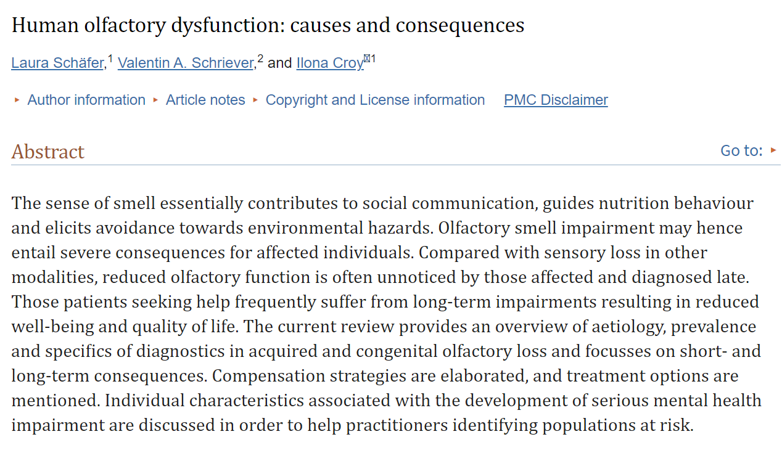
Promoting research and IT culture
www.ncbi.nlm.nih.gov/pmc/articles/PMC7835667/

Slide 31
Take home message
Olfactory pathway
How to perform practical to check sense of smell
Disorders of sense of smell

Slide 32
References
Sr.# | Types of reference material | Names/links of reference material
1 | Text book | Guyton AC, Hall JE. Textbook of Medical Physiology. 14th ed. Philadelphia, PA: Saunders; 2020
2 | Text book | Sherwood L. Human Physiology: From Cells to Systems. 10th ed. Boston, MA: Cengage Learning; 2020.
3 | Manual | Practical Physiology by Dr Saqib Sohail 1st edition
6 | Research papers | www.ncbi.nlm.nih.gov/pmc/articles/PMC7835667/ doi: 10.1007/s00441-020-03381-9
7 | YouTube Video | https://youtu.be/3RJ553NIaMQ?si=Mkz-kEzael9qOJ3N https://youtu.be/jHgElXwxFVg?si=-50BAuoFsYtio7ke

