Slide 2
Second Year MBBS 2025 Gastrointestinal Module Small Group Discussion Saliva and Mastication ,Stages of Swallowing , clinical disorders of Esophagus and Swallowing
DR. Ali Zain
00-00-0000

Slide 3
Table of Contents
Sr # | Content | Slide #
1 | Motto, Vision | 4
2 | Professor Umar Model of Integrated Lecture | 5
3 | Bloom’s Taxonomy(Domains of learning) | 6
4 | Diagrammatic Representation of Blooms Taxonomy | 7
5 | Learning Objectives | 8
6 | Horizontal Integration | 9,10,11,12
7 | Core knowledge | 9 - 18
8 | Vertical Integration | 20 - 25
9 | Biomedical Ethics(lesson of the day) | 27
10 | Suggested Research Article | 28,29
11 | Brainstorming(SEQ relevant with lecture) | 32,33
12 | Promoting IT and research culture(Digital Library) | 30
13 | References of this lecture | 34

Slide 4
Motto Vision; The Dream/Tomorrow
To impart evidence based research oriented medical education
To provide best possible patient care
To inculcate the values of mutual respect and ethical practice of medicine
Wisdom
Truth
Service

Slide 5
Professor Umar Model of Integrated Lecture
60%
CORE SUBJECT
20%
HORIZONTAL
INTEGRATION
Physiology
biochemistry
8%
VERTICAL INTEGRATION
Pathology
pharmacology
7%
VERTICAL INTEGRATION
Clinical integration
5%
VERTICAL INTEGRATION
Research, professionalism
Ethics
Digital library

Slide 6
Bloom's Taxonomy : Domains Of Learning
Sr. # | Domain of learning | Abbreviation | Levels of the domain | Meaning
1 | Cognition | C | C1 | Recall / Remembering
2 |  |  | C2 | Understanding
3 |  |  | C3 | Applying / Problem solving
4 | Psychomotor | P | P1 | Imitation / copying
5 |  |  | P2 | Manipulation / Follows instructions
6 |  |  | P3 | Precision / Can perform accurately
7 | Attitude | A | A1 | Receiving / Learning
8 |  |  | A2 | Respond / Starts responding to the learned attitude
9 |  |  | A3 | Valuing / starts behaving according to the learned attitude

Slide 7
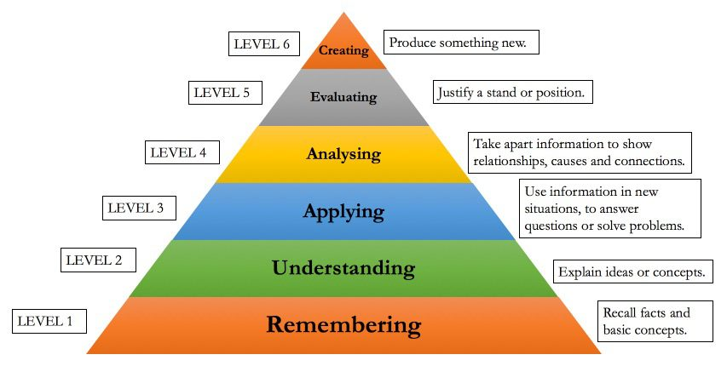
Diagrammatic Representation Of Blooms Taxonomy

Slide 8
Learning Objectives
Sr. # | Learning Objective | Domain of Learning
1 | To Recall saliva secretion and its composition | C1
2 | To Understand Mastication and different stages of Swallowing | C2
3 | To Explain Achalasia and vomiting | C2

Slide 9
Saliva
Core knowledge/
Horizontal integration (Biochemistry)
Liquid secreted into the mouth by glands, providing lubrication for chewing and swallowing, and aiding digestion. It contains:
Serous Secretion (ptyalin (an α-amylase)
Mucus Secretion. (mucin for lubricating and for surface protective purposes).

Slide 10
Salivary Glands
Core knowledge/
Horizontal integration (Anatomy)
The principal glands of salivation are:
a. Parotid (entirely serous type secretion)
b. Submandibular (both serous and mucus secretion)
c. Sublingual (both serous and mucus secretion)
Saliva contains especially large quantities of K+ and HCO3-.

Slide 11
Secretion of Saliva
Core knowledge/
Horizontal integration (Anatomy)
REFERENCE: Guyton and Hall Textbook of Physiology fourteenth Edition page no. 810

Slide 12
Salivary Gland and Secretion
Core knowledge/
Horizontal integration (Anatomy)
Reference: Sherwood Human Physiology 9th edition pg#574

Slide 13
Mastication (chewing)
Core knowledge
The teeth are admirably designed for chewing.
Anterior teeth (incisors) ….strong cutting action.
The posterior teeth (molars) …. grinding action.
Most of the muscles of chewing are innervated by the motor branch of the fifth cranial nerve
Much of the chewing process is caused by a chewing reflex(controlled by nuclei in Brainstem).

Slide 14
Swallowing
Core knowledge
Process by which food move from mouth to stomach . It includes:
(1) Voluntary stage, which initiates the swallowing process
(2) Pharyngeal stage, which is involuntary
(3) Esophageal stage, another involuntary phase

Slide 15
Swallowing
Core knowledge
Reference: Sherwood Human Physiology 9th edition pg#577

Slide 16
Core knowledge
Swallowing
Reference: Sherwood Human Physiology 9th edition pg#577

Slide 17
Core knowledge
Swallowing
Reference: Sherwood Human Physiology 9th edition pg#577

Slide 18
Core knowledge
Swallowing
Reference: Sherwood Human Physiology 9th edition pg#577

Slide 19
Vertical Integration

Slide 20
Paralysis of Swallowing Mechanism
Vertical integration (Medicine /Gastroenterology)
Damage to 5th , 9th or 10th cerebral nerve lead to paralysis of swallowing.
Poliomyelitis or Encephalitis….damage to swallowing centre.
Swallowing abnormalities include:
Complete abrogation
Failure of glottis to close
Failure of soft palate and uvula to close

Slide 21
Achalasia
Vertical integration (Medicine /Gastroenterology)
Results due to damage in the neuronal network of Myenteric plexus in the lower 2/3rd of Esophagus.

Slide 22
Vertical integration (Medicine /Gastroenterology)
Diagnosis:
Barium swallow(Birds beak sign) Treatment:
1.Balloon dilatation
2.Antispasmodic drugs
Reference: https://www.google.com/search?q=achalasia&tbm=isch&ved=2a

Slide 23
Vomiting
Vertical integration (Medicine /Gastroenterology)
Vomiting is the means by which:
Upper gastrointestinal tract rids of its contents.
When almost any part of upper tract become excessively irritated ,over distended or even over excitable.

Slide 24
Vomiting center
Vertical integration (Medicine /Gastroenterology)
REFERENCE: Guyton and Hall Textbook of Physiology fourteenth Edition page no. 837

Slide 25
Vomiting Act
Vertical integration (Medicine /Gastroenterology)
It includes:
A deep breath
Raising of hyoid bone and larynx to pull upper esophageal sphincter open.
Closing of glottis
Lifting of soft palate

Slide 26
Family Medicine
Family Medicine
A 20 years female presented with complaints of
progressive dysphagia ( more for liquids) regurgitation
and retrosternal chest discomfort. Her barium swallow
Shows Bird’s beak sign. What is the role of family
physician in this case?
To take detail history of patient.
Perform detail examination.
Suggest treatment .
Suggest lifestyle modifications
Refer to the specialist.

Slide 27
Bioethics

Slide 28
Lesson Of the Day Consent
Bioethics
Consent is the “autonomous authorization of a medical intervention by individual patients.”
Relevant case: A 20 years female presented with complaints of progressive dysphagia, regurgitation and retrosternal chest discomfort. Her barrium swallow shows bird’s beak sign .Achalasia is diagnosed.she was advised for balloon dilatation.But she refuses .
Solution: The patient didn’t allow the procedure .the doctor can’t proceed according to the medical ethics.

Slide 29
Suggested Research Article
Promoting Research Culture
Journal:
Clinical endoscopy
2023
Reference:https://www.ncbi.nlm.nih.gov/pmc/articles/PMC10565433/

Slide 30
Crux of Suggested Research Article
Promoting Research Culture
Endoscopic assessment is important for early diagnosis to rule out diseases that mimic achalasia symptoms, such as pseudo-achalasia, esophageal cancer, esophageal webs, and eosinophilic esophagitis.
The major endoscopic characteristics suggestive of achalasia include a widened esophageal lumen and food residue in the esophagus.

Slide 31
How To Access Digital Library
Promoting IT and Research Culture
Steps to Access HEC Digital Library
Go to the website of HEC National Digital Library.
On Home Page, click on the INSTITUTES.
A page will appear showing the universities from Public and Private Sector and other Institutes which have access to HEC National Digital Library HNDL.
Select your desired Institute.
5. A page will appear showing the resources of the institution
6. Journals and Researches will appear
7. You can find a Journal by clicking on JOURNALS AND DATABASE and enter a keyword to search for your desired journal. Link:https://www.topstudyworld.com/2020/05/access-hec-digital-library.html?m=1

Slide 32
Brainstorming

Slide 33
Structured Essay Question Related To Topic
Brainstorming
Q.NO.1: A 20 years female presented with complaints of progressive dysphagia ( more for liquids) regurgitation and retrosternal chest discomfort. Her barium swallow shows Bird’s beak sign. The most likely diagnosis in this case is?

Slide 34
Answer
Brainstorming
Achalasia

Slide 35
References
Books:
Guyton And Hall textbook of Medical Physiology 14th Edition
Ganong’s Review of Medical Physiology 25th Edition
Sherwood, 9th edition.
Silverthorn Physiology,6th edition
Vander’s Human Physiology,14th edition
Google images.
2.Medical Journal articles:
Role of endoscopy in patients with achalasia
Reference:https://www.ncbi.nlm.nih.gov/pmc/articles/PMC10565433
3.Video link /youtube:
https://youtu.be/JtBtk00EiVM?si=y-2DAPW49eQwqU6N

Slide 36
Take Home Message
Core knowledge:
Saliva and Mastication ,Stages of Swallowing , clinical disorders of Esophagus and Swallow
Integration:
Biochemistry, Anatomy ,Medicine and Gastroenterology
Research:
Role of endoscopy in patients with Achalasia
Biomedical Ethics:
Consent for treatment of Achalasia patient.
Family Medicine:
Counseling of a patient with Achalasia.

