Slide 1
Probability Sampling Techniques
Block X Otorhinolaryngology
Module-II 4th Year MBBS
Dr. Mehwish Riaz Dr. Afifa Kulsoom

Slide 3
Vision & Mission of RMU
Wisdom
Truth
Service
To impart evidence based research oriented medical education
To provide best possible patient care
To inculcate the values of mutual respect and ethical practice of medicine

Slide 4
Sequence Of Lecture
Learning objectives (1 slide)
Core Subject (27 slides)
EOLA(End of lecture assessment) 1 slide
Digital Library References
Research 1 slide
Bioethics 1 slide
Artificial Intelligence 1 slide

Slide 5
Prof Umer Model

Slide 6
Learning Objectives
Discuss significance of sampling frame
Enlist the types of probability sampling
Appraise different real-life scenarios to apply different probability techniques of sampling
Consider ethical issues in sampling for health research

Slide 7
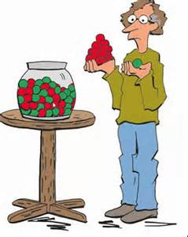
Sampling

Slide 8
What is Sampling???
Core Subject
A sample is a subset of a population and the process of drawing a part (subset) from whole set of population is called sampling.
A sample should be representative of the population to allow the generalizability of the results to the whole population.

Slide 9
What is Sampling???
Core Subject

Slide 10
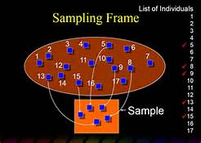
What is Sampling Frame ???
Core Subject
Sampling frame is the list of all persons/units of population from which the sample is selected.

Slide 11
Types Of Sampling
Core Subject
Sampling
Random/
Probability
Sampling
Non-random/
Non-probability
Sampling

Slide 12
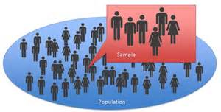
Random/Probability Sampling
Core Subject
In probability/random sampling, every participant has an equal chance of being included or excluded from the study population.

Slide 13
Types Of Random/Probability Sampling
Core Subject
Simple Random
Sampling
Systematic Sampling
Stratified Sampling
Multistage Sampling
Cluster Sampling

Slide 14
How to do simple random sampling??
Core Subject
Make A Sampling Frame
Select Required Sample Randomly

Slide 15
Simple Random Sampling
Core Subject

Slide 16
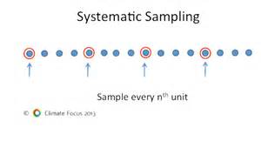
2. Systematic Sampling
Core Subject
In this type of sampling, individuals/units are selected at regular intervals.

Slide 17
How To Do Systematic Sampling?
Core Subject
Example: Select a sample size of 10 from a population of 200 by using the technique of systematic sampling.
STEP 1: Make a sampling frame.
STEP 2: Divide population by sample size
(200/10=20)
STEP 3: Select any number randomly between 1 to 20. (lets say it’s 12)

Slide 18
How To Do Systematic Sampling?
Core Subject
STEP 4 : So, we will select the 12th individual/unit and then every 20th individual/unit after12 in the sampling frame.
STEP 5: So, the final sample achieved via this technique would be
12, 32, 52, 72, 92, 112, 132, 152, 172, 192

Slide 19
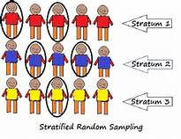
3. Stratified Sampling
Core Subject
used when the population is divided into sub-groups/strata (e.g. on the basis of age, sex, disease, religion, etc) and the researcher wants to study the characteristics of these sub-groups/strata and the relationship between these sub-groups/strata.

Slide 20
How To Do Stratified Sampling??
Core Subject
STEP1: Make strata of population into homogenous, non-overlapping groups on the basis of shared attributes of the members.
STEP 2: A random sample from each stratum is taken in a number proportional to the stratum’s size.

Slide 21
How To Do Stratified Sampling?
Core Subject
Example: There are two strata A and B having population 12 and 8 respectively. Achieve sample size 5 out of these strata
STEP 1: Make sampling frame of both strata.
STEP 2: Sample size of 5 out of 20 (12+8) means 25%.

Slide 22
How To Do Stratified Sampling?
Core Subject
Select
Proportionately select 25% sample from both strata.
25% of 12=3 and 25% of 8= 2 (it means we have to select 3 people from stratum A and 2 from stratum B)
Select
Select the sample from the two strata by using the technique of simple random sampling.

Slide 23
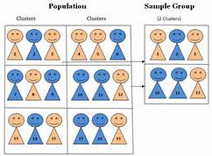
4. Cluster Sampling
Core Subject
This is a two stage sampling technique which involves dividing the population into clusters and then choosing the sample.

Slide 24
How To Do Cluster Sampling??
Core Subject
STAGE 1: Population is divided into clusters and then some of these clusters are selected by using simple random sampling.
01
STAGE 2: All individuals/units in the clusters selected in the stage 1 are selected as sample.
02

Slide 25
5. Multistage Sampling
Core Subject
STAGE 1: Population is divided into strata and then some of these are selected by using simple random sampling.
STAGE 2: Individuals/units in the strata selected through simple random sampling.

Slide 26
Multistage Sampling
Core Subject

Slide 27
Multistage Sampling
Core Subject

Slide 28
Multistage Sampling
Core Subject

Slide 29
Difference Between Cluster & Stratified Sampling Difference Between Cluster & Multistage Sampling
Core Subject

Slide 30
Sample Size
Core Subject
A sample that is TOO BIG will lead to the waste of precious resources such as time and money, while a sample that is TOO SMALL will not allow you to gain reliable insights.

Slide 31
Sample Size Calculation:
Core Subject
n = N × Z2 × P×(100-P) / d2 (N-1) + Z2 × P × (100-P)
^{WHERE}
n is sample size
N is size of population
Z is level of confidence, i.e. 95%=1.96
P is presumed prevalence in %age
d is acceptable margin of error usually 5%

Slide 32
Margin Of Error
Core Subject
This is the positive and negative deviation you allow on your survey results for the sample.
The deviation between the opinions of your respondents and the opinion of the entire population
Suppose you set your margin of error on 5%. If – let’s hope so! – 90% of your survey respondents like the ‘Fall 2016’ line, a 5% margin of error means that you can be ‘sure’ that between 85% (90%-5) and 95% (90%+5) of the entire population actually likes the ‘Fall 2016’ line.

Slide 33
Confidence Level
Core Subject
It tells you how sure you can be that between 85% and 95% of the population likes the ‘Fall 2016’ campaign.
Suppose you chose the 95% confidence level – which is pretty much the standard in quantitative research then in 95% of the time between 85% and 95% of the population likes the ‘Fall 2016’ line.

Slide 34
Sample Size Calculators
Core Subject
https://www.openepi.com/SampleSize/SSCohort.htm
Sample size calculation with G power
WHO sample size calculator

Slide 35
Research, Bioethics, Artificial Intelligence

Slide 36
Ethical Issues Posed By Cluster Randomized Trials In Health Research https://trialsjournal.biomedcentral.com/articles/10.1186/1745-6215-12-100
Ethics

Slide 37
Approaches to Sampling for Quality Control of Artificial Intelligence in Biomedical Research https://www.ncbi.nlm.nih.gov/pmc/articles/PMC10306966/#:~:text=Artificial%20intelligence%20(AI)%20in%20medicine,analytics%2C%20and%20patient%20treatment%20planning.

Slide 38
Panel Sampling in Health Research https://www.thelancet.com/journals/lanpsy/article/PIIS2215-0366(20)30358-8/fulltext
Research

Slide 39
End of Lecture Assessment
There are 6 residential blocks having 16 flats each. Researcher wants to conduct a survey on prevalence of anemia in women of reproductive age group. At the end he wants to distribute iron samples. Which of the following sampling methods is preferable in this case?
Option list
a) Cluster Sampling
b) Consecutive sampling
c) Multistage sampling
d) Simple random sampling
e) Stratified Sampling

Slide 40
Suggested readings
K Park. Chapter health information & basic health statistics pg. 792,793

