Slide 2
department of obs & gynae
rawalpindi teaching hospital

Slide 3
University Motto, Vision, Values & Goals
Mission Statement To impart evidence-based research-oriented health professional education Best possible patient care Mutual respect, ethical practice of healthcare and social accountability. Vision and Values Highly recognized and accredited centre of excellence in Medical Education, using evidence-based training techniques for development of highly competent health professionals, who are lifelong experiential learner and are socially accountable. Goals The Undergraduate Integrated Learning Program is geared to provide you with quality medical education in an environment designed to:

Slide 4
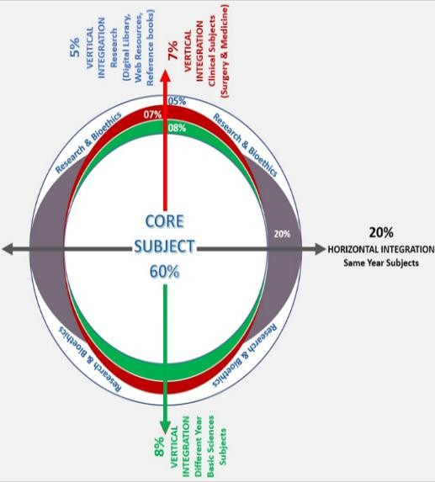
PROF UMER MODEL OF INTEGRATED LECTURE

Slide 5
A 60 year old lady presented in gynae opd with complaint of vaginal bleeding for 1 week. She had her last menstrual period 2 years back. She is diabetic. On examination she is vitally stable, BMI 30kg/m2 abdomen is soft ,nontender , speculum examination shows normal looking cervix . On TVS endometrial thickness is 10mm.

Slide 6
Learning objectives
Define postmenopausal bleeding (PMB).
Identify causes of PMB.
Evaluate the patient with PMB.
Interpret the investigations of PMB.
Formulate the treatment plan.

Slide 10
CERVICLE POLYP

Slide 17
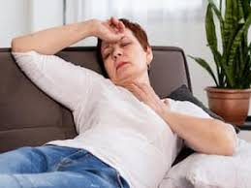

Slide 42
Atrophic vaginitis
Treated by topical estrogen

Slide 47
RESEARCH
Sung S, Carlson K, Abramowitz A. Postmenopausal Bleeding. [Updated 2023 Dec 20]. In: Stat Pearls [Internet]. Treasure Island (FL): Stat Pearls Publishing; 2024 Jan-https://www.ncbi.nlm.nih.gov/books/NBK562188/

Slide 48
BIOMEDICAL ETHICS
Any patient presenting with postmenopausal bleeding should be investigated by TVS and endometrial sampling to rule out malignancy.

Slide 49
FAMILY MEDICINE
Any patient presenting with postmenopausal bleeding need evaluation and should be referred to specialist.

