Slide 1
PHARYNGEAL POUCH/
ZENKER’S DIVERTICULUM

Slide 2
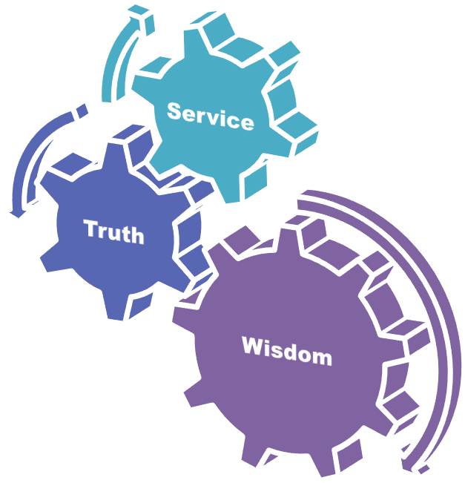
University Motto, Vision, Values & Goals
Mission Statement To impart evidence-based research-oriented health professional education Best possible patient care Mutual respect, ethical practice of healthcare and social accountability. Vision and Values Highly recognized and accredited centre of excellence in Medical Education, using evidence-based training techniques for development of highly competent health professionals, who are lifelong experiential learner and are socially accountable. Goals The Undergraduate Integrated Learning Program is geared to provide you with quality medical education in an environment designed to:

Slide 3
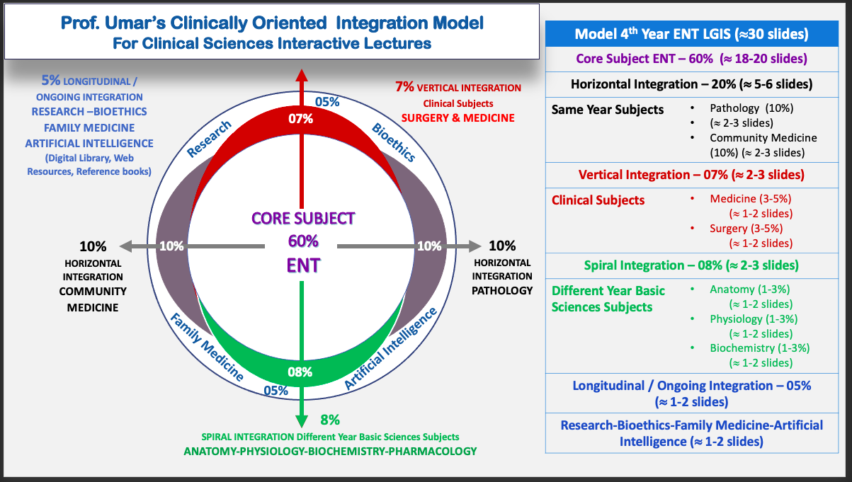
Prof Umer Model Of Integrated Lecture

Slide 4
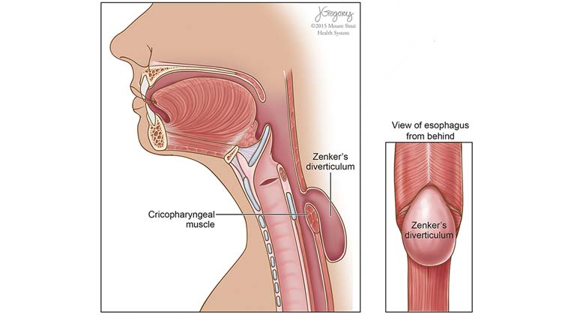
DEFINITION
Zenker's diverticulum, also known as pharyngeal pouch, is a pouch that forms at the junction of the pharynx and esophagus
It typically occurs in older adults and is more common in men than women.

Slide 5
CAUSE
The exact cause of Zenker's diverticulum is not fully understood
It is believed to be due to a combination of factors including muscle weakness in the area, increased pressure during swallowing, and abnormalities in the coordination of swallowing muscles.

Slide 6
SIGNS AND SYMPTOMS
Difficulty swallowing (dysphagia), especially with solid foods.
Regurgitation of undigested food.
Bad breath (halitosis) due to retained food in the diverticulum.
Coughing or choking, particularly when lying down.
Weight loss due to difficulty in eating.

Slide 7
INVESTIGATION
BARIUM SWALLOW:
This test involves swallowing a contrast material (barium) that coats the esophagus and shows up on X-rays. A Zenker's diverticulum will appear as a pouch protruding from the esophagus.
ENDOSCOPY:
A flexible tube with a camera on its end (endoscope) is inserted through the mouth to examine the throat and esophagus. This can help visualize the diverticulum and assess its size and location.
MANOMETRY:
This test measures the pressure and coordination of muscle contractions in the esophagus and can help identify any abnormalities contributing to the diverticulum.

Slide 8
TREATMENT
OBSERVATION:
Small diverticula that are asymptomatic may not require treatment and can be monitored periodically.
DIETARY AND LIFESTYLE CHANGES:
Avoiding certain foods that exacerbate symptoms, such as tough or fibrous foods, and practicing good swallowing techniques can help manage symptoms.
ENDOSCOPIC PROCEDURES:
Endoscopic techniques such as diverticulotomy or diverticuloplasty can be used to surgically remove or reduce the size of the diverticulum.
SURGICAL RESECTION:
In cases where the diverticulum is large or causing severe symptoms, surgical removal may be necessary. This can be done through open surgery or minimally invasive techniques such as laparoscopy.

Slide 9
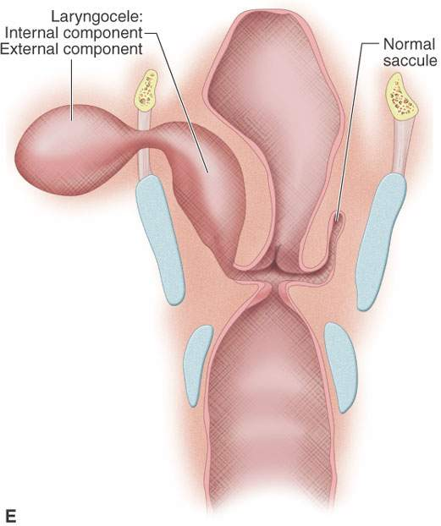
LARYNGOCELE

Slide 10
Integration With Radiology
Spiral Integration

Slide 11
Differential Diagnosis

Slide 12
Management / Tratment

Slide 13
Medical Treatment
Vertical Integration

Slide 14
Research
https://scholar.google.com/scholar?hl=en&as_sdt=0%2C5&q=laryngocele&btnG=#d=gs_qabs&t=1710306610942&u=%23p%3Du-Y5u6N1DUsJ
https://www.sciencedirect.com/science/article/abs/pii/S1542356513013232

Slide 15
Biomedical Ethics
Before doing any medical and surgical treatment, informed consent must be taken
Prognosis should be explained to patients and attendants

Slide 16
Family Medicine
Any patient who presents with difficulty in swallowing food, regurgitation of food or any neck swelling should be referred to ENT specialist and investigate for anomalies of phryngeal pouche and laryngocele.

Slide 17
Artificial Intelligence & Zenker’s diverticulum
Medical Imaging Interpretation:
AI algorithms can assist radiologists in interpreting medical imaging studies such as barium swallows or endoscopic images used in the diagnosis of Zenker's diverticulum, including the presence and size of the diverticulum, aiding in more accurate and efficient diagnosis
Clinical Decision Support:
By analyzing patient data, including symptoms, imaging results, and medical history, AI systems can provide recommendations for appropriate treatment options, considering factors such as the size of the diverticulum and the patient's overall health status.

Slide 18
Surgical Assistance:
AI technologies such as robotics can assist surgeons in performing procedures with greater precision, control, enhanced visualization and dexterity.
Allowing surgeons to perform minimally invasive procedures with improved outcomes for patients
Predictive Analytics and Personalized Medicine:
AI algorithms can analyze large datasets of patient information to identify patterns and predict outcomes for individuals with Zenker's diverticulum.
This can help tailor treatment plans to the specific needs of each patient, optimizing therapeutic interventions and improving overall patient care.

Slide 19
AI and Laryngocele
Medical Imaging Interpretation:
AI algorithms can assist radiologists and otolaryngologists in interpreting medical imaging studies, such as CT scans or MRI scans, used in the diagnosis of laryngocele.
Clinical Decision Support:
By analyzing patient data, including imaging results, symptoms, and medical history, AI systems can provide recommendations for appropriate management strategies, considering factors such as the size and location of the laryngocele and the patient's overall health status.

Slide 20
Surgical Planning and Assistance:
AI technologies can assist surgeons in preoperative planning and intraoperative guidance.
Allowing surgeons to visualize the laryngocele and adjacent structures more accuratel, hence reducing the risk of complications.
Outcome Prediction and Follow-up Monitoring:
AI algorithms can analyze patient data to predict outcomes following treatment for laryngocele and monitor patients during the postoperative period.
By tracking clinical parameters and imaging findings over time, AI systems can identify potential complications or recurrence of laryngocele, enabling early intervention and optimized patient care.

Slide 21
REFERENCES
SCOTT BROWN OTOLARYNGOLOGY 8th edition
Disease of ENT Saleem Iqbal Bhutta
PL Dhingra, 8th edition

