Slide 1
Perinatal infections
Microbe Module
3rd Year MBBS
Dr Kiran Fatima
Pathology Department
Rawalpindi Medical University

Slide 2


Professor Umar Model of Integrated Lecture
20% HORIZONTAL INTEGRATION
Physiology
biochemistry
60%
CORE SUBJECT
7% VERTICAL
INTEGRATION
Clinical integration
8% VERTICAL
INTEGRATION
Pathology
pharmacology
5% VERTICAL
INTEGRATION
Research, professionalism
Ethics Digital library
3

Slide 3




Motto Vision; The Dream/Tomorrow
To impart evidence based research oriented medical education
To provide best possible patient
care
To inculcate the values of mutual respect and ethical practice of medicine

Slide 4

Learning objectives
Enable students to define and understand perinatal infections
To discuss fetomaternal complications due to
perinatal infections and pregnancy outcome
To discuss management of perinatal infections
To understand ethical issues related

Slide 5
Definition
Core
Infectious diseases contracted during pregnancy having serious impact on
both the mother & fetus.
Some infections cause congenital abnormalities (rubella, syphilis,
toxoplasmosis, cytomegalovirus, chickenpox).
Other infections can be transmitted from mother to baby during pregnancy (parvovirus) or around the time of delivery (human immunodeficiency virus (HIV), hepatitis B, hepatitis C, herpes, group B streptococcus).

Slide 6
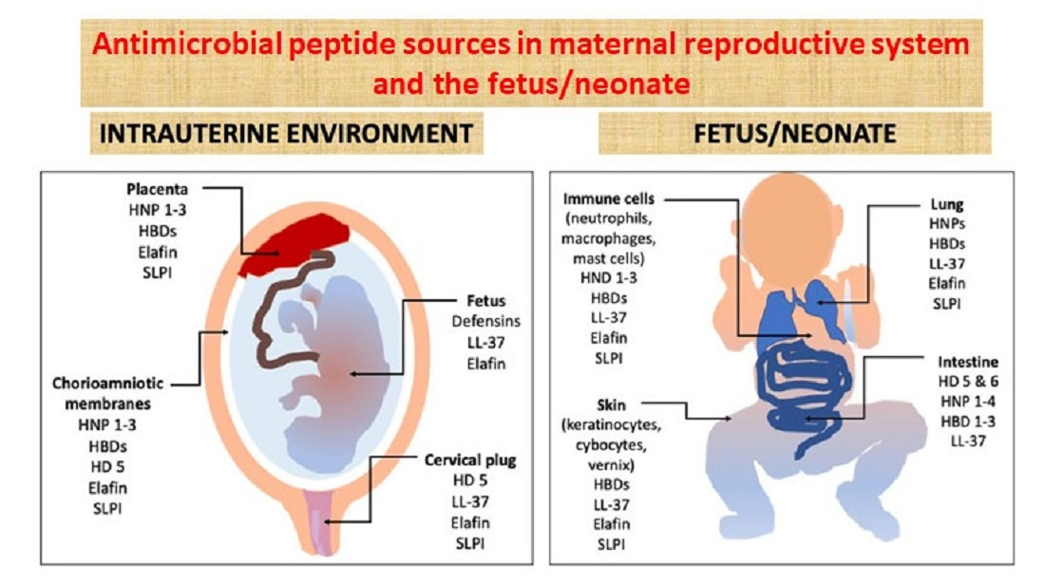
Spiral

Slide 7
Rubella
Core
Causative organism | Incidence & mode of transmission | Clinical features | diagnosis | complication s | treatment
Toga virus | 2% in nullipara 1.2% in multi Droplet infection | 20-50% asymtomatic, Febrile rash 80% | 80% in first trimester 25% at the end of 2nd trimester Occurs in 100%of infants infected in first trimester | Cong Rubella syndrome Sensorineural deafness Cong cataract Blindness Encephalitis Endocrine problems | <16weeks offer TOP >16 weeks reassurance

Slide 8
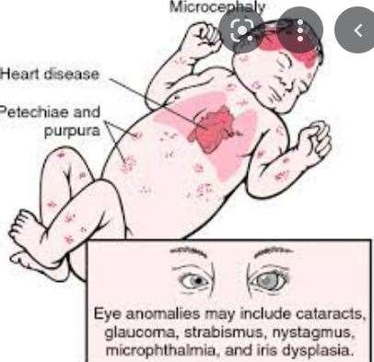
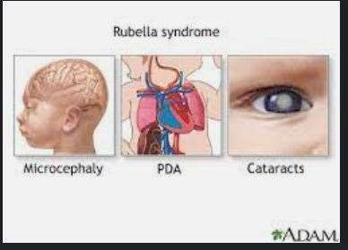
Core
Screening
In the UK, NICE recommendations are that all women should be offered rubella susceptibility screening early in their pregnancy to identify women at risk of contracting rubella infection

Slide 9
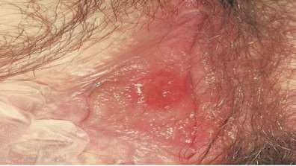
Syphilis
(NICE recommends screening)
Core
Causative organism | Incidence & mode of transmission | Clinical features | diagnosis | complication s | treatment
Treponema pallidium | STI Early untreated (primary or secondary) syphilis, 70–100 % infants infected 25 %will be stillborn | Primary: painless ulcers(condylo mata) Secondary: 6weeks- 6months Maculopapular rash Tertiary: cardiovascular &neurological problems | VDRL RPR test TPHA | 70–100 % infants infected 25 %will be stillborn | Penicillin therapy If women untreated then treat the baby

Slide 10
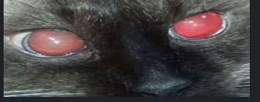
Toxoplasmosis
Core
Causative organism | Incidence & mode of transmissi on | Clinical features | diagno sis | complications | treatment
Toxoplas ma gondii protozoan parasite in cat faeces, soil, or uncooked meat. | ingestion of parasite undercook meat unwashed hands. 16 /1000 in France UK <2 per 1000 preg | Glandular fever like illness severely infected infants Ventriculomega ly Microcephaly Chorioretinitis Cerebral calcifications | ELISA IgM Sabin feldman dye test PCR Amnio centesis USG | Ist trimester: 85% fetal damage,10 % transmission 3rdTrimest: 85% transmission , 10% fetal damage | Spiramycin for 2- 3Gm per oral for 3 weeks reduces the incidence of transplacental Offer termination of pregnancy if infection confirmed on ultrasound

Slide 11

CytomegaloVirus(CMV)
Core
Causative organism | Incidence & mode of transmission | Clinical features | diagnosis | complications | treatment
DNA herpes virus | respiratory droplet transmission excreted in urine. 1-2% 60% women immune 40% infect 30% will transmit virus | Asymptomati Flu like symptoms Infected infants neurological demage,blindness,d eafness, developmental delay, spleenomagaly, hepatomegaly, anemia, thrombocytopenia, jaundice,rash | IgG IgM | IUGR Microcephaly Ventriculomegaly intracerebral calcifications Hydrops ascites | offer TOP

Slide 12

Chicken pox
Core
Causative agent | Incidence Mode of transmission | Clinical features | Diagnosi s | complications | treatment
varicella zoster virus (VZV) | 1 in 200 women Droplet spread Direct personel contact. | Itchy blisters Non-immune pneumonia 10%,hepatitis,enc ephalits | Clinical IgG | maternal risks bleeding, thrombocytopeni a, ,DIC, coagulopathy and hepatitis Delivery during the viremic period extremely hazardous. | (VZIG) - non immunized effective 10 days after contact oral acyclovir 800 mg --5 times for 7 days if present within 24 hours of the onset of rash and >20 weeks gestation.

Slide 13
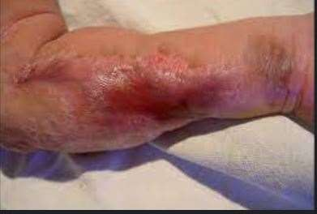
Chicken pox
Core
Clinical features | incidence | treatment
Fetal varicella syndrome skin scarring in dermatomal distribution eye defects (microphthalmia, chorioretinitis,cataracts) hypoplasia of the limbs neurologicalabnormalitiy microcephaly, cortical atrophy, developmental delay and dysfunction of bowel and bladder sphincters | FVS occur between 3 - 28 weeks gestation. Risk appears to be lower in first trimester. | Elective delivery avoided until 5–7 days after onset of maternal rash Neonatal ophthalmic examination If birth occurs within 7-day after onset of maternal rash, or mother develops the chickenpox rash within the 7-day after birth, the neonate should be given VZIG. infant should be monitored for signs of infection until 28 days after the onset of maternal infection. Neonatal infection should be treated with acyclovir VZIG is of no benefit once neonatal chickenpox has developed

Slide 14
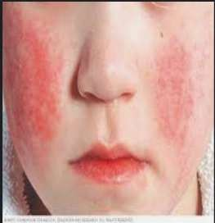
Parvo virus
Core
Causative agent | Incidence Mode of spread | Clinical features | Diagnosis | complicatio ns | treatment
Parvo virus | Droplet infection 50% immune. Pregnannt women working with children (teachers) | mild flu-like illness. children rash (slapped cheek syndrom). In fetus aplastic anemia. Hydrops cardiac failure liver congestion. | ultrasound scan-hydrops MCA Dopplers viral DNA PCR in maternal and fetal serum or amniotic fluid,most sensitive accurate test. | before 20 weeks hydrops fetalis and intrauterine death,fetal loss 10% After 20 weeks fetal loss rate 1 per cent. | Fetal hydrops recover spontaneously or in utero transfusion. anemia treated in utero complete recovery parvovirus does not cause neurological damage

Slide 15
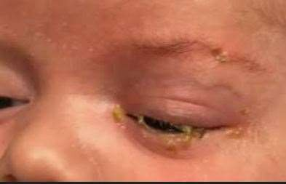
Gonococal infection
Causative agent | Incidence/mo de of spread | Clinical features | Complications | Diagnosis | treatment
Neisseria gonorrhea Gram neg diplococci | Common STI | Asymptomatic mucopurulent discharge dysuria . low grade fever rash ,polyarthritis. increase risk of coinfection with chlamydia , | preterm rupture of membranes and preterm birth Opthalmia neonatorum | Bacteriological Swabs should be taken . Concomitant infections with Chlamydia screened | Cephalosporins safe in pregnancy Newborn eyes Erthyromycin drops

Slide 16
Chlamydia
Core
NICE recommends that all women booking for antenatal Care who are younger than 25 years are
informed of the National Screening Program
Causative agent | Incidence Mode of spread | Clinical features | diagnosis | complica tions | treatment
Chlymadia trachomatis | STI one in 8-10 men and women | Asymptom atic It can be associated with PID Neonate: Pneumonia conjunctivi tis | NAAT | PID Fetal: PPROM, Pre term delivery, LBW | Treatment Azithromycin &Erythromyc Tetracycine avoided in preg

Slide 17

Listeriosis
Core
Causative agent | incidenc e | Clinical features | complications | diagnos is | treatment
Listeria Monocyto genesis Anaerobic, Gram+bacillus. | 18 times higher in pregnant than non pregnant 1 in 8000 | Contaminated food (unpasteurized milk, ripened soft cheese) | Flu-like Illness Malaise asympomatic. Miscarriage or still birth 20% Premature delivery 50% Neonates RDS.fever,sepsis Neurological sym Neonatal mortality 38% | Vaginal swab, placenta | ampicillin 2 g given every 6 hours

Slide 18
Malaria
Core
Infective organism
This is a protozoan parasite transmitted by the female anopheline mosquito
P. falciparum carries the worst prognosis for the mother and fetus.
Prevalence
One billion people worldwide carry parasites & 0.5–3 million people per
year die from malaria.
Parasitaemia is higher in primiparous women (66 percent) than multiparous
women (21–29 per cent).

Slide 19
Clinical features
Vertical
Maternal
Cyclical spiking pyrexia.
Miscarriage and preterm Labour.
Severe anaemia may develop rapidly.
Haemolysis causes jaundice and renal failure.
Hypoglycemia may be severe in pregnancy.
Pulmonary edema due to abnormal capillary permeability results
in high mortality app 50%
Fetal
premature delivery and low birthweight
Placental sequestration of parasites is associated with abnormal
uteroplacental Doppler wave form.
Coinfection with HIV is common

Slide 20
Management
vertical
Insecticide sprays, mosquito nets, appropriate clothing to reduce the risk of mosquito bites.
Drug prophylaxis can all be used.
choice of antimalarial will vary, depending on local patterns of disease and drug resistance.

Slide 21
Group B streptococcus
core
GBS is a gram positive coccus frequently found as a vaginal
commensal.
It is the most common cause of severe early onset infection in
newborn infants.
Approximately 25% women in UK are carriers of GBS
Mortality from early onset GBS disease in Uk is 6% and 18% in
preterm infants.

Slide 22
Clinical features
core
Mother may be asymptomatic as GBS is a common vaginal commensal.
An infected neonate may demonstrate signs of neonatal sepsis including
Sudden collapse
Tachyponea
nasal flaring
poor tone
jaundice

Slide 23
core
Managment
Antenatal: if found accidentally, antenatal treatment is not recommended as it doesn't reduce likelihood of GBS colonization at the time of delivery.
Intrapartum:Antibiotics given in labor are estimated to be 60-80%
effective in reducing early onset neonatal GBS infection.
Intravenous penicillin 3g after onset of labor and then 1.5g 4 hourly until
delivery.
Clindamycin 900mg IV to those allergic to penicillin

Slide 24
Risk factor based prophylaxis
core
Intrapartum fever
PROM > 18 hours
Prematurity less than 37 weeks
Previous infant with GBS.
Incidental detection of GBS in current pregnancy
GBS bacteruria

Slide 25
Herpes Simpllex
core
HSV is a double stranded DNA virus.
two types,HSV-1 and HSV-2.
Genital herpes is a STD caused by HSV-2.
most common sexually transmitted infection in UK.
Neonatal herpes is acquired at or near the time of delivery due to
contact with infected secretions.
It is rare with incidence of 1 in 60000 live births.

Slide 26
Clinical features
core
Presents as ulcerative lesions on vulva,vagina or cervix.
Women may give history of recurrent infections in which lesion is
florid.
Primary infection may be associated with systemic symptoms and
may cause urinary retention.
Neonatal herpes is classified into three subgroups:
Localized to skin,eye and mouth
CNS disease(encephalitis alone)
Multiorgan involvement

Slide 27
Factors influencing transmission
core
Primary or recurrent infection
Presence of transplacental maternal neutralizing antibodies
Duration of PROM before delivery
Use of fetal scalp electrodes
Risk is greater if primary infection acquired within 6 weeks of
delivery.

Slide 28
Management
Vertical
Swab for viral detection for culture and PCR
Advice of a GUM consultant regarding mode of delivery.
C section should be recommended to all women presenting with
primary episode at the time of delivery or within 6 weeks of EDD.
IV Acyclovir given intrapartum to the mother and subsequently to
the neonate may be considered.

Slide 29
Viral Hepatitis B&C
HEP C screening is recommended world wide as part of antenatal
screening
5.8% risk of vertical transmission, furthur ↑ if HIV +
Currently no treatment approved during pregnancy
Hep B Screening in antenatal population done in pakistan due to increased prevelance
( 9 in 10 women pass infection to new born), via contact with blood and bodily fluids, and vertical transmission
HBV vaccine is safe in pregnancy
New born prophylaxis(active and passive immunization within 12
hours of birth)

Slide 30
HIV
core
Causative agent: human immunodeficiencey virus(HIV)
Mode of transmission: anal or sexual,sex,needle stick injury,
Risk to fetus :1%,but ↑ furthur if untreated infection
Managment:
Antiretroviral treatment should be continued
Vaginal delivery permissible if viral count is low
Avoid prolonged ruptured membranes
High viral load, cesarean section and avoiding breast feeding
reduces risk of neonatal infection
Neonate started ART ,soon after birth( 6hrs)

Slide 31


Beneficence
Vertical integration
The principle of beneficence is the obligation of physician to act for the benefit of the patient and supports a number of moral rules to protect and defend the right of others, prevent harm, remove conditions that will cause harm, help persons with disabilities, and rescue persons in danger.
It is worth emphasizing that, the language here is one of positive requirements. The principle calls for not just avoiding harm, but also to benefit patients and to promote their welfare.
TAKE HOME
MESSAGE

Slide 32
Ethical Issues
Counseling( feto/ maternal complications, fetal prognosis)
TOP ( Maternal/fetal indication)
Mode and time of delivery
Referral to GUC in case of STI
Support groups for physical and mental deformities of newborn.

Slide 33
Refrences
Obsterics by ten teachers. Louise C. Kenny, Jenny E. Myers. 20th ed
ISBN 9781498744393. Published June 1, 2017 by CRC Press
Dewhurst's Textbook of Obstetrics & Gynaecology, 9th Edition
Keith Edmonds (Editor-in-Chief), Christoph Lees (Co-Editor), Tom Bourne
(Co-Editor)ISBN: 978-1-119-21142-6
  3. Protocols for Infectious Disease in Obstetrics and Gynecology, 2nd Edition
  Philip Mead, W David Hager
  ISBN: 978-0-632-04324-8

Slide 34
Take home message
Perinatal infections are infections that occur around the time of birth, affecting both the mother and/or the newborn. Early recognition and treatment are crucial to prevent serious complications like sepsis, meningitis, and even death. Prevention strategies, including maternal screening and appropriate antibiotic prophylaxis, play a vital role in reducing the incidence of these infections.

Slide 35
Family medicine
A 28-year-old woman, G2P1 at 38 weeks gestation, presents to the labor and delivery unit with fever, chills, and uterine tenderness. Her membranes have been ruptured for 24 hours. Fetal heart rate monitoring shows tachycardia. Which of the following is the MOST likely diagnosis?
a) Urinary tract infection
b) Appendicitis
c) Chorioamnionitis
d) Placental abruption
Answer: c) Chorioamnionitis

Slide 36


