Slide 1
Microbe Module 3rd Year MBBS
Pathogenesis and lab diagnosis of infectious agents in microbiology
Dr Kiran Fatima
Pathology Department
Rawalpindi Medical University

Slide 5
Learning outcomes
Student will be able to understand;
What is virulence?
What are the types of toxins ?
How different infectious agents cause disease. How to identify different microorganisms in lab.
How culture medias and other biochemical test specify the organism in lab diagnosis.

Slide 6
Study questions
What is virulence?
What are the types of toxins ?
How different infectious agents cause disease. How to identify different microorganisms in lab.
How culture medias and other biochemical test specify the organism in lab diagnosis.
What are the various methods for detection of bacterial infection?
Which information is obtained by Gram staining?
Name the various bacterial culture plates.
How should various bacterial samples be sent to the lab?
What are the various molecular methods for the detection of bacterial infections.

Slide 7
Virulence
Pathology
core
Core Content
Virulence is the measure of the pathogenicity of an organism
number of infecting bacteria,
route of entry into the body,
specific and nonspecific host defense mechanisms,
and virulence factors of the bacterium.

Slide 8
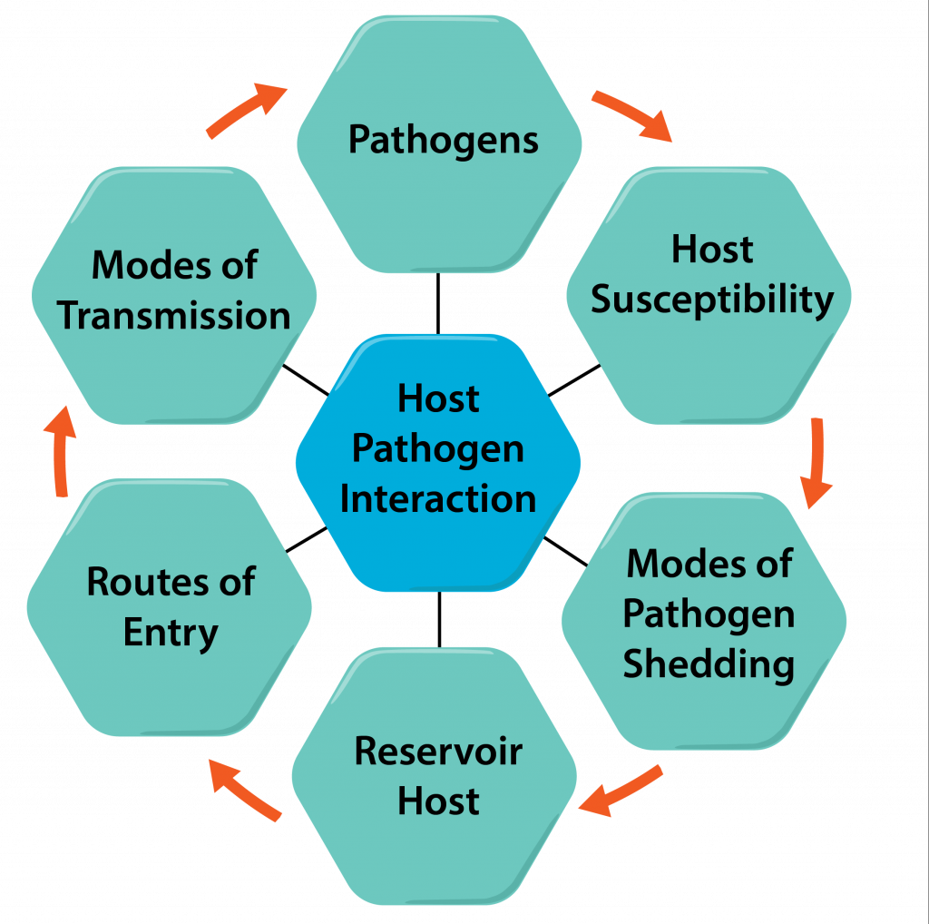
spiral

Slide 9
Survival outside the human host
Pathology core
Core Content
Resistance to drying.
Spore forms of clostridium and bacillus
Waxy cell walls of mycobacterium.
Cold growth
Listeria monocytogenes and yersinia enterocolitica
Short-term survival skills
Staph.Aureus and streptococcus pyogenes

Slide 10
Survival outside the human
Core Content
Host
Growth and survival in water
The opportunistic pseudomonas
Grow well in tap water, soil,drains,vegetables
Legionella,--grow in streams, contaminates air- conditioning cooling tanks and hot water tanks.

Slide 11
Colonization of the human body
Pathology core
Core Content
A. Normal flora
1.Reduce the risk of colonization by pathogens
2. Infection by normal flora in immunocompromised or by disturbance in
Normal flora

Slide 12
Colonization pattern by pathogens
Pathology core
Core Content
Colonization with local or systemic spread
To cause disease
2. Colonization with little invasiveness but toxin production.(Corynebacterium diphtheriae)
3.Colonization by a pathogens without disease
(Carrier state)

Slide 13
Major Mechanism of colonization
Pathology core
Core Content
1.Specific attachment to cellular surfaces
a.Gram-positive bacteria ---teichoic acids.
b.Gram-negative bacteria attach through proteins on the pili
2 .Adhesions by adhesins
3. avoiding antibodies by IgA protease
4. Biofilm formation
5. Antigenic variation.

Slide 14
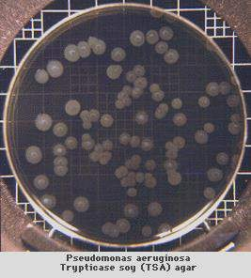
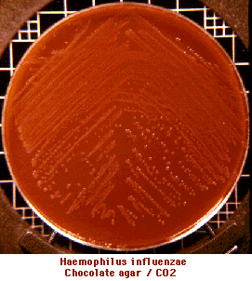
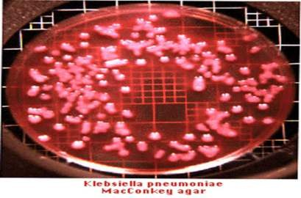
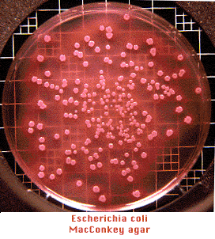
spiral

Slide 15
Evasion of host defenses
Pathology core
Core Content
Successful competition with native flora, use of local products
Suppression of flora by production of antibacterials
Colonization after disruption of flora (eg. antibiotics)
Motility, chemotaxis: motile organisms penetrate mucus layer
Trans-mucus attachment structures
Damage cilia
Avoid immunoglobulins, macrophages
Injuries (foreign bodies, tract blockage)

Slide 16
Bacterial Toxins
Pathology
core
Core Content
Establishing precise role in pathogenesis, mechanism of action of bacterial toxins is extremely important, could lead to more rational approaches to disease control or management

Slide 17
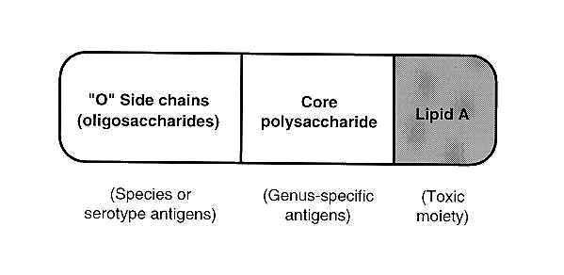
Endotoxins
Pathology
core
Core Content

Slide 18
Exotoxins
Pathology core
Core Content
Produced by both, Gram-positive and Gram- negative bacteria
Usually secreted, usually proteins
Strongly antigenic, highly toxic, tissue- specific
Relatively heat-labile, easily toxoided
Readily neutralized by antibodies
Specific mode of action often obscure

Slide 19
Classificaton of toxins
Pathology core
Core Content
enterotoxin, neurotoxin, histotoxin
membrane-damaging
S.aureus---Alpha toxin—pore forming cytolysin
Streptococcus pyogenes –Streptolysin O—pore forming
Clostridium perfringes ------Alpha toxin--Lecithinase hydrolyzes

Slide 20
A-B toxins that inhibit protein synthesis
Pathology core
Core Content
Protein synthesis-inhibiting:
Corynebacterium diphtheriae—Diphtheria toxin
Pseudomonas aeruginosa----Exotoxin A
Shigella dysenteriae type 1—Shiga toxin(ST)
Enterohemorrhagic Escherichia coli--Verotoxin

Slide 21
A-B toxin that increase cAMP
Pathology core
Core Content
Vibrio cholerae—cholera toxin
Enterotoxic e.Coli—–e.Coli labile toxin
Bacillus anthracis----anthrax toxin
Bordetella pertussis ----pertussis toxin

Slide 22
Neurotoxins
Pathology
core
Core Content
Many toxins are extraordinarily powerful
botulinum toxin 3 million times more potent than strychnine
28 grams, properly distributed, will kill the entire population of the world
tetanus toxin: lethal dose far less than an immunizing dose
CLOSTRIDIUM TETANI---TETNUS TOXIN
CLOSTRIDIUM BOTULINUM-BOTULINUM TOXIN.

Slide 23
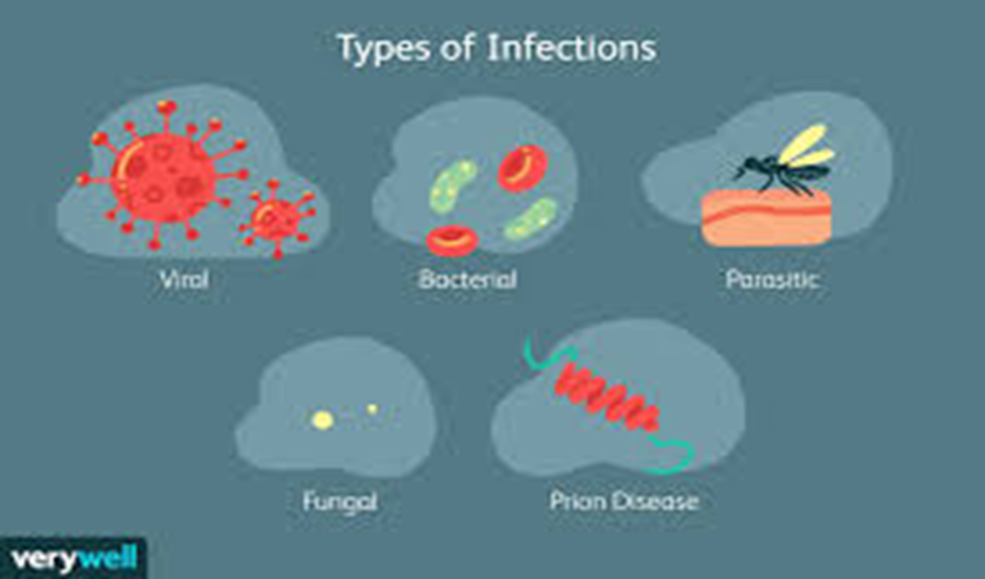
Disease causing micro organisms
Pathology
Core Content

Slide 24
History of the disease
Core Content
Start of the diagnostic cycle :
· History; possible exposures
· Symptoms
Helps the physician to decide
· type of pathogen
· appropriate specimen for culture

Slide 25
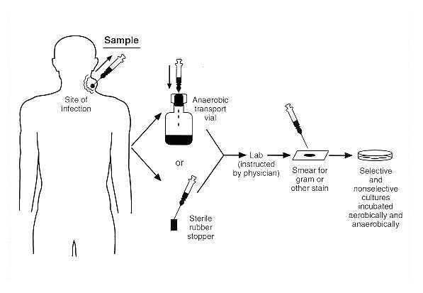
Pathology
spiral
Core Content

Slide 26
2. Collection of the specimen
Pathology core
Core Content
Sterile equipment
Minimum of contamination from other organs
Example : cleaning the surface of the skin, biopsies (eg. upper intestinal infections) aspiration
Collection of the specimen at the right time
Example : Typhoid fever
S. typhi present in blood 1st week
S. typhi present in feces/urine 2nd – 3rd week
Antibodies 5th week

Slide 27
Pathology core
d. Labeling and packaging of the specimen
Patient’s name, location, date and time of collection, type of
specimen
e. Storage of the specimen, or, Some Like It Hot
Example : Campylobacter, Neisseria, Hemophilus
f. Transport of the specimen, or, The Quick and the Dead
Important for two reasons :
bacterial count : leave it too long and they’ll overgrow
swifter-growing commensals : leave it too long and they’ll
outgrow the pathogen
g. Anaerobes : oxygen death CO2 generation system Anaerobic indicator Reducing agents

Slide 28
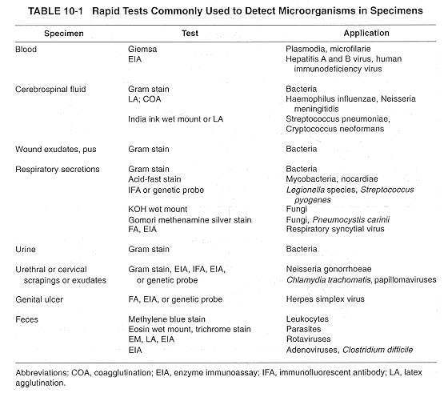
vertical

Slide 29
Microscopic examination
Pathology core
Core Content
Gram staining or ZN staining of collected samples
Some areas are sterile parts of body → CSF, joint fluid, blood
Presence of bacteria in those area are critical

Slide 30
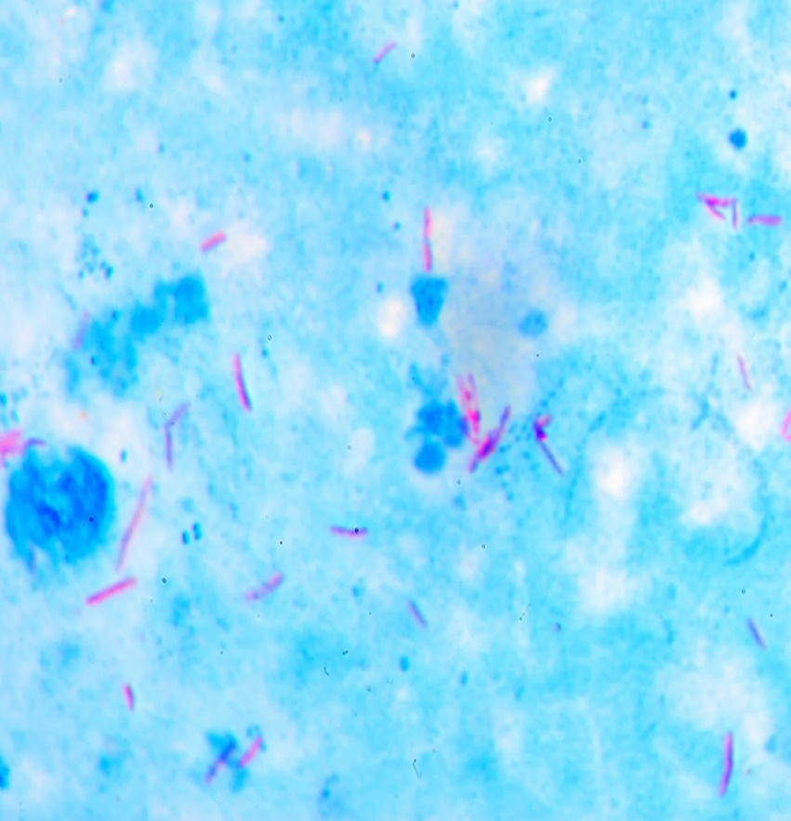
Gram staining and ZN staining
Pathology core

Slide 31
Microscopic examination
Pathology core
Core Content
Gram staining will reveal either gram positive or gram negative
Shape of bacteria will also determine either cocci or bacilli
Arrangement of bacteria show specific bacteria as staphylococcus in grape like arrangement, streptococci in diplococci / chains form

Slide 32
Culture media
Pathology core
Core Content
Culture media is a gel or liquid that contains nutrients and is used to grow bacteria or microorganisms. They are also termed growth media. Different cell types are grown in various types of medium.

Slide 33
Amie’s transport media
Pathology core

Slide 34
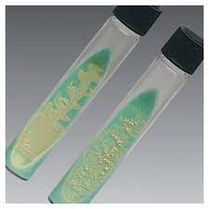
Types of media
Pathology core
Core Content
Lowenstein Jensen media

Slide 35
Culture based methods
Core Content
Commonly used culture medias and agar
Blood agar → various bacteria
Chocolate agar → N. meningitidis and N. gonorrhoae
MacConkey → various gram negative
Thayer Martin → N. gonorrhoae from non sterile site
Chocolate agar X and V → H. influenzae
Lowenstein Jensen → M. tuberculosis

Slide 36
Specimens for culture
Pathology core
Core Content
Blood culture → in culture bottles
Throat culture → in gel swab or sterilized dry swab
Sputum culture → in sterilized container ( a reliable specimen has more than 25 leukocytes and less than 10 epithelial cells per 100X field
CSF → is a critical sample should be sent immediately to lab
Stool culture → APW, Selenite F broth, Cary blair medium, skirrow medium

Slide 37
Specimens for culture
Pathology core
Core Content
Urine culture → in sterilized container can be stored at 4oC or boric acid container
Genital tract medium → in gel swab or sterilized dry swab
Pus → in sterilized container
Wound / abscess secretion → in gel swab or sterilized dry swab

Slide 38
Core Content

Slide 39
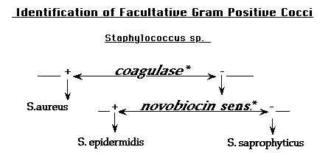
Core Content

Slide 40
core
LABORITORY DETECTION OF HEPATITS B DNA

Slide 41
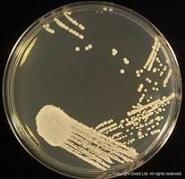
core
LABORITORY DETECTION OF FUNGUS ON SABOURAD AGAR

Slide 42
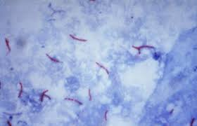
Core Content
LABORITORY DETECTION OF OF MYCOBACTERIUM TUBERCULOSIS

Slide 43
LABORTORY DIAGNOSIS OF PARASITIC INFECTIONS

Slide 44
Biomedical ethics
longitudinal
Doctor must respect patient confidentiality.
Patient should be shown empathy and counselled appropriately

Slide 45
Family medicine
longitudinal
Question:
This particular strain of S. pneumoniae is highly virulent and causes more severe disease compared to other strains. Explain how a virulence factor of S. pneumoniae can contribute to the development of pneumonia.
Answer:
Streptococcus pneumoniae possesses a capsule composed of polysaccharides, known as a capsular polysaccharide (CPS). This CPS is a key virulence factor that contributes to the development of pneumonia in several ways:Adherence and Colonization: The CPS allows S. pneumoniae to adhere to the respiratory epithelium in the lungs. This is the first step in establishing colonization, a prerequisite for infection.Immune Evasion: The CPS acts as a physical barrier, hindering the host's immune system from recognizing and phagocytosing the bacteria. This allows S. pneumoniae to evade the immune response and establish itself within the lungs.Antiphagocytosis: Some CPS types can specifically inhibit the ability of neutrophils (white blood cells) to engulf and destroy the bacteria. This further weakens the host's immune response.Inflammation: The CPS can trigger an inflammatory response in the lungs. While inflammation is a normal immune response, excessive inflammation caused by a highly virulent strain can lead to tissue damage and contribute to the severity of pneumonia.

Slide 46
Research
longitudinal

