Slide 1
Pediatric Ophthalmology

Slide 2
Contents:
Learning objectives
Evaluation and management of pediatric tumor
Integration with Histopathology and pathogenesis of tumors
Research and ethics in tumors
Role of artificial intelligence in tumor
End of lecture assessment
References

Slide 3
Learning Objectives:
At the end of this lecture, students will be able to
Describe retinoblastoma , its clinical presentation and management.
Describe rhabdomyosarcoma, its clinical presetation and management.

Slide 4
Eye screening
American academy of ophthalmology recommendations:
Newborn- red reflex & pupil responses
6-12 months
12-36months
red reflex & pupil responses
red reflex & pupil responses
photoscreen test
3-5 yrs
visual acuity and ocular alignment
5 yrs and older
visual acuity and ocular alignment

Slide 5
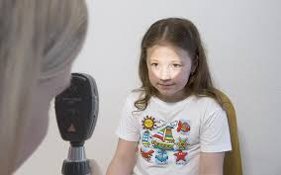
Red reflex
myopia
Hypermetropia

Slide 6
photoscreening

Slide 7
Comprehensive eye examination
An ophthalmologist should see the child if the screening shows signs of:
Prematurity
Ocular misalignment
Refractive errors
amblyopia
Nystagmus
Family history of childhood ocular problems

Slide 8
Visual development and assessment

Slide 9
Common pediatric eye conditions
Refractive errors
Strabismus
Amblyopia
Congenital glaucoma
Congenital cataract
ROP
Tumors
Retinoblastoma
rhabdomyosarcoma

Slide 10
Leukocoria
PREDICT
Persistent hyperplastic vitreous
Retinoblastoma/Retinopathy of prematurity
Endophthalmitis
Dysplasia of retina
Inflammatory membrane
Congenital cataract/ Coats disease
Toxocariasis

Slide 11
1. Congenital cataract

Slide 12
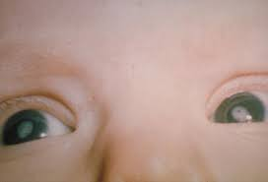
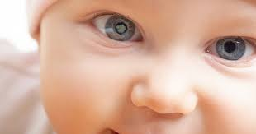
1. Congenital cataract
6: 10,000 live births
Visually significant/ not
unilateral/ bilateral
Progressive/ stable
Congenital/ acquired

Slide 13
Etiology:
Bilateral | Unilateral
Autosomal dominant- familial | Idiopathic-90%
Chromosomal anomalies: Trisomy 21 Trisomy 18 Trisomy 13 | Ocular anomalies: Persistent fetal vasculature
Intrauterine infections TORCH
Ocular anomalies: Aniridia Anterior segment dysgenesis
Metabolic disorders Galactosemia Hypoparathyroidism Storage disorders
Idiopathic- 50%

Slide 14
Visually significant cataract
Retinal details not visible with direct ophthalmoscope
unilateral
Central opacity > 3mm
Nystagmus/ strabismus

Slide 15
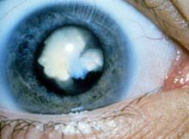
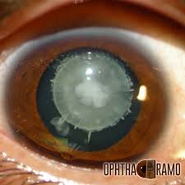
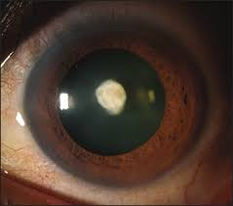
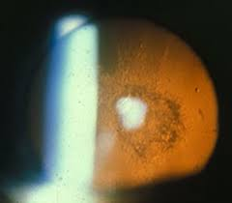
Morphological types of congenital cataract
Total cataract
Nuclear cataract
Lamellar cataract
Anterior polar
Posterior subcapsular

Slide 16
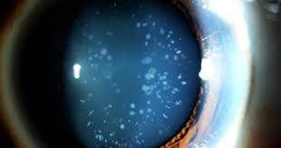
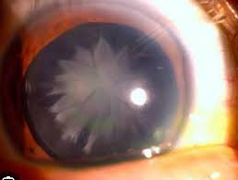
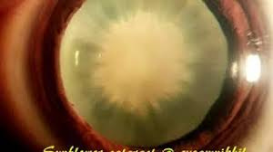
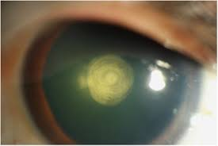
rosette cataract
Sunflower cataract
Posterior polar

Slide 17
Treatment:
Age < 1year
lensectomy
1-5 yrs
Lensectomy with IOL
>5 yrs
LMA with IOL

Slide 18
Important points:
Short axial length
Steep cornea
Globular lens– crowded AC, difficult biometry
PCO- universal,
High risk of secondary glaucoma
Amblyopia
Myopic shift
Make biometry difficult
hence posterior capsulorhexis with Ant vit done in all cases below 5 yrs

Slide 19
Refractive correction
Contact lenses
spectacles

Slide 20
2. ROP

Slide 21
2. ROP
Retinopathy– retinal pathology
Prematurity–
<35 weeks &
< 1500gms

Slide 22
Normal retinal development

Slide 23
Pathophysiology
Stage 1: hyperoxia—
Vasoconstriction, VEGF downregulation
Stage 2: ischemia
Upregulation of VEGF,
Neovascularization– hemorrhage, fibrosis, retinal detachment

Slide 24
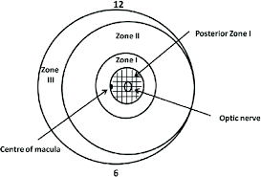
Zones of ROP

Slide 25
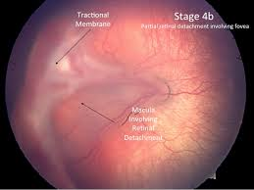
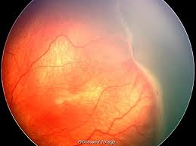
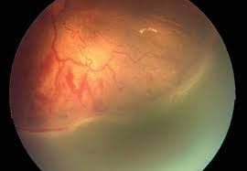
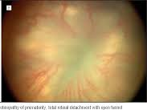
Stages of ROP

Slide 26
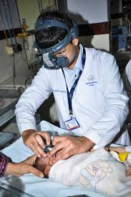
PROPERA Screening Criteria (Pakistan Retinopathy of Prematurity Educational and Research Alliance)
Screening Criteria
Birth Weight 2 Kg or less
Gestational Age 35 weeks or less
First screening—4-6 weeks post gestation age
Follow up visits
More severe disease – F/U after 1 week
Less severe disease – F/U after 2 weeks

Slide 27
TREATMENT OPTIONS

Slide 28
Laser Photocoagulation

Slide 29
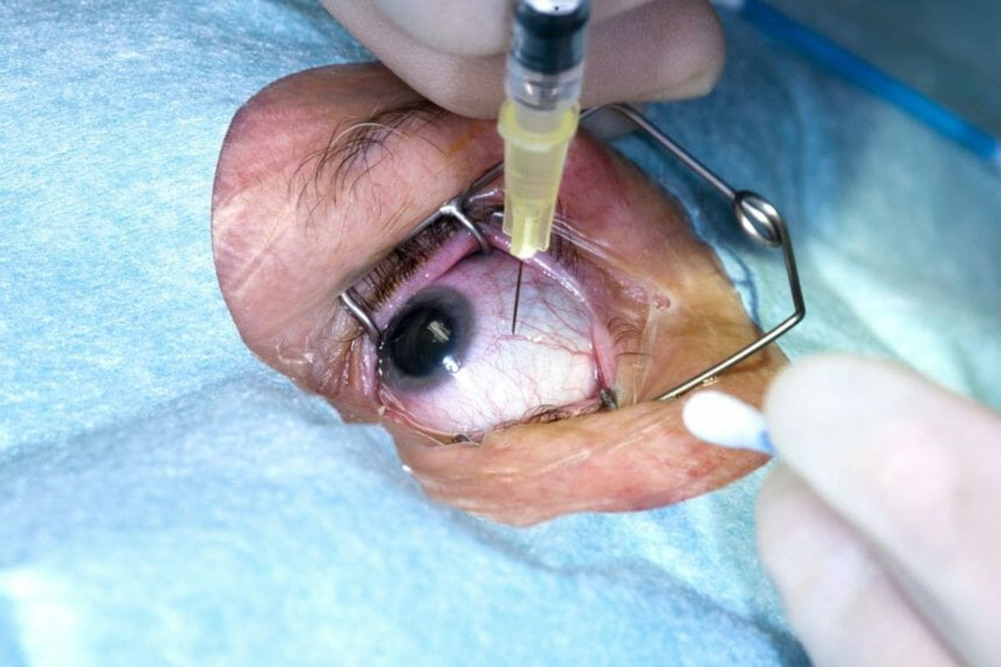
Intravitreal Anti-VEGF

Slide 30
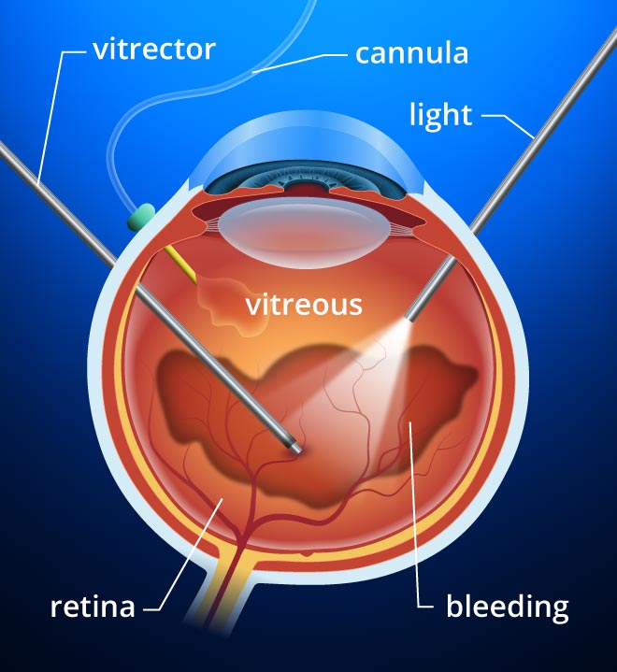
Pars plana Vitrectomy

Slide 31
3. Retinoblastoma

Slide 32
Retinoblastoma
Most common primary intraocular malignancy of childhood
3% of all childhood cancers
Incidence 1:15000 live births

Slide 33
Retinoblastoma
Heritable (40%)
Non heritable (60%)
Multifocal
Bilateral
Unilateral
Secondary tumors
No secondary tumors
95% sporadic
5% familial
100% bilateral heritable

Slide 34
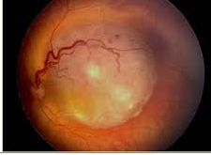
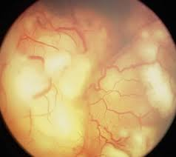
Types/ growth pattern
Vitreous seed
exophytic
endophytic
diffuse

Slide 35
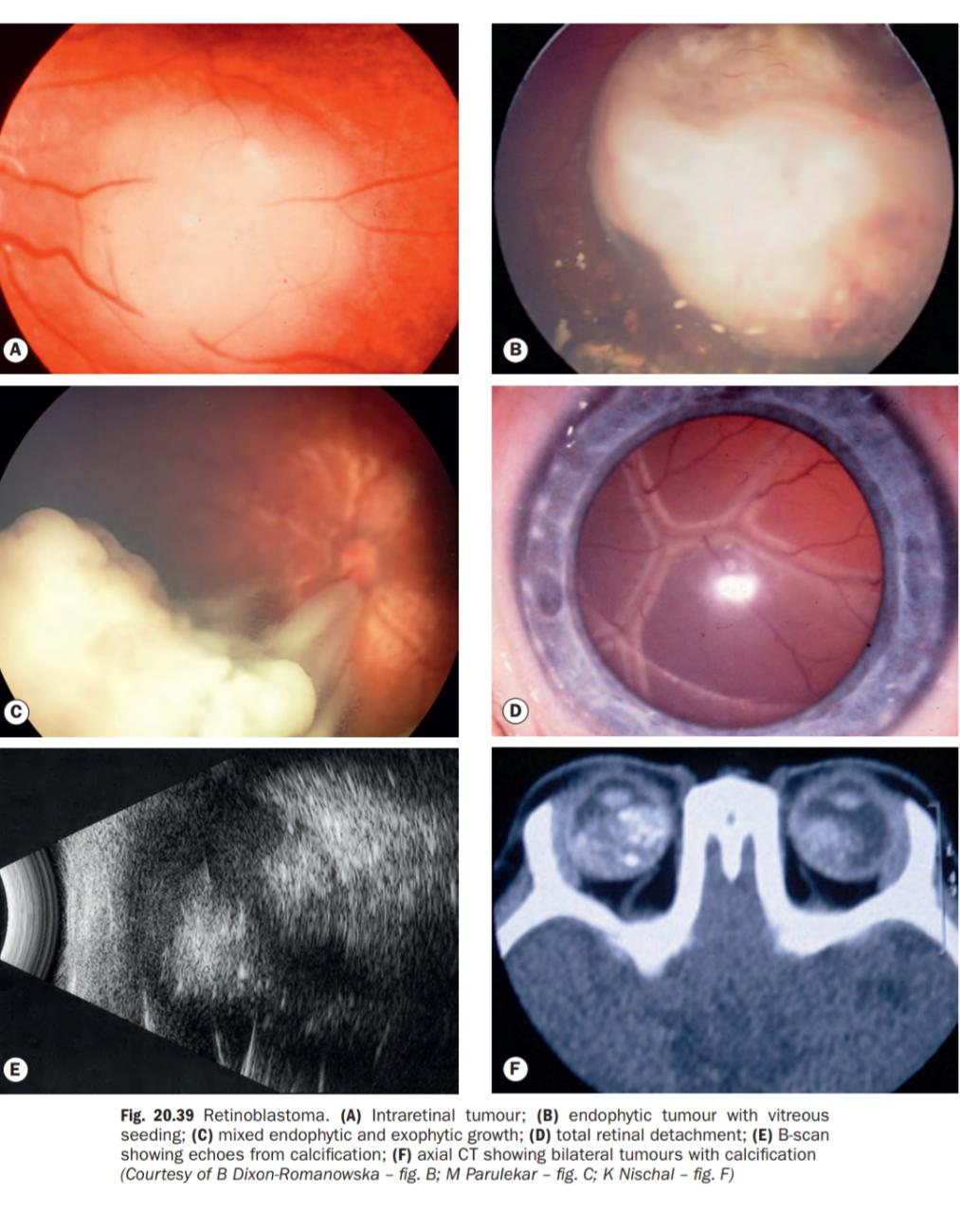

Slide 36
spread
Optic nerve invasion may occur, with spread of tumor along the sub arachnoid space to the brain
Metastatic spread is to regional lymph nodes, lungs, brain and bone

Slide 37
Clinical presentation
Presentation
Age:
Within 1st year of life in bilateral cases
Around 2 years of age if the tumor is unilateral
Careful enquiry of about family is critical

Slide 38
Leukocoria-- Commonest presentation 60%
Strabismus-- 2nd most common 20%
Painful red eye with secondary glaucoma
Poor vision
Inflammation or pseudoinflammation mimicking orbital or preseptal cellulitis
Metastatsis involving regional lymph nodes and brain

Slide 39
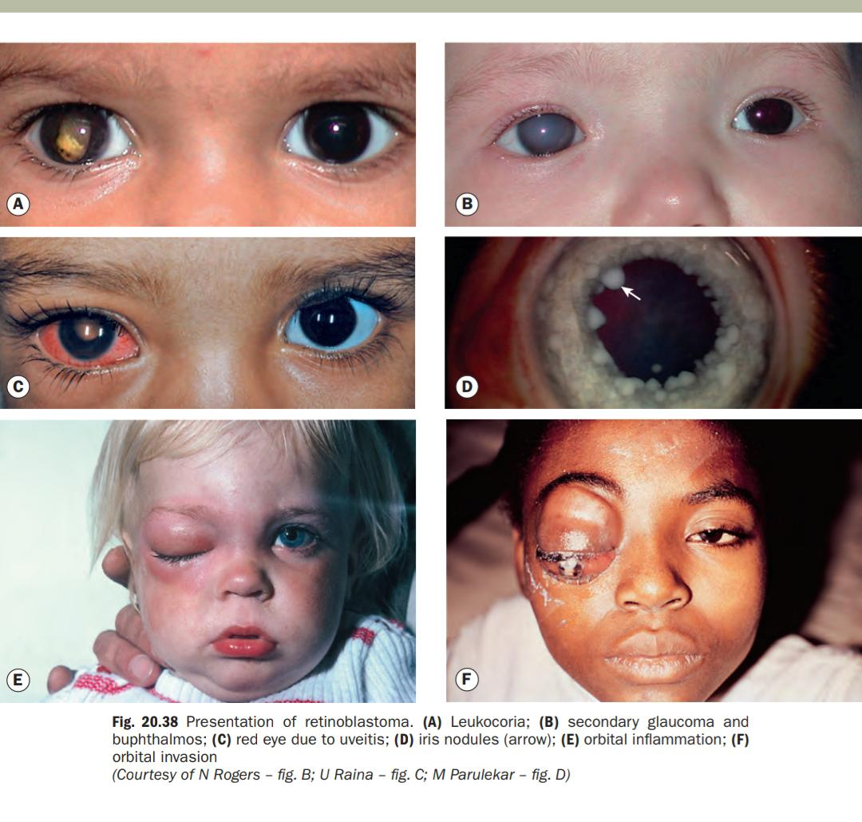

Slide 40
Investigation
1. Red reflex testing-with direct ophthalmoloscopy

Slide 41
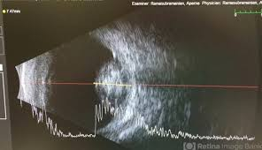
2. B scan

Slide 42
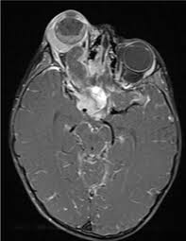
3. MRI brain+ orbits with and without contrast

Slide 43
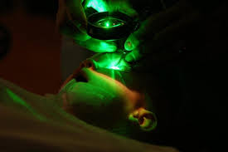
4. Examination under anesthesia
Pre laser tumors
Post laser

Slide 44
Treatment
A collaborative approach is required involving the ophthalmologist, pediatric oncologist, ocular pathologist, geneticist, allied health professional and parents

Slide 45
Medical management:
Systemic Chemotherapy-- VEC
Vincristine, Etoposide and Carboplatin
Intravitreal and intra ophthalmic chemotherapy-- melphalan
Cryotherapy
External beam radiotherapy

Slide 46
Surgical management:
Enucleation
Exenteration
Frequent follow up
Rehabilitation(Cosmetic shells, orbital implants, ocular prosthesis)

Slide 47
Rhabdomyoscarcoma

Slide 48
Rhabdomyoscarcoma
Most common primary orbital malignancy in children
Average age of onset-- 7 years
The tumor is derived from undifferentiated mesenchymal cells that have the potential to differentiate into striated muscles

Slide 49
Diagnosis
unilateral
proptosis
mimics inflammatory condition e.g. orbital cellulitis
Most common location - superonasal

Slide 51
Investigations
MRI
CT Scan
Incisional biopsy to confirm diagnosis
Metastatic workup
lungs and bones most common sites

Slide 52
Treatment
MEDICAL:
Combined radio and chemo therapy
SURGICAL:
debulking
Prognosis for patients with disease confined to orbit is good

Slide 53
Research and ethics:
According to an article published in JCPSP most children with retinoblastoma showed an advanced stage of tumor at the time of diagnosis, so rate of globe preservation is less than developed countries.
Hence early screening of leucocoria in infants should be mandatory.
Before enucleation and exenteration, informed written consent should be obtain from parents.

Slide 54
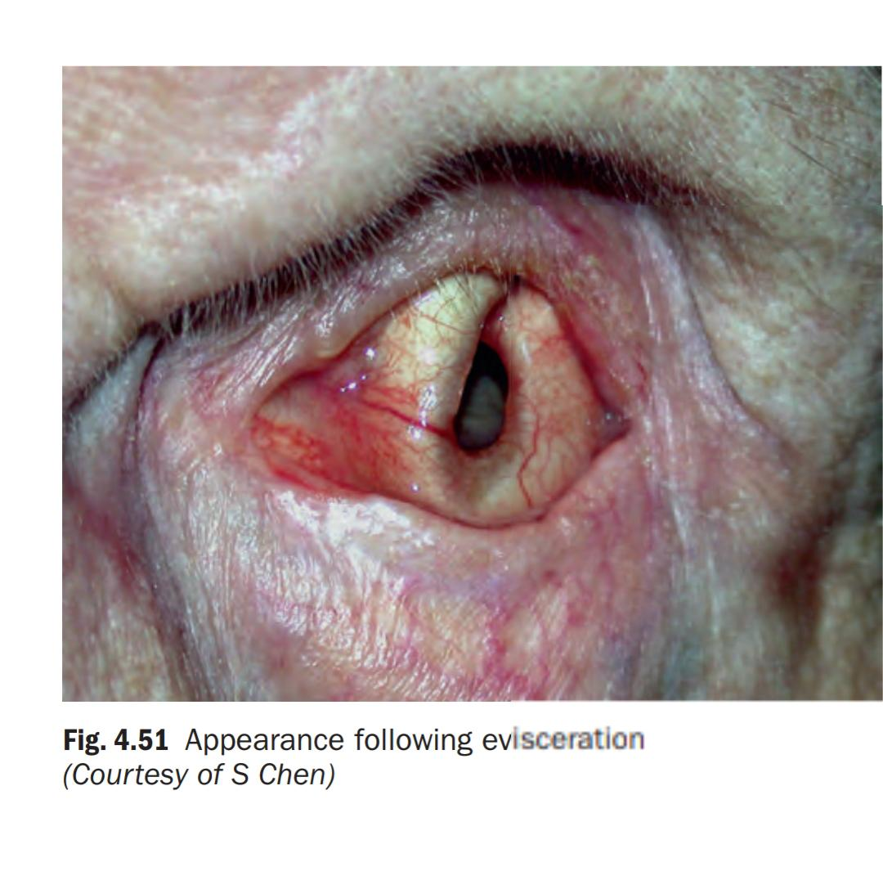

Slide 55
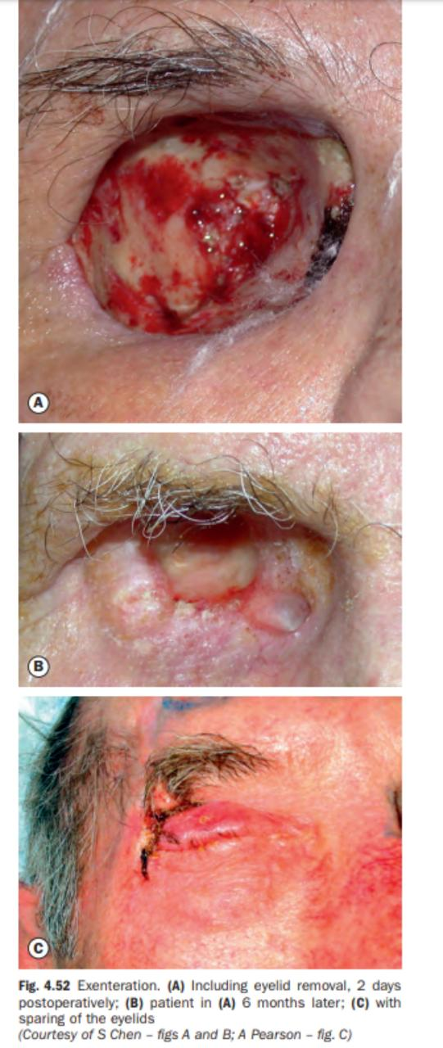

Slide 56
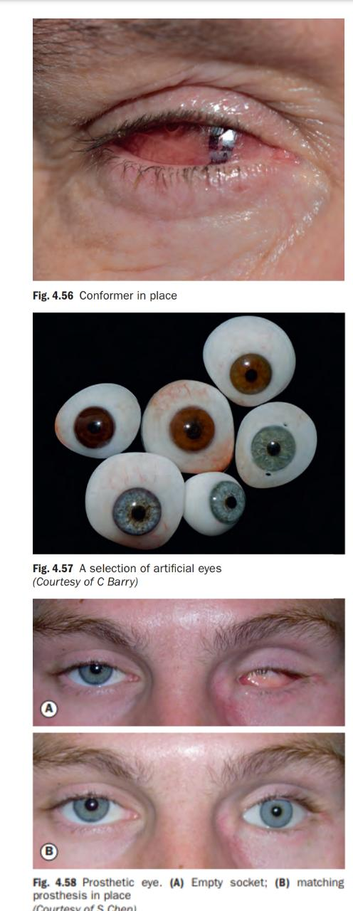

Slide 57
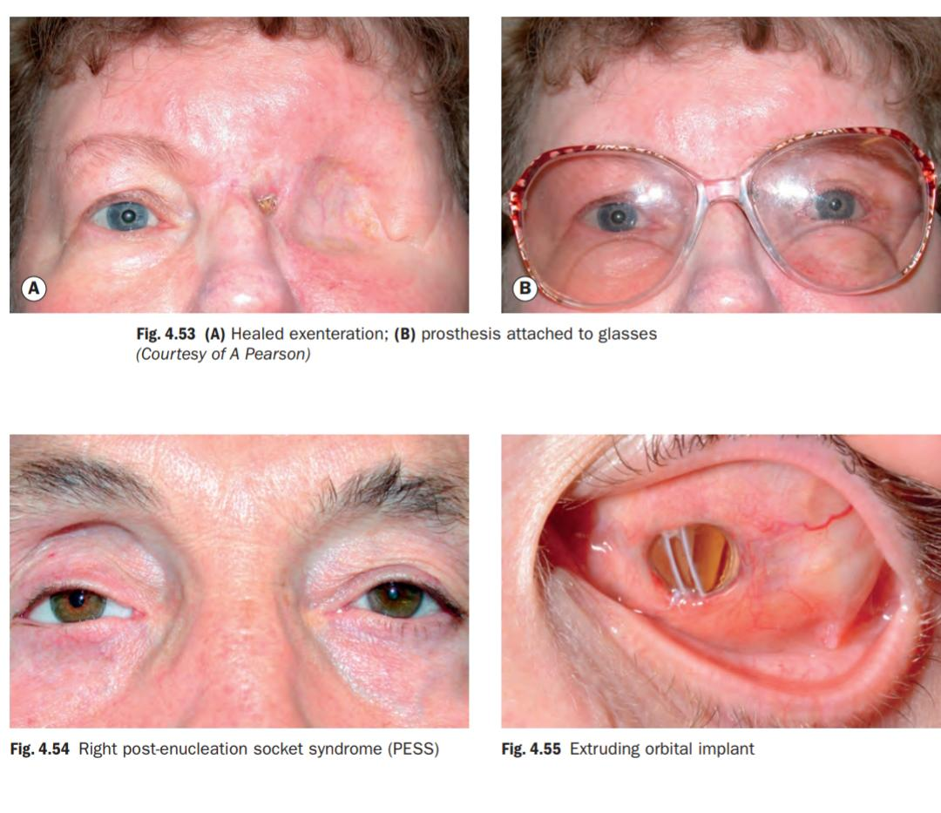

Slide 58
Artificial intelligence in retinoblastoma:
A retrospective study was done at The Operation Eyesight Universal Institute for Eye Cancer (SK) and Hyderabad Eye Research Foundation (SK), Hyderabad, India to explore the utility of artificial intelligence (AI) and machine learning in the diagnosis and grouping of intraocular retinoblastoma (iRB).
It turned out that AI is a promising screening tool for retinoblastoma detection and staging.

Slide 59
EOLA( END OF LECTURE ASSESSMENT)
A 2 years old child was brought to eye OPD with complaint of leukocoria in his left eye. On B scan there was a dense white homogenous mass in vitreous along with calcification
What could be the most likely diagnosis?
What other investigation you would like to perform?
What could be the likely mode of inheritance?

Slide 60
EOLA contd: Picture description

Slide 61
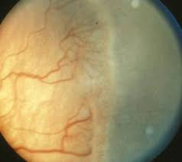
EOLA

Slide 62
References:
Kanski clinical ophthalmology, 8th edition 497-504, 109-110
Basic ophthalmology by Renu Jogi,
Kaliki, Swathi; Vempuluru, Vijitha S; Ghose, Neha; Patil, Gaurav; Viriyala, Rajiv¹; Dhara, Krishna K¹. Artificial intelligence and machine learning in ocular oncology: Retinoblastoma. Indian Journal of Ophthalmology 71(2):p 424-430, February 2023. | DOI: 10.4103/ijo.IJO_1393_22

