Slide 1
Environment(noise)
Block X Otorhinolaryngology
Module-II
4th Year MBBS
DR AFIFA KULSOOM,ASSISTANT PROF COMMUNITY MEDICINE
DR MEHWISH RIAZ, ASSISTANT PROF COMMUNITY MEDICINE

Slide 2


Slide 3
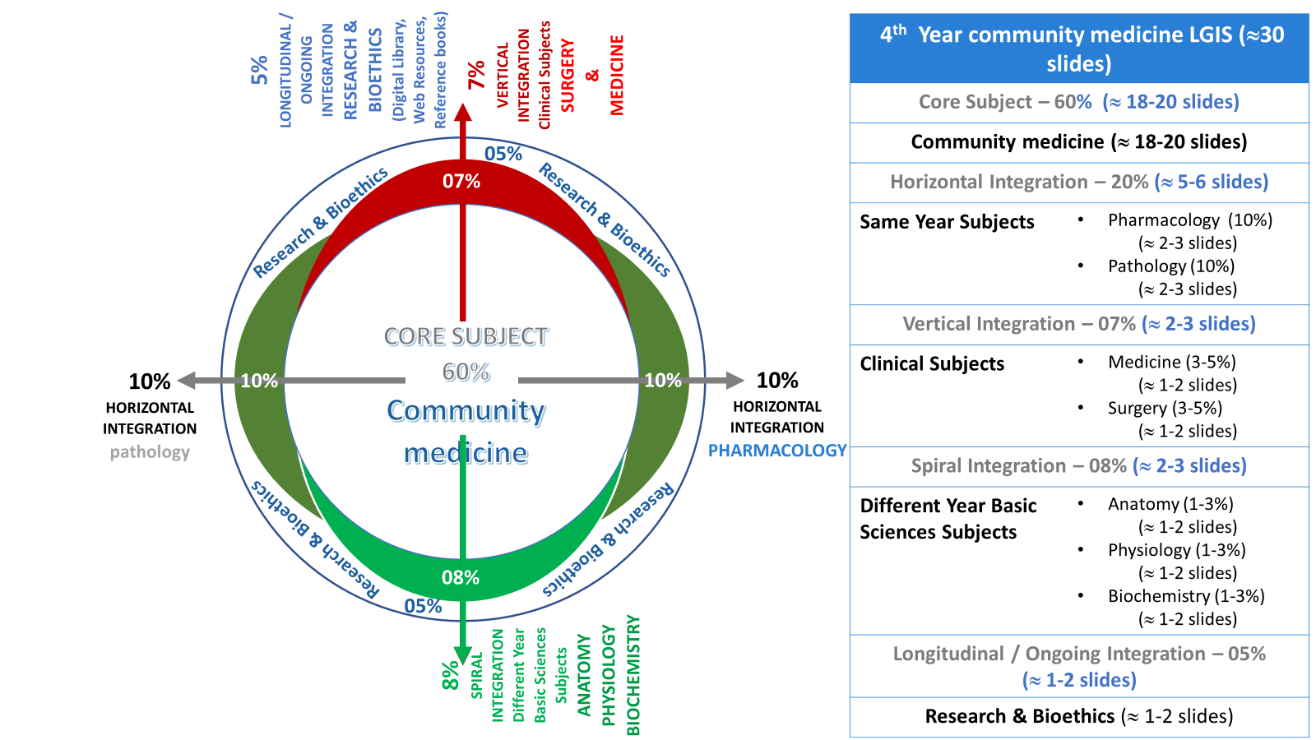
Prof Umar model

Slide 4
Sequence of Lecture
Learning objectives (01 slide)
Core component (08 slide)
Vertical integration (03 slide)
Horizontal integration (01 slide)
Research (01 slide)
References (01 slide)
End of lecture assessment (2 slides)

Slide 5
Learning objectives
Define noise and explain its sources
Describe properties of noise
Apprehend auditory & non auditory effects of noise exposure
Recommend approaches of noise control

Slide 6
Definition
Core concept
Noise:
“Sound that is unwanted or disrupts one’s quality of life”
Pollution: “Undesirable state of the natural environment being
contaminated with harmful substances as a result of human activities”
Noise pollution
“ Refers to sounds in the environment that are caused by humans and that threaten the health or welfare of human or animal inhabitants”.

Slide 7
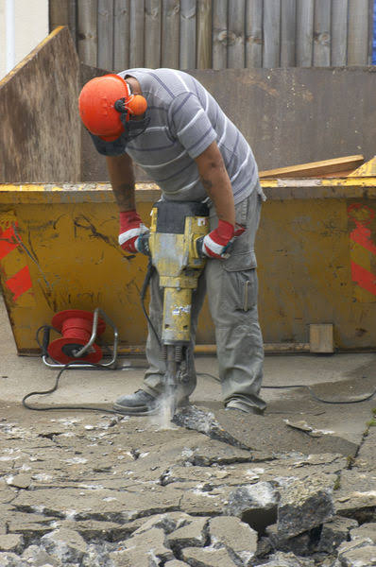

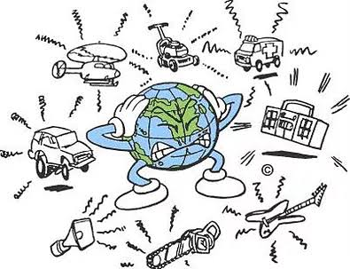

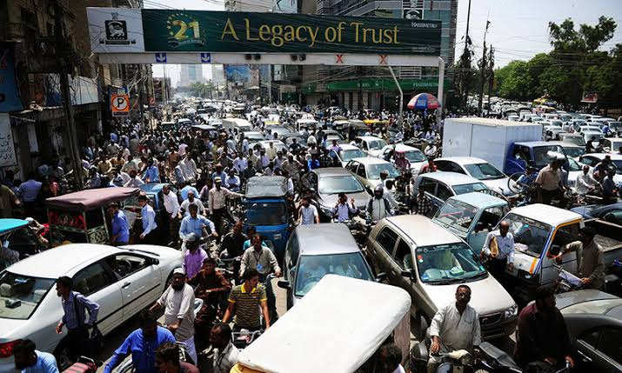
Sources of Noise Pollution
Core concept

Slide 8
Properties of Noise
Core concept
Two main properties:
Loudness or intensity
Frequency

Slide 9
Properties of Noise
Core concept
Loudness or Intensity
  Depends upon the amplitude of the vibrations which initiates the noise
  When we say it is 60 dB, it means 60dB more intense than the smallest distinguishable sound “ Reference sound pressure” of 0.0002 microbar or dynes/cm²
  A Dyne =1/ 1000000th of the atmospheric pressure
  A daily exposure up to 85 dB is the maximum limit which human ear can tolerate without substantial damage to hearing.
Contd
Notes:
The loudness of noise is measured in decibels (dB)
Normal Conversation 60-65 dB
Whispering 20-30 dB
Heavy Street Traffic 60-80 dB
Boiler Factories 120 dB
Children crying 80 dB
Jet take off 50 dB

Slide 10
Properties of Noise….
Core concept
Frequency
  The frequency is denoted as Hertz (Hz)
  One Hz = one wave/ second
  The human ear can hear frequencies from 20 to 20,000 Hz
  This range is reduced with age and other subjective factors
  Infra-audible : Vibrations below 20 Hz
  Ultra-sonic: Vibrations above 20,000 Hz

Slide 11

Properties of Noise….
Core concept
          Acceptable noise levels(dB)
Residential | Bed room Living room | 25 40
Commercial | Office Conference Restaurants | 35-40 40-45 40-60
Industrial | Workshop Laboratory | 40-60 40-50
Educational | Class room Library | 30-40 35-40
Hospitals | Wards | 20-35

Slide 12
Community Noise Levels in Decibels
Core concept
-150-160 Mechanical damage
-140 Threshold of pain
- 120 Motor car horn
- 110 Train passing a station
- 85 Recommended Maximum
- 80 Printing Press
- 70 Heavy Street traffic
- 60 Normal conversation
- 40 Quite Library
-20 Whisper
- 10

Slide 13
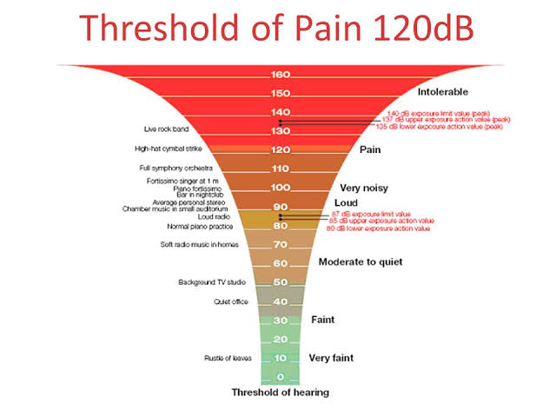
Comparative Noise levels
Horizontal integration

Slide 14
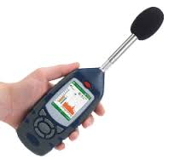
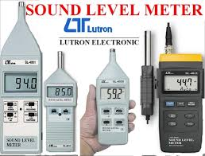
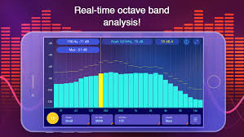
Measurement of Noise
Core concept
  Sound Level Meter
    Measures the intensity of sound in dB
  Octave Band Frequency Analyzer
    Measures the noise in octave bands and forms the sound spectrum
    Indicates the characteristics of
    the noise, whether it is
    high-pitched, low-pitched or
    of variable pitch
Contd

Slide 15
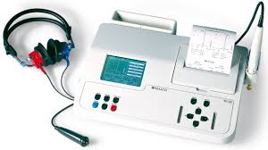
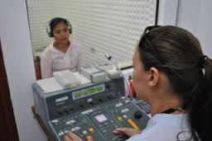
Measurement of Noise….
Core concept
  Audiometer
    Measures hearing ability
    Zero line at the top in the audiogram represents normal hearing
    Noise-induced hearing loss shows a characteristic dip in the curve at 4000 Hz frequency

Slide 16
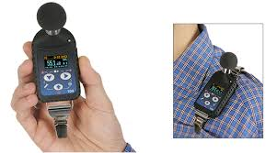
Measurement of Noise….
Core concept
Personal Noise Dosimeters:
  A specialized sound level meter to measure the noise exposure of a person over a period of time
  Worn on the body of a worker with the Microphone mounted on the middle-top of the person’s most exposed shoulder
  Area monitoring can be used to estimate noise exposure when the noise levels are relatively constant and employees are not mobile
Notes:
A specialized sound level meter intended specifically to measure the noise exposure of a person integrated over a period of time
(usually to comply with Health and Safety regulations such as the Occupational Safety and Health (OSHA)
personal noise dosimeters are often worn on the body of a worker with the microphone mounted on the middle-top of the person’s most exposed shoulder
Area monitoring can be used to estimate noise exposure when the noise levels are relatively constant and employees are not mobile

Slide 17
Effects of Noise pollution
Core concept
Auditory effects
Auditory fatigue
Deafness:
  Temporary hearing loss
  Permanent hearing loss
Non Auditory effects
High blood pressure
Interference in speech communication
Annoyance
Decrease in efficiency
Psychological changes

Slide 18
Auditory Effects Of Noise
Pollution
Vertical integration
1.Auditory fatigue
    Appears at 90 dB and greatest at 4000 Hz
    Associated with whistling and buzzing in the ears
    2. Deafness:
      Temporary Hearing Loss
      Results from a specific exposure to noise and the victim is unaware
      Occurs in frequencies between 4000-6000Hz
      Disappears within 24 hours of exposure

Slide 19
Auditory Effects Of Noise
Pollution
Vertical integration
      Permanent Hearing Loss
      Results from repeated or continuous exposure to noise around 100 dB
      Associated with inner ear damage
      Exposure to noise above 160 dB may rupture the tympanic membrane and cause permanent loss of hearing
      When this happens in an industry, it is called “ Occupational Hearing Loss”

Slide 20
Non-Auditory Effects Of Noise
Pollution
Core concept
  Interference with Speech:
    Maximum disturbance at 300-500 Hz range in speech communication
    Such frequencies are commonly found in road and air traffic
    2. Efficiency:
    Decreases due to loss of concentration
    Specially where mental concentration is required
    Reduction in noise may increase work out put

Slide 21
Non-Auditory Effects Of Noise
Pollution
Vertical integration
  3. Annoyance:
    A psychological response, neurotic people are more sensitive than balanced people
    Workmen exposed to higher intensities of noise are often irritated, short tempered and impatient
    More likely to resort to agitation and disrupt production

Slide 22
Non-Auditory Effects Of Noise
Pollution
Horizontal integration
  4. Physiological Changes:
  Temporary changes occur:
    Rise in blood pressure
    Rise in intracranial pressure
    Increase in heart rate and breathing
    Increase in sweating
    Visual disturbances like impaired colour perception, reduced night vision

Slide 23
Non-Auditory Effects Of Noise
Pollution
Horizontal integration
        General symptoms:
        Giddiness, nausea and fatigue
        Sleep disturbance
  5. Psychological changes:
        Memory loss
        Severe depression, panic attacks
        Sleep disruption
  6. Economic Losses:
      Due to harmful effects of noise like hearing loss of the industry workers

Slide 24
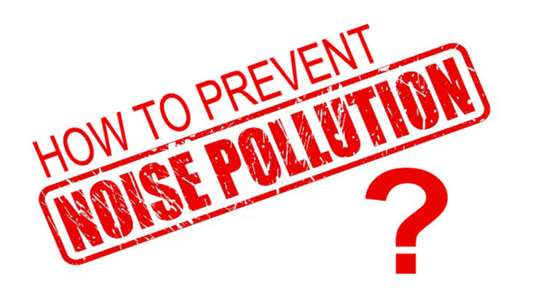

Slide 25
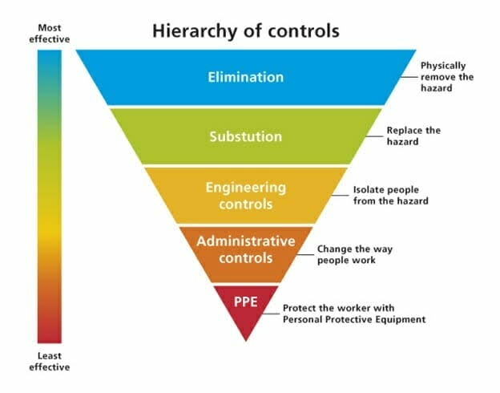
Control Of Noise
Pollution
Core concept

Slide 26
Control Of Noise
Pollution
Core concept
Careful Planning of Cities
  Division of cities in various zones separated by green belts
  Separate areas for industry and transport
  House fronts should lie not less than 15 m from the road
  Widening of main streets
Control of Vehicles
  Heavy vehicles should not be routed into narrow streets
  Indiscriminate blowing of the horn and use of pressure horn should be prohibited
  Regular servicing and tuning of automobiles

Slide 27
Control of Noise pollution
Core concept
Control of noise in industries and railways:
  Control at Source:
    By segregating noisy machines, application of noise mufflers
    Should be away from residential areas
    If not possible than green belts must be laid down between them
    By improving acoustic insulation of the buildings and making them sound proof
  Control of Transmission
    By building enclosures and covering room walls with absorbing material

Slide 28
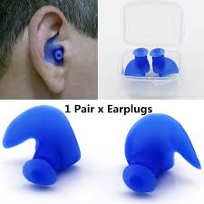
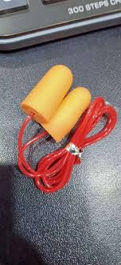
Control Of Noise
Pollution
Core concept
  Protection of Exposed Persons
    Hearing protection of workers exposed to sound more than 85dB or 150 Hz frequency
    Use of ear plugs
    Regular check up
    Periodical audiogram
    Rotation from noisy place to quite places
    Use of Personal Noise Dosimeters

Slide 29
Control of noise Pollution
Family medicine
Health Education:
    To achieve workers participation
    Community participation
    Social awareness programs should be taken up, to educate the public about the causes and effects of noise pollution.
    Community development or urban management:
    Should be done with long-term planning, along with an aim to reduce noise pollution

Slide 30
Control Of Noise
Pollution
Core concept
    Legislation:
    For providing various controls
    Worker’s compensation for loss of hearing
    Regulations should be imposed to restrict the use of loudspeakers/ public address systems and sound producing instruments in crowded areas and public places.
    Restrictions on the use of Horns, sound emitting construction equipments and bursting of fire crackers
    Consequences of any violation in silence zones / areas

Slide 31
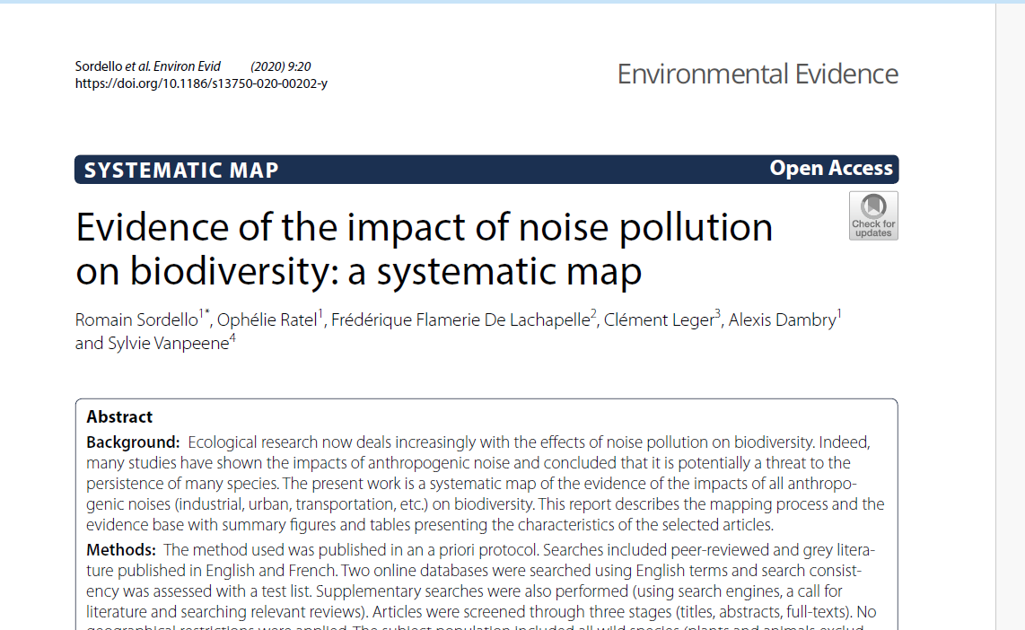
Research
Spiral integration
https://environmentalevidencejournal.biomedcentral.com/articles/10.1186/s13750-020-00202-y

Slide 32

Artificial intelligence
Spiral integration
https://gemmo.ai/ai-noise-pollution/

Slide 33
End of lecture assessment
A person presented with hearing loss after 12 hours of noise exposure. This hearing loss disappeared shortly afterwards. The frequency of noise is likely to be between the ranges of:
1000 – 2000 Hz
2000 – 4000 Hz
4000 – 6000 Hz
6000 – 8000 Hz
8000 – 10,000 Hz

Slide 34
References
K park book of community medicine 778-787
Ilyas Ansari

