Slide 2
THEME:A Neck Mass at the Submandibular Triangle.
To impart evidence-based research-oriented health
To impart evidence-based research-oriented health
To impart evidence-based research-oriented health
DR. Usman Qureshi
M.B.B.S F.C.P.S
HEAD OF THE DEPARTMENT
SURGERY UNIT–II, BBH
RAWALPINDI MEDICAL UNIVERSITY

Slide 3
University Motto, Vision, Values & Goals
Mission Statement To impart evidence-based research-oriented health professional education .Best possible patient care Mutual respect, ethical practice of healthcare and social accountability. Vision and Values Highly recognized and accredited centre of excellence in Medical Education, using evidence-based training techniques for development of highly competent health professionals, who are lifelong experiential learner and are socially accountable. Goals The Undergraduate Integrated Learning Program is geared to provide you with quality medical education in an environment designed to:

Slide 4
PROF UMER MODEL OF INTEGRATED LECTURE

Slide 5
LEARNING OBJECTIVES
At The End Of This Lecture Students Shall Be Able To Learn:
To understand the surgical anatomy of the submandibular glands
To make D/D of this swelling including submandibular gland
Advise specific investigation to diagnose submandibular gland Swelling
Know the surgical options of neck swelling management

Slide 6
CLINICAL SCENARIO
A 45-year-old man presents with a painless swelling in the submandibular region. The swelling has been gradually increasing in size over the past three months. On physical examination, the mass is firm, non-tender, and mobile. There is no associated lymphadenopathy. Which of the following is the most likely diagnosis?
A. Submandibular gland sialadenitis B. Submandibular gland stone (sialolithiasis) C. Submandibular gland tumor D. Reactive lymphadenopathy E. Branchial cleft cyst

Slide 7
Answer: C. Submandibular gland tumor
Explanation:
The presentation of a gradually enlarging, painless, firm, and mobile mass in the submandibular region is highly suggestive of a submandibular gland tumor. Submandibular gland tumors are typically slow-growing and may not be associated with pain or other acute inflammatory signs.

Slide 8
CLINICAL SCENARIO
A 50-year-old man reports a slowly enlarging mass in his submandibular region. He has no pain or signs of infection. Fine-needle aspiration cytology reveals pleomorphic adenoma. What is the recommended treatment for this condition?
A. Observation B. Radiation therapy C. Surgical excision D. Chemotherapy E. Steroid therapy

Slide 9
Answer: C. Surgical excision
Explanation: Pleomorphic adenoma is the most common benign tumor of the salivary glands. The recommended treatment is surgical excision to prevent potential malignant transformation and to achieve complete removal of the tumor.
Observation is not recommended due to the risk of growth and transformation.
Radiation therapy and chemotherapy are not standard treatments for benign tumors.
Steroid therapy is not indicated in the management of pleomorphic adenomas.

Slide 10
INTRODUCTION
The Submandibular glands are bilateral salivary glands located in the Submandibular Triangle.
Their mixed serous and mucous salivary secretions are important for the lubrication of food during mastication to enable effective swallowing and aid digestion.
The submandibular gland is located within the anterior part of the submandibular triangle. The boundaries of this triangle are:
Superiorly: Inferior body of the mandible.
Anteriorly: Anterior belly of the digastric muscle.
Posteriorly: Posterior belly of the digastric muscle

Slide 11
The glands have a superficial and deep lobe separated by the mylohyoid muscle.
The Wharton duct, the submandibular gland’s primary excretory duct, drains into the oral cavity at the sublingual caruncle. The sublingual caruncle is a papilla located medial to the sublingual gland and lateral to each side of the frenulum linguae.
The submandibular gland produces approximately 70% of the saliva in the unstimulated state.

Slide 12
ANATOMY

Slide 13
ANATOMY

Slide 14
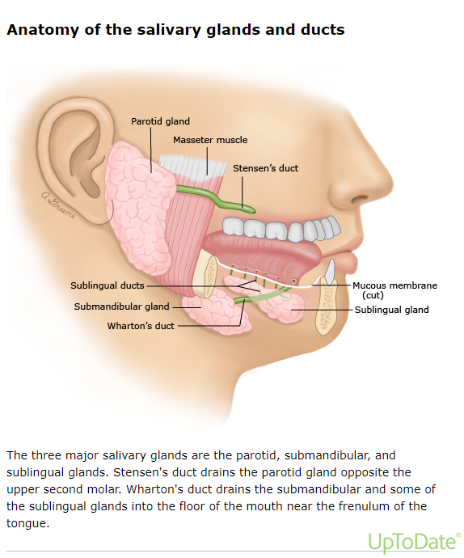

Slide 15
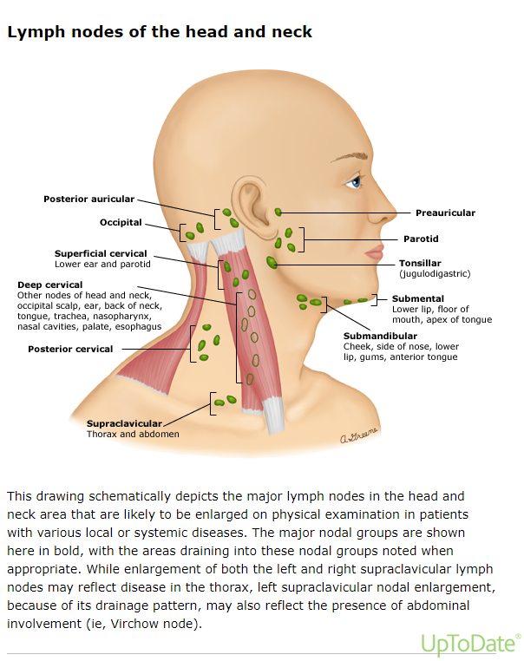

Slide 16
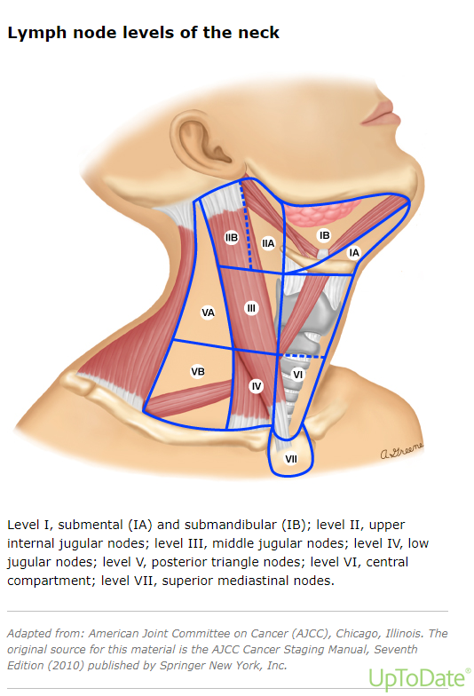

Slide 17
DIFFERENTIAL DIAGNOSIS
Sialadenitis
Sialolithiasis
Lymphadenitis
Benign Tumors
Pleomorphic adenoma
Dermoid cyst
Lymphangioma
neurofibroma
Infantile fibromatosis
Malignant Tumors
Adenoid cystic CA
Malign mixed tumor
Lymphoma
Metastatic CA

Slide 18
Clinical Menifestation
Signs and symptoms of a salivary gland tumor may include:
A lump or swelling on neck
Numbness in part of face
Muscle weakness on one side of face
Persistent pain in the area of a salivary gland
Difficulty swallowing
Trouble opening mouth widely
Fever
Weight Loss

Slide 21
INVESTIGATIONS
HISTORY AND EXAMINATION (Bimanual+Oral Cavity)
USG NECK
CT SCAN
MRI
FNAC
Excisional Biopsy

Slide 22
Treatment Options
Complete Surgical resection is the cornerstone of treatment. Patients with benign tumors and low-grade malignancies are typically treated with surgery alone.
Patients with high-grade carcinomas and those with positive margins or other high-risk features are usually treated with surgery and adjuvant radiation therapy (RT).
Patients with unresectable tumors may be treated with RT alone or RT in combination with chemotherapy.

Slide 23
Surgical Treatment Options
Benign tumors are most commonly treated by simple excision of the gland. The marginal mandibular branch of the facial nerve, the hypoglossal nerve, and the lingual nerve should be spared.
Submandibular gland tumors, nearly half of which are malignant, are treated with submandibular sialoadenectomy, a resection of the submandibular gland.
Selective neck dissection and adjuvant radiation therapy are therapeutic approaches for advanced tumor staging or aggressive pathologies.
The surgical approach may be transcervical, intraoral, or endoscopic.

Slide 24
REFERENCES
Guzzo M, Locati LD, Prott FJ, et al. Major and minor salivary gland tumors. Crit Rev Oncol Hematol 2010; 74:134.
Spiro RH. Salivary neoplasms: overview of a 35-year experience with 2,807 patients. Head Neck Surg 1986; 8:177.
Xiao CC, Zhan KY, White-Gilbertson SJ, Day TA. Predictors of Nodal Metastasis in Parotid Malignancies: A National Cancer Data Base Study of 22,653 Patients. Otolaryngol Head Neck Surg 2016; 154:121.
Dillon PM, Chakraborty S, Moskaluk CA, et al. Adenoid cystic carcinoma: A review of recent advances, molecular targets, and clinical trials. Head Neck 2016; 38:620.
Hay AJ, Migliacci J, Karassawa Zanoni D, et al. Minor salivary gland tumors of the head and neck-Memorial Sloan Kettering experience: Incidence and outcomes by site and histological type. Cancer 2019; 125:3354.
Jayaprakash V, Merzianu M, Warren GW, et al. Survival rates and prognostic factors for infiltrating salivary duct carcinoma: Analysis of 228 cases from the Surveillance, Epidemiology, and End Results database. Head Neck 2014; 36:694.

Slide 25
Any Question?
Thankyou

