Slide 1


Slide 2
LADIES AND GENTLEMEN PLEASE RISE FOR THE NATIONAL ANTHEM

Slide 3
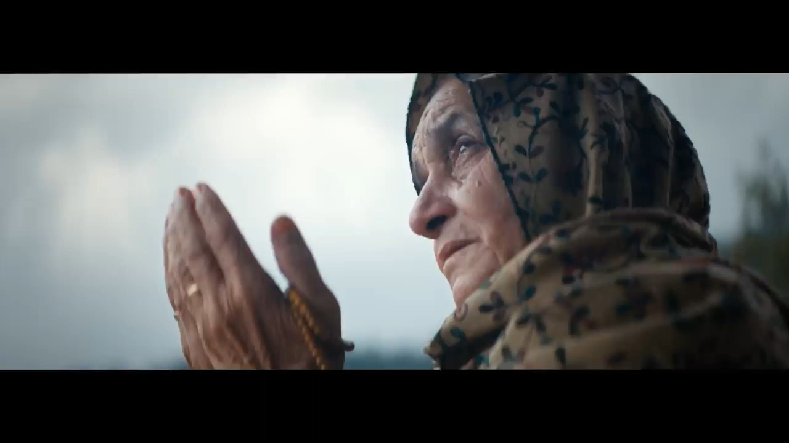

Slide 4

University Motto, Mission, Vision & Values
Mission Statement
To impart evidence-based research-oriented health
professional education, best possible patient care,
mutual respect, ethical practice of healthcare and social accountability.
Vision and Values
Highly recognized and accredited center of excellence in
Medical Education, using evidence-based training techniques for development of highly competent health professionals, who are lifelong experiential learner and are socially accountable.

Slide 5
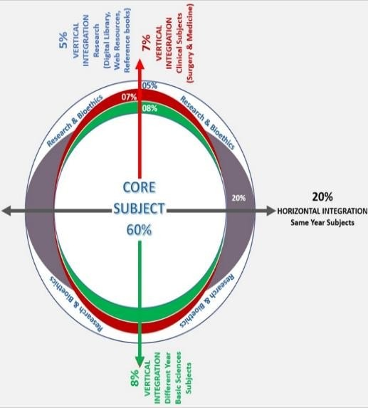
Prof Umar Model Of Integrated Lecture

Slide 6
Sequence Of LGIS
Learning objectives
Core concept of subject 80%
Related Anatomy, Pathology(vertical integration 5%)
Related Epidemiology (horizontal integration – 10%)
Research article related to topic (3%)
Ethics (2%)

Slide 7
Learning objectives
At the end of this session you all ill be able to:
Identify clinical symptoms and sign of the disease.
Describe the underpinned pathology
Define two types of polyps
Differentiate between them
Plan how to manage the patient

Slide 8
Nasal Polyps

Slide 9
Nasal Polyp
Hypertrophied, oedematous, prolapsed mucosa of nose & paranasal sinus.
Properties of nasal polyp:
Pedunculated
Does not bleed on probing
Gray in colour
Glistening
Smooth surface
Insensitive to pain
Mobile

Slide 10
A 7-year-old boy presented with history of repeated attacks of mucopurulent discharge, nasal obstruction and anosmia. O/E there was a firm mass visible in left nostril.
What is your probable diagnosis.
How will you manage the patient.

Slide 11
Antro-choanal Polyp

Slide 12
Etiology & origin
Etiology:
Infective maxillary sinusitis
Anomaly of maxillary sinus ostium
Origin:
Arises from maxillary sinus mucosa & exits via its natural or accessory ostium

Slide 13
Clinical Presentation
Child
Unilateral nasal obstruction
Unilateral nasal discharge

Slide 14
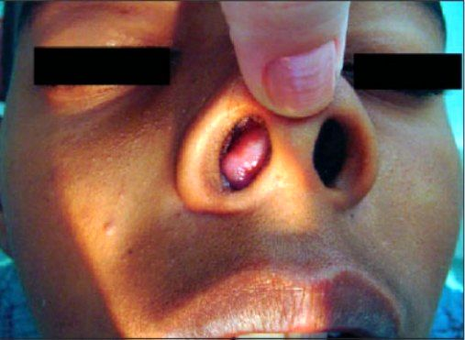

Slide 15
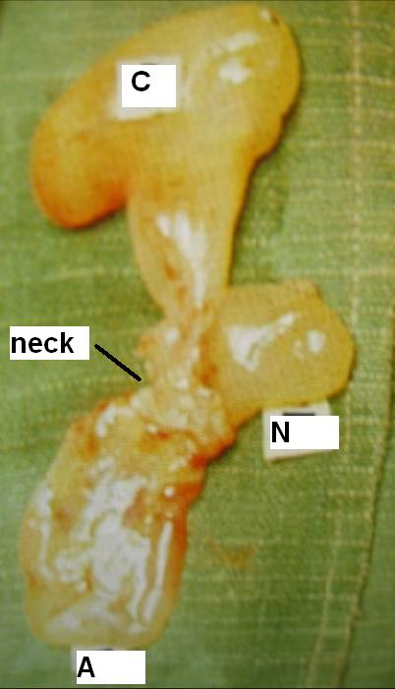
Parts of Killian’s A.C. polyp
Antral: globular
Nasal: flattened transversely
Choanal: globular
Neck: present at maxillary ostium

Slide 16
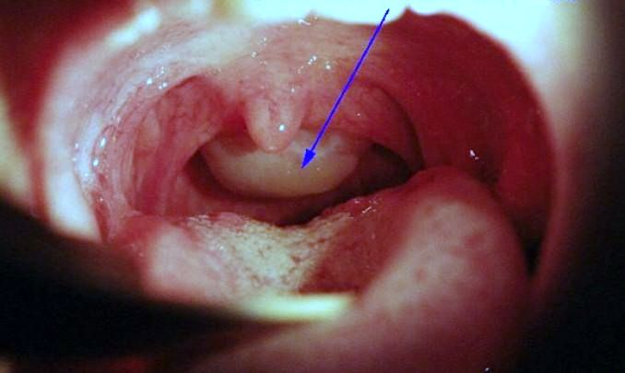
Oropharynx examination

Slide 17
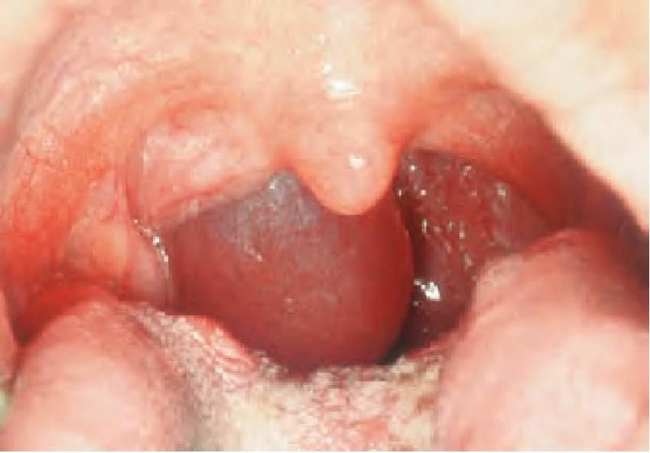
Oropharynx examination

Slide 18
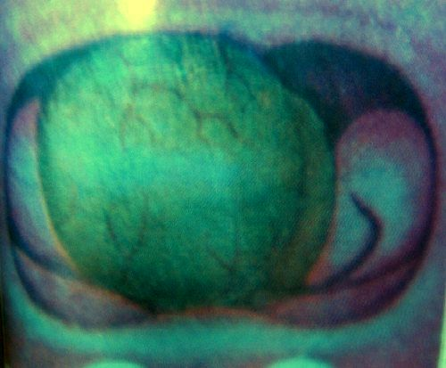
Posterior rhinoscopy

Slide 19
Examination of nasal mass
Inspection = side, size, number, color, surface, pedunculated or sessile, origin, attachment
Probing = consistency, sensitivity to touch, bleeding on touch, can be passed all around
Shrinkage with decongestant drops

Slide 20
Probe test
Antrochoanal polyp | Hypertrophied turbinate
Insensitive to pain | Sensitive
Probe can be passed all around | Cannot be passed
Mobile | Not mobile

Slide 21
Why AC polyp goes back?
1. Maxillary ostium is directed posteriorly
2. Cilia beat posteriorly
3. Air current flows posteriorly
4. Nasal floor slopes posteriorly
5. Posterior nasal cavity is larger
6. Negative oropharynx pressure while swallowing

Slide 22
Differential diagnosis
Hypertrophied inferior turbinate
Blob of mucous
Inverted papilloma
Rhinosporiosis & rhinoscleroma
Angiofibroma
Meningocoele
Malignancy

Slide 23
Investigations
Diagnostic Nasal Endoscopy
X-ray PNS (Waters view)
CT scan PNS (coronal cuts)

Slide 24
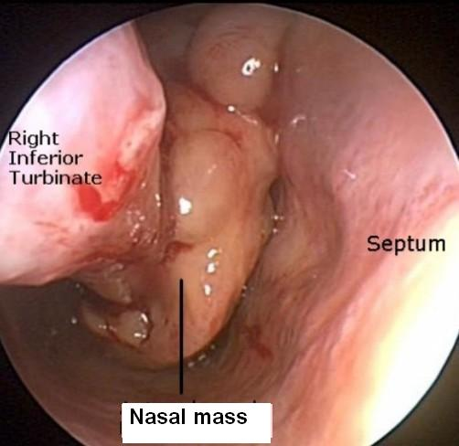
Diagnostic Nasal Endoscopy

Slide 25
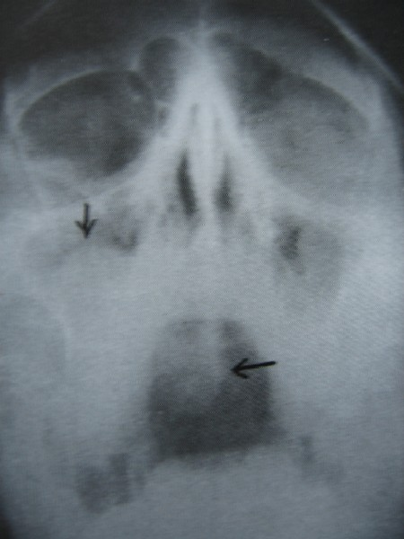
X-ray Paranasal Sinus

Slide 26
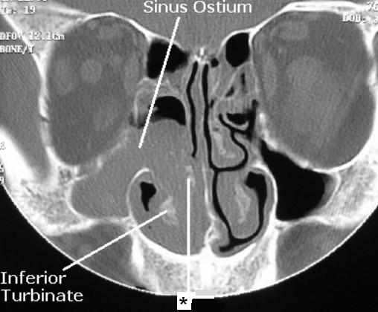
C.T. scan Paranasal Sinus

Slide 27
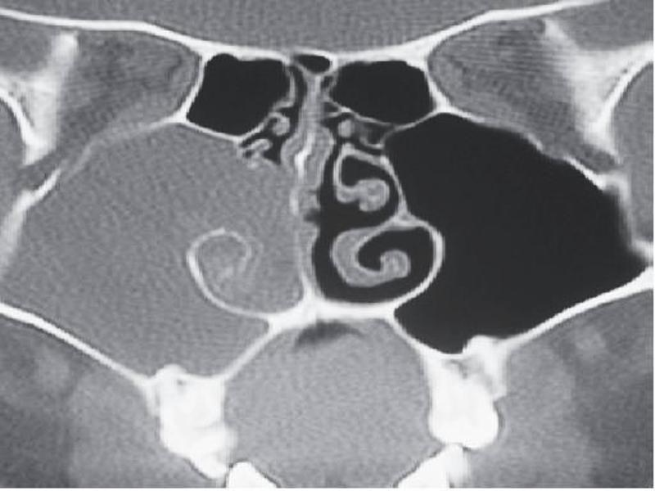
C.T. scan Paranasal Sinus

Slide 28
Treatment
Antibiotics (pre & post operatively)
F.E.S.S. (avulsion polypectomy with middle meatal antrostomy)
Caldwell – Luc operation (for recurrence)

Slide 29
How to prevent recurrence
Complete removal of all parts
Wide middle meatal antrostomy (widening of maxillary sinus ostium)
Post-operative antibiotics

Slide 30
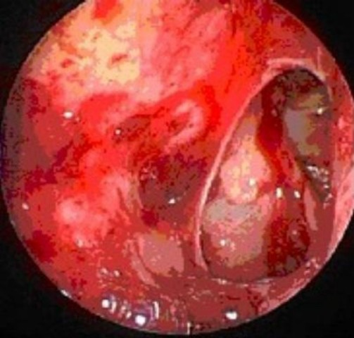
Middle meatal antrostomy

Slide 31
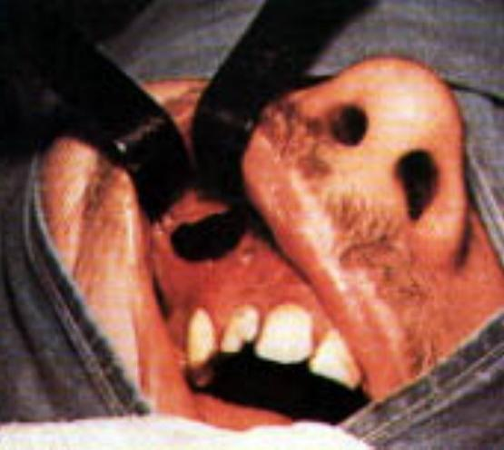
Caldwell – Luc Operation

Slide 32
A middle aged man presented with sneezing, rhinorrhea, and bilateral nasal obstruction. O/E there were grape like structures visible in both nasal cavities.
What is your probable diagnosis?
How will you manage the patient?

Slide 33
Ethmoid Polyp

Slide 34
Clinical Presentation
Adult patient
Bilateral nasal obstruction
Bilateral watery nasal discharge
Excessive, paroxysmal sneezing

Slide 35
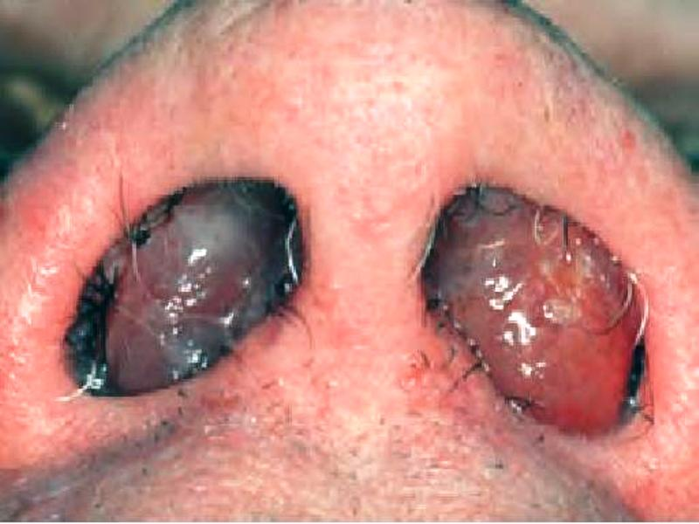
Examination

Slide 36
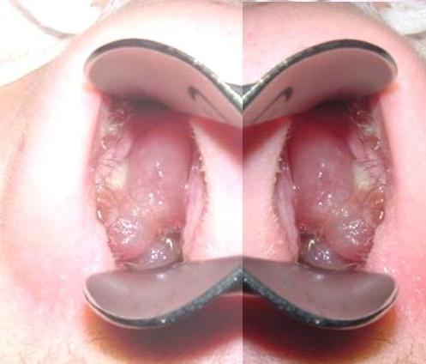
Anterior rhinoscopy

Slide 37
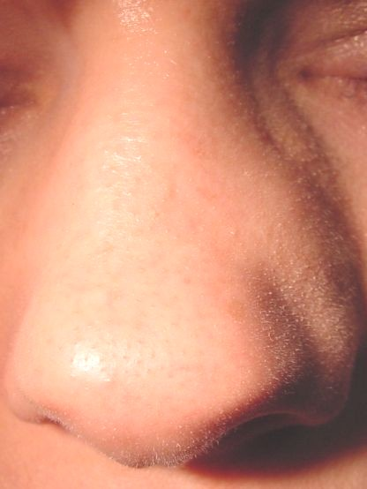
Broadening of nasal bridge

Slide 38
Etiology of ethmoid polyp
?

Slide 39
Associated diseases
1. Aspirin intolerance + Bronchial asthma + Ethmoid polypi = Samter’s triad
2. Cystic fibrosis
4. Kartagener’s syndrome (ciliary dyskinesia + situs invertus)
5. Young’s syndrome (hyperviscous mucous + azoospermia)
3. Allergic fungal sinusitis

Slide 40
Investigations
Diagnostic Nasal Endoscopy (D.N.E.)
X-ray PNS
C.T. scan P.N.S.
Tests for allergy

Slide 41
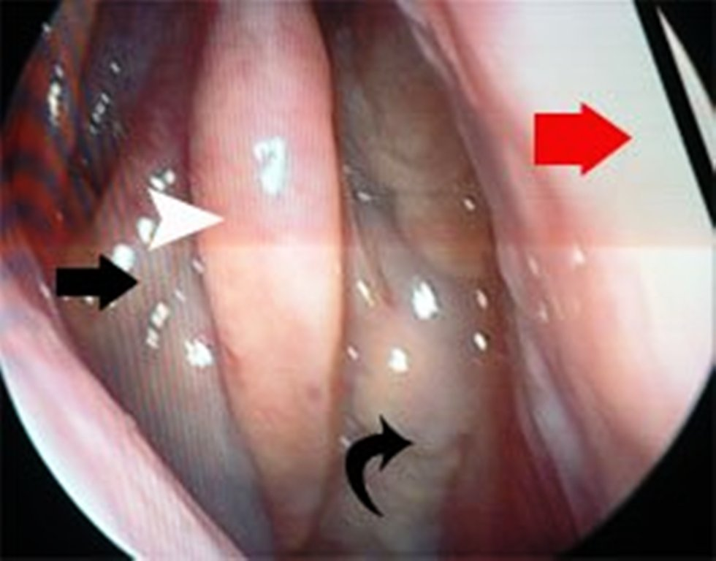
Diagnostic Nasal Endoscopy

Slide 42
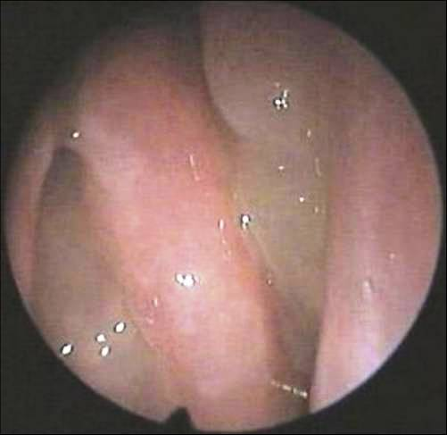
Diagnostic Nasal Endoscopy

Slide 43
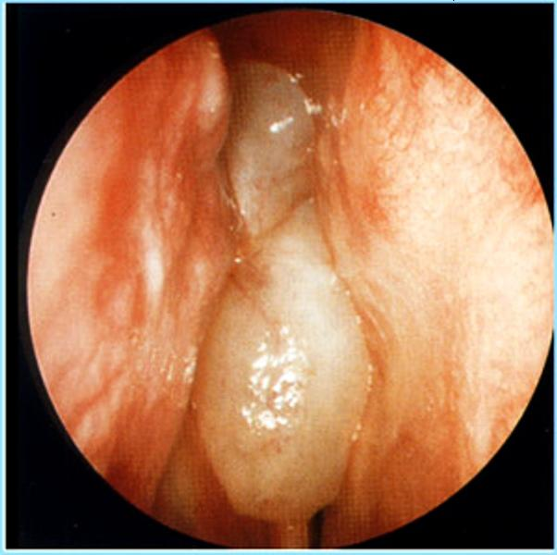
Diagnostic Nasal Endoscopy

Slide 44
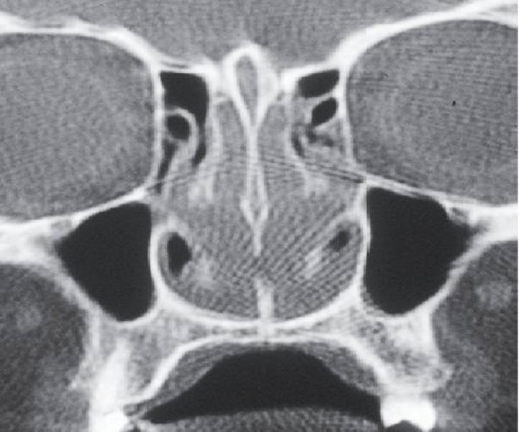
CT scan Paranasal Sinus

Slide 45
Non-surgical Treatment
Given for very small polyps
Avoid allergens
Oral antihistamines (1-3 months)
Corticosteroid nasal sprays (3-6 months)
Oral prednisolone (30mg/day for 2 weeks)

Slide 46
Medical polypectomy
?

Slide 47
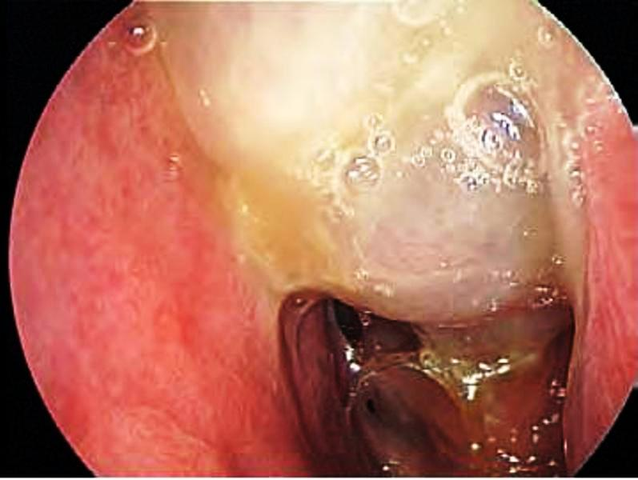
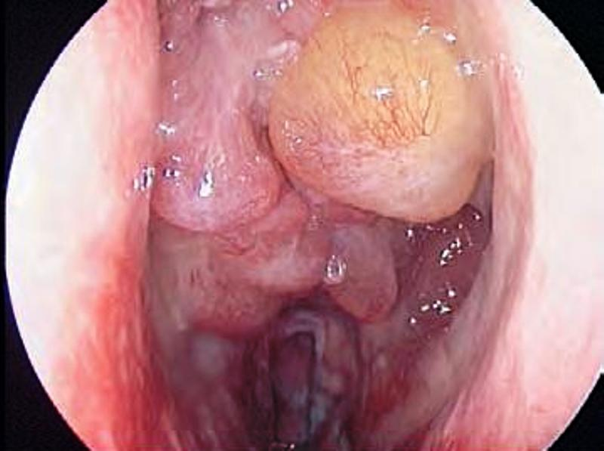
Pre-steroid vs Post-steroid

Slide 48
Surgical Treatment
Intra-nasal avulsion polypectomy
Extra-nasal external ethmoidectomy
Trans-antral ethmoidectomy
Functional Endoscopic Sinus Surgery
• Conventional
• Micro-debrider

Slide 49
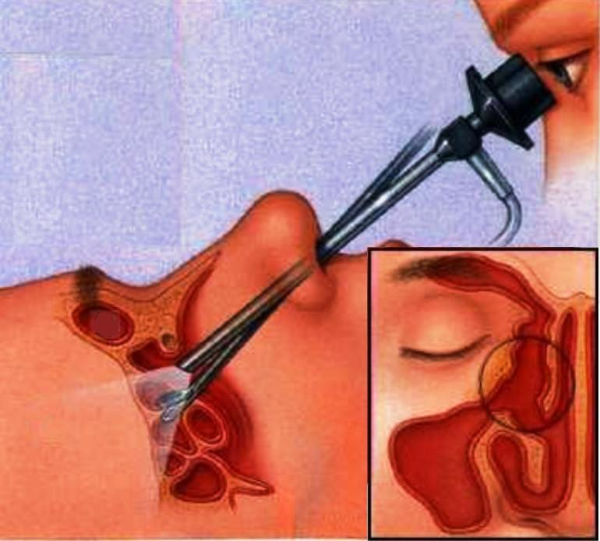
F.E.S.S.

Slide 50
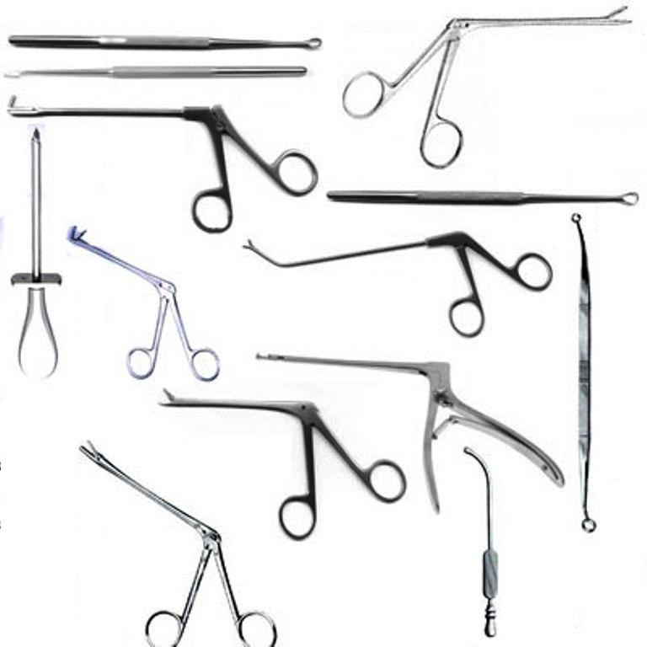
F.E.S.S. instruments

Slide 51
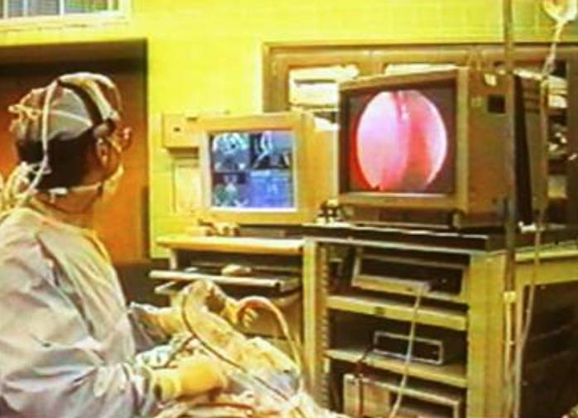
F.E.S.S. with navigation

Slide 52
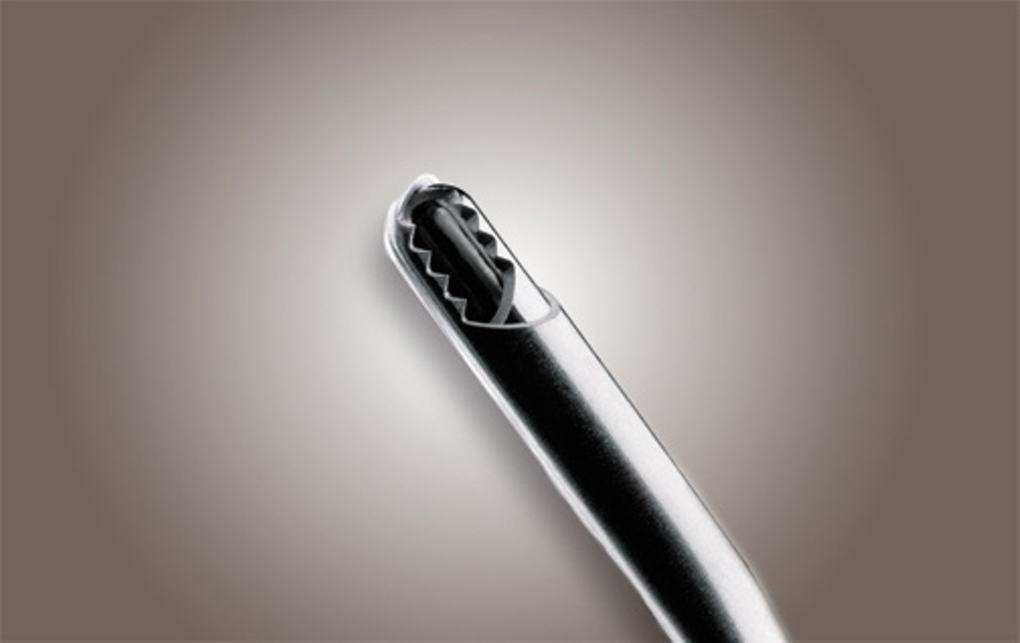
Micro-debrider

Slide 53
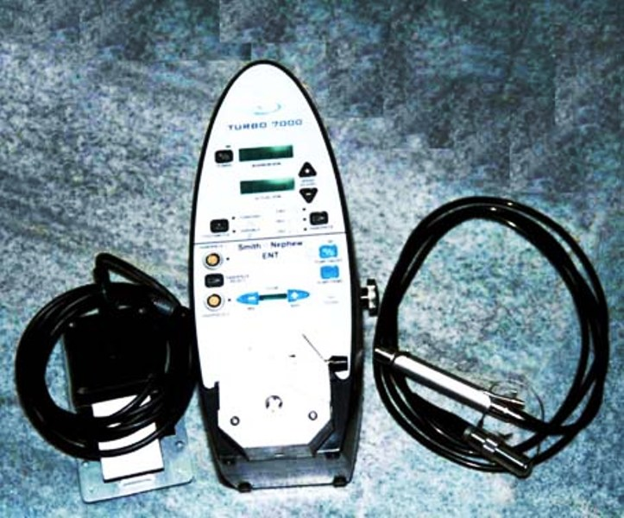
Micro-debrider

Slide 54
How to prevent recurrence
1. Complete removal of all polyps
2. Avoid allergens
3. Post-operative course of:
Oral antihistamines (1-3 months)
Corticosteroid nasal sprays (3-6 months)

Slide 55
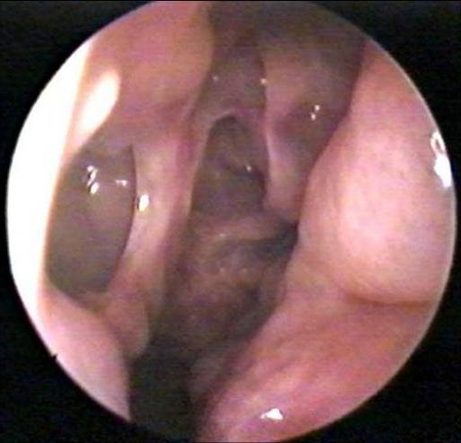
Bilateral FESS cavities

Slide 56
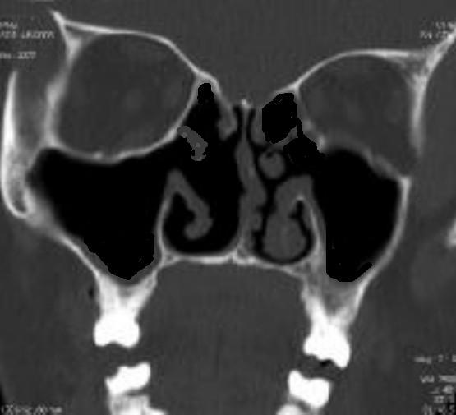
Post FESS CT scan

Slide 57
Antrochoanal polyp | Ethmoid polyp
Seen in adolescents & children | Adult
Etiology is infection | Allergic
Single | Multiple
Unilateral | Bilateral
Shape is tri-lobed (dumbbell) | Grape like
Grows backward | Forward
Treatment is surgical | Medical + Surgical
Recurrence is uncommon | Common

Slide 58
Biomedical ethics
Biomedical ethics in nasal polyp patients involves autonomy, beneficence, non-maleficence, and justice. Patients must be informed about treatment options and risks to ensure informed consent.
Physicians should provide effective care while minimizing harm, avoiding unnecessary procedures, and monitoring for recurrence.
Justice requires fair access to treatment and post-care. Ethical concerns include long-term steroid use, surgical risks, and patient-centered decision-making.

Slide 59
Family Medicine
Family medicine in nasal polyps focuses on early diagnosis, medical management, and patient education. Physicians provide intranasal steroids, monitor recurrence, and coordinate with specialists for severe cases. Preventive care, lifestyle guidance, and managing comorbidities ensure holistic, long-term treatment.

Slide 60
Artificial intelligence
AI enhances nasal polyp management through precise diagnosis, treatment prediction, and personalized care. It analyzes imaging, monitors recurrence, and optimizes therapy selection, improving efficiency and outcomes.

Slide 61
Research
https://pmc.ncbi.nlm.nih.gov/articles/PMC2504067/
Research on nasal polyps focuses on causes, treatment advancements, and novel therapies. Studies explore the role of genetics, immune responses, and environmental triggers in polyp development.

Slide 62
References
https://www.researchgate.net/publication/350555802_Study_of_Nasal_Polyps_in_a_Tertiary_Care_Hospital
https://pmc.ncbi.nlm.nih.gov/articles/PMC2504067/

Slide 63

Thank You

