Slide 1
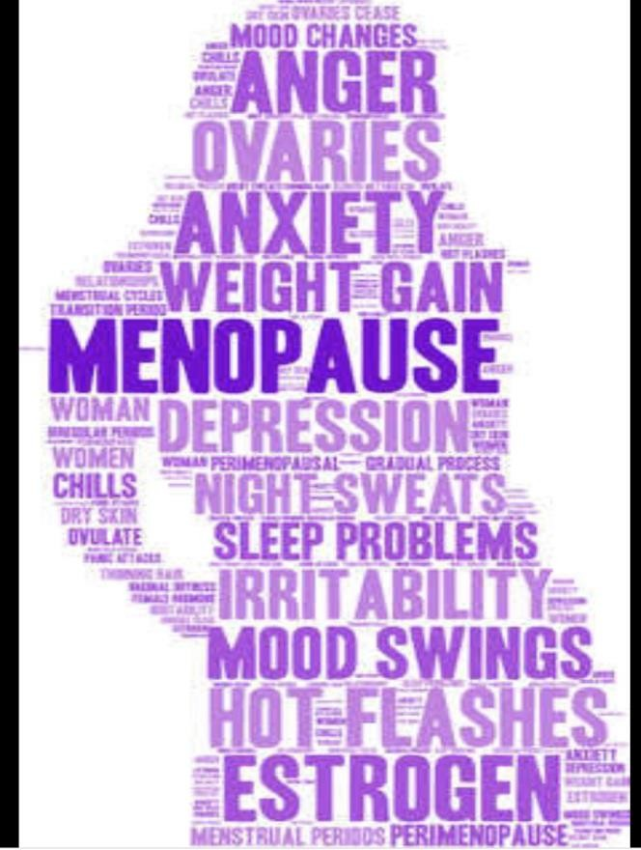
Menopause
Department of Obs& Gynae
Rawalpindi teaching hospital

Slide 2
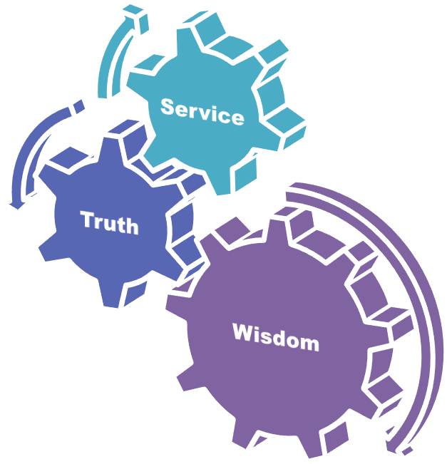
University Motto, Vision, Values & Goals
Mission Statement To impart evidence-based research-oriented health professional education Best possible patient care Mutual respect, ethical practice of healthcare and social accountability. Vision and Values Highly recognized and accredited centre of excellence in Medical Education, using evidence-based training techniques for development of highly competent health professionals, who are lifelong experiential learner and are socially accountable. Goals The Undergraduate Integrated Learning Program is geared to provide you with quality medical education in an environment designed to:

Slide 3
Learning Objectives
At the end of the lecture, the students should be able to
Define menopause
Enlist causes of menopause
Enlist the effects of menopause
Enumerate the non-hormonal therapy for menopausal symptoms
Critically appraise the importance of HRT

Slide 4
Definition
Menopause is a Greek word
“Menos” | means. | month
“Pausos” | means | cessation
Women’s final menstrual period

Slide 5
Definition (Cont’d)
Permanent Cessation of menstruation for consecutive 12 months resulting from loss of ovarian follicular function usually due to aging
Average age :
95% attain menopause :
51-52 years
45-55 years
Premature menopause:
Any menopause that occurs before age 40 Incidence: 1%

Slide 6
Few terminologies
Premature ovarian insufficiency:
A continuum of impaired ovarian function leading to amenorrhea in women younger than age 30
incidence: 0.1%
Causes:
Chromosome abnormality
Autoimmune diseases
FSH receptor abnormality
Disruption of estrogen synthesis and infections
e.g. (tuberculosis, mumps, malaria, varicella)

Slide 7
Few terminologies (Cont’d)
Perimenopause/ Climacteric :
The time around menopause: “the menopause
Marked by menstrual cycle changes
transition”
Menstrual cycle may occur more or less frequently, may skip a menstrual cycle
Bleeding may be lighter
Symptoms of menopause such as hot flashes
Climacteric is a Greek word “Klimax” i.e. the climb to the menopause

Slide 8
Induced or iatrogenic menopause
Medical
Chemotherapy
Pelvic radiation therapy
GnRH agonist
Surgical
Bilateral oophorectomy (with or without hysterectomy)
Relatively early after hysterectomy with conservation of ovaries

Slide 9
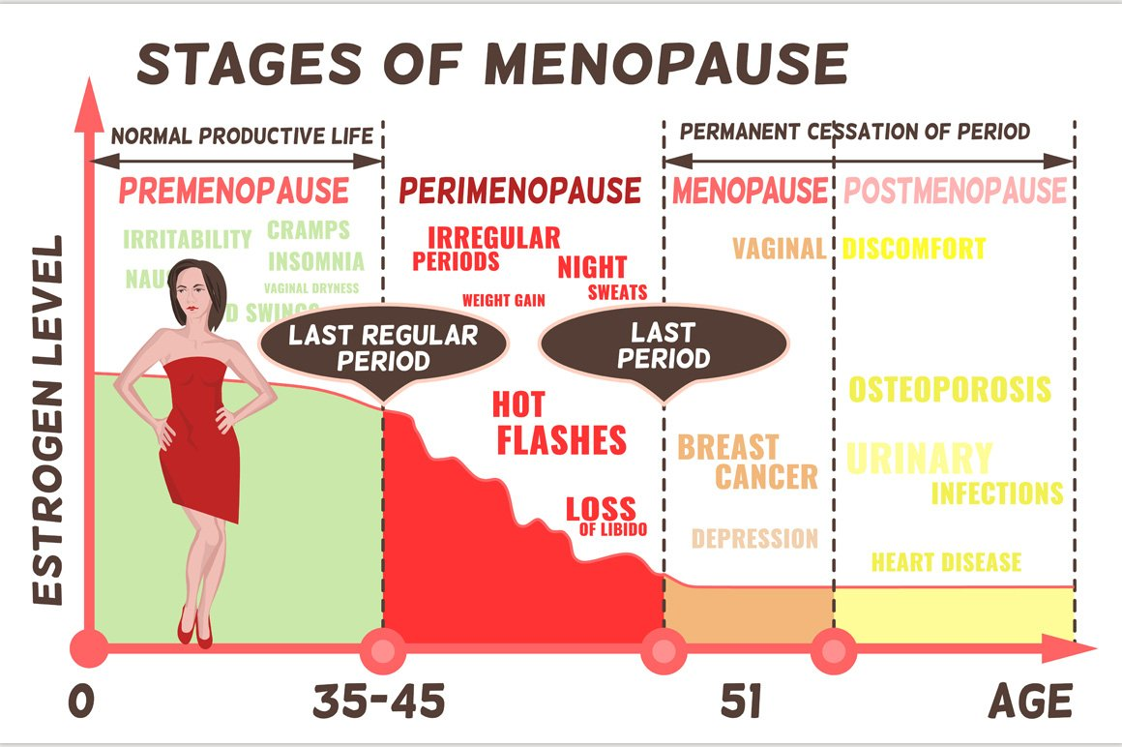

Slide 10
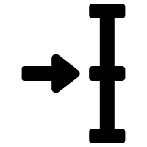
HOW WOMEN ARE AFFECTED BY THE MENOPAUSE?
IMMEDIATE/
EARLY ONSET
(0-5 years)
INTERMEDIATE
(3-10 years)
LONG TERM
(>10 years)

Slide 11
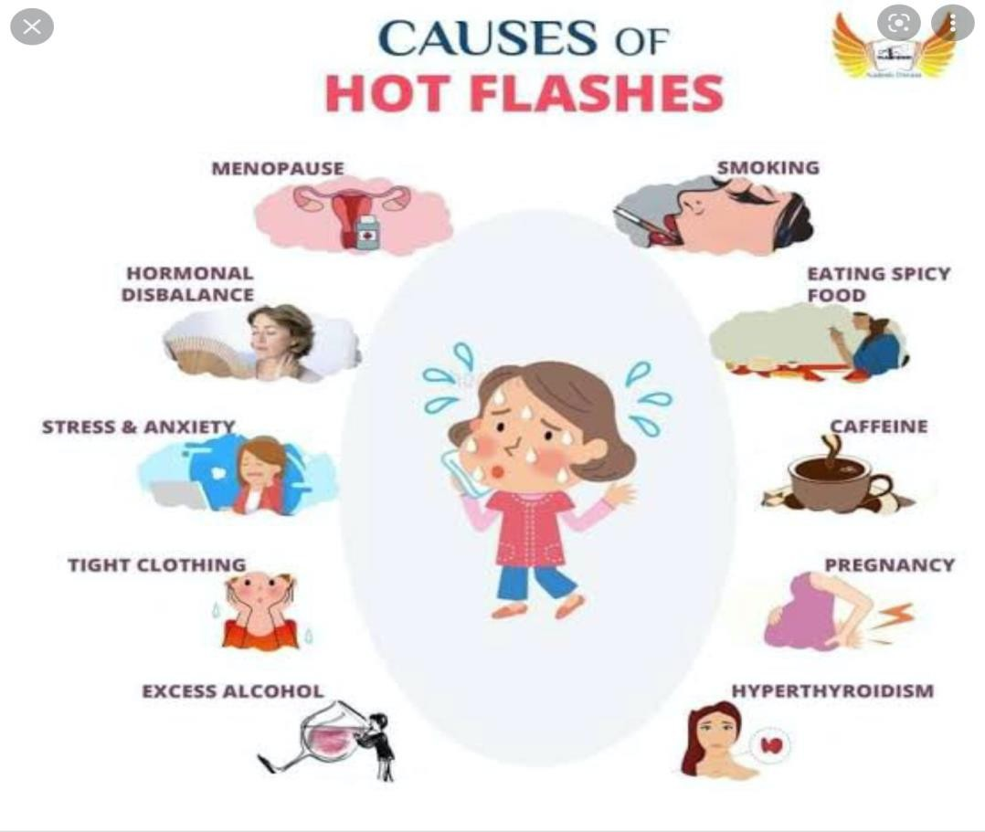
Effects of menopause (Cont’d)
Immediate: (0-5 years)
Vasomotor symptoms.
Hot flushes & night sweats
Occur in 75-80% of menopausal women often starting during perimenopause
Only 20-30% women seek medical
advice
Hot flashes may last up to 7-8 years with symptoms persisting 4-5 years after menopause

Slide 12
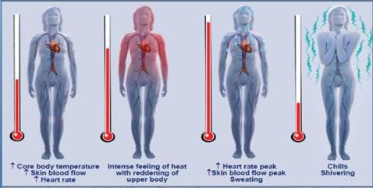
Thermoregulation control

Slide 13
Effects of menopause (Cont’d)
Immediate: (0-5 years)
Psychological symptoms (labile mood, anxiety, tearfulness)
Loss of concentration & poor memory
Joint aches & pains
Dry & itchy skin
Hair changes
Decreased sexual desire

Slide 14
Effects of menopause (Cont’d)
Intermediate (3-10 years) Genitourinary symptoms:
Vaginal dryness & soreness
Dyspareunia
Urgency of urine
Recurrent UTI
Urogenital prolapse

Slide 15
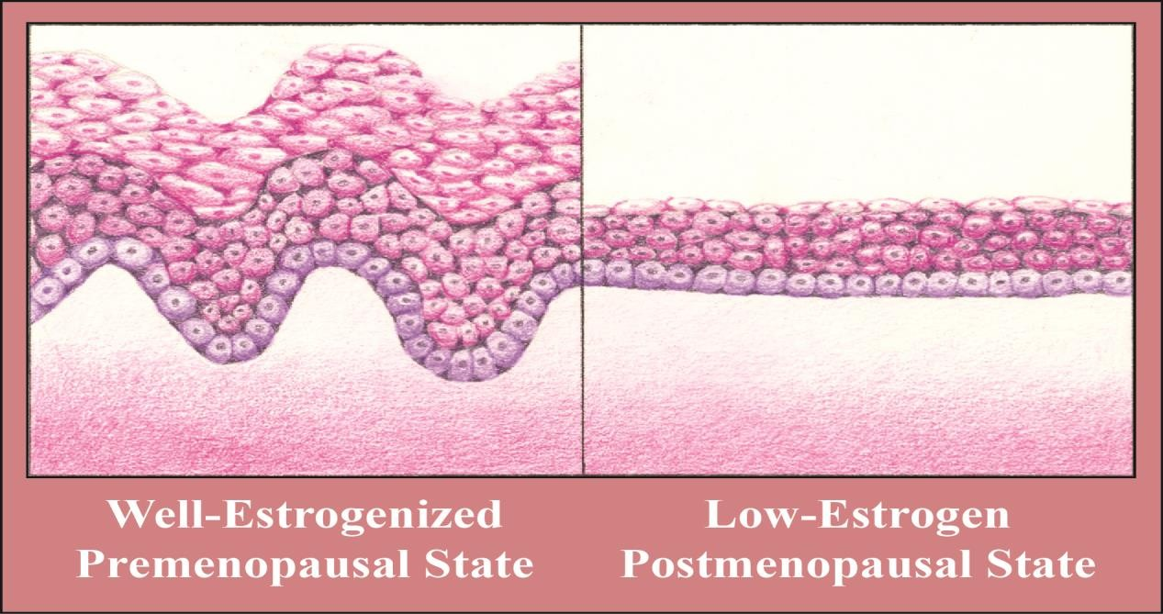
Loss of estrogen to vaginal epithelium
Reduced cellular turnover
Reduced glandular activity
Reduced elasticity
More traumatized
On examination:
Dry & pale
Petechial haemorrhages
Labia: shrink & fusion& narrowing

Slide 16
Effects of menopause (Cont’d)
Long term (> 10 years)
Osteoporosis
Cardiovascular disease
Dementia

Slide 17
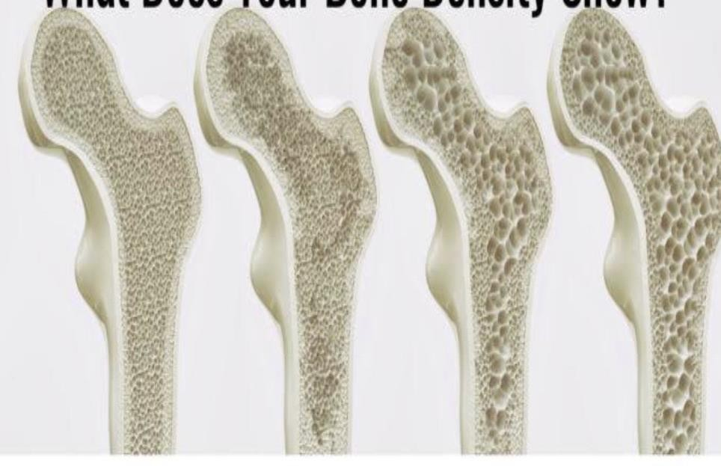
Osteoporosis
A skeletal disorder characterized by compromised bone strength predisposing to an increased risk of fracture
Ratio of fracture among women: men is 4:1
Process of remodeling : laid down by osteoblast &
resorbed by osteoclast
The balance of resorption vs deposition
Attainment of peak bone mass

Slide 18
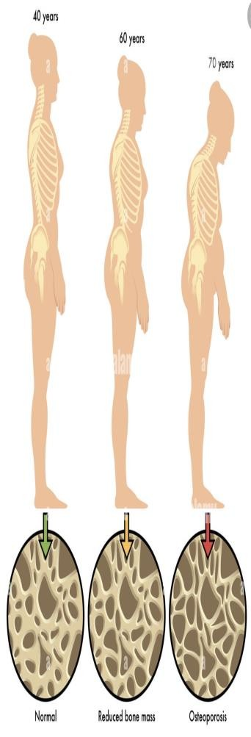
Lower estrogen levels account for about 2/3 of bone loss during the 5-7 years around menopause
Definitions based on BMD results:
Normal: T-score greater than or equal to –1.0
Low bone mass (osteopenia): T-score between –1.0 and –2.5
Osteoporosis: T-score less than or equal to –2.5

Slide 19
Risk factors for osteoporosis
Family history of osteoporosis or hip fracture
Smoking
Alcohol
Long-term steroid use
POI &hypogonadism
Induced menopause (Medical treatment for gynaecological issues)
Disorders of thyroid & parathyroid metabolism
Disorders of gut absorption, malnutrition, liver disease.

Slide 20
Cardiovascular system
30% of overall deaths: IHD & stroke
Increasing secondary to obesity, diabetes, and hypertension
Estrogen has supportive role as vasodilator effect on vessel wall
Menopause transition
Nutrition
Exercise
Gynaecoid to android
Changes in serum lipid levels

Slide 21
Alzheimer’s disease
Common in women
3 times more common in women after age of 65 years as compared to men
May be an expression of estrogen deficiency state
Less common in obese (estrogen production in adipose tissue)
Delayed or prevented by estrogen therapy
Estrogen : effect on vascularity of CNS
Promotes neuronal growth & neurotransmission

Slide 22
MANAGEMENT OPTIONS
FOR MENOPAUSAL SYMPTOMS

Slide 23
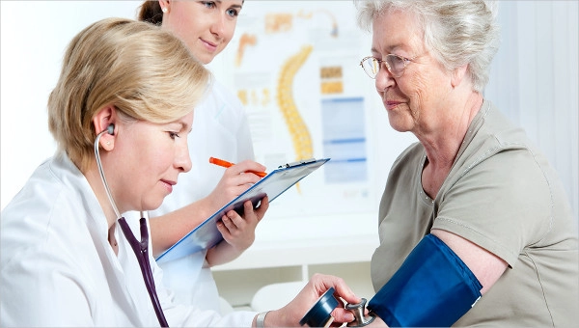
HEALTH & LONGEVITY
RELEVANT SYMPTOMS
SIGNS
B.P, BMI, vaginal assessment, breast examination.
LIFESTYLE
Exercise, nutrition, smoking, alcohol, sexual hx, contraceptive needs.
PERSONAL MEDICAL/GYNAECOLOGICAL HX
Obs hx, drugs, age of menopause, cancer hx & tx, chronic disease, steroids, fracture hx.
FAMILY HISTORY
CVD, Osteoporosis, Thromboembolic disease

Slide 24
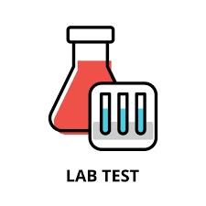
DIAGNOSIS
How?
Serum FSH
>30 IU/L
HISTORY alone
D/D
Pregnancy
Hyperthyroidism
Hyperprolactinoma
Medication ( tamoxifen, SERMS)
Carcinoid/ Pheochromocytoma

Slide 25
MANAGEMENT
PREVENTION
.
COUNSELLING
TREATMENT

Slide 26
Beneficial effects of life style changes
Stop smoking
Reduce alcohol consumption
Normal BMI Benefits:
Reduction of CVD
Beneficial effect on bone loss
Less severe vasomotor symptoms

Slide 27
Non-hormonal approach
Complementary/ drug free therapy:
Acupuncture, Reflexology, Hypnotism
Herbal/ natural preparations:
Black cohosh, Evening primrose, Ginseng, Kava kava
“Natural hormones”:
Phytoestrogens e.g. isoflavones & red clover

Slide 28
Non-hormonal treatment for vasomotor symptoms
Alpha – adrenergic agonists
Beta blockers
Modulators of central neurotransmission

Slide 29
Hormone replacement therapy
Estrogen-alone Estrogen-progestogen Progestogen alone
Estrogen therapy (ET): Unopposed estrogen is prescribed both a) systemically for women who do not have a uterus, and b) locally in very low doses for any woman with vaginal symptoms
Estrogen-progestogen therapy (EPT): Progestogen is added to ET to protect women with a uterus against endometrial cancer, which can be caused by estrogen alone

Slide 30
CYCLIC/Sequential HRT
Perimenopausal / early postmenopausal.
CONTINUOUS COMBINED HRT
Known postmenopausal/ > 54 yrs
OESTROEGENS
Oestradiol
Oestrone sulphate
Oestriol
Conjugated equine oestrogen
PROGESTOGENS
Norethisterone
Levonorgestrel
Dydrogesterone
Medroxyprogesterone acetate
Drospirenone
Micronized progesterone
Testosterone: disorders of sexual desire& energy levels: fail to respond to normal HRT

Slide 31
Tablet, convenient, cheap
Lipid metabolism& caogulation sys: liver
first –pass metabolism
ORAL
TRANSDERMAL
Patch, gel.
Direct delivery
VAGINAL
Oestradiol: tablet, ring
Oestriol: cream
Progesterone: Mirena
INTRAUTERINE

Slide 32
BENEFITS OF HRT
Improved vasomotor symptoms
90%
Within 6 weeks
.
The skeleton
Prevent bone loss
Prevent osteoporosis
POF
↓ incidence of fragility fractures
Improved sleep patterns
Daytime energy levels
CVS
The lower genital tract
Preventive effect if started early in menopause
↓ IHD & mortality
WINDOW OF OPPORTUNITY
.
Improves:
Dryness
Soreness
Irritation
Dyspareunia
Cystitis
Dysuria
.

Slide 33
CONTRAINDICATONS
 | Suspected pregnancy Breast CA Active liver disease Uncontrolled hypertension Known VTE Known Thrombophilia Otosclerosis
ABSOLUTE
 | Uninvestigated abnormal bleeding Large uterine fibroids Hx of benign breast disease Unconfirmed personal hx or strong family hx of VTE Chronic stable liver disease Migraine with aura
RELATIVE

Slide 34
HT formulation, route of administration, and timing of initiation produce different effects (e.g. transdermal route may carry lower risk for thrombosis)
Absolute risks for HT use in healthy women ages 50-59 are low, but can include thrombosis, stroke, and cardiovascular events
HT initiation in older women carries greater risks
Breast cancer risk increases with EPT beyond 3-5 years
ET can be considered for longer duration of use because it carries a lower risk for breast cancer
Consider each woman’s priorities and risk factors prior to initiating HT

Slide 35
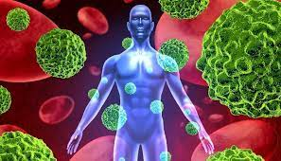
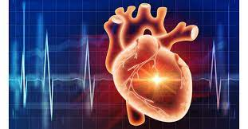
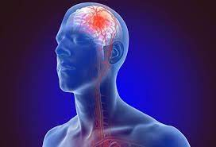
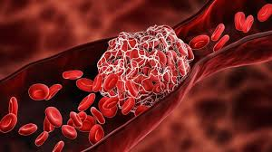
RISKS OF HRT
CA
CVD
STROKE
VTE
Breast
50-59 yrs…..22.5/1000; 7.5 yrs of HRT
Endometrial
ovarian.
Younger- beneficial
Old- deleterious
Higher-combined
Incidence> in old age,
Additional risk of
2/10000/yr HRT
.
Clotting system
Incidence in Age >50 doubles with HRT

Slide 36
SUMMARY
01
Menopause is the key point in the life of woman
02
It is important to rule out other disease processes
03
Medical management of menopause is not necessary but
may significantly improve patient quality of life.
04
HRT is the best available therapy for menopausal symptoms

Slide 37
THANKYOU

