Slide 1
Laboratory diagnosis of bacterial infections
Microbe Module
3rd Year MBBS
By: Dr Kiran Fatima
Pathology Department
Rawalpindi Medical University

Slide 2
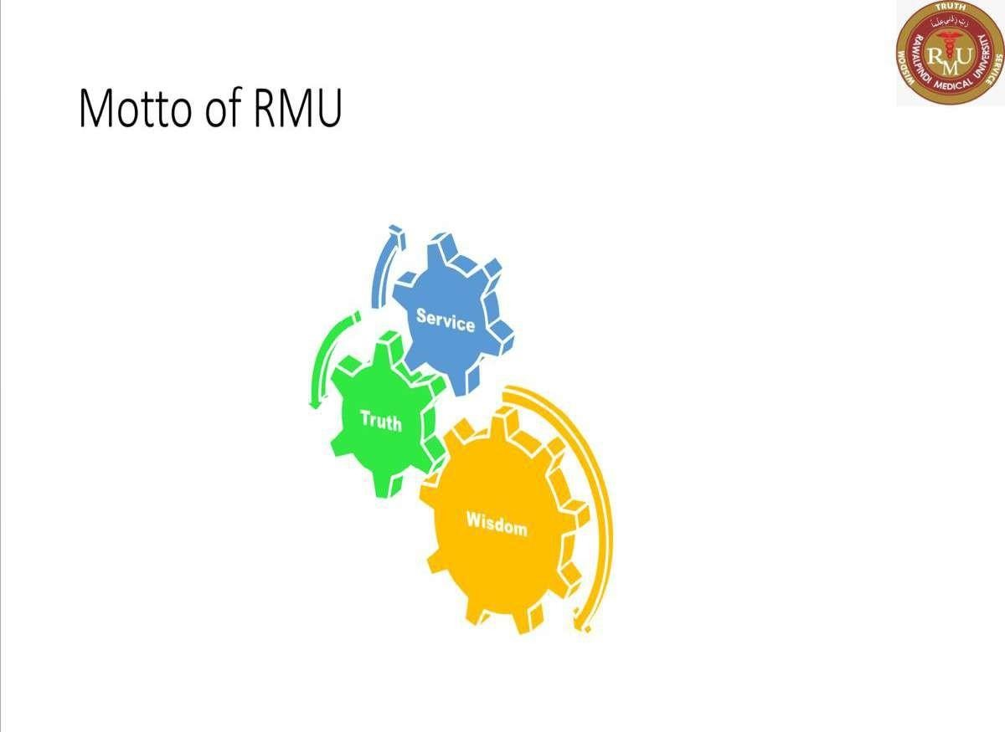

Slide 3
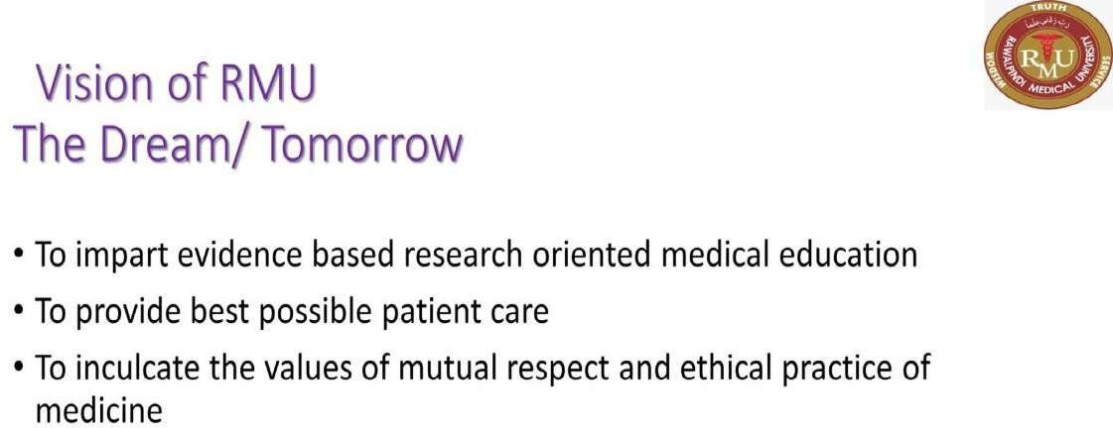

Slide 4
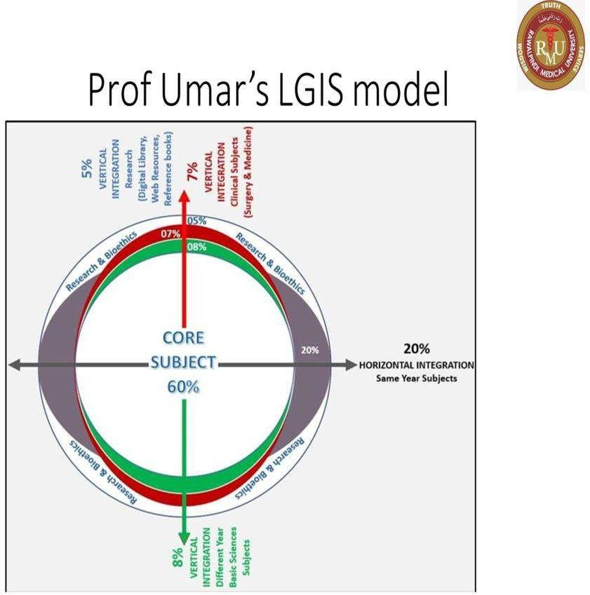

Slide 5
Learning objectives
Approach to laboratory diagnosis for bacterial infections
Methods of laboratory diagnosis (Microscopic, culture based, serological and molecular methods)

Slide 6






Levinson, W. Review of Medical Microbiology and Immunology. 15th ed. McGraw-Hill Education / Medical; 2020

Slide 7
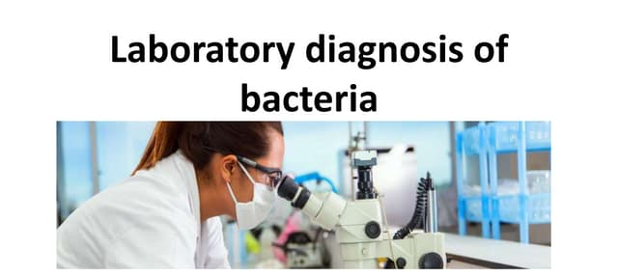
spiral

Slide 8
Laboratory diagnosis
Core Content
4 major methods are:
Microscopic examination
Culture based methods
Serological methods
Molecular diagnostic methods

Slide 9
Microscopic examination
Core Content
Gram staining or ZN staining of collected samples
Some areas are sterile parts of body
→ CSF, joint fluid, blood
Presence of bacteria in those area are critical

Slide 10
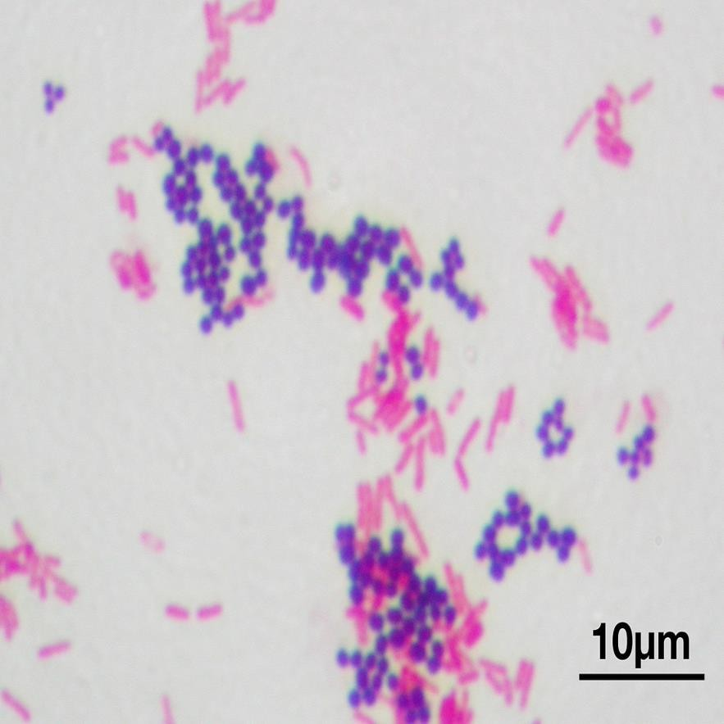
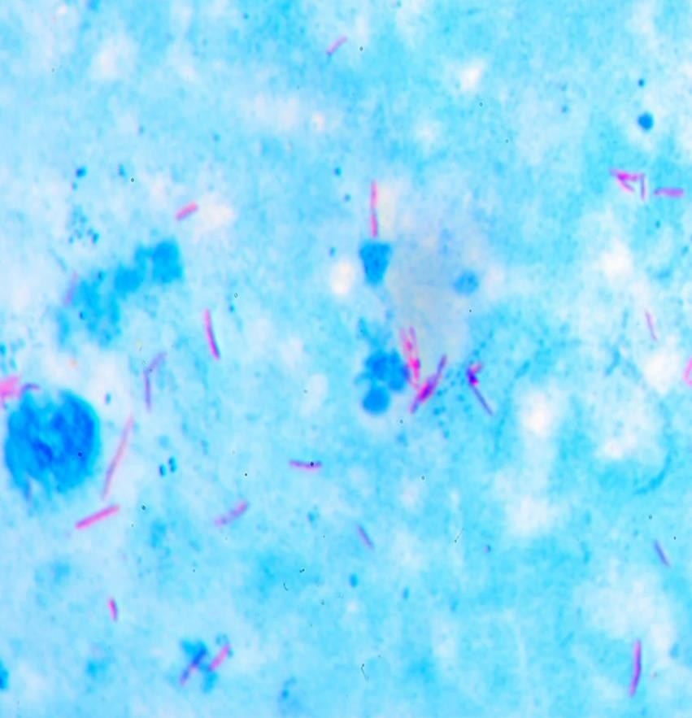
Gram staining and ZN staining
Core Content

Slide 11
Microscopic examination
Core Content
Gram staining will reveal either gram positive or gram negative
Shape of bacteria will also determine either cocci or bacilli
Arrangement of bacteria show specific bacteria as staphylococcus in grape like arrangement, streptococci in diplococci / chains form

Slide 12
Culture media
Core Content
Culture media is a gel or liquid that contains nutrients and is used to grow bacteria or microorganisms. They are also termed growth media. Different cell types are grown in various types of medium.

Slide 13
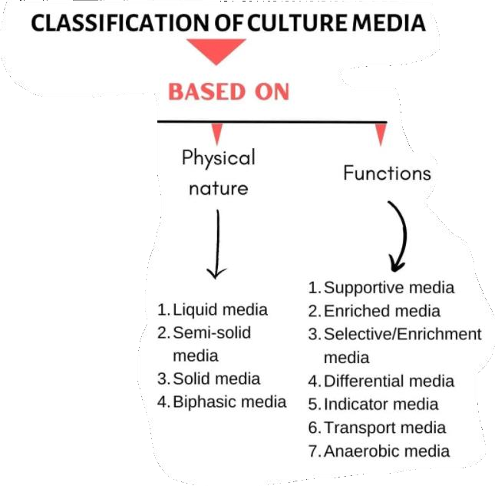
Culture Medias
Core Content

Slide 14
Culture based methods
Core Content
Commonly used culture medias and agar
Blood agar → various bacteria
Chocolate agar → N. meningitidis and N. gonorrhoae
MacConkey → various gram negative
Thayer Martin → N. gonorrhoae from non sterile site
Chocolate agar X and V → H. influenzae
Lowenstein Jensen → M. tuberculosis

Slide 15
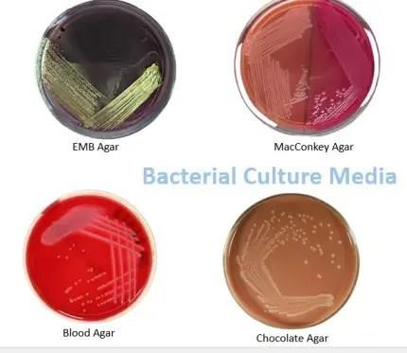
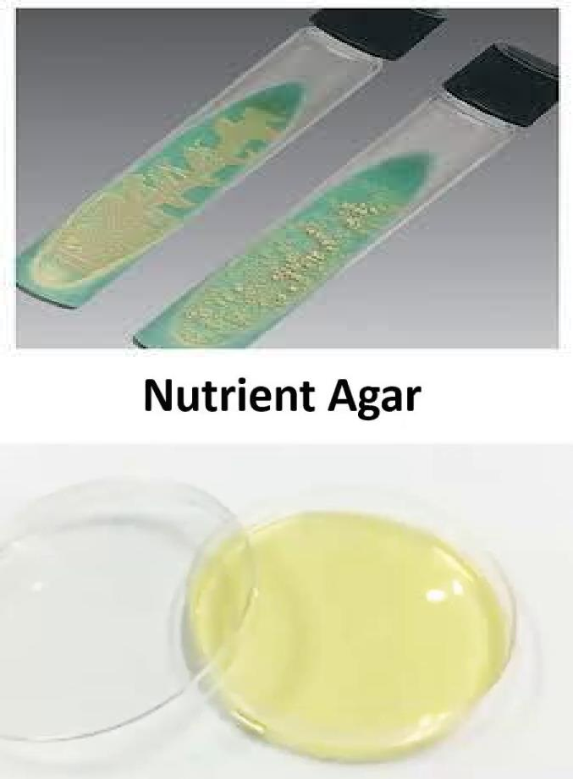
Types of media
Core Content
Lowenstein Jensen media

Slide 16
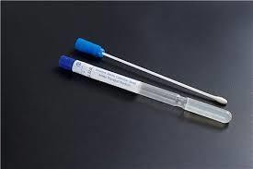
Amie’s transport media
Core Content

Slide 17
Specimens for culture
Core Content
Blood culture → in culture bottles
Throat culture → in gel swab or sterilized dry swab
Sputum culture → in sterilized container ( a reliable specimen has more than 25 leukocytes and less than 10 epithelial cells per 100X field
CSF → is a critical sample should be sent immediately to lab
Stool culture → APW, Selenite F broth, Cary blair medium, skirrow medium

Slide 18
Specimens for culture
Core Content
Urine culture → in sterilized container can be stored at 4oC or boric acid container
Genital tract medium → in gel swab or sterilized dry swab
Pus → in sterilized container
Wound / abscess secretion → in gel swab or sterilized dry swab

Slide 19
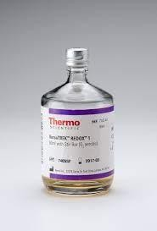
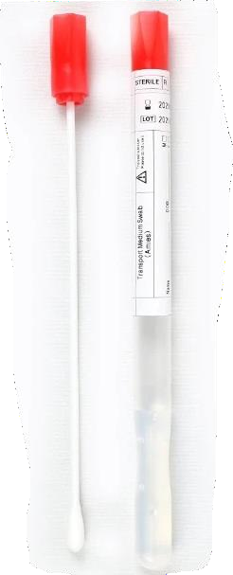
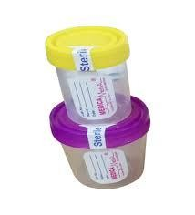
Containers for culture
Core Content

Slide 20
Serological methods
Core Content
Identification of an organism with KNOWN ANTI-SERUM
Slide agglutination
Latex agglutination
ELISA
Fluorescent Antibody tests
Identification of serum antibodies with KNOWN ANTIGENS
Slide or tube agglutination
Serological tests for Syphilis (VDRL, RPR, TTPA)
Cold agglutinin (for Mycoplasma pneumoniae)

Slide 21
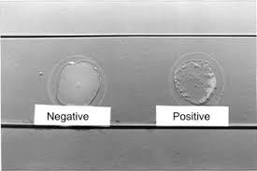
Slide agglutination test
Core Content

Slide 22
Molecular diagnostic methods
Core Content
NAAT (PCR)
Gene sequencing analysis
MALDI-TOF mass spectrometry

Slide 23
Family medicine
Longitudinal
A 25-year-old female presents with dysuria, frequency, and urgency. A urine culture is ordered. The Gram stain of the urine shows numerous gram-negative rods. Which of the following would be the MOST appropriate next step in the laboratory?
a) Acid-fast staining b) Catalase test c) Antimicrobial susceptibility testing d) India ink preparation
Correct Answer: c) Antimicrobial susceptibility testing

Slide 24
Research
New Microbiological Techniques for the Diagnosis of Bacterial Infections and Sepsis in ICU Including Point of Care
Anna Maria Peri ¹, Adam Stewart ^{1,2}, Anna Hume ^{2,3}, Adam Irwin ^{1,4}, Patrick N A Harris ^{1,3,✉}
PMCID: PMC8207499 PMID: 34149321
Abstract
Purpose of Review
The aim of this article is to review current and emerging microbiological techniques that support the rapid diagnosis of bacterial infections in critically ill patients, including their performance, strengths and pitfalls, as well as available data evaluating their clinical impact.
Recent Findings
Bacterial infections and sepsis are responsible for significant morbidity and mortality in patients admitted to the intensive care unit and their management is further complicated by the increase in the global burden of antimicrobial resistance. In this setting, new diagnostic methods able to overcome the limits of traditional microbiology in terms of turn-around time and accuracy are highly warranted. We discuss the following broad themes: optimisation of existing culture-based methodologies, rapid antigen detection, nucleic acid detection (including multiplex PCR assays and microarrays), sepsis biomarkers, novel methods of pathogen detection (e.g. T2 magnetic resonance) and susceptibility testing (e.g. morphokinetic cellular analysis) and the application of direct metagenomics on clinical samples. The assessment of the host response through new “omics” technologies might also aid in early diagnosis of infections, as well as define non-infectious inflammatory states.
https://pmc.ncbi.nlm.nih.gov/articles/PMC8207499/

Slide 25
Take home message
Lab diagnosis of bacterial infections involves a multi-step process: specimen collection and processing, microscopic examination (e.g., Gram stain), and culture to isolate and identify the causative organism. Antimicrobial susceptibility testing is crucial to guide appropriate treatment. Serological tests and molecular methods may also be used in certain cases.

Slide 26
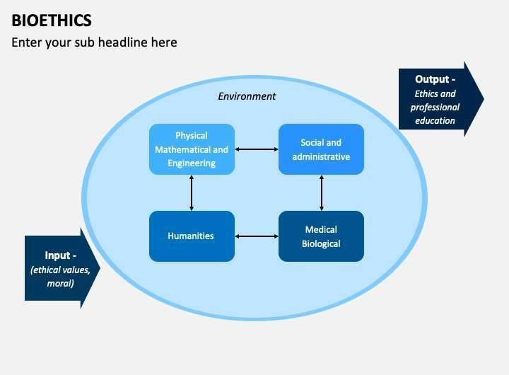

Longitudinal

Slide 27

Thank You …..!

