Slide 2
non communicable diseases Block 1 EYE MODULE health management information system
Dr.Abdul Qudoos
Dr. asif butt

Slide 3
Vision & Mission of RMU
Wisdom
Truth
Service
To impart evidence based research oriented medical education
To provide best possible patient care
To inculcate the values of mutual respect and ethical practice of medicine

Slide 4
Sequence Of Lecture
Statement of learning outcomes (01 slide)
Core Subject( 09 slides)
Horizontal Integration(06 slides)
Vertical integration( 07 slides)
EOLA(End of lecture assessment) (01 slides)
Digital Library References (02 slides)
( Research, Bioethics, Artificial Intelligence) (02 slides)

Slide 5
Learning objectives
Define HMIS
Difference between data and information
Discuss essential elements & functions of HMIS
Describe steps in developing HMIS
Discuss various sources of health information

Slide 6
HMIS Pakistan
Notes:
HMIS Pakistan

Slide 7
Notes:
World bank data.. Illustration of indicators

Slide 8
Notes:
World health organisation: covid-19. data Download links: https://covid19.who.int/who-data/vaccination-data.csv

Slide 9
World health organization tuberculosis dashboard
Notes:
https://worldhealthorg.shinyapps.io/TBrief/?_inputs_&sidebarCollapsed=true&entity_type=%22country%22&iso2=%22PK%22&sidebarItemExpanded=null

Slide 10
HMIS
A System that provides specific INFORMATION SUPPORT to the DECISION MAKING process during planning, implementation and evolution of health programming for appropriate use of resources at all levels of health system

Slide 11
HMIS
Mechanism for collection, processing , analysis and transmission of information required for organizing and operating health services and also for research and training

Slide 12
HMIS
It is to provide reliable, relevant , up to-date timely and reasonably complete information for health managers at all levels , central, intermediate local
Sharing technical scientific information and provide data at periodic intervals

Slide 13
Uses of health information
Measure health status of people
quantify health problems medical and health care needs
Local,national and international comparisons of health status
Planning, administration effective management of health services and programs

Slide 14
WHO requirements
population based
avoid unnecessary agglomeration of data
problem based
have functional and operational terms
express information briefly and imaginatively
Provision for feedback

Slide 15
Uses of health information
Accessing effectiveness and efficiency of health services
To access satisfaction and attitudes of beneficiaries with health system
For research into particular problems of health needs and problems

Slide 16
Important features for good HIMS
Relevance
Standardization :uniformity in definitions of variables collected .IMR)
Data Collecting & Aggregation Instruments: These instruments should be simple, easily understood by users
Data Presentation:
Flow of information
Filtration of information
Feedback

Slide 17
Data and information
Health Data;
Collection of observations in scientific manner. qualitative, quantitative

Slide 18
Health information
Health Data shaped or arranged in a meaningful manner to be used for planning and operating health systems

Slide 19
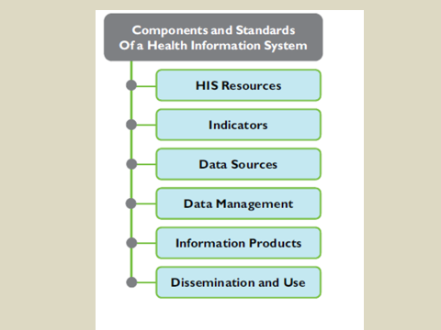

Slide 20
HMIS

Slide 21
Health information system components
These components can be divided into inputs
Processes and outputs
Inputs: Health information system resources
legislative,
regulatory
planning frameworks
required to ensure a fully functioning health information system, and the resources that are prerequisites for such a system to be functional.

Slide 22
resources
Personnel
financing
logistics support
information
communications technology (ICT)
coordinating mechanisms within and between the six components

Slide 23
Health information system resources
coordination and leadership
information policies
financial and human resources
Health information system infrastructure

Slide 24
Health status indicators

Slide 25
Data collection : sources of data
Population based and institution based approaches
Censuses
Registration of vital events
Population based surveys
Hospital records
Disease registers
Notification of diseases
Epidemiological surveillance endemic disease like tuberculosis , malaria

Slide 26
indicators :Accessibility of health care
Percentage of population within 5km or one hour long walk of nearest health care provider

Slide 27
Indicators for provision of primary health care
Percentage of children under 5 years of age or with pregnant women visited by community health worker in specified period of time
Percentage of pregnant women who receive at least one antenatal visit
Percentage of children age 12 -23 months who are fully immunized

Slide 28
DHIS PUNJAB OPD REGISTER

Slide 32
STEPS IN DEVELOPING HMIS
Planning and designing phase; comprises of situation analysis, budgeting, software development
Implementation phase; data collections, transfer, entry, reporting
Monitoring ;day to day overseeing
Evaluation phase; periodic check of impact of programmers

Slide 33
Sources----Contd.
1;THE CENSUS
2;VITAL EVENTS(Births & Deaths)
A.---- In Rural Areas. according to provincial setup.
B.---- In Urban Areas (Municipal Registration Office within 4 Days)
C.----In Medical Institutions (Local Health Authorities-to DDO(H),DO(H), Civil Surgeon)
3;INFECTIOUS DISEASES (Only 18 Priority Health Problems are to be reported)

Slide 34
Sources Contnd….
4;HOSPITAL & DISPENSARY RECORD:
OPD Register
Indoor Register
Abstract Register (Daily Tabulation of Diseases)
Annual Return (Daily, Monthly, Quarterly Reports)

Slide 35
Contnd…….
5;HEALTH MANPOWER STATISTICS(PMDC, Nursing Council)
6;POPULATION SURVEYS : (Morbidity, Mortality, Nutritional Surveys)
7;EPIDEMIOLOGICAL SURVIELLANCE : ( Malaria, T.B.)
8;DEMOGRAPHIC SURVEYS: population density
9;ECONOMIC SURVEYS
10;NON QUANTIFIABLE INFORMATION: health policies, laws

Slide 36
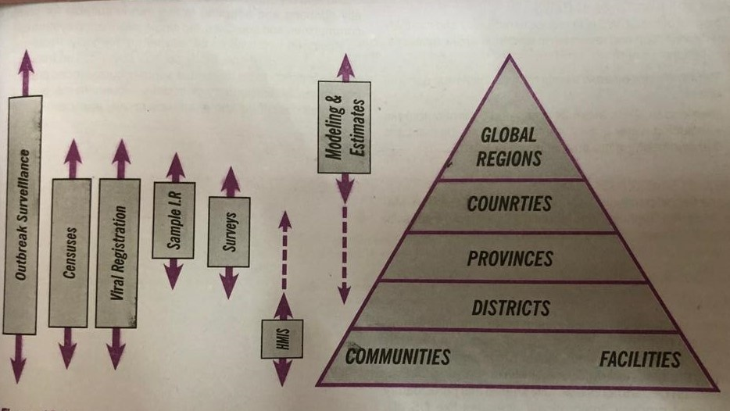
Information tools at diff levels

Slide 37
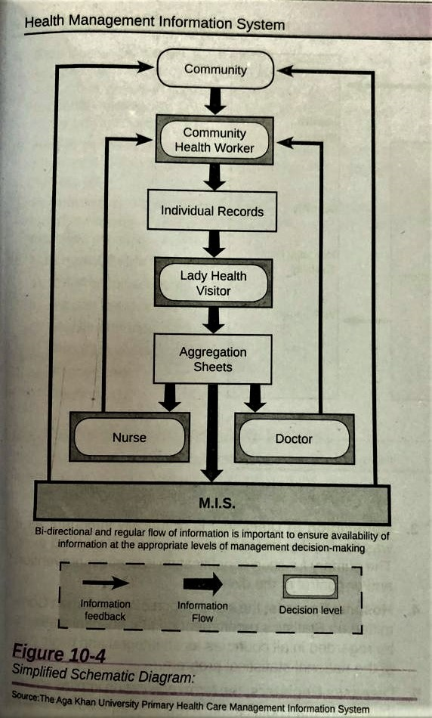

Slide 38
DEFINITIONS
Health Institutions
A. First Level Care Facility (FLCF)
A facility where there is first contact between a Client / Patient and a health care provider.
Basic Health Unit (BHU)
Rural Health Centre (RHC)
Dispensary (Disp)
Sub Health Centre (SHC)
First Aid Post (FAP)
MCH Centre (MCH)
OPD of Hospital

Slide 39
Cotnd……..
B. Referral Level Care Facility (RLCF)
Care Provider
For Curative Care
For Preventive Care
Patient / Client

Slide 40
Data Collection HMIS / FLCF
For Patient / Client
Management : ------------- 11 Record Cards
For Facility Management
Aggregation : --------------- 19 Registers

Slide 41
Data Collection Instruments (Facility Based)
REPORT FORMS
Immediate Report
Monthly Report
Yearly Report

Slide 42
End of lecture accessment
Considering HMIS is system consist of input, process and output components. Which parameter of the HMIS is related with input component?
Data management
Data resources
Feedback
HMIS resources
Information products

Slide 43
End of lecture assessment
For planning HMIS, the situation analysis is required in depth. This important parameter relates to
Evaluation phase
Implementation phase
Monitoring phase
Planning and designing phase
Situation analysis phase

Slide 44
Ethics in information system
Ozair FF, Jamshed N, Sharma A, Aggarwal P. Ethical issues in electronic health records: A general overview. Perspectives in clinical research. 2015 Apr;6(2):73.
Rogerson S, Miller KW, Winter JS, Larson D. Information systems ethics–challenges and opportunities. Journal of Information, Communication and Ethics in Society. 2019 Mar 8;17(1):87-97.

Slide 45
Research in HMIS
Doolin B. Power and resistance in the implementation of a medical management information system. Information Systems Journal. 2004 Oct;14(4):343-62.
Haag S, Cummings M, Dawkins J. Management information systems. Multimedia systems. 1998;279:280-97.

