Slide 1
Health Education -I
Block-ll Ophthalmology(EYE)

Slide 2
Vision & Mission of RMU
Wisdom
Truth
Service
To impart evidence based research oriented medical education
To provide best possible patient care
To inculcate the values of mutual respect and ethical practice of medicine

Slide 3
Prof Umar’s Model

Slide 4
Sequence of the Session
Statement of learning outcomes (01 slide)
Order & Components of the session
Core subject ( contains throughout relevant clinical contents) ( 22 slides)
Vertical integration( 1 slide)
Research pertinent to enhance understanding o the subjects (01 slides)
Bioethics : pertinent discussion (01 slides)
End o the session relevant assessments ( 02 slides)
Suggested additional readings ( 01 slide)

Slide 5
Learning Objectives
At the end of this session students should be able to:
Define health communication and understand its types.
Explain role of sender, receiver, feedback and content of health message
Explains Shannon Weaver communication model
Appreciate communication barriers
Explain various functions of health communication

Slide 6
Health Education
Core Content
A process that informs, motivates and helps people to adopt and maintain healthy practices and lifestyle, advocates environmental changes as needed to facilitate this goal and conducts professional training and research to the same end.
(National conference on preventive medicine in USA)

Slide 7
Health Education
Core Content
A process aimed at encouraging people to want to be healthy ,to know how to stay healthy, to do what they can individually and collectively to maintain health and to seek help when needed.
(Alma – Ata declaration)

Slide 8
Types of Communication
Core Content
Didactic (One-way).
Socratic (Two-way).
Formal and Informal
Verbal.
Non-Verbal.
Visual
Telecommunication and Internet

Slide 9
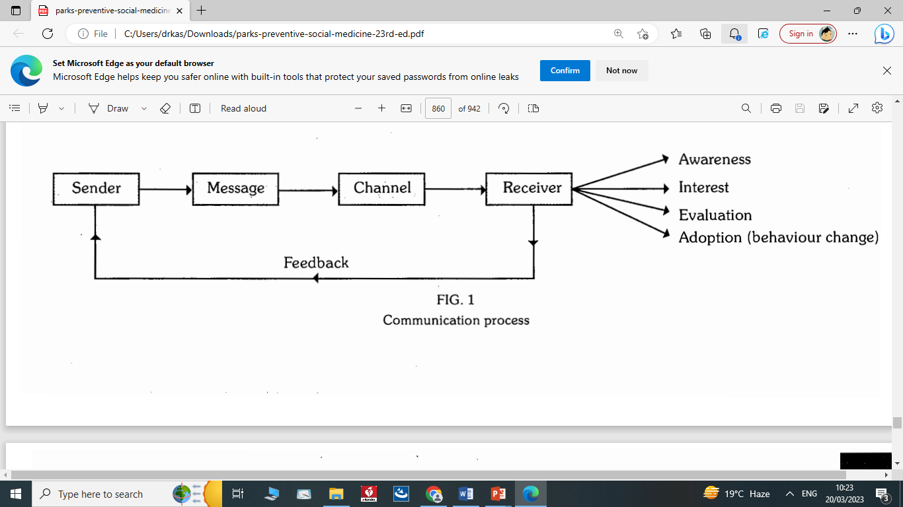
Shannon Weaver Communication Model
Core Content

Slide 10
Components
Core Content
Sender----Source
Message----Content
Channel ----medium
Receiver----audience
Feedback

Slide 11
Sender
Core Content
Clear in his objective
Confident
Creditable
Concise message
Knowledge, interest and needs of audience
Command on channels of communication
Prof. ability and constraints

Slide 12
Core Content
Receiver
Single person or a group of audience
Types of audience
1. Controlled or homogeneous
2. Uncontrolled or free audience
Phases of health education in receiver

Slide 13
Feed back
Core Content
The flow of information from audience to the sender
In inter personal communication, feedback is immediate.
In mass communication, feedback is obtained through opinion polls, attitude surveys and interviews

Slide 14
Core Content
Message
RIGHT MESSAGE TO RIGHT PERSON AT RIGHT TIME
Clear, understandable, meaningful and complete message
A good message must be
In line with the objective
Based on felt needs
Specific and accurate
Timely and adequate
Fitting the audience
Interesting
Culturally and socially acceptable

Slide 15
Channels of communication
Interpersonal communication
face to face(direct)
more effective, more persuasive
Mass media
Core Content
T.v, radio, newspaper, magazines, journals, any other printed information , internet
Covering relatively larger population in short time.
Folk media
folk dances, folk singing, dramas.
Every community has its own network of traditional or folk media.

Slide 16
Feedback
Core Content
Based on reaction of audience to message
Provides opportunity to sender to modify the message
Obtained through surveys, proforma and interviews

Slide 17
Food for thought!!
Vertical integration
In Pakistan, NCDs are among the top 10 causes of morbidity and mortality, and it is estimated that NCDs and injuries cause 77% of age-standardized deaths. Keeping in view the raising burden of NCD , Government of Pakistan has decided to launch Health Education campaign at population(mass) level to create awareness before development of illness.
Which channel of health communication can be adapted as best strategy to create awareness among masses.
Population (Mass) strategy targets which phase natural history of disease spectrum and corresponding level of prevention

Slide 18
Communication barriers
Core Content
1.Physiological (hearing diff)
2.Psychological (emotional disturbances, intelligence level, language or comprehension difficulties, neurosis)
3.Environmental
(noise, Invisibility, congestion)
4.Cultural (illiteracy, base line knowledge, customs, beliefs, linguistic, rural & urban, Regional& religious norms and values)

Slide 19
Functions of Health Communication
Core Content
Information
Education
Motivation
Persuasion
Counseling
Raising Morals
Health Development
Organization

Slide 20
Functions of health communication
Core Content
Information:
Education:
Correct.
Scientific.
Eliminates social and psychological barriers.
Increase the awareness of the audience so that the can perceive their health needs.
Unfelt needs become felt needs and the felt needs transform into their demands.
Brings changes in Life styles and the risk factors of the diseases.
Education alone is insufficient unless there is any progress in the access to the proven preventive measures.

Slide 21
Functions of health communication
Core Content
Motivation
Counseling
A power to drive a person to behave.
Translation of health information into human behavior.
Stages of motivation.
Persuasion:
An art of winning friends
A conscious attempt to influence the belives,knowledge,values and behavior in some desired way.
It implies choice, not force.
A counselor should be able to:
Communicate information
Gain the trust of the people
Be sympathetic
Understand the feelings of others
Help people reduce their problems.

Slide 22
Functions of health communication
Raising Morale
Core Content
Health Development
The capacity of a group of people to pull together persistently or consistently.
Communication –vertical or horizontal, internal or external is the first step in any attempt to raise the morale of group of people or health team.
Judicial use of health communication media contributes to health development.
Preparation of the masses for their roles for the health development of the community.

Slide 23
Functions of health communication
Core Content
Health Organization
Important source of INTER and INTRA-SECTORAL coordination.
Communication is the life and blood of an organization.

Slide 24
End of lecture assessment
1. In rural areas diarrhea is common health problem and many cases with sever dehydration were reported during moon soon season. Health authorities debated in meeting to educate mothers about use of ORS and on priority most effective method they finalized for health communication to the mothers of the area was:
a. Learning by doing in women groups
b. Distribution of health educational hand bills
c. Radio awareness program for the rural masses
d. Online awareness lectures for the mothers
e. T.V awareness program for the masses

Slide 25
Bioethics
Ethics in Health Promotion and Health Education
https://journals.sagepub.com/doi/pdf/10.1177/216507998703500504
The Ethics of Health Education as Public Health Policy
Faden, Ruth R., and Alan I. Faden. “The Ethics of Health Education as Public Health Policy.” Health Education Monographs, vol. 6, no. 2, 1978, pp. 180–97. JSTOR, http://www.jstor.org/stable/45240567. Accessed 31 Mar. 2023.

Slide 26
Digital Library /Research
Carter, S.M., Cribb, A. & Allegrante, J.P. How to Think about Health Promotion Ethics. Public Health Rev 34, 9 (2012). https://doi.org/10.1007/BF03391661
Cribb A, Duncan P. Health Promotion and Professional Ethics. Hoboken, NJ: Blackwell Publishing; 2002.
https://academic.oup.com/heapro/article/23/4/380/630187

Slide 27
Reading sources:
Primary (recommended textbooks)
J Parks textbook of Preventive & social Medicine. Ch.20 Pages ( 23rd edition)
Textbook of Community Medicine & Public Health. By Muhammad Illyas , Dr Irfanullah Siddiqui Ch.29 p:513(8th edition)
Additional readings
http://nbcpakistan.org.pk/assets/may-16-bioethics-facilitator-book---may-16%2C-2017.pdf(for Bioethics)

