Slide 1
Health Education
&
Communication
Module 2 : EYE : Fourth Year MBBS

Slide 3
Vision & Mission of RMU
Wisdom
Truth
Service
Vision
Highly recognized and accredited center of excellence in Medical Education, using evidence-based training techniques for development of highly competent health professionals, who are lifelong experiential learner and are socially accountable.
Mission Statement
To impart evidence-based research-oriented health professional education in order to provide best possible patient care and inculcate the values of mutual respect, ethical practice of healthcare and social accountability.

Slide 4
Prof Umar’s Model

Slide 5
Sequence of the Session
Learning outcomes (1 slide)
Core Subject (16 slides)
Vertical integration (1)
EOLA(End of lecture assessment) (1 slide)
Further reading/Digital Library References (I slide)
Research, Bioethics, Artificial Intelligence (3 slides)

Slide 6
Learning objectives
By the end of this lecture students will be able to describe
• Explain principles of health education
• Appraise different ways of practice of health education
Understand social marketing
Comprehend CHC message development protocol

Slide 7
Core subject

Slide 8
Health practitioner involvement in health education
Explaining to patients and attendants
Explaining prescriptions for treatment
Advice on changing harmful health habits
Hopefully-encourage civic action to provide a healthful environment

Slide 9
Methods of maintaining behavioral change
Support groups e.g weight management group
Positive reinforcement
Negative reinforcement e.g taking fine for smoking in smoking cessation programmes

Slide 10
Foundations of health education
Behavioral sciences
psychology
sociological approach
anthropology
Formal & informal education
Public health
tools for public health(epidemiology, biostats, health education methods) help educator in developing, implementing & evaluating health education programs

Slide 11
Key Principles of Health Education
Credibility
Interest
Participation
motivation
Comprehension
Reinforcement repetition
Learning by doing
Known to un known
Setting an example
Good Human Relations
feedback
Leadership

Slide 12
Practice of Health Education
Audiovisual aids
Auditory aids
Visual aids
Combined AV aids
Methods in health communication
Individual approach
Group approach
Mass approach

Slide 13
AV AIDS
Auditory aids
radio, tape recorder, microphones, amplifiers, ear phones
Visual aids
Not requiring projection
Requiring projection
Combined AV aids

Slide 14
METHODS IN HEALTH COMMUNICATION

Slide 15
Mass media versus interpersonal communication
Mass media
Personal communication
Reaches widest population
Gets public attention
More effective for those with above average educational level
Gives support to concentrated programs such as those for a week or month
Capitalizes on warmth and understanding and knowledge of communication
Provides the opportunities for involvement, for asking questions, expressing fears and learning more.
More for average and below average educational level
Changes in behavior more readily, when reasonable explanations are presented

Slide 16
Past Achievements of Health Educators
Health Edu. Campaigns for EPI, ORT, Anti-Smoking, less use of sugar and Ghee e.t.c
Film shows in slums
Video cassettes for mass education
Question Answer talks on Radio& T.V.
Health Education program for Schools.
Transport Advertisement planned.
Articles for publication.
Cinema slides for theatre.

Slide 17
Constraints of Health Education Programs
Human resource constraints
Financial resource constraints
Lack of Organizational framework to integrate with other sectors.
Un-coverage of Illiterate population.
Absence of training in H.E. and communication
Lack of research in the relevant field.
Irresponsible Evaluation of Health Education programs.

Slide 18
Planning and management
Collection of information
Identification of the problem
Deciding on priorities
Setting goals and measurable objectives
Assessment of resources
Consideration of possible solution
Preparation of a plan of action
Implementing the plan
Monitoring and evaluation
Reassessment of the process of planning

Slide 19
Evaluation of program
Evaluation is the process of inquiry into the performance of a program me
Two major components
1. formative evaluation
2. summative evaluation

Slide 20
Hospital based health education
General awareness of the importance of early diagnosis & t/m.
Better communication b/w health care professional & members of the community.
Increased community support
Continued education after hospitalization to follow up.
Accompanied relatives should be contacted.

Slide 21
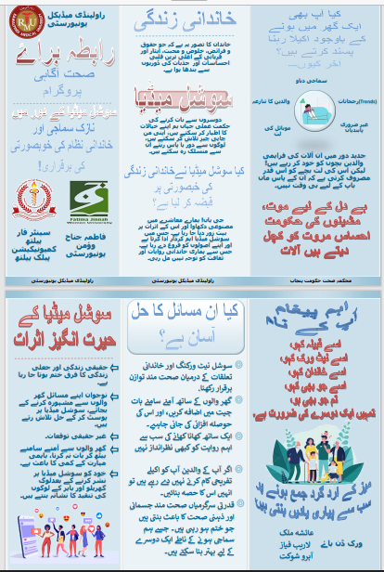
Developing a health education message
Simple
Concise
Focused

Slide 22
Social Marketing
“Social marketing is the practice of utilizing the philosophy, tools, and practice of commercial marketing for health and /or social programs.”

Slide 23
Factors in Social marketing
Knowledge
Attitude
Behaviour
Social norms and values
Religion and cultures
Ability
Life style
Influences

Slide 24
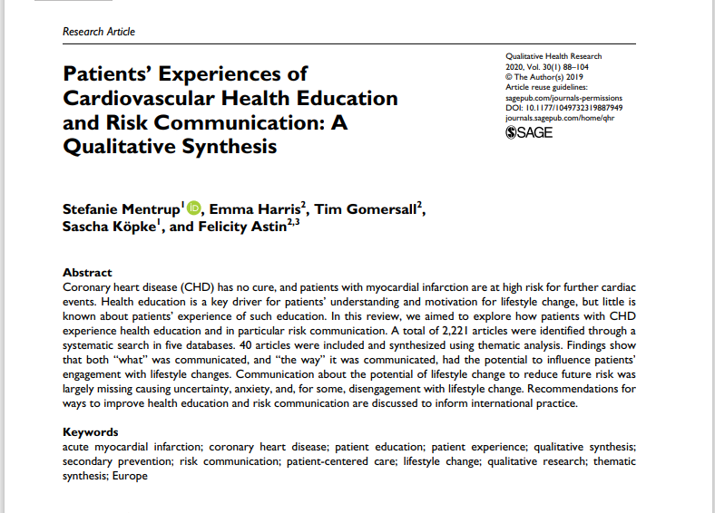
VERTICAL INTEGRATION

Slide 25
Research,Bioethics, Artificial Intelligence

Slide 26
Ethics & health education
https://www.nchec.org/code-of-ethics#:~:text=Health%20Education%20Specialists%20are%20ethically,values%2C%20attitudes%2C%20and%20opinions.
Article I: Core Ethical Expectations
Health Education Specialists display personal behaviors that represent the ethical conduct principles of honesty, autonomy, beneficence, respect, and justice. The Health Education Specialist should, under no circumstances, engage in derogatory language, violence, bigotry, racism, harassment, inappropriate sexual activities or communications in person or through the use of technology and other means

Slide 27
Research in health education
https://journals.lww.com/academicmedicine/Fulltext/2021/03000/Decolonizing_Global_Health_Education__Rethinking.16.aspx
Abstract
Global health often entails partnerships between institutions in low- and middle-income countries (LMICs) that were previously colonized and high-income countries (HICs) that were colonizers. Little attention has been paid to the legacy of former colonial relationships and the influence they have on global health initiatives. There have been recent calls for the decolonization of global health education and the reexamination of assumptions and practices under pinning global health partnerships.

Slide 28
Use of AI in generating Patient Education Materials
https://journals.lww.com/op-rs/abstract/2024/03000/optimizing_ophthalmology_patient_education_via.16.aspx
This study suggests that AI tools, when guided by appropriate prompts, can generate accessible and comprehensible PEMs in the field of ophthalmic plastic and reconstructive surgeries, balancing readability with the complexity of the necessary information.

Slide 29
End of Lecture Assessment
Health Department assigns a team of Health workers to visit a flood hit area in Sindh to address the displaced population regarding causes, prevention, and treatment of diarrhea. The least effective method of communication in this case would be:
a) role playing
b) demonstrations
c) announcement through loud speakers
d) group discussion
e) lectures

Slide 30
Reading sources:
Primary (recommended textbooks)
J Parks textbook of Preventive & social Medicine. Ch.20 , 26th edition)
Textbook of Community Medicine & Public Health. By Muhammad Illyas , Dr Irfanullah Siddiqui

Slide 31
THANKS

