Slide 1
HEALTH CARE DELIVERY SYSTEMS OF PAKISTAN
Module-Endocrinology

Slide 4
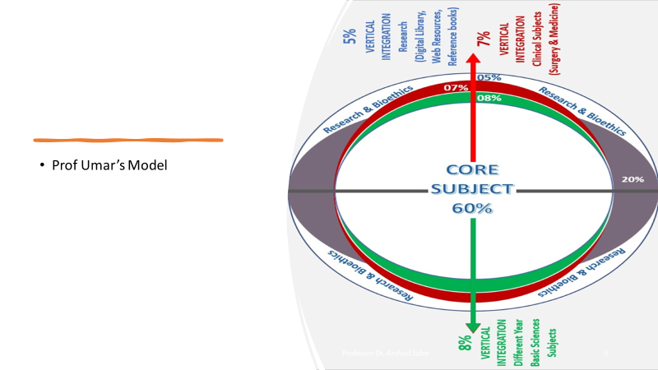

Slide 5
LEARNING OUTCOMES
To Describe the levels of health care system To Elaborate the healthcare services available at all levels of healthcare system To Describe the tiers of health care system of Pakistan To Discuss the functions of healthcare system of Pakistan

Slide 6
LECTURE SEQUENCE
CORE CONTENT 29 SLIDES
ARTIFICIAL INTELLIGENCE 01 SLIDE
RESEARCH 01 SLIDE
BIO ETHICS 01 SLIDE
EOLA 01 SLIDE

Slide 7
HEALTH CARE
CORE CONTENT
“Multitude Of Services Rendered To Individuals, Families Or Communities By The Agents Of The Health Services Or Professions For The Purpose Of Promoting, Maintaining Or Restoring Health” (31) Ed. 22
Services Might Be Staffed, Organized, Administered And Financed
People Are Being Served
Diagnosed, Helped, Cured, Educated, Rehabilitated
Completely Or Largely : Government Functions
CORE CONTENT

Slide 8
HEALTH SYSTEM
CORE CONTENT
Health Services
Constitute Management Sector & Involves Organizational Matters
Planning , Determining Priorities, Mobilizing , Allocating Resources
Translating Policies Into Services, Evaluation And Health Education
CORE CONTENT

Slide 9
HEALTH SYSTEM GOALS
CORE CONTENT
A. Health Services for all , full range and basic social services
B. Effective Primary Health care ( Health For all)
CORE CONTENT

Slide 10
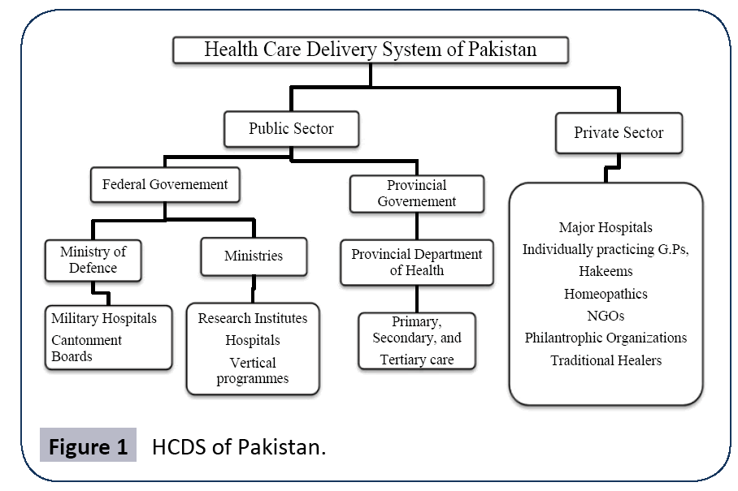
CORE CONTENT

Slide 11
CHANGING CONCEPTS
CORE CONTENT
Comprehensive Health Care :1946
Basic Health Services:1965 UNICEF/WHO
Primary Health Care : 1978 / 2000

Slide 12
ELEMENTS OF HEALTH CARE
CORE CONTENT
Education concerning prevailing health problems and methods of preventing and controlling
Promotion of food Supply and proper nutrition
An adequate supply of safe water and basic sanitation
Maternal and child health care, including family planning
Immunization against major infectious diseases
Prevention and control of locally endemic diseasses
Appropriate treatment of common diseases and injuries
Provision of essential drugs

Slide 13
FUNCTIONS OF HEALTH SYSTEM
CORE CONTENT
Appropriateness Essential Human Needs Comprehensiveness Preventive, Curative, Promotional Adequacy Services Proportionate To Requirement | Availability Population / center, Dr - Pt ratio Accessibility Geographic, Economic, Cultural Affordability Means of individual & state Feasibility Operational efficiency, logistics, human resources and material

Slide 14
LEVELS OF HEALTH CARE
CORE CONTENT
PRIMARY HEALTH CRE
Essential Health care
SECONDARY HEALTH CARE
Intermediate
TERTIARY HEALTH CARE
Specialized
CORE CONTENT

Slide 15
HEALTH CARE DELIVERY FRAMEWORK PAKISTAN
CORE CONTENT
WHO Pakistan
Tertiary care
Secondary care
Primary care
Tertiary care
Secondary care
Primary care
Notes:
Over the years, health system in pakistan is faced with another challenge and that is of inverted pyramid of levels of health care compared to the WHO recommendations. Resources (both human and financial) are committed to less needed tertairy care ,leaving the essential Primary care perniciuos .

Slide 16
CORE CONTENT
HEALTH CARE SYSTEM IN PAKISTAN
CENTRE OF EXCELLENCE
HRD (CME, CPD, CED)
Specialized Care for referred cases
Research and Development
All the three tiers are important
Tertiary Health Care
Primary Secondary Health Care Complex
Training some cadres
District Comprehensive
health Care Programme
Primary Health Care
Service Delivery
Community
Community
Community
Diagnose &Treat
Diagnose Treatment Ref
Diagnose suspect refer
Detect

Slide 17
LEVELS OF CARE
CORE CONTENT
PRIMARY HEALTH CARE (BHU * RHC)
The “first” level of contact between the individual and the health system.
Essential health care (PHC) is provided.
A majority of prevailing health problems can be satisfactorily managed.
The closest to the people.
Provided by the primary health centers.

Slide 18
LEVELS OF CARE
CORE CONTENT
SECONDARY HEALTH CARE THQ * DHQ
More complex problems are dealt with.
Comprises curative services
Provided by the district hospitals
The 1st referral level
TERTIARY HEALTH CARE (Teaching Hospitals)
Offers super-specialist care
Provided by regional/central level institution.
Provide training programs

Slide 19
INTERNATIONAL SUPPORT IN HEALTH CARE DELIEVRY SERVICES
CORE CONTENT
Support to the delivery of an identified package of essential services that is based on integration of service delivery.
Introduction of Family Practice and promotion of Public-Private Partnerships models in service delivery
Quality of services and patient safety as one of the main components of service delivery
Preventive
Promotive
Curative
Rehabilitation

Slide 20
LIMITATIONS OF HEALTH SYSTEM
CORE CONTENT
The Health Care Delivery Suffer From Some Key Issues Like
The High Population Growth
Uneven Distribution Of Health Professionals
Deficient Workforce
Insufficient Funding
Limited Access To Quality Health Care Services.

Slide 21
HEALTH STATUS
CORE CONTENT
Extreme Poverty
Improvement In Access To Energy,
Increased Industrial Activities,
Reduction In Maternal Mortality
Improvement In Undernourishment
Food Insecurity,
Wash And Housing, And Finally,
Climate Action.
(Pakistan SDGs Status Report 2021)

Slide 22
CORE CONTENT
HEALTH STATUS
SDGS Index Claims To Track A Country’s Performance On The 17 SDGS.
Overall, Pakistan’s SDGS Index Score
53.11 In 2015 To 63.5 In 2020 i.e. 19.5 Percent Up From The Baseline Of 2015.
There Are Sectoral Achievements At Different Levels. Considerable Decline In

Slide 23
HEALTH TEAM
CORE CONTENT
Health Care Workers
Role of physicians
Auxillary workers ( paramedical term x)
Medical & non medical
Phsycians, nurses, social workers, health
Assistants, trained dais, village health guides, host of others
HOSPITAL TEAM vs COMMUNITY TEAM
CORE CONTENT

Slide 24
HEALTH CARE DELIVERY SERVICES
CORE CONTENT
1,276 : HOSPITALS
BEDS : 146,053
BHU
5,558
RHC
736
5,802
DISPENSARIES
Maternity & Child Health Centers
TB CENTERS
780
416

Slide 25
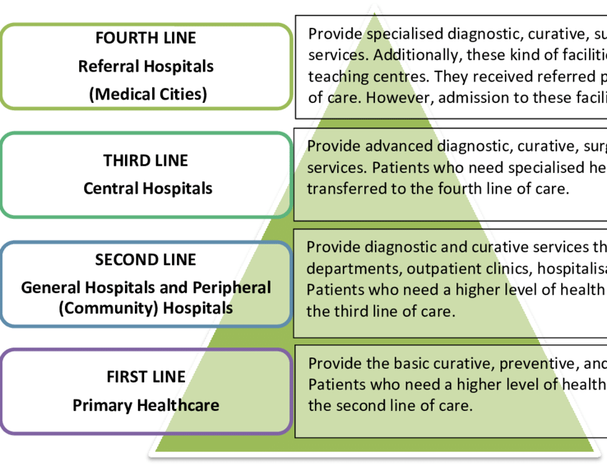
CORE CONTENT
CORE CONTENT

Slide 26
NATIONAL HEALTH CARE SERVICES
CORE CONTENT
I) Sehat Sahulat Programme (SSP)
Ii) Expanded Programme On Immunization (EPI)
Iii) Polio Eradication Initiative (PEI) Programme
Iv) National Health Information System (NHIS)
V) Malaria Control Programme (MCP)
Vi) Tuberculosis (TB) Control Programme
Vii) Human Immunodeficiency Virus (HIV)/Acquired Immunodeficiency Syndrome (AIDS) Control Programme
Viii) Civil Registration And Vital Statistics (CRVS)
iX) Challenge Of COVID-19 Outbreak

Slide 27
ROUTINE SERVICES
CORE CONTENT
All Essential Care Health Services are equipped with advanced, sophisticated modern diagnostic /therapeutic facilities.
Major services provided at these hospitals are diagnostic
therapeutic Nuclear Medicine
Theranostics
Radiotherapy
Chemotherapy
Notes:
Theranostics refers to the pairing of diagnostic biomarkers with therapeutic agents that share a specific target in diseased cells or tissues.

Slide 28
HEALTHCARE SERVICES AVAILABLE AT ALL LEVELS OF HEALTHCARE SYSTEM
CORE CONTENT
HCDS
Provincial
Federal
Gov’t
BHU,RHC
PHILANTHROPIST
EDHI
Private
NGOS
THQ, DHQ
TERTIARY CARE
RESEARCH
CLINICS
HOSPITALS
WHO
UNICEF
GAVI
M & BILL GATE
CHIPPA
TRUSTS
HAKEEMS
HEALERS
Armed Forces, Parastatals Such As Sui Gas, WAPDA, Railways, Fauji Foundation And The Employees Social Security Institution
VOLUNTEER HEALTH AGENCIES
Diverse Group Of Doctors, Nurses, Pharmacists, Traditional Healers, Drug Vendors, As Well As Laboratory Technicians, Shopkeepers And Unqualified Practitioners.
NATIONA HEALTH PROGRAMS

Slide 29
CONTD
CORE CONTENT
Regularization of services of over 100’000 Lady Health Workers (LHWs) - significant step towards increasing the outreach and delivery of health care
National Health Insurance Initiative caters to the health needs of population living below the poverty line through provision of free health services(Health Cards)
Notes:
The flagship program of Pakistan health system i.e lady health workers

Slide 30
ROLE OF ARTIFICIAL INTELLIGENCE
ARTIFICIAL INTELLIGENCE
https://www.foreseemed.com/artificial-intelligence-in-healthcare

Slide 31
RESEARCH
RESEARCH
https://www.ncbi.nlm.nih.gov/pmc/articles/PMC5344175/

Slide 32
BIOETHICS
BIOETHICS
Four commonly accepted principles of health care ethics, excerpted from Beauchamp and Childress (2008), include the:
Principle of respect for autonomy,
Principle of nonmaleficence,
Principle of beneficence, and
Principle of justice.
https://depts.washington.edu/bhdept/ethics-medicine/bioethics-topics/articles/principles-bioethics

Slide 33
ASSESSMEMT
CORE CONTENT
Which level of healthcare delivery services in Pakistan is responsible for providing primary healthcare to the population?
A) Tertiary Care
B) Secondary Care
C) Primary Care
D) Quaternary Care
E) Palliative Care
Answer: C) Primary Care

Slide 34
SOURCE
PARKS TEXT BOOK PREVENTIVE AND SOCIAL MEDICINE
Thank you

