Slide 1
Glomerular disease Renal Module 4th Year MBBS
Dr. Kiran Fatima
Pathology Department
Rawalpindi Medical University

Slide 2
MOTTO OF RMU
Wisdom
Truth
Service

Slide 3
VISION OF RMU THE DREAM/ TOMORROW
To impart evidence based research oriented medical education
To provide best possible patient care
To inculcate the values of mutual respect and ethical practice of medicine

Slide 4
PROF UMAR’S LGIS MODEL

Slide 5
How to use HEC Digital Library
Steps to Access HEC Digital Library
Go to the website of HEC National Digital Library.
On Home Page, click on the INSTITUTES.
A page will appear showing the universities from Public and Private Sector and other Institutes which have access to HEC National Digital Library (HNDL).

Slide 6
4. Select your desired Institute.
5. A page will appear showing the resources of the institution
6. Journals and Researches will appear
7. You can find a Journal by clicking on JOURNALS AND DATABASE and enter a keyword to search for your desired journal.

Slide 7
Learning objectives
Explain the manifestations of glomerular diseases
Classify glomerular diseases
Describe the pathogenesis of glomerular diseases
Describe the defining parameters for nephritic syndrome
Explain the clinicopathological features of nephritic syndrome

Slide 8
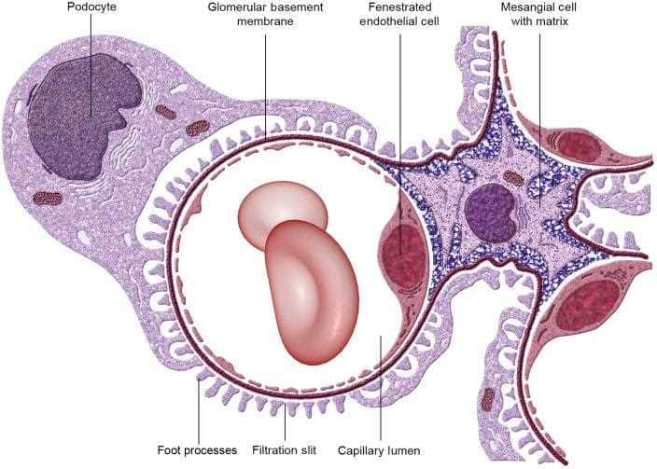
GLOMERULAR DISEASES
Integration Anatomy
Dr Mudassira Zahid
Associate Professor
Pathology Department
RMU

Slide 9
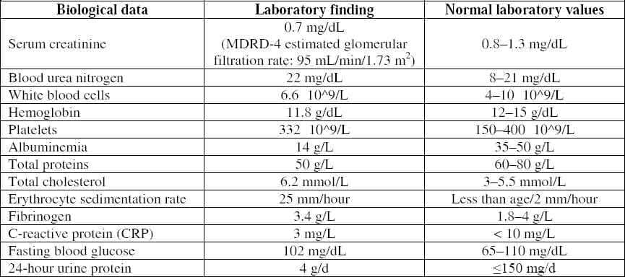
Core Content

Slide 10
LABS
.

Slide 11
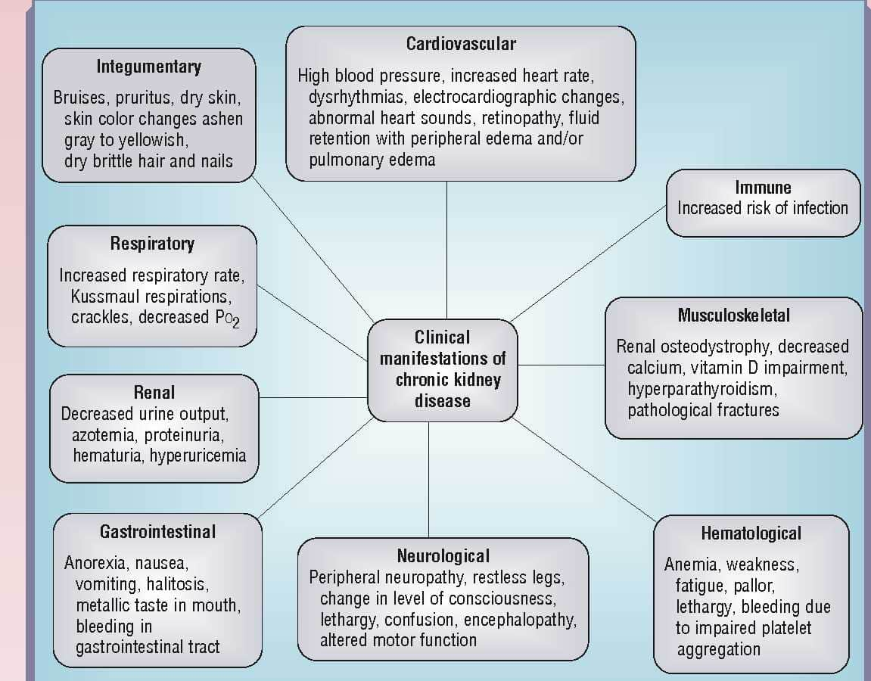
Manifestations Of Renal Diseases
Core Content

Slide 12
Azotemia
Core Content
↑BUN and creatinine levels
Due to ↓GFR.
Prerenal azotemia →hypoperfusion of the kidneys in the absence of parenchymal damage.
Postrenal azotemia→ urine flow obstruction distal to the kidney.
Uremia → Azotemia + constellation of clinical signs and symptoms and biochemical abnormalities

Slide 13
Chronic kidney disease
Core Content
It is the end result of all chronic renal parenchymal diseases (previously called chronic renal failure)
a diminished GFR persistently less than 60 mL/minute/1.73 m² for at least 3 months
and/or persistent albuminuria.
End-stage renal disease (ESRD) the GFR is less than 5% of normal; this is the terminal stage of uremia.

Slide 14
Nephrotic syndrome
Core Content
Group of symptoms and laboratory parameters characterized by
massive proteinuria, >3.5 g/24hr
edema, Pitting type
hypoalbuminemia, less than 2.5g/dL
Hyperlipidemia, >5.17 mmol/L cholesterol
lipiduria.

Slide 15
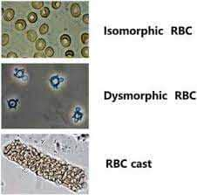
Nephrotic syndrome
Core Content
Nephritic syndrome acute onset comprising signs of nephritis.
It is characterized by
hematuria gross / microscopic with dysmorphic red cells and red cells casts in urine
↓ GFR oliguria
azotemia
hypertension
subnephrotic proteinuria .

Slide 16
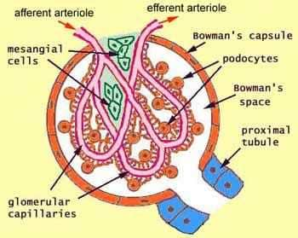
Normal structure of a glomerulus
Integration Anatomy

Slide 17
Normal glomerulous. Ultramicrophotograph
Integration Histology
Notes:
Glomerulous is composed of : a.capillary tuft with fenestrated endothelium b.GBM c. podocytes with foot processes d. parietal cells lining capsule e. mesangial cells.

Slide 18
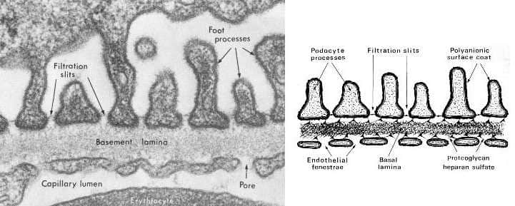
The filtration barrier
Integration Physiology
GBM --
Lamina rara interna
Thick dense central layer
Lamina rara externa
Collagen type IV Proteoglycans
Fibronectin Glycoproteins
Laminin

Slide 19
Filtration membrane
Core Content
Endothelial fenestration: 70-90 nm; negatively charged
GBM: collagen IV meshwork, have holes of 3.6 nm (Size barrier). Filtration slits bridged by zipper like slit diaphragm bridged by proteins (nephrin)
having pores (3.6nm) and negatively charged (charge and size barrier both).
Notes:
Endothelial fenestration:70-90 nm; negatively charged, Charge barrier. Thickness of GBM:200-400nm (300nm).collagen IV meshwork, have holes of 3.6 nm (Size barrier). Filtration slits bridged by zipper like slit diaphragm having pores (3.6nm) and negatively charged ( charge and size barrier both).

Slide 20
Glomerular barrier function
Core Content
completely impermeable to molecules of the size and molecular charge of albumin (a 70kDa protein).
discriminates among protein molecules according to their size (the larger, the less permeable), their charge (the more cationic+, the more permeable), and their configuration

Slide 21
Glomerular Injury mechanisms
Core Content

Slide 22
Core Content

Slide 23
Core Content
Two patterns of deposition of immune complexes as seen by immunofluorescence microscopy.
A, Granular, characteristic of circulating and in situ immune complex deposition.
B, Linear, characteristic of classic anti-glomerular basement membrane (anti-GBM) antibody glomerulonephritis.

Slide 24
Core Content
Localization of immune complexes in the glomerulus:
(1) subepithelial humps, as in acute glomerulonephritis;
(2) epimembranous deposits, as in membranous nephropathy and Heymann nephritis;
(3) subendothelial deposits, as in lupus nephritis and membranoproliferative glomerulonephritis;
(4) mesangial deposits, as in IgA nephropathy.
EN, Endothelium; EP, epithelium; GBM, glomerular basement membrane; LD, lamina densa; LRE, lamina rara externa; LRI, lamina rara interna; MC, mesangial cell; MM, mesangial matrix.

Slide 25
Mediators Of injury
Core Content
Neutrophils, monocytes Macrophages,
T-cells, NK cells
Platelets
Mesangial cells
Complement products
chemokines, Growth factors
Eicosanoids, nitric oxide, angiotensin, and endothelin
Cytokines, IL-1 and TNF, coagulation factors

Slide 26
Core Content

Slide 27
Core Content

Slide 28
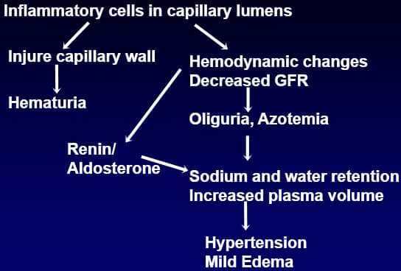
Core Content

Slide 29
Core Content

Slide 30
Assessment of patterns of renal injury
Core Content
Renal biopsy is an important tool for evaluation of renal problems especially glomerular disease.
Light microscopy(LM),
Electron microscopy(EM)
Immunofluorescence microscopy (IF) constitute a triad for diagnosis of glomerular disease.

Slide 31
Normal glomerulus
Integration Histology
Notes:
Normal Glomerulous.

Slide 32
Neprotic syndrome
Core Content
Acute proliferative (post streptococcal, post infectious) glomerulonephritis
Rapidly progressive(crescentic) glomerulonephritis
IgA nephropathy

Slide 33
Clinical presentation of nephritic syndrome
Core Content
Hematuria
Red cell casts in urine
Azotemia
Oliguria
Mild to moderate hypertension
Subnephrotic Proteinuria
Edema

Slide 34
Acute proliferative (post streptococcal, postinfectious) GN
Core Content
Diffuse proliferation of glomerular cells with influx of leucocytes
Sudden onset of gross hematuria
Immune complex disease
exogenous Ag… infections
endogenous Ag… SLE
Age: 6-10 yrs, any age
Labs: increased antistreptococcal Ab, decreased C3

Slide 35
Pathogenesis
Core Content
Causative agent (Gp A beta hemolytic streptococci, virus, fungi, parasites)
1-4 weeks after pharyngitis/ skin infection
Streptococcal Ag are exogenously planted from circulation in sub epithelial location
In situ immune complex
inflammatory reaction

Slide 36
Core Content

Slide 37
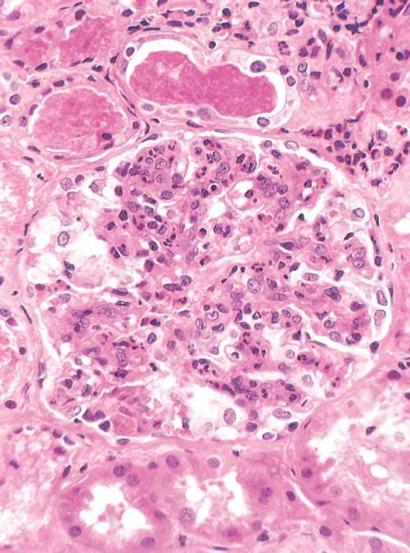
Light microscopy
Core Content
Glomeruli: enlarged, hyper cellular
Involvement is global, diffuse
Proliferation of endothelial cells, mesangial cells
Infiltration by neutrophils, monocytes
In severe cases, crescents formed.
Interstitium: edema, inflammation
Tubules: red cell casts

Slide 38
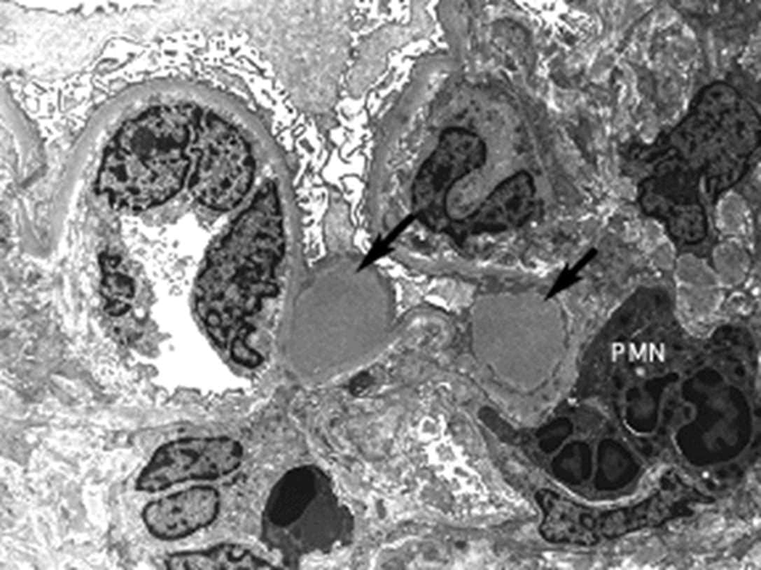
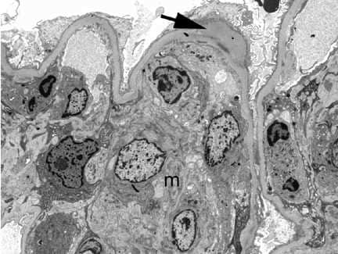
Electron microscopy
Core Content
Discrete, electron dense deposits
Sub epithelial humps (finely granular, dome-shaped, electron dense, representing immune complex
deposits) against the GBM

Slide 39
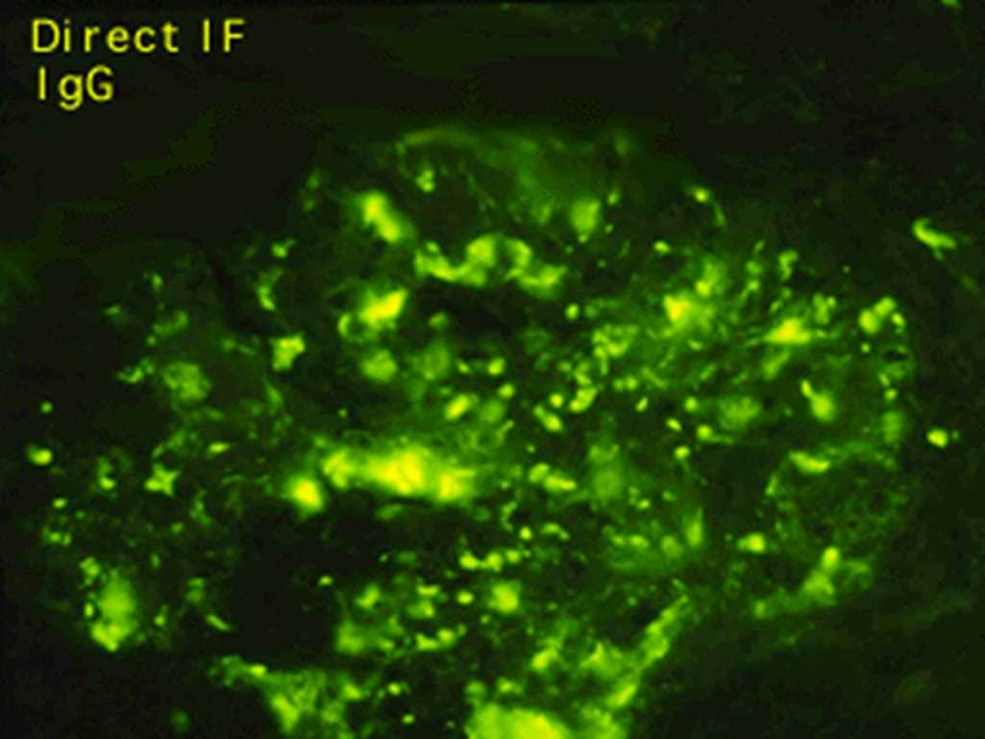
Immunofluorescence
Core Content
Granular deposits
IgG, C3
Mostly sub epithelial

Slide 40
Non-streptococcal acute GN
Core Content
Bacteria streptococcal endocarditis, pneumococcal pneumonia, meningococcemia
Viral hepatitis B,C, mumps, measles, chickenpox, HIV, varicella
Parasite malaria, toxoplasma

Slide 41
Rapidly progressive (crescentic) GN
Core Content
Syndrome of severe glomerular injury but not specific etiologic form
Rapid and progressive loss of renal function, severe oliguria, signs of nephritic syndrome
If untreated death in few weeks or months

Slide 42
Types
Core Content

Slide 43
Type I (anti GBM antibody mediated crescentic glomerulonephritis)
Core Content
Presence of autoantibodies against the glomerular basement membrane (GBM)
Inciting Ag is alpha 3 chain of collagen type IV

Slide 44
Type II (immune complex mediated crescentic glomerulonephritis)
Core Content
Caused by deposition of immune complexes along GBM
Immune complex diseases that involves the glomerulus include SLE, acute proliferative glomerulonephritis, Henoch–Schönlein purpura and IgA nephropathy.

Slide 45
Type III (pauci immune crescentic glomerulonephritis)
Core Content
Absent anti GBM Ab, immune deposits
Present ANCA (anti-neutrophil cytoplasmic antibody)
Associated with systemic vasculitis such as microscopic polyangitis & Wegener granulomatosis.

Slide 46
Morphology
Core Content
Kidneys enlarged & pale with petechial hemorrhages on cortical surfaces

Slide 47
Morphology
Core Content
Crescents are formed by
proliferation of parietal cells
by migration of monocytes and macrophages into the urinary space.
Neutrophils and lymphocytes may be present.
The crescents may obliterate the urinary space and compress the glomerular tuft.
Fibrin strands are frequently prominent between the cellular layers in the crescents. the escape of procoagulant factors, fibrin and cytokines into Bowman space may contribute to crescent formation.

Slide 48
Immunoflourescence
Core Content
immune complex-mediated cases show granular immune deposits;
Goodpasture syndrome cases show linear GBM fluorescence for Ig and complement,
Pauci-immune cases have little or no deposition of immune reactants.

Slide 49
Electron microscopy
Core Content
Electron microscopy shows ruptures in the GBM, a severe injury that allows leukocytes, plasma proteins such as coagulation factors and complement, and inflammatory mediators to reach the urinary space, where they trigger crescent formation

Slide 50
IgA nephropathy
Core Content
Affects children & young adults
Prominent IgA deposits in mesangium
Recurrent hematuria

Slide 51
Microscopy
Core Content
Light microscopy,
Glomeruli: normal to mesangial widening and segmental inflammation
Electron microscopy presence of electron dense deposits in mesangium.

Slide 52
Core Content
Immunofluorescence
Mesangial deposition of IgA along with C3 & properdin

Slide 53
Take home messsage
Glomerular diseases damage the kidney's filtering units (glomeruli), leading to protein and/or blood in the urine. They can be caused by various factors, including infections, autoimmune diseases, and diabetes. Diagnosis often involves urine tests, blood tests, and sometimes a kidney biopsy.

Slide 54
Research
https://www.ncbi.nlm.nih.gov/books/NBK535404/
Chronic Kidney Disease
Satyanarayana R. Vaidya; Narothama R. Aeddula.
Author Information and Affiliations
Last Update: July 31, 2024.
Go to:
Continuing Education Activity
Chronic kidney disease (CKD) is characterized by the presence of kidney damage or an estimated glomerular filtration rate (eGFR) of less than 60 mL/min/1.73 m², persisting for 3 months or more. CKD involves a progressive loss of kidney function, often leading to the need for renal replacement therapy, such as dialysis or transplantation. The 2012 KDIGO CKD classification considers the underlying cause and categorizes CKD into 6 stages of progression and 3 stages of proteinuria based on glomerular filtration rate and levels of albuminuria. Although the causes of CKD vary, certain disease processes exhibit similar patterns.
The implications of CKD are extensive—it emerges from various disease processes and affects cardiovascular health, cognitive function, bone metabolism, anemia, blood pressure, and many other health indicators. Early recognition of CKD is the first step in treating it, and various methods for measuring eGFR have been described. Both modifiable and non-modifiable risk factors influence the progression of CKD. Management of CKD involves adjusting medication dosages according to the patient's eGFR, preparing for renal replacement therapies, and addressing reversible causes to slow disease progression. This activity reviews the etiology, evaluation, and management of CKD, emphasizing the crucial role of an interprofessional healthcare team in providing comprehensive care. An interprofessional approach focuses on both modifiable and non-modifiable risk factors to manage and mitigate the progression of the disease.

Slide 55
Family medicine
A 10-year-old child presents with hematuria following a recent strep throat infection. What is the most likely diagnosis?
IgA nephropathy
b) Post-streptococcal glomerulonephritis
c) Minimal change disease
d) Hereditary nephritis

