Slide 2
Mechanism of glomerular injury, nephritic syndrome Renal Module 4th Year MBBS
Dr. Kiran Fatima
Pathology Department
Rawalpindi Medical University

Slide 3
MOTTO OF RMU
Wisdom
Truth
Service

Slide 4
VISION OF RMU THE DREAM/ TOMORROW
To impart evidence based research oriented medical education
To provide best possible patient care
To inculcate the values of mutual respect and ethical practice of medicine

Slide 5
PROF UMAR’S LGIS MODEL

Slide 6
How to use HEC digital library
Steps to Access HEC Digital Library
Go to the website of HEC National Digital Library.
On Home Page, click on the INSTITUTES.
A page will appear showing the universities from Public and Private Sector and other Institutes which have access to HEC National Digital Library (HNDL).

Slide 7
4. Select your desired Institute.
5. A page will appear showing the resources of the institution
6. Journals and Researches will appear
7. You can find a Journal by clicking on JOURNALS AND DATABASE and enter a keyword to search for your desired journal.

Slide 8
Learning objectives
Classify glomerular diseases
Describe the pathogenesis of glomerular diseases
Explain the manifestations of glomerular diseases
Describe the defining parameters for nephritic syndrome
Explain the clinico pathological features of nephritic syndrome

Slide 9
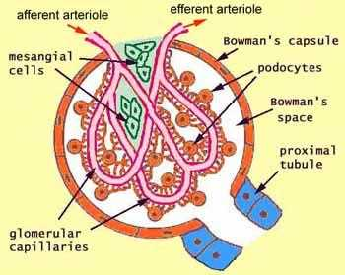
Normal structure of a glomerulus
Integration Anatomy

Slide 10
Normal glomerulous. Ultramicrophotograph
Integration Histology
Notes:
Glomerulous is composed of : a.capillary tuft with fenestrated endothelium b.GBM c. podocytes with foot processes d. parietal cells lining capsule e. mesangial cells.

Slide 11
Normal glomerulus
Integration Histology
Notes:
Normal Glomerulous.

Slide 12
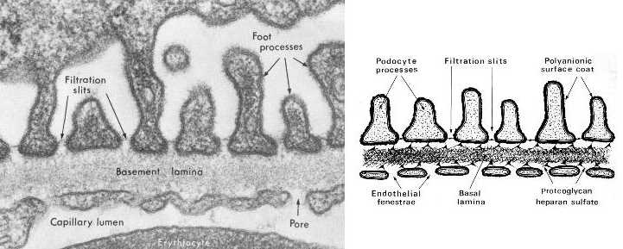
The filtration barrier
Integration Physiology
GBM --
Lamina rara interna
Thick dense central layer
Lamina rara externa
Collagen type IV Proteoglycans
Fibronectin Glycoproteins
Laminin

Slide 13
Glomerular barrier function
Integration Biochemistry
Completely impermeable to molecules of the size and molecular charge of albumin (a 70kDa protein).
Discriminates among protein molecules according to their size (the larger, the less permeable), their charge (the more cationic+, the more permeable), and their configuration

Slide 14
Glomerular injury mechanisms
Core Content

Slide 15
Core Content

Slide 16
Core Content
Two patterns of deposition of immune complexes as seen by immunofluorescence microscopy.
A, Granular, characteristic of circulating and in situ immune complex deposition.
B, Linear, characteristic of classic anti-glomerular basement membrane (anti-GBM) antibody glomerulonephritis.

Slide 17
Core Content
Localization of immune complexes in the glomerulus:
(1) subepithelial humps, as in acute glomerulonephritis;
(2) epimembranous deposits, as in membranous nephropathy and Heymann nephritis;
(3) subendothelial deposits, as in lupus nephritis and membranoproliferative glomerulonephritis;
(4) mesangial deposits, as in IgA nephropathy.
EN, Endothelium; EP, epithelium; GBM, glomerular basement membrane; LD, lamina densa; LRE, lamina rara externa; LRI, lamina rara interna; MC, mesangial cell; MM, mesangial matrix.

Slide 18
Mediators of injury
Core Content
Neutrophils, monocytes Macrophages,
T-cells, NK cells
Platelets
Mesangial cells
Complement products
chemokines, Growth factors
Eicosanoids, nitric oxide, angiotensin, and endothelin
Cytokines, IL-1 and TNF, coagulation factors

Slide 19
Core Content

Slide 20
Core Content

Slide 21
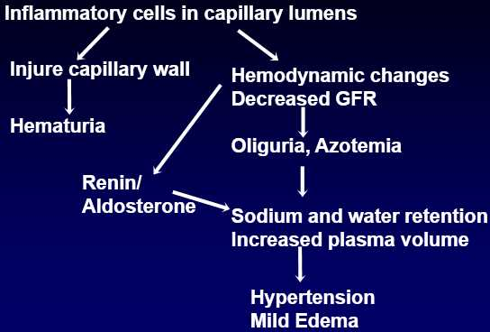
Core Content

Slide 22
Core Content

Slide 23
Assessment of patterns of renal injury
Core Content
Renal biopsy is an important tool for evaluation of renal problems especially glomerular disease.
Light microscopy(LM),
Electron microscopy(EM)
Immunofluorescence microscopy (IF) constitute a triad for diagnosis of glomerular disease.

Slide 24
Neprotic syndrome
Integration Histology
Acute proliferative (post streptococcal, post infectious) glomerulonephritis
Rapidly progressive(crescentic) glomerulonephritis
IgA nephropathy

Slide 25
Clinical presentation of nephritic syndrome
Vertical Integration Medicine
Hematuria
Red cell casts in urine
Azotemia
Oliguria
Mild to moderate hypertension
Subnephrotic Proteinuria
Edema

Slide 26
Acute proliferative (post streptococcal, postinfectious) GN
Core Content
Diffuse proliferation of glomerular cells with influx of leucocytes
Sudden onset of gross hematuria
Immune complex disease
exogenous Ag… infections
endogenous Ag… SLE
Age: 6-10 yrs, any age
Labs: increased antistreptococcal Ab, decreased C3

Slide 27
Pathogenesis
Core Content
Causative agent (Gp A beta hemolytic streptococci, virus, fungi, parasites)
1-4 weeks after pharyngitis/ skin infection
Streptococcal Ag are exogenously planted from circulation in sub epithelial location
In situ immune complex
inflammatory reaction

Slide 28
Core Content

Slide 29
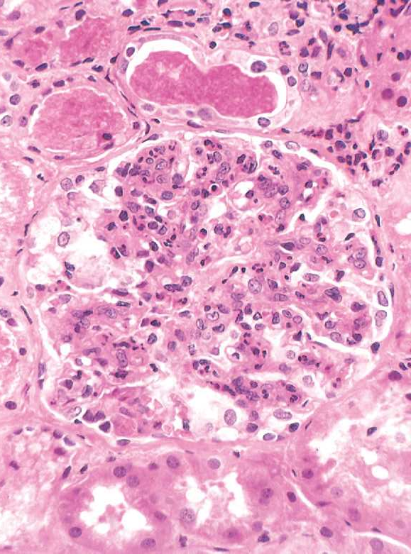
Light microscopy
Core Content
Glomeruli: enlarged, hyper cellular
Involvement is global, diffuse
Proliferation of endothelial cells, mesangial cells
Infiltration by neutrophils, monocytes
In severe cases, crescents formed.
Interstitium: edema, inflammation
Tubules: red cell casts

Slide 30
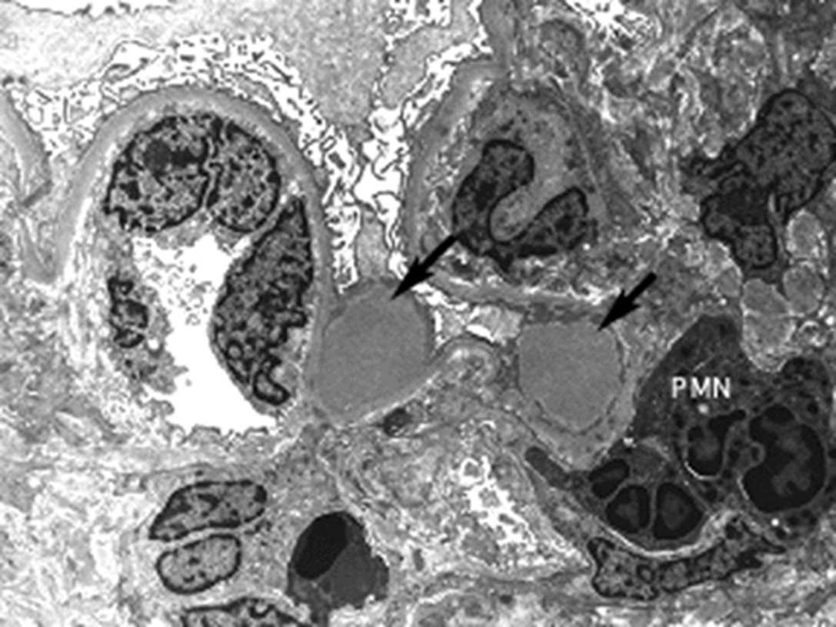
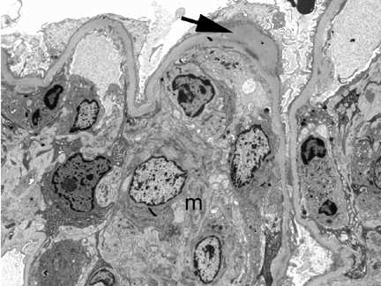
Electron microscopy
Core Content
Discrete, electron dense deposits
Sub epithelial humps (finely granular, dome-shaped, electron dense, representing immune complex
deposits) against the GBM

Slide 31
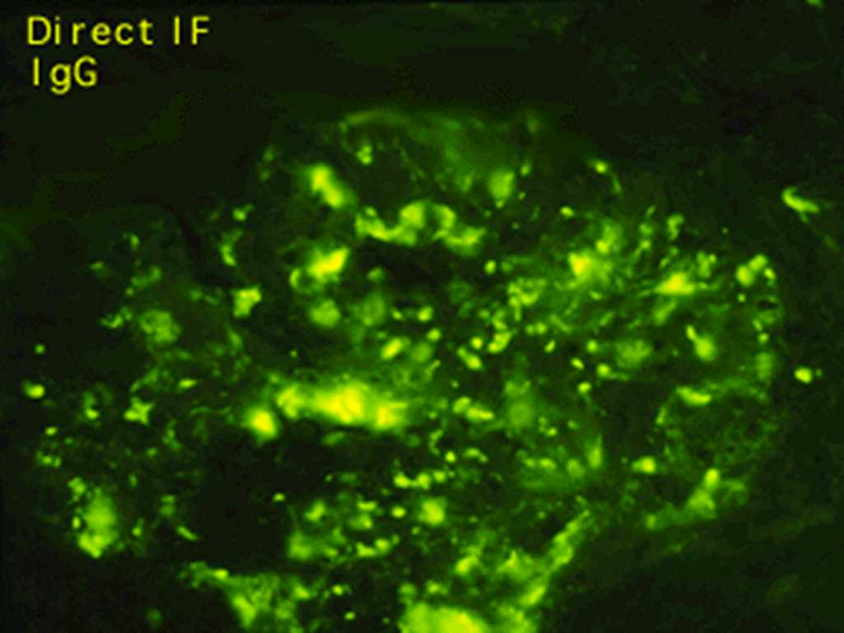
Immunofluorescence
Core Content
Granular deposits
IgG, C3
Mostly sub epithelial

Slide 32
Non-streptococcal acute GN
Core Content
Bacteria streptococcal endocarditis, pneumococcal pneumonia, meningococcemia
Viral hepatitis B,C, mumps, measles, chickenpox, HIV, varicella
Parasite malaria, toxoplasma

Slide 33
Rapidly progressive (crescentic) GN
Core Content
Syndrome of severe glomerular injury but not specific etiologic form
Rapid and progressive loss of renal function, severe oliguria, signs of nephritic syndrome
If untreated death in few weeks or months

Slide 34
Types
Core Content

Slide 35
Type I (anti GBM antibody mediated crescentic glomerulonephritis)
Core Content
Presence of autoantibodies against the glomerular basement membrane (GBM)
Inciting Ag is alpha 3 chain of collagen type IV

Slide 36
Type II (immune complex mediated crescentic glomerulonephritis)
Core Content
Caused by deposition of immune complexes along GBM
Immune complex diseases that involves the glomerulus include SLE, acute proliferative glomerulonephritis, Henoch–Schönlein purpura and IgA nephropathy.

Slide 37
Type III (pauci immune crescentic glomerulonephritis)
Core Content
Absent anti GBM Ab, immune deposits
Present ANCA (anti-neutrophil cytoplasmic antibody)
Associated with systemic vasculitis such as microscopic polyangitis & Wegener granulomatosis.

Slide 38
Morphology
Core Content
Kidneys enlarged & pale with petechial hemorrhages on cortical surfaces

Slide 39
Morphology
Core Content
Crescents are formed by
proliferation of parietal cells
by migration of monocytes and macrophages into the urinary space.
Neutrophils and lymphocytes may be present.
The crescents may obliterate the urinary space and compress the glomerular tuft.
Fibrin strands are frequently prominent between the cellular layers in the crescents. the escape of procoagulant factors, fibrin and cytokines into Bowman space may contribute to crescent formation.

Slide 40
Immunofluorescence
Core Content
immune complex-mediated cases show granular immune deposits;
Goodpasture syndrome cases show linear GBM fluorescence for Ig and complement,
Pauci-immune cases have little or no deposition of immune reactants.

Slide 41
Electron microscopy
Core Content
Electron microscopy shows ruptures in the GBM, a severe injury that allows leukocytes, plasma proteins such as coagulation factors and complement, and inflammatory mediators to reach the urinary space, where they trigger crescent formation

Slide 42
IgA nephropathy
Horizontal Integration CM
Affects children & young adults
Prominent IgA deposits in mesangium
Recurrent hematuria

Slide 43
Microscopy
Core Content
Light microscopy,
Glomeruli: normal to mesangial widening and segmental inflammation
Electron microscopy presence of electron dense deposits in mesangium.

Slide 44
Core Content
Immunofluorescence
Mesangial deposition of IgA along with C3 & properdin

Slide 45
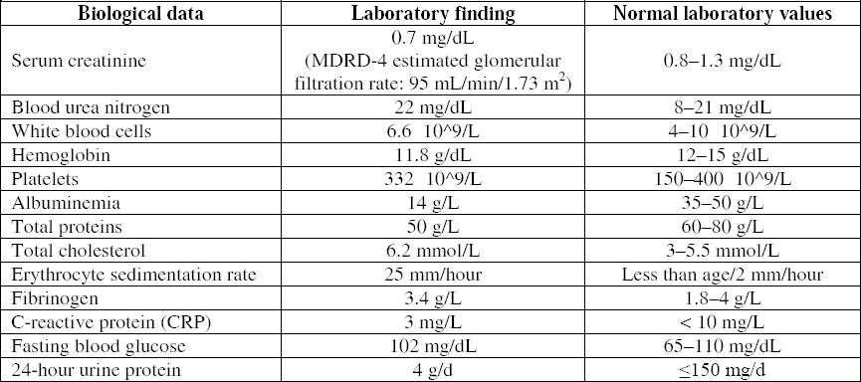
Core Content

Slide 46
Azotemia
Vertical Integration Medicine
↑BUN and creatinine levels
Due to ↓GFR.
Prerenal azotemia →hypoperfusion of the kidneys in the absence of parenchymal damage.
Postrenal azotemia→ urine flow obstruction distal to the kidney.
Uremia → Azotemia + constellation of clinical signs and symptoms and biochemical abnormalities

Slide 47
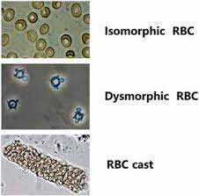
Nephritic syndrome
Vertical Integration Medicine
Nephritic syndrome acute onset comprising signs of nephritis.
It is characterized by
hematuria gross / microscopic with dysmorphic red cells and red cells casts in urine
↓ GFR oliguria
azotemia
hypertension
subnephrotic proteinuria .

Slide 48
Family medicine
A patient is diagnosed with nephrotic syndrome. Which of the following would you expect to find in their urine?
Red blood cells
b) White blood cells
c) Protein
d) Glucose

Slide 49
Take home message
Glomerular diseases damage the tiny filters (glomeruli) in the kidneys, leading to protein and blood in the urine. They can be caused by various factors, including infections, autoimmune diseases, and genetic conditions. Symptoms may include swelling, foamy urine, and decreased kidney function. Diagnosis often involves urine tests, blood tests, and sometimes a kidney biopsy.

Slide 50
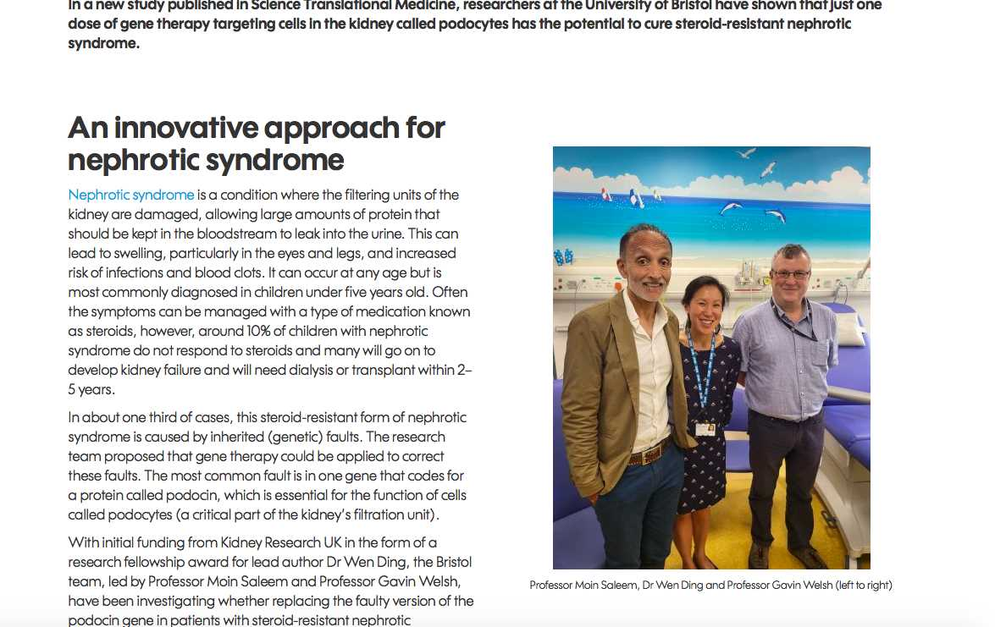
Research

