Slide 1
1

Slide 2
Global Warming
Block X Otorhinolaryngology
Module-II 4th Year MBBS Dr Mehreen Noor, Dr Mehrish Saleem

Slide 4
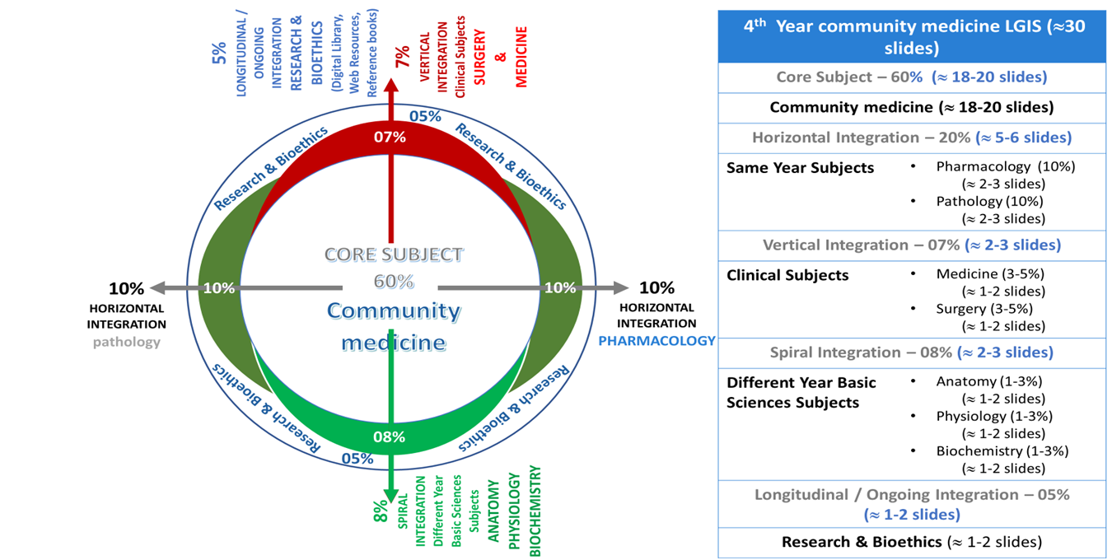
Prof Umar's Integration Model

Slide 5
Sequence of Lecture
Learning Objectives (1 slide)
Vertical integration ( 4 slides)
Core Subject (30 slides)
Research ( 1 slide)
Bioethics (1 slide)
End of lecture assessment (1 slide)
Reading source information (1 slide)

Slide 6
Learning Objectives
At the end of the session students will be able to
Enlist natural and Artificial methods of air purification
Describe Greenhouse effect and greenhouse gases
Identify greenhouse gases source
Define ozone hole and its importance
Explain link between global warming and climate change

Slide 7
Disinfection/Purification Of Air
Natural Methods:
Winds
Sunlight
Rain
Plants
Artificial Methods:
Containment
Replacement
Dilution
Disinfection:
Mechanical methods
UV Radiation
Chemical Mist
Dust Control

Slide 8
Artificial Methods of Air Purification
1.Containment:
Arresting polluted air at the source, neutralizing, detoxifying it before releasing in the atmosphere
2.Replacement:
with non-toxic or less toxic ones. e.g., use of electricity for coal.
3.Arrestors:
Mechanical devices to prevent the escape of toxic substances into the air
4.Dilution:
Establishment of “green belts” between industrial and residential areas
5. Disinfection:
UV Radiation
Chemical Mist
Dust Control

Slide 9
Air Purification
Legislation: Air pollution is controlled in many countries by
Suitable legislation. Legislation covers such matters such as
Height of chimneys, creation of smokeless zones, and enforcement of standards for ambient air quality.

Slide 10
Green House Effect
It is a phenomenon that keeps the earth warm just for the existence of life on it
The average surface temperature of Earth is about 15 °C.
At same distance from sun , our moon which has no atmosphere its average temperature ~ -23 °C (9 °F)
During the lunar day, the surface temperature averages 107 °C And during the lunar night, it averages −153 °C

Slide 11
Green House Effect
"If there were no atmosphere, the Earth's temperature would have been –18.7 °C. This is approximately 33 °C colder than the current average temperature of +14.5 °C. The Earth's atmosphere, through the greenhouse effect, raises the surface temperature by 33 °C, making it habitable.

Slide 12
How Green House Effect Works ?
Earth's temperature is a result of the equilibrium between the solar energy absorbed by the Earth and the long wave (infra-red) radiation from the Earth escaping into space.
It is the warming of Earth ’s surface and troposphere (the lowest layer of the atmosphere) caused by the presence of water vapor, carbon dioxide, methane, and certain other gases in the air.
The sunlight that reach earth surface is converted into heat which bounces off earth surface into space. These green house gases absorbs high heat and radiate it back to earth causing increase temperature
Remember , Major components of earth atmosphere nitrogen 78%, oxygen 21% , Argon 0.9% have no green house effect.

Slide 13
Green House Gases
Water vapor
Carbon dioxide
Methane
Nitrous oxide
Chlorofluorocarbons

Slide 14
Green House Gases
Each gas's effect on climate change depends on three main factors:
How much is in the atmosphere?
How long do they stay in the atmosphere?
How strongly do they impact the atmosphere?

Slide 15
Green House Gases Carbon Dioxide (CO2)
Carbon dioxide enters the atmosphere through burning fossil fuels (coal, natural gas, and oil), solid waste, trees and other biological materials, and also as a result of certain chemical reactions (e.g., manufacture of cement).
Human activities increasing carbon dioxide production
Transportation
Electricity
Industry
Carbon dioxide (CO₂) is the primary greenhouse gas emitted through human activities.

Slide 16
Fluorinated (Green House Gases) Sources
Hydrofluorocarbons (HFCs) used in various sectors and applications, such as refrigerants , air-conditioning and heat pump equipment.
Perfluorocarbons (PFCs) used in the electronics sector (for example for plasma cleaning of silicon wafers) as well as in cosmetic and pharmaceutical industry, also used in fire extinguishers and can still be found in older fire protection systems.
Sulphur hexafluoride (SF₆) is used mainly as an insulating gas, in high voltage switchgear and in the production of magnesium and aluminum.

Slide 17
Reduced Emissions Green House Gases
Energy sector and fuel sector reforms.
Green house gases like carbon dioxide can be reduced by efficient use of energy , more fuel efficient vehicles. Use of better electrical appliances'. Aim is to reduce fossil fuel use. Using fuel with low carbon can help reduce carbon dioxide emission
Carbon dioxide capture and sequestration technologies potentially greatly reduce CO₂ emissions from new and existing coal- and gas-fired power plants, industrial processes, and other stationary sources of CO₂

Slide 18
Stratosphere Ozone layer
Stratospheric ozone is formed naturally by chemical reactions involving solar ultraviolet radiation (sunlight) and oxygen molecules
In the first step, solar ultraviolet radiation breaks apart one oxygen molecule (O2) to produce two oxygen atoms (2 O)
In the second step, each of these highly reactive atoms combines with an oxygen molecule to produce an ozone molecule (O3)
It absorbs ultraviolet radiation from sun. it is being constantly formed and break/lost involving chemical reactions

Slide 19
Ozone Depletion
When chlorine and bromine atoms come into contact with ozone in the stratosphere, they destroy ozone molecules.
One chlorine atom can destroy over 100,000 ozone molecules before it is removed from the stratosphere.
Compounds that release chlorine or bromine in stratosphere upon exposure to UV. light
chlorofluorocarbons (CFCs), hydrochlorofluorocarbons (HCFCs
carbon tetrachloride, and methyl chloroform.
ODS that release bromine are halons and methylbromides

Slide 20
Ozone Hole
When the "ozone hole" forms, essentially all of the ozone in the lower stratosphere is destroyed. The upper stratosphere is much less affected, however, the overall amount of ozone over the continent declines by 50 percent or more. The ozone hole does not go all the way through the layer; on the other hand, it is not a uniform 'thinning' of the layer either. It is a "hole" in the sense of "a hole in the ground", that is, a depression; not in the sense of "a hole in the windshield."

Slide 21
Consequences Of Ozone Depletion On humans
Stratosphere ozone layer absorbs UVB ultraviolet light from the sun, its depletion will increase UVB levels which could increase incidence of:
• Basal and squamous cell CA
• Malignant melanoma
• Cortical cataracts
• Sunburns
• Weakening of immune system

Slide 22
Consequences of ozone depletion
Effects on crops
• Rice crops effected as increase UV levels effect cyanobacteria.
Effects On Plankton
• widespread extinction of plankton which are vitally important for marine life.

Slide 23
Troposphere Ozone As Air Pollutant
Ozone in the troposphere is major constituent of photochemical smog
Formed as photochemical reaction of UV light and air pollutants like nitrogen oxide .
It harmful effects on human health
It cause breathing problems, asthma, reduce lung function and lung disease

Slide 24
How Climate Change Affects Human Health
https://www.epa.gov/climateimpacts/climate-change-and-human-health

Slide 25
Global Warming and climate change
Human activities – particularly the burning of fossil fuels – have released sufficient quantities of carbon dioxide and other greenhouse gases to trap additional heat in the lower atmosphere and affect the global climate.
In the last 130 years, the world has warmed by approximately 0.85ºC. Each of the last 3 decades has been successively warmer than any preceding decade since 1850
Green house gases are linked with human activity , accumulate in the atmosphere and trap the heat energy that bounce off of earth surface increasing earth temperature

Slide 26
Global warming climate change
Climate change affects the social and environmental determinants of health – clean air, safe drinking water, sufficient food and secure shelter.
Between 2030 and 2050, climate change is expected to cause approximately 250 000 additional deaths per year, from malnutrition, malaria, diarrhea and heat stress.
The direct damage costs to health (i.e. excluding costs in health-determining sectors such as agriculture and water and sanitation), is estimated to be between USD 2-4 billion/year by 2030.

Slide 27
Global warming Health challenges
Extreme Heat
Extreme high air temperatures contribute directly to deaths from cardiovascular and respiratory disease, particularly among elderly people. In the heat wave of summer 2003 in Europe for example, more than 70 000 excess deaths were recorded
High temperatures also raise the levels of ozone and other pollutants in the air that exacerbate cardiovascular and respiratory disease.

Slide 28
Global warming Environmental challenges
Natural disasters and variable rainfall patterns
Globally, the number of reported weather-related natural disasters has more than tripled since the 1960s. Every year, these disasters result in over 60 000 deaths, mainly in developing countries.
Rising sea levels and increasingly extreme weather events will destroy homes, medical facilities and other essential services. More than half of the world's population lives within 60 km of the sea. People may be forced to move, which in turn heightens the risk of a range of health effects, from mental disorders to communicable diseases.

Slide 29
Global warming
Floods and extreme precipitation are also increasing in frequency and intensity heighten the risk of water-borne diseases, and create breeding grounds for disease-carrying insects such as mosquitoes. Also cause drownings and physical injuries, damage homes and disrupt the supply of medical and health services.
Rising temperatures decrease the production of staple foods will increase the prevalence of malnutrition and undernutrition, which currently cause 3.1 million deaths every year

Slide 30
Global warming and climate change. Health challenges
Malaria is strongly influenced by climate. Transmitted by Anopheles mosquitoes, malaria kills over 400 000 people every year – mainly children under 5 years old in certain African countries. The Aedes mosquito vector of dengue is also highly sensitive to climate conditions, and studies suggest that climate change is likely to continue to increase exposure to dengue.

Slide 31
Prevention And Control Of Air Pollution
Containment
Escape of toxic substances into the air which can be achieved through engineering methods like enclosure, ventilation and air cleaning and using arresters for removal of coatainments
Replacement .
replacing technological process where by new methods produce no air pollution. New methods of electricity production, renewable energy use instead of coals ,central heating system, new electric vehicles etc. reducing lead in petrol

Slide 32
Prevention And Control Of Air Pollution
Dilution
Establishment of green belts around industrial units.
Legislation
clean air acts, height of chimneys , smoke free zone. Examination of industrial units
International action
WHO set up international network of laboratories for monitoring and study of air pollution

Slide 33
Relevant research: Indicators of Global Climate Change 2023: annual update of key indicators of the state of the climate system and human influence
Human-induced warming has been increasing at a rate that is unprecedented in the instrumental record, reaching 0.26 [0.2–0.4] °C per decade over 2014–2023. This high rate of warming is caused by a combination of net greenhouse gas emissions being at a persistent high of 53±5.4 Gt CO2e yr−1 over the last decade, as well as reductions in the strength of aerosol cooling. Despite this, there is evidence that the rate of increase in CO2 emissions over the last decade has slowed compared to the 2000s, and depending on societal choices, a continued series of these annual updates over the critical 2020s decade could track a change of direction for some of the indicators presented here.
https://essd.copernicus.org/articles/16/2625/2024/

Slide 34
End Of Lecture Assessment
How does the greenhouse effect contribute to global warming?
A) By trapping heat in the Earth's atmosphere
B) By releasing heat from the Earth's surface into space
C) By decreasing solar radiation
D) By increasing Earth's albedo (reflectivity)
Answer: A) By trapping heat in the Earth's atmosphere
Notes:
Key e

Slide 35
Suggested readings
JE, PARK
ILYAS public health and community medicine book

Slide 36
Thankyou
36

