Slide 2
National Health Programs Of
Pakistan
(Module 3 Endocrinology)
Dr Imrana Saeed

Slide 3
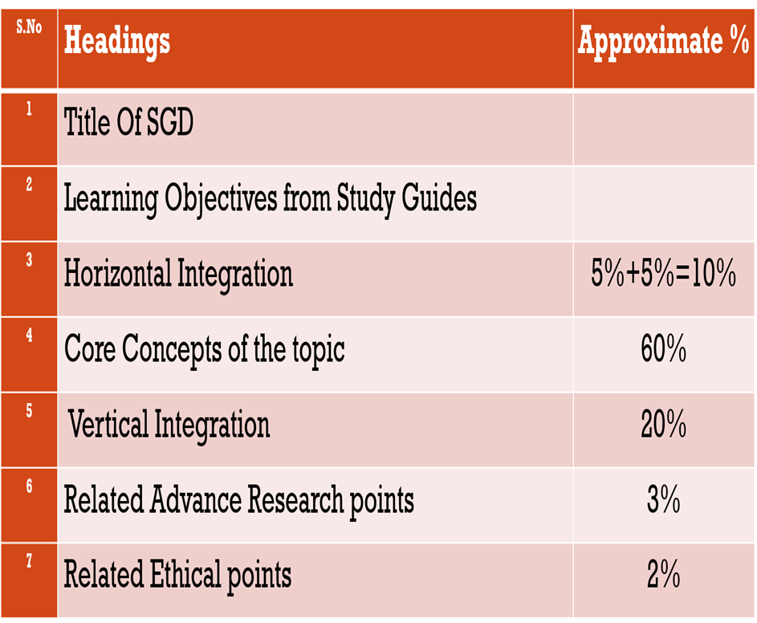

Slide 5
Prof Umar's Model

Slide 6
Sequence of Lecture
Learning Objectives 1 slide
Core Subject 25 slides
Vertical integration 6 slides
Research and bioethics 2 slides
Family medicine 2 slides
End of lecture assessment 1 slides

Slide 7
Learning Objectives
At the end of session student will be able to
Explain Program and national health Program
Differentiate between horizontal and vertical health program
Enlist important National health Programs
Discuss key points regarding National Program for
family planning and primary healthcare, EPI, AIDS Control program, Hepatitis Control Program

Slide 8
PROGRAM
Step by step approach to guide the actions
necessary to reach a Predetermined goal.

Slide 9
Why National health program?
Core Concept
High disease burden.
Geographical spread.
Proven strategies for prevention and control are available
Adequate infrastructure is in place.
Resources for program implementation are available

Slide 10
Vertical VS Horizontal Program
Horizontal
Focused on range of issues, not a single disease
Prevention focused
Driven by all in the community
Integrated into health system which helps with sustainability
Vertical
Often disease specific
Focused on control interventions
Generally driven by outsiders/donors
Not sustainable without continued funding, target specific population

Slide 11
Vertical National Health Programs
Core Concept
National program for family planning and primary health care(LHWs program
National expanded program of immunization(EPI)
National Tuberculosis Control program(DOTS)
AIDS Control Program
Hepatitis Control Program

Slide 12
Vertical National Health Programs cont….
Core Concept
National maternal, neonatal and Child health program
Iodine deficiency disorder control program
Leprosy Control program
Malaria Control Program
ARI Control program

Slide 13
Vertical National Health Programs cont….
Core Concept
Blindness Control program
Nutrition program
Health management information system(HMIS)
Health education program
Five years developmental program

Slide 14
National program for family planning and Primary health care(LHWs program)
Core Concept
Launched in 1994
High maternal and childhood mortality
Week demographic transition High proportion of vulnerable population.

Slide 15
Objectives of Family Planning Program:
Core Concept
Development of effective health manpower
(LHWs)
Provision of promotive, preventive, curative ,rehabilitative
Services to which population has effective access
To bridge gap b/w community and health care system through awareness

Slide 16
Core Concept
Program Targets
Reduction of Infant Mortality Rate
Reduction of Maternal Mortality Rate
Increase in contraceptive prevalence rates
Increase EPI coverage rates
Increase in exclusive breastfeeding

Slide 17
Routine duties of the Lady Health Workers
Core concept
Mobilization of community (immunization, Antenatal care etc)
Liaison between formal health system and the community
Health education and community awareness
Provision of Primary Health care services to community
Provision of Maternal & Family planning services (condoms, oral pills, Iron & folic acid tablets)

Slide 18
Routine duties of the LHWs cont…..
6) Prevention and treatment of minor ailments ( cotrimoxazole, paracetamol, ORS, skin remedies etc)
7) Promotion of deliveries by skilled birth attendants
8) Support to other vertical programs (nutrition, immunization, TB, Malaria, etc)

Slide 19
Expanded Program on Immunization
Vertical integration
Launched in 1978
Against following diseases
Childhood TB
Diphtheria
Pertussis
Tetanus,
Poliomyelitis(OPV&IPV)
Rubella
7.Measles
8.Hepatitis
9.Hemophilus Influenza type B
10.Pneumococcal vaccine
11.Diarrhea (Rotavirus)
12.Typhoid

Slide 20
OBJECTIVES:
EPI objectives
Vertical integration
Affirm the commitment of the Government of Pakistan to provide safe, effective and cost-effective vaccination against vaccine preventable diseases
Set national standards and guidelines for immunization aligned with the global goals and evidence base, and encourage the generation of local evidence for vaccination against vaccine preventable diseases.

Slide 21
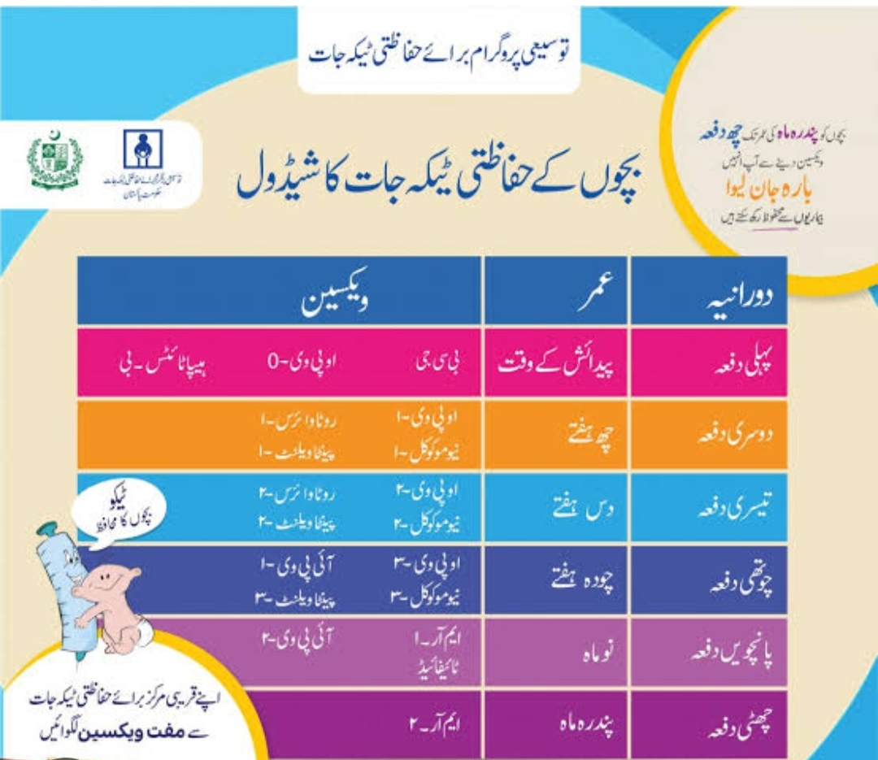

Slide 22
Expanded Program on Immunization
Vertical integration
Government has brought GAVI support for introduction of Pneumococcal vaccine for country under cofinancing mechanism
Pakistan has made tremendous progress towards achieving Polio eradication targets.

Slide 23
National TB Program
Core Concept
Our Mission: A TB free Pakistan
Our Vision: Universal Access to TB care
achieving zero TB death
GOAL: to reduce by 50% prevalence of TB
In general population by 2025 in Comparison with
2012

Slide 25
National Aids Control Program
Core Concept
HIV/AIDS
Act now to stop an epidemic in Pakistan

Slide 26
GOALS
Core Concept
To prevent a generalized epidemic in Pakistan
by containing the spread of HIV/AIDS and elimination
Of stigma and discrimination against those infected and effected

Slide 27
Program Objectives
Core Concept
Prevention of HIV transmission
Safe blood transfusion
Reduction of sexually transmitted diseases
Establishment of surveillance
Reduce stigma attached with disease
Training of health staff
Research and behavioral sciences

Slide 28
Hepatitis Control Program
Vertical integration
Hepatitis is a general term meaning inflammation Of liver and can be caused by variety of di viruses Such as Hepatitis A,B,C,D,E
Hepatitis A and E spread through fecal contamination of food, or drinking water While B,C,D are transmitted through percutaneous Or parenteral contact with infected food.

Slide 29
PROGRAM GOAL
Vertical integration
To reduce morbidity and mortality due to hepatitis B & C

Slide 30
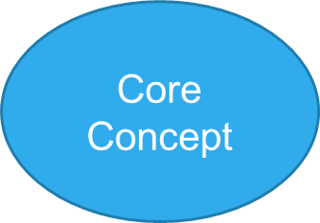
OBJECTIVES
To increase coverage of Hepatitis B immunization Services especially of target population sub groups, and high endemic regions of province
To improve hospital waste management

Slide 31
Malaria Control Program
Core Concept
Early diagnosis and prompt treatment at general Health facilities and community based approaches Towards home treatment
Intensive and comprehensive public education activities

Slide 32
Underlying Risk Factors for Malaria Endemicity and Outbreaks in Pakistan
Core Concept
Unpredictable transmission patterns
Poor socioeconomic conditions, malnutrition,low immunity
Overstretched health infrastructure
Unhygienic camps of internally displaced population providing mosquito breeding places.

Slide 33
Vision: Malaria Free Pakistan
Core Concept
Goal: Reduce Malaria burden
By 75% in high and moderate
And eliminate Malaria in low endemic areas

Slide 36
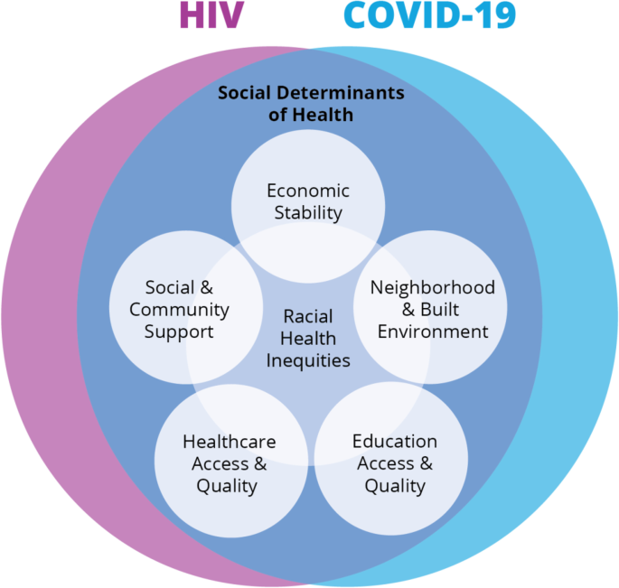
ETHICS
The social issues associated with AIDS can be understood in two ways.
Firstly, they may refer to its social determinants.
Secondly, they relate to its social impact (economic loss).
The ethical issues relating to confidentiality and partner notification within the context of HIV infection are complex.
https://www.ncbi.nlm.nih.gov/pmc/articles/PMC4923030/

Slide 37
Abstract Investigators must incorporate new thinking into traditional biomedical research ethics which will address the role of innovation; access to treatment; the impact of fear, stigma, and denial; concerns around autonomy for vulnerable populations; capacity building;
Research
Hlongwa P. Current ethical issues in HIV/AIDS research and HIV/AIDS care. Oral Dis. 2016 Apr;22 Suppl 1:61-5. doi: 10.1111/odi.12391. PMID: 27109274.

Slide 38
MCQ 1
Expanded Program on Immunization does not cover which of following disease
Diphtheria
Pneumonia
Tuberculosis
Rota virus
Rabies
Answer:E

Slide 39
Group 1 (Discussion On Questions/Activity)
Q 1) Pakistan is 5th most populous country, what do you think, is the role of national family planning program in controlling the population explosion?
Discuss role of LHWs in this regard
Q 2) Polio is eradicated world wide except Pakistan and Afghanistan. What are the special efforts of Our national EPI program in this aspect?
What are social issues related to polio vaccine refusal and what is our moral and ethical duty in addition to our professional duty as a doctor ?

Slide 40
Group 2 (Discussion On Questions/Activity)
Q1)According to WHO ranking Pakistan is 5th (among 22) high TB burden country. Discuss the goals of national TB control program to reduce this burden till 2025?
Q2)AIDS is labelled as global epidemic. National AIDS program of Pakistan is working on global agenda to halt this epidemic. Discuss what ethical and social issues are challenge in achieving targets of this program?

Slide 41
Reading source
Ilyas Ansari text book of public health and community medicine
(8th edition)
Page 69-71

