Slide 1
Module : I Otorhinolaryngology(ENT)
Dr Khola Noreen
Dr. Sana Bilal

Slide 2
Cohort Study design

Slide 4
Vision & Mission of RMU
Wisdom
Truth
Service
Vision
Highly recognized and accredited center of excellence in Medical Education, using evidence-based training techniques for development of highly competent health professionals, who are lifelong experiential learner and are socially accountable.
Mission Statement
To impart evidence-based research-oriented health professional education in order to provide best possible patient care and inculcate the values of mutual respect, ethical practice of healthcare and social accountability.

Slide 5
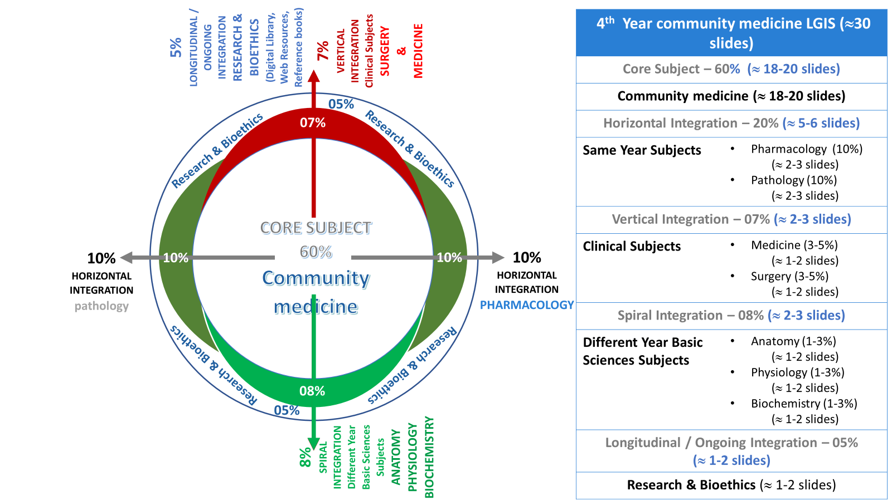
Prof Umar model

Slide 6
Sequence of the Session
Statement of learning outcomes (01 slide)
Order & Components of the session
Core subject ( contains throughout relevant clinical contents) ( No.28 slides)
Research pertinent to enhance understanding o the subjects (01 slides)
Bioethics : pertinent discussion (01 slides)
End o the session relevant assessments ( 02 slides)
Suggested additional readings ( 01 slide)

Slide 7
Learning Objectives
At the end of this session students should be able to;
Comprehend cohort study & its types.
Explain steps of cohort studies
Derive & interpret analytical outcomes of cohort studies (Relative risk, Attribute-able risk, Population attribute-able Risk)
Describe differences b/w case-control and cohort studies.

Slide 8
Recall of previous learning
What is usual outcome of descriptive study?
What are two basic features of case-control studies?
What do you mean by matching and how it is performed.
What are analytical outcomes of a case-control study.
Attention: Your active involvement is part of your internal assessment
Notes:
5. Recall bias, Non establishment of temporality of the association

Slide 9
Cohort study
Also called Prospective, Follow-up, Longitudinal, Incidence- & Forward- looking studies
Observational study.
Analytical studies: analyze the hypothetical association.
Most reliable epidemiological / observational study method to test an etiological Hypothesis
Close to an Experimental study

Slide 10
Basic features of Cohort studies
Two comparable cohorts are identified prior to the appearance of disease under investigation
Study groups are observed over a period to determine the frequency of disease among them
Study proceed from cause to effect.

Slide 11
Types of Cohort study
Prospective cohort studies
Retrospective cohort studies
If reliable past records on exposure & disease are available
Saves time and effort
Like Hospital / Industry workers
A combination of prospective and retrospective cohort studies

Slide 12
When is Cohort-study undertaken?
sufficient evidence about disease causation is available via descriptive & case control studies
Stable & manageable cohorts are available
Exposure in general may be rare but disease is common in those who are exposed (exposure to X-rays)
Risk of attrition is minimal
Enough resources are available

Slide 13
Criteria for assembling cohorts
1. Freedom from disease
2. Equal susceptibility for disease
3. Comparability must be maintained
4. Diagnostic & eligibility criteria are pre-defined

Slide 14
Cohort Study- sketch diagram
Time
Direction of inquiry
Developed disease+++
Exposed to R/F
Individuals are free from disease
Did not develop dis
Population
Developed Disease +
Not exposed to R /F
Did not develop disease

Slide 15
Steps for undertaking a cohort study
Step 1: Selection of study subjects
General population
Special groups
Select group (professional groups)
Exposure group (working in radiology dept, asbestos industry worker)
Step 2: Obtaining data on exposure
Information about exposure can be obtained from:
Cohort members
Review of records
Medical examination
Environmental surveys
Basic information about demographic variables which might affect the frequency of disease

Slide 16
Steps for undertaking a cohort study (Contd.)
Step 3: Selection of comparison groups
Internal comparisons:
In-built comparison groups
Single cohort enter the study ------classified into comparison groups according to level of exposure
External comparisons:
When degree of exposure is not available (smokers & non-smokers)
Comparison with general population rates:
If none is available, mortality rate of exposed group is compared with that of general population in same geographical area as exposed group

Slide 17
Steps of Cohort study… (Contd.)
Step 4: Follow up ----95%
Periodic medical examination
Review of medical records
Routine surveillance for morbidity & mortality
Mailed questionnaires (preferably all three on annual basis)
Issue of attrition
Step 5: Analysis
Incidence rates of outcomes in both groups
Estimation of risk via relative risk

Slide 18
Analytical framework of Cohort study
Cohorts status | Disease development
 | Yes | No
Exposed to suspected etiological factor | a | b
Not exposed to suspected etiological factor | c | d

Slide 19
Analysis (use of “Headphones” and “early hearing loss”)
 | Developed disease | Not developed disease
Exposed to R/F | a (30) | b (70) | a + b (100)
Not Exposed to R/F | c (10) | d (90) | c + d (100)
 | a+c | b+d | n = 200
I. Incidence rate in Exposed = a / a + b x 100 (30%)
Incidence rate in Not-Exposed = c / c+ d x 100 (10%).
II. Relative Risk:
Incidence in Exposed = a / a + b x 100 = 30 = 3 / 1 = 3
Incidence in not-Exposed = c / c+ d x100 10
RR or Risk Ratio = 3
Interpretation: incidence rates of disease in exposed are 3 times higher as compare to incidence rates of those who are not exposed.

Slide 20
Interpretation of Relative Risk
Relative Risk:
a direct measure of strength of association between suspected cause and effect
RR = 1, means no association
RR > 1, means positive association between exposure and disease under study
RR < 1 (0.25) means the exposure is protective and exposed have 0.75 times or 75% less chances of developing the disease as compared to non-exposed.

Slide 21
Attributable Risk (AR) or Risk Difference
difference in incidence rates of disease between exposed group and the non-exposed group
Incidence-Rate Exposed – Incidence-Rate non-Exposed
AR% = ----------------------------------------------------------------- X 100 Incidence rate among exposed
30 - 10 / 30 = 20 / 30 X 100 = 66.66%
provides an estimate of the proportion of disease among the exposed that is attributed to the particular exposure and could be prevented by eliminating exposure.
AR% indicates the preventable fraction of disease

Slide 22
Population Attributable Risk (PAR ). %
It is the RATIO of incidence of disease in the total population minus the incidence of disease among those who were non exposed to the suspected causal factor to Incidence in total population
Incidence in total pop. – Incidence non-Exposed
-------------------------------------------------------- X 100 Incidence in total pop. (say 15%)
15 - 10 / 15 = 05 / 15 X 100 = 33.33%
It provides the estimate of amount by which the disease can be reduced in that population if the suspected factor was eliminated or modified.

Slide 23
Advantages of Cohort study
Incidence rate can be calculated
Several possible outcome related to exposure can be studied simultaneously
Provides direct estimate of RR
Time & Dose response ratios can be calculated
As comparison groups are formed before disease development, bias can be minimized.

Slide 24
Disadvantages of Cohort study
Need large No. of people
long time to complete the study and obtain results
Administrative problems.
Loss of the study population during study due to migration, refusal & death etc. (attrition)
Selection of comparison groups is a limiting factor
Changes in methods & diagnostic criteria over prolonged follow up time
May itself alter people behavior (loss of exposed people)
Ethical issue

Slide 25
Difference between Case Control & Cohort study
Case control study | Cohort study
1. From effect to cause | From cause to effect
2. Starts with the disease | Starts with the risk factor
3. Tests whether suspected cause occurs more frequently in diseased | Tests whether disease occurs more frequently in exposed
4. First approach to test the hypothesis, also for exploratory studies | Reserved for testing of precisely formulated hypothesis
5.Involves fewer No. of subjects | Involves larger No. of subjects
6.Yields relatively quick results | Long follow up period needed, delayed results
7. Suitable for rare diseases | Not suitable for rare diseases
8. Yields estimate of OR | Yields Incidence Rate, RR, AR, PAR
9. Cannot yield information about diseases other than studied | Can yield information about more then one disease outcome
10. Relatively inexpensive | Expensive

Slide 26
20.0-Research Ethics and Consent: 59
Bioethics
20.3
In situations where study subjects are too young or too incapacitated, as well as the mentally ill or unconscious person, consent to take part in research may be unobtainable. Research is best avoided unless it can be shown to be relevant and potentially beneficial to the patient and there is no objection from parents or relatives.
20.4
Medical research involving human subjects should be conducted only by scientifically qualified persons and under the supervision of a clinically competent medical person.
20.5
The right of research subjects to safeguard their integrity must always be respected. Every precaution should be taken to respect the privacy of the subject, and the confidentiality of the patient’s information.
20.5.1
Research results must always preserve patient anonymity unless permission has been given by the patient to use his or her name.
"Principles of the ethical practice of public health,” version 2.2,
Public Health Leadership Society (2002).
Reproduced with permission. National Bioethics Committee Guidelines Pakistan. Page:page 59

Slide 27
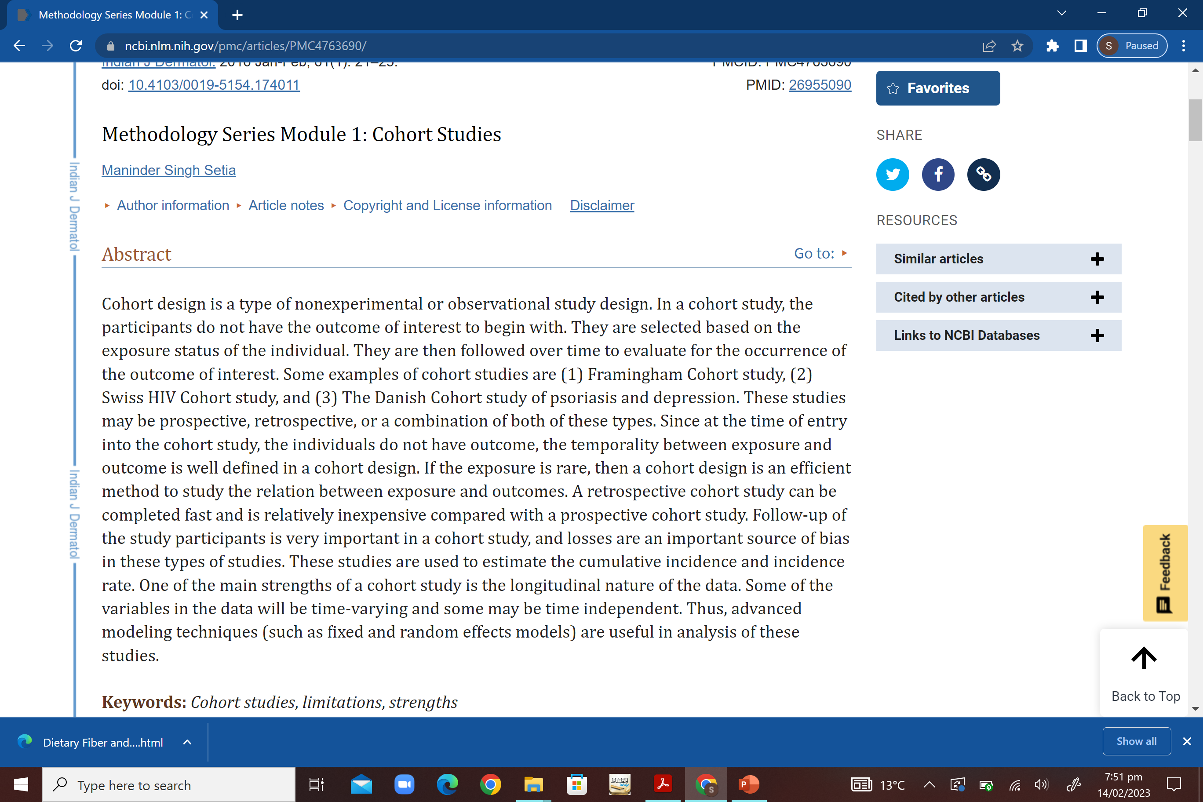
Research
Source: https://www.ncbi.nlm.nih.gov/pmc/articles/PMC4763690/

Slide 28
End of lecture assessment (EOLA)
To determine the association between cigarette smoking and lung cancer , a total number 10,000 individuals were included in study. Out of these 7000 were cigarette smokers. After 20 years of follow up,70 individuals in smokers and 3 in non smokers developed lung cancer. Appropriate measure of strength of association between exposure and outcome in this case would be;
Odds ratio
Risk difference
Relative risk
Population Attributable risk
Student’s t-test
2. A researcher wants to calculate the absolute risk of contracting a disease, the most
suitable study design would be
case control study
cross sectional study
cohort study
experimental study
correlational study

Slide 29
MCQs with key
In order to determine the association between cigarette smoking and lung cancer , a total number 10,000 individuals were included in study. Out of these 7000 were cigarette smokers. After 20 years of follow up,70 individuals in smokers group and 3 in non smoker group developed lung cancer .The appropriate measure of strength of association between exposure and outcome of interest in this case would be;
Odds ratio
Risk difference
Relative risk
Population Attributable risk
Student’s t-test
2. A researcher wants to calculate the absolute risk of contracting a disease, the most
suitable study design would be
case control study
cross sectional study
cohort study
experimental study
correlational study

Slide 30
Reading sources:
Primary (recommended textbooks) readings
J Parks textbook of Preventive & social Medicine. Ch.3 Pages 63-93 ( 26th edition)
Textbook of Community Medicine & Public Health. By Muhammad Illyas , Dr Irfanullah Siddiqui Ch.4 (latest edition)
Additional readings (reference books)
Epidemiology by Leon Gordis

