Slide 1
Module: I Otorhinolaryngology(ENT)
Dr Khola Noreen
Dr. Sana Bilal

Slide 2
Fundamental Science of Epidemiology

Slide 4
Vision & Mission of RMU
Wisdom
Truth
Service
To impart evidence based research oriented medical education
To provide best possible patient care
To inculcate the values of mutual respect and ethical practice of medicine

Slide 5
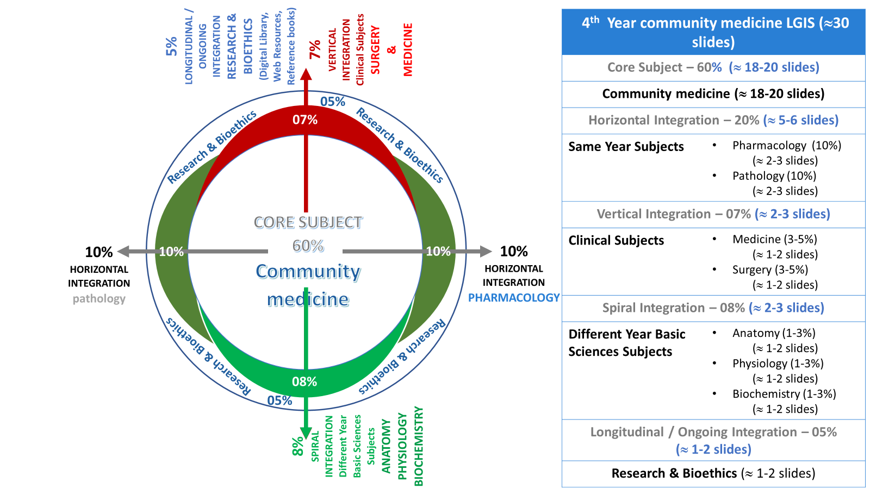
Prof Umar model

Slide 6
Sequence of the Session
Statement of learning outcomes (01 slide)
Order & Components of the session
Core subject ( contains throughout relevant clinical contents) ( No.6-31 slides)
Research pertinent to enhance understanding o the subjects (03 slides)
Bioethics : pertinent discussion (01 slides)
End o the session relevant assessments ( 02 slides)
Suggested additional readings ( 01 slide)

Slide 7
Learning Objectives
At the end of this session students should be able to:
Comprehend & Define of epidemiology
Explain central concepts embodied in definition of Epidemiology
Explain Epidemiologic approach to health problems
Enumerate uses of epidemiology
Explain Time-Place-Person format of studying diseases

Slide 8
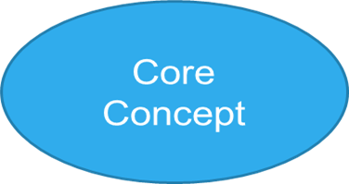
Definition of Epidemiology
Epidemiology is the study of the Frequency, Distribution and Determinants of disease, health related states or events in specified populations, and the application of this knowledge to the control & prevent health problems.
Epidemiologist explores the dimensions & distribution of a health problem, what factors influence this distribution, with purpose to identify causes of health problems, and hence to define measures to control these health problems.

Slide 9
Central concepts of epidemiology
Epidemiology is study of diseases as a mass phenomenon.
Epidemiology is basic science of Public Health
Epidemiology is study of Epidemics
Epidemiology is data driven
Epidemiology is a quantitative science
Epidemiology is an observational science

Slide 10
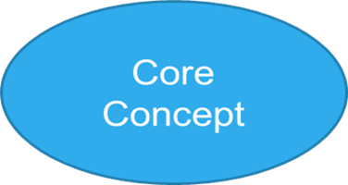
Epidemiologic Approach
It is study of a disease, or any health-related state as a “mass phenomenon”.
Asking questions and making comparison
what, who, when, where why & how approach. (5Ws of epidemiology).
Epidemiology is detective branch of medical science.
Epidemiology of Tuberculosis, Suicides, Roadside Accidents, Covid-19 & Chikungunya.

Slide 11
John Snow, physician(1813-1858)
Outbreaks of Cholera in London
People were dying and cause (control) was not known?
The popular theory at the time was that bad gases caused it (‘miasma’ theory)

Slide 12
What he did !
Performed analysis of Mortality
Analysis by place: he mapped the cases & found most were from near Broad Street
Narrative: People had complained that the water smelt bad. Most cases had water delivered by Cart from Broad Street Pump.
He pursued a hypothesis - that the local water was the cause of the problem.
Notes:
12

Slide 13
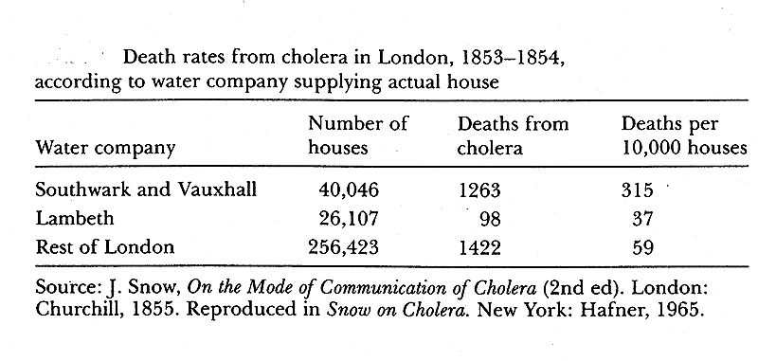
What he did!
Recorded deaths by water supplier Companies.
Conclusion: Risk of death was highest in people using water from Southwark and Vauxhall water company.
There may be an association b/w water supplied and disease occurrence
Notes:
13

Slide 14
Father of Epidemiology

Slide 15
Aim of epidemiology
To assess magnitude and distribution of health problems in population
To identify the causes or risk factors of the health problems
To provide data essential for planning, implementation and evaluation of health services and deciding priorities for health action . Covid-19 Daily data and actions - NCOC

Slide 16
What is job of epidemiologist
Counts cases or health events and describe them in relation to personal, time and place characteristics. (DF, TB, Covid-19..)
Divides the number of cases by an appropriate denominator to calculate frequency of its occurrence (Rates, Ratio, Proportion)
Compares rates of disease, over time, over places & peoples.
Also Critically analyzes: the similarities within groups and the dissimilarities between diseased and non-diseased groups. Concludes upon crucial factors, would be responsible for health or disease state.

Slide 17
Three basic components of Epidemiology
1 | Study of frequency of disease (magnitude ) | Quantifications of the Health problem / health related states or events. | Assessment of the Health status or Health problem status
2 | Study Distribution of disease In term of time-place-person | Scientific characterization of the health problem to identify causes of health problems Contextual information | Quantifications of health & disease pertinent facts
3 | Study of Determinants of disease in term of Agent-Host-Environment | Comparisons within and between groups are made & associations are suspected & decided (similarities and dis- similarities) | Statistical reasoning to suspect and decide causes of health problems

Slide 18
Study of Frequency of disease
It involves measurements of disease occurrence in population
Disease Incidence rates
Disease Prevalence rates
Affects ( Disability rates)
Severity ( fatality rates & mortality rates)
Survival ( survival rates )
Death due to disease
Other measurements
Natality (birth rates, live birth rates, still birth rates)
Host (Social, Demographic and Biological attributes) and Environmental characteristics (living place, Housing, climate, water, healthcare delivery system)
Biostatistics is basic tool of measurements in epidemiology

Slide 19
Study of disease distribution
Health or Disease are not uniformly distributed in human population, but in Patterns and epidemiology is the scientific approach to study these distribution patterns in order to explain occurrence of disease.

Slide 20
Study of disease distribution (study of pattern)
Epidemiology is “characterization of health problem by time, place and person” to collect each possible piece of information relevant to epidemiologic event which would help to explain its cause of occurrence, risk factors, its spread etc.
It is a comprehensive approach to study micro detail of the epidemiologic event.
This constitute Descriptive epidemiology (who, when & where).

Slide 21
time distribution
Study of diseases in relevance to time of their occurrence. (all cases in appeared in same time
seasonal trend. (asthma cases …in spring season …. High Pollen count)
Whether diseases has increased/decreased over time..time trends. (cancers, DM showing upward time trends)
Study of time patterns makes data more informative, potential and presentable.
Epidemic Curve.

Slide 22
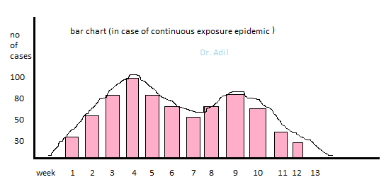
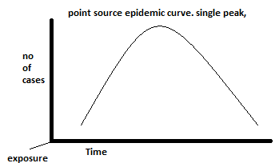
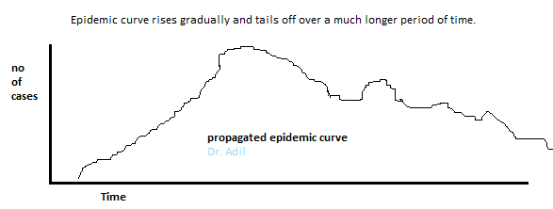

Slide 23
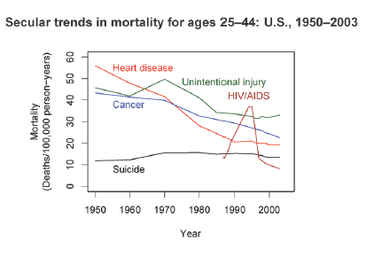
Time Data

Slide 24
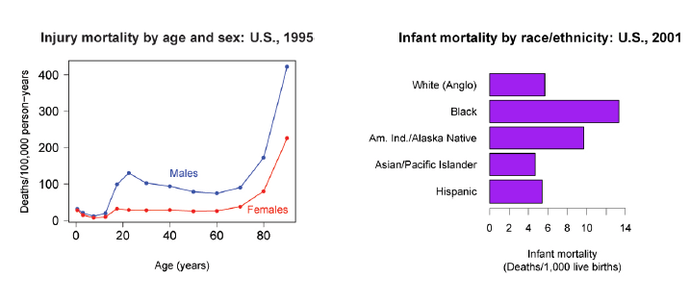
Person Data

Slide 25
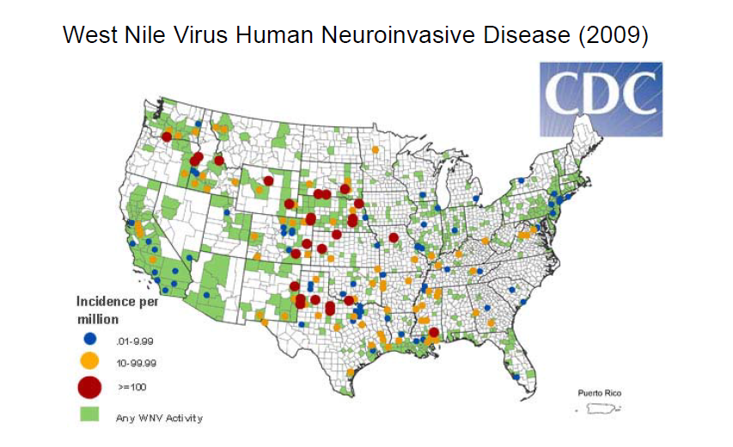
Place Data

Slide 26
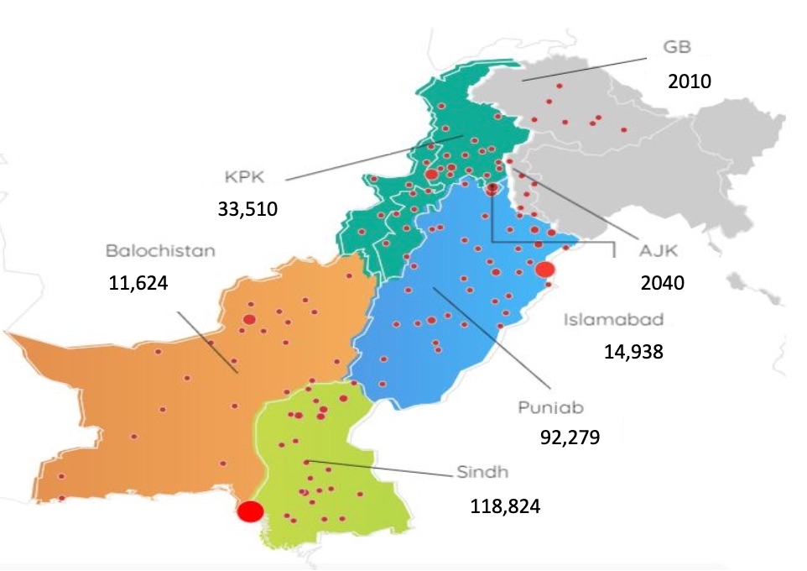
COVID-19 2020
scene (Distribution by Place)

Slide 27
Person Distribution
Inherent | Age , sex, race | Links
Biological | Immunity, | Infectious diseases
Acquired | Marital status | High mortality in unmarried
Social | Occupation | Asbestos workers & Ca-lungs
Physiological state | Post menopause | HTN
Living conditions | Over crowding | communicable diseases like TB
It is study of diseases occurrence by personal characteristics of the population.
Diseased and Non-diseased persons.

Slide 28
Basic tools of measurement in Epidemiology
RATE
Is measure of frequency with which a particular event or condition occurs in a defined population over specified period”.
Ratio
expresses relationship in size between two random quantities. Male to Female Ratio in class.
Proportion is a ratio which indicates relation in magnitude of a part to the whole. numerator is always included in denominator. it is expressed in percentage (%).

Slide 29
Uses of epidemiology
Provide knowledge to prevent & control diseases
Inform about health & disease trends in population
Monitor health status of the people
Identify, investigate & mange Epidemics
Design & evaluate new healthcare interventions
Monitor & Evaluate healthcare services / Programs
Identification of medical syndromes (natural history of diseases)
Research

Slide 30
Epidemiology of Monkeypox
Research
A total of 26,384 U.S. monkeypox cases were reported during May 17–October 6, 2022. Among 59% of persons with data on gender and recent sexual or close intimate contact, 70% reported recent male-to-male sexual contact. Black and Hispanic persons continue to be disproportionately affected.
Epidemiologic Features of the Monkeypox Outbreak and the Public Health Response — United States, May 17–October 6, 2022
Weekly / November 11, 2022 / 71(45);1449–1456
SOURCE: https://www.cdc.gov/mmwr/volumes/71/wr/mm7145a4.htm#:~:text=A%20total%20of%2026%2C384%20U.S.,continue%20to%20be%20disproportionately%20affected.
Other suggested site:https://www.who.int/news-room/fact-sheets/detail/monkeypox

Slide 31
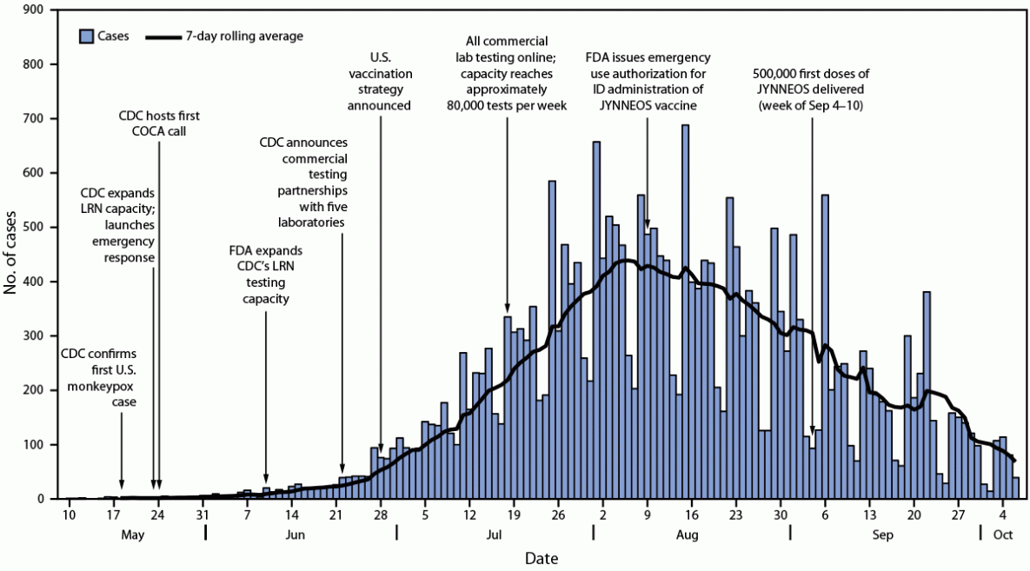
Research

Slide 32
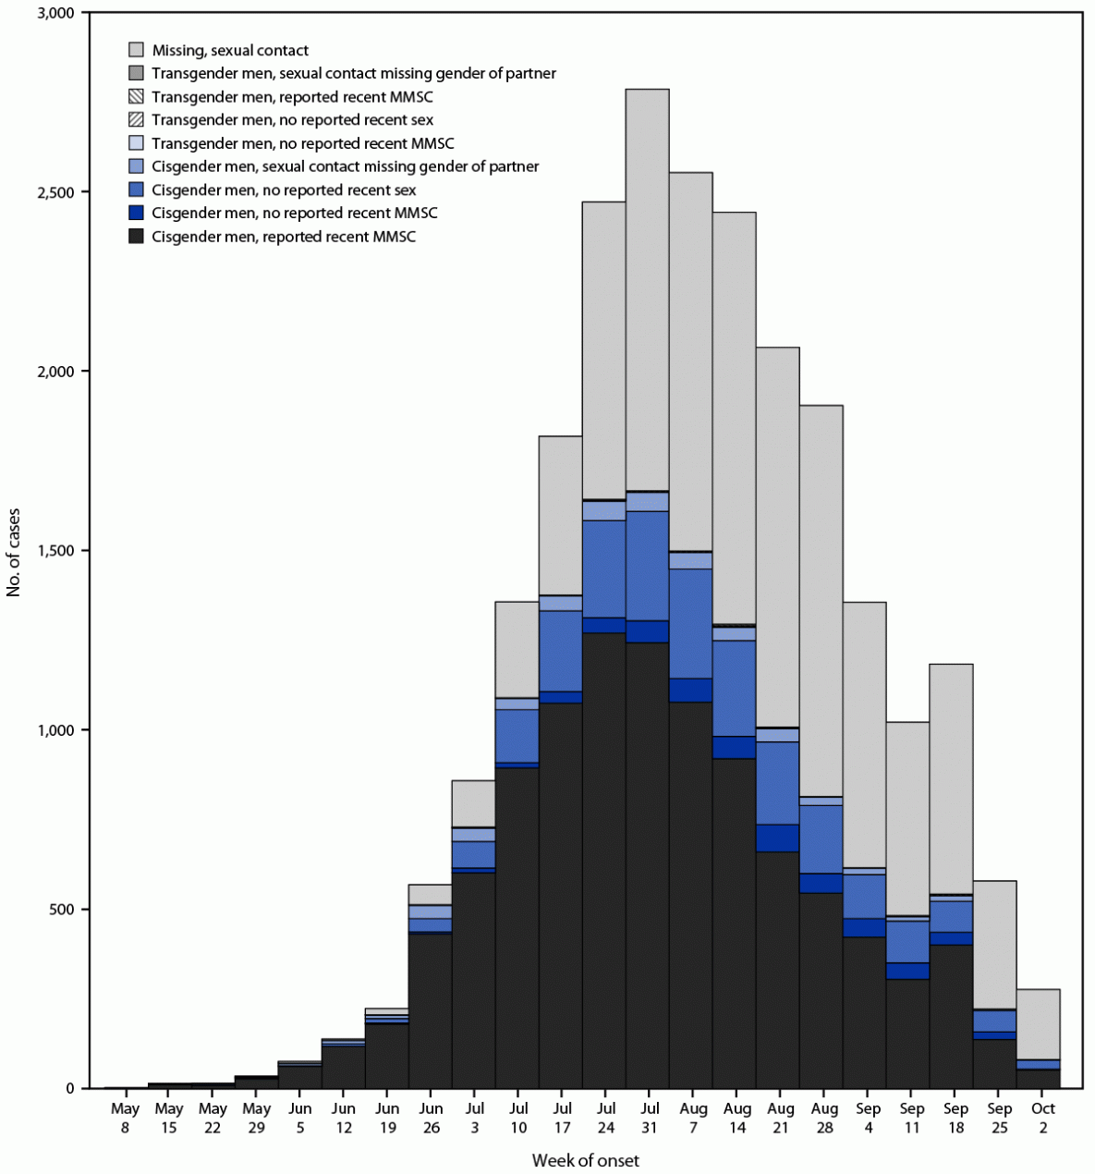
Research

Slide 33
Public Health Ethics
7. Identifying and promoting the fundamental requirements for health in a community are of primary concern to public health.
The way in which a society is structured is reflected in the health of a
community. The primary concern of public health is with these underlying structural aspects. While some important public health programs are curative in nature, the field as a whole must never lose sight of underlying causes and prevention. Because fundamental social structures affect many aspects of health, addressing the fundamental causes rather than more proximal causes is more truly preventive.
Case for Discussion
An influenza epidemic has begun in Pakistan confirmed by the World Health Organization (WHO) with some reported deaths. No one knows yet how serious the problem may be because there is no information on the extent of the outbreak. Large-scale public vaccination programs are not expected to be available for 8 to 12 weeks.
"Principles of the ethical practice of public health,” version 2.2,
Public Health Leadership Society (2002).
Reproduced with permission.
National Bioethics Committee Guidelines Pakistan. Page 314

Slide 34
Let’s see how you are learning the subject (assessment-1 )
Epidemiology is quantitative science but the primary tools of measurement in epidemiology include:
Recording Epidemic, endemic, pandemic states
Quantifying Incidence, and prevalence of diseases
The mathematical tools Rate, ratio, proportion
Recording natural history of diseases
Recording phenomenon of agent-host-envrironment

Slide 35
Let’s see how you are learning the subject (assessment-2 )
The scientific format to study the disease or other health related states in the population as to study distribution of disease to study its magnitude and find all contextual information comprises:
What, Why and How approach
Study of Host, Agent and Environment factors related to problem
Study Time, Place and Person distribution of the problem
Asking questions and making comparison approach
Studying the :web of causation” approach

Slide 36
Reading sources:
Primary (recommended textbooks)
J Parks textbook of Preventive & social Medicine. Ch.3 Pages 53-63( 26th edition)
Textbook of Community Medicine & Public Health. By Muhammad Illyas , Dr Irfanullah Siddiqui Ch.4 (latest edition)
Additional readings
Epidemiology by Leon Gordis

