Slide 2
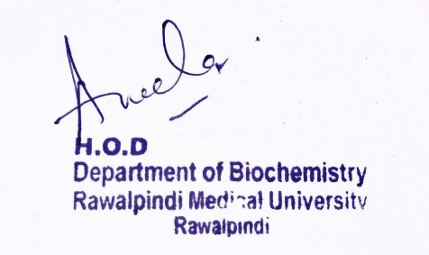
Foundation Module 1st Year MBBS (LGIS) ENZYMES
Presenter: Dr Raja Khalid Yaqub Date: 27-01-25

Slide 3
Motto, Vision, Dream
To impart evidence based research oriented medical education
To provide best possible patient care
To inculcate the values of mutual respect and ethical practice of medicine
Wisdom
Truth
Service

Slide 4
Professor Umar Model of Integrated Lecture

Slide 5
Learning Objectives
At the end of this lecture students should be able to
Explain different types of enzyme inhibition with examples
Describe regulation of enzyme activity

Slide 6
Enzyme Inhibition
Core Knowledge
Any substance that can decrease the velocity of an enzyme-catalyzed reaction is considered to be an inhibitor.
Inhibitors can be reversible or irreversible.
Irreversible inhibitors bind to enzymes through covalent bonds.
Ferrochelatase, an enzyme involved in heme synthesis, is irreversibly inhibited by lead.
Reversible inhibitors bind to enzymes through noncovalent bonds
The two most commonly encountered types of reversible inhibition are competitive and noncompetitive.

Slide 7
A. Competitive Inhibition
Core Knowledge
This type of inhibition occurs when the inhibitor binds reversibly to the same site that the substrate would normally occupy and, therefore, competes with the substrate for binding to the enzyme active site.
1. Effect on Vmax: The effect of a competitive inhibitor is reversed by increasing the concentration of substrate. At a sufficiently high [S], the reaction velocity reaches the Vmax observed in the absence of inhibitor, that is, Vmax is unchanged in the presence of a competitive inhibitor.
7

Slide 8
Competitive Inhibition
Core Knowledge
2. Effect on Km: A competitive inhibitor increases the apparent Km for a given substrate. This means that, in the presence of a competitive inhibitor, more substrate is needed to achieve half Vmax.
3. Effect on the Lineweaver–Burk plot: Competitive inhibition shows a characteristic Lineweaver–Burk plot in which the plots of the inhibited and uninhibited reactions intersect on the y axis at 1/Vmax (Vmax is unchanged).
The inhibited and uninhibited reactions show different x-axis intercepts, indicating that the apparent Km is increased in the presence of the competitive inhibitor because − 1/Km moves closer to zero.
8

Slide 9
Core Knowledge
9

Slide 10
Core Knowledge
Statin drugs as examples of competitive inhibitors:
Statin drugs are cholesterol-lowering agents that competitively inhibit the rate-limiting (slowest) step in cholesterol biosynthesis.
Statins, such as atorvastatin and pravastatin, are structural analogs of the natural substrate for this enzyme and compete effectively to inhibit HMG CoA reductase. By doing so, they inhibit de novo cholesterol synthesis

Slide 11
Non-competitive Inhibition
Core Knowledge
This type of inhibition is recognized by its characteristic effect causing a decrease in Vmax
Noncompetitive inhibition occurs when the inhibitor and substrate bind at different sites on the enzyme.
1. Effect on Vmax: Effects of a noncompetitive inhibitor cannot be overcome by increasing the concentration of substrate. Therefore, noncompetitive inhibitors decrease the apparent Vmax of the reaction

Slide 12
Core Knowledge
Noncompetitive Inhibition
2.Effect on Km: Noncompetitive inhibitors do not interfere with the binding of substrate to enzyme. Therefore, the enzyme shows the same Km in the presence or absence of the noncompetitive inhibitor
3. Effect on Lineweaver–Burk plot: Noncompetitive inhibition is readily differentiated from competitive inhibition by plotting 1/vo versus 1/[S] and noting that the apparent Vmax decreases in the presence of a noncompetitive inhibitor, whereas Km is unchanged

Slide 13
Core Knowledge

Slide 14
Regulation of the Enzyme Activity
Core Knowledge
REGULATION OF CHANGE IN ACTIVITY OF EXISTING ENZYMES
Allosteric
Covalent Modification
Proteolysis
Compartmentalization
Cascade Mechanism
Protein-Protein Interaction
REGULATION OF CHANGE IN ENZYME CONCENTRATION
Induction
Repression
Degradation

Slide 15
Core Knowledge
A) Regulation of Allosteric Enzymes
Allosteric enzymes are regulated by molecules called effectors (also called modifiers) that bind noncovalently at a site other than the active site.
These enzymes are usually composed of multiple subunits, and the regulatory (allosteric) site that binds the effector may be located on a subunit that is not itself catalytic.
The presence of an allosteric effector can alter the affinity of the enzyme for its substrate, or modify the maximal catalytic activity of the enzyme, or both.

Slide 16
Core Knowledge
Homotropic Effectors
When the substrate itself serves as an effector, the effect is said to be homotropic
Most often, an allosteric substrate functions as a positive effector.
In such a case, the presence of a substrate molecule at one site on the enzyme enhances the catalytic properties of the other substrate-binding sites. Thus, their binding sites exhibit cooperativity.
These enzymes show a sigmoidal curve when reaction velocity (v_{o}) is plotted against substrate concentration ([S]).
This contrasts with the hyperbolic curve characteristic of enzymes following Michaelis-Mentes kinetics.
The concept of cooperativity of substrate binding is analogous to the binding of oxygen to hemoglobin.

Slide 17
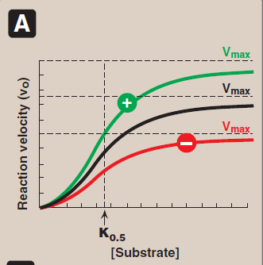
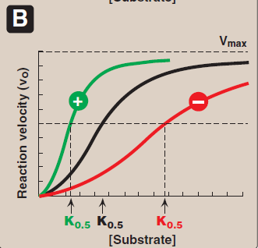
Core Knowledge

Slide 18
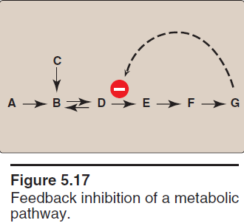
Heterotropic Effectors
Core Knowledge
The effector may be different from the substrate, in which case the effect is said to be heterotropic.
For example, consider the feedback inhibition of a general enzyme. The enzyme that converts D to E has an allosteric site that binds the product, G increases. If the concentration of G increases, the first irreversible step unique to the pathway is typically inhibited.

Slide 19
Core Knowledge
B. Regulation of Enzymes by Covalent Modification
Many enzymes may be regulated by covalent modification, most frequently by the addition or removal of phosphate groups from specific serine, threonine, or tyrosine residues of the enzyme.
Protein phosphorylation is recognized as one of the primary ways in which cellular processes are regulated.

Slide 20
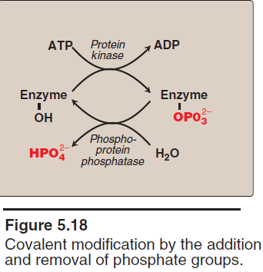
Core Knowledge
1. Phosphorylation and Dephosphorylation
Phosphorylation reactions are catalyzed by a family of enzymes called protein kinases that use adenosine triphosphate (ATP) as a phosphate donor.
Phosphate groups are cleaved from phosphorylated enzymes by the action of phosphoprotein phosphatases.

Slide 21
Core Knowledge
2. Response of Enzyme to Phosphorylation
Depending on the specific enzyme, the phosphorylated form may be almost as active than the unphosphorylated enzyme
For example, phosphorylation of glycogen phosphorylase (an enzyme that degrades glycogen) increases activity, whereas the addition of phosphate to glycogen synthase (an enzyme that synthesizes glycogen) decreases activity.

Slide 22
Core Knowledge
C. Induction and Repression of Enzyme Synthesis
The regulatory mechanisms described above modify the activity of existing enzyme molecules.
However, cells can also regulate the amount of enzyme present by altering the rate of enzyme degradation or, more typically, the rate of enzyme synthesis.
The increase (induction) or decrease (repression) of enzyme synthesis leads to an alteration in the total population of active sites.

Slide 23
Functions of Enzymes
Horizontal Integration
The digestive system: Enzymes help the body break down larger complex molecules into smaller molecules, such as glucose, so that the body can use them as fuel.
DNA replication: Each cell in the body contains DNA. Each time a cell divides, the cell needs to copy its DNA. Enzymes help in this process by unwinding the DNA coils.
Liver enzymes: The liver breaks down toxins in the body. To do this, it uses a range of enzymes the facilitate the process of destroying the toxins.

Slide 24
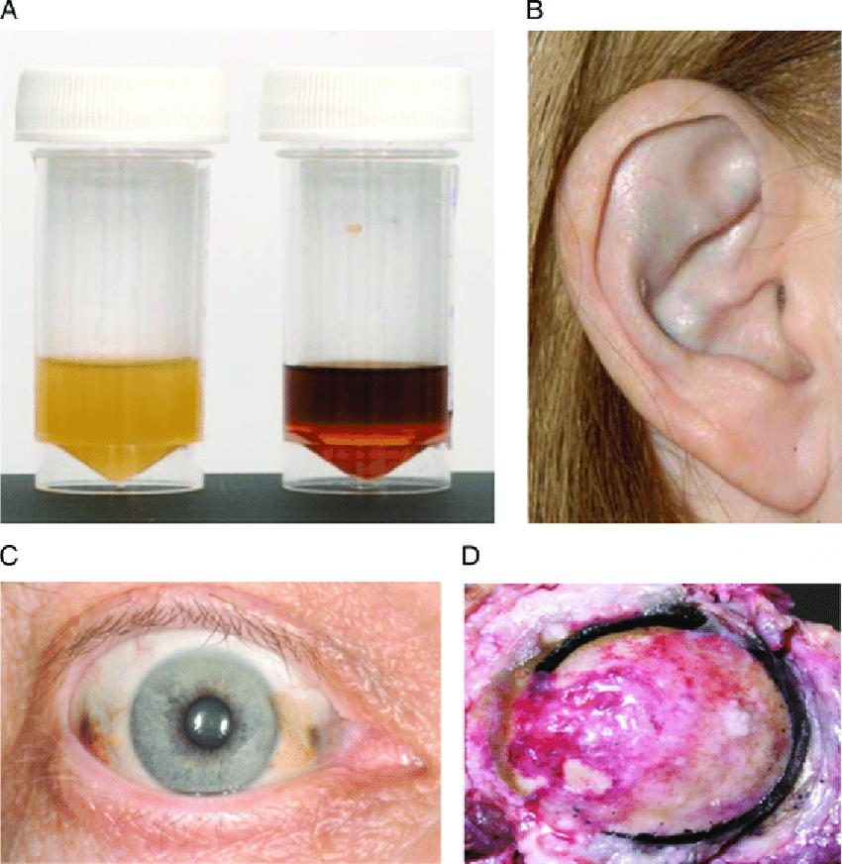
Action of Antibiotics
Vertical Integration
Albinism results from an absent or defective copper requiring tyrosinase. Total absence of the pigment from the hair, eyes and the skin.
Alkaptonuiria results from the deficiency of enzynme homogentisic acid oxidase, resulting in the accumulation homogentisic acid

Slide 25
Family Medicine
Spiral Integration
Family Medicine plays important role in following manner:
Early Diagnosis
Education
Dietary Guidance
Monitoring
Refer to Specialists

Slide 26
Artificial Intelligence
Spiral Integration
AI can assist in several ways to support individuals with albinism.
Diagnostic assistance: AI-powered image recognition and analysis tools can aid in the early detection of skin conditions such as skin cancer, which individuals with albinism are at higher risk for.
Vision Assistance: AI-powered vision enhancement technologies can help individuals with albinism compensate for vision impairments.
Personalized Healthcare: AI algorithms can analyze genetic data to provide personalized healthcare recommendations based on an individual's genetic predispositions and medical history

Slide 27
Suggested Research Article
Spiral Integration
https://pmc.ncbi.nlm.nih.gov/articles/PMC6152246/
Abstract
The actions of many drugs involve enzyme inhibition. This is exemplified by the inhibitors of monoamine oxidases (MAO) and the cholinsterases (ChE) that have been used for several pharmacological purposes. This review describes key principles and approaches for the reliable determination of enzyme activities and inhibition as well as some of the methods that are in current use for such studies with these two enzymes. Their applicability and potential pitfalls arising from their inappropriate use are discussed. Since inhibitor potency is frequently assessed in terms of the quantity necessary to give 50% inhibition (the IC₅₀ value), the relationships between this and the mode of inhibition is also considered, in terms of the misleading information that it may provide. Incorporation of more than one functionality into the same molecule to give a multi-target-directed ligands (MTDLs) requires careful assessment to ensure that the specific target effects are not significantly altered and that the kinetic behavior remains as favourable with the MTDL as it does with the individual components. Such factors will be considered in terms of recently developed MTDLs that combine MAO and ChE inhibitory functions.

Slide 28
Bioethics
Spiral Integration
Appropriate information
Explain to patient or his family the genetic aspects of the condition
Counselling

Slide 29
How To Access Digital Library
Steps to Access HEC Digital Library
Go to the website of HEC National Digital Library
On Home Page, click on the INSTITUTES
A page will appear showing the universities from Public and Private Sector and other Institutes which have access to HEC National Digital Library HNDL
Select your desired Institute
A page will appear showing the resources of the institution
Journals and Researches will appear
You can find a Journal by clicking on JOURNALS AND DATABASE and enter a keyword to search for your desired journal

Slide 30
Learning Resources
Textbook of Biochemistry, Lippincott Illustrated Reviews 8th edition, chapter no
Google scholar
Google images

