Slide 2
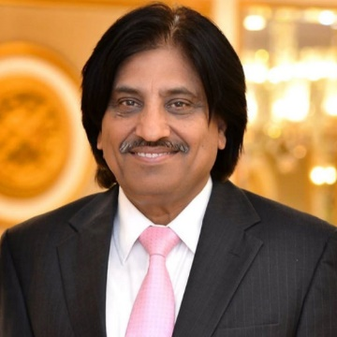
NUMBER OF SLIDES ACCORDING TO DR UMAR LGIS MODEL
Introductory slides
Bismillah 1
Introduction 1
Mission vision 1
Dr. Umar model of LGIS 1
Gain attention slides 2
Learning objectives 1
Core Concept 15
Horizontal Integration 7
Vertical integration 20
Recent Articles 2
Assessment 3
Recommended Books 1
Take home message 1

Slide 3
PROF UMER MODEL OF INTEGRATED LECTURE

Slide 4
 | Mission Statement To impart evidence-based research-oriented health professional education in order to provide best possible patient care and inculcate the values of mutual respect, ethical practice of healthcare and social accountability. Vision and Values Highly recognized and accredited center of excellence in Medical Education, using evidence-based training techniques for development of highly competent health professionals, who are lifelong experiential learner and are socially accountable. Goals of the Undergraduate Integrated Modular Curriculum To provide you with quality medical education in environment designed to: Provide thorough grounding in the basic theoretical concepts underpinning the practice of medicine. Develop and polish the skills required for providing medical services at all levels of the Health care delivery system. Help you attain and maintain the highest possible levels of ethical and professional conduct in your future life.
TRUTH, WISDOM & SERVICE
“OUT MOTTO”

Slide 5
RADIOGRAPHY OF SKULL
Dr.saba
SR Radiology
DR madiha
Consultant Radiologist

Slide 6
LEARNING OBJECTIVES
To know radiographic modality/ies used in skull imaging. (X-rays mainly as topic comprises of plain radiography only)
To know advantages and disadvantages of this modality.
To know indications and contraindications.
Overview on normal skull appearance and common pathologies. Core concept

Slide 7
Varying opacities seen on an X-RAY
Intense white: Metal
White: bone and calcification
Gray: soft tissue
Dark gray: Fat
Black: air
Core concept

Slide 8
ADVANTAGES & DISADVANTAGES of skull X-ray
ADVANTAGES:
Widely available
Economical
Good in diagnosing fracture/air within subcutaneous/deeper tissues.
Good in diagnosing skull size and configuration as initial workup.
DISADVANTAGES:
Radiation
Poor tissue details
Inadequate diagnostic details at times
Core concept

Slide 9
SKULL
It is a bony structure supporting brain making an external covering as well as face.
Composed of many bones, formed by intramembranous ossification, joined together by fibrous joints called sutures.
Bones of the skull divided into 2 groups.
Cranium
1. Calvarium/skull vault
2. Skull base
Face
Core concept

Slide 10
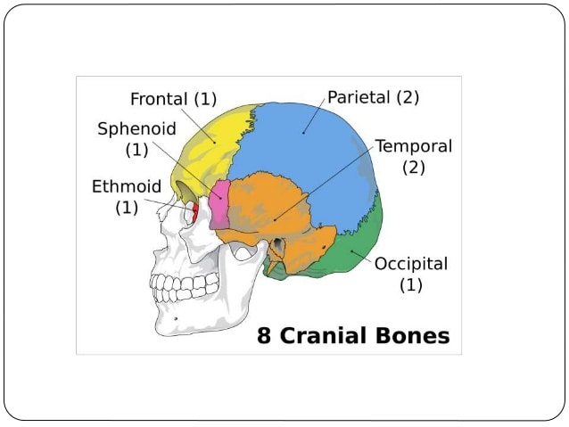
Horizontal integration

Slide 11
Horizontal integration

Slide 12
Total skull bones = 22 Cranial = 8 Facial = 14
Horizontal integration

Slide 13
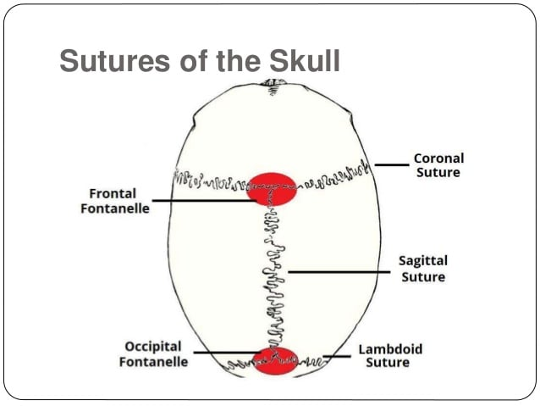
Horizontal integration

Slide 14
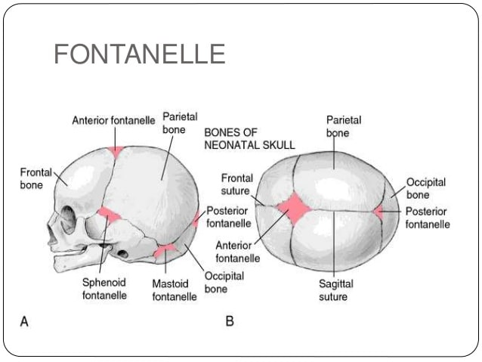
Horizontal integration

Slide 15
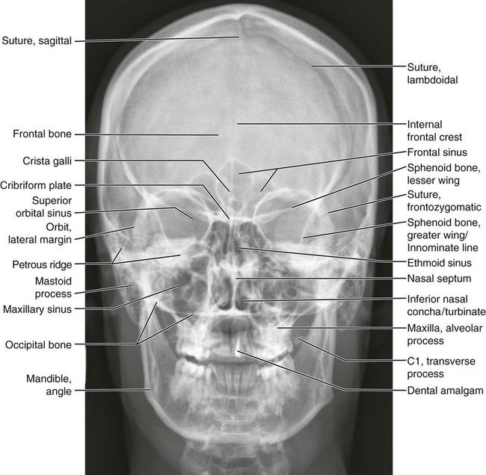
Horizontal integration

Slide 16
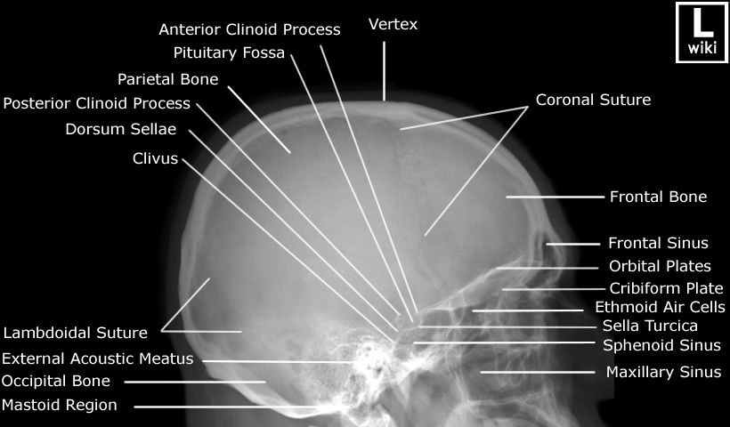
Horizontal integration

Slide 17
Horizontal integration

Slide 18
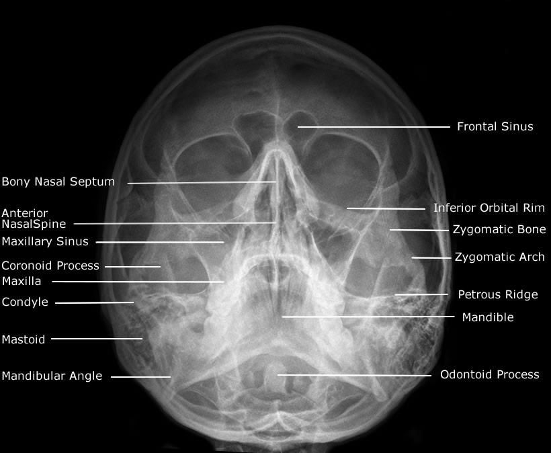
Horizontal integration

Slide 19
Patient positioning
Depending upon patients condition, it may be taken in recumbent or erect position.
Remove all metallic hair pins/clips, as well as untie the hair braid which may cause artifacts.
Basic X-ray Views:
Lateral
Occipito-fr0ntal (PA – zero degree)
Fronto-occipital (AP)
Core concept

Slide 20
Core concept

Slide 21
Core concept

Slide 22
Core concept

Slide 23
Core concept

Slide 24
Core concept

Slide 25
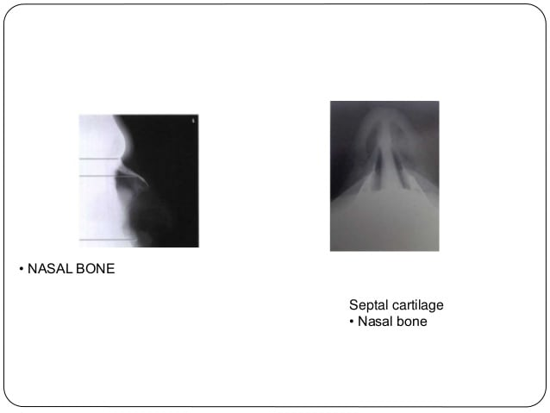
Horizontal integration

Slide 26
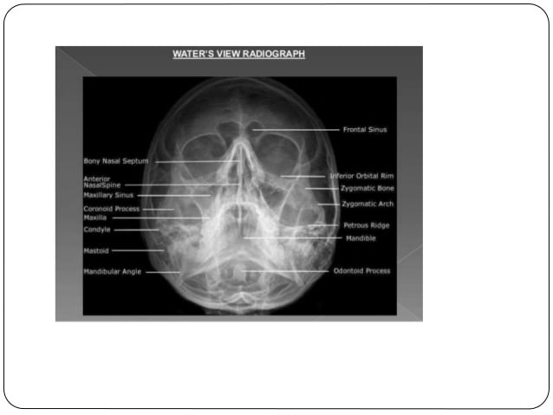
Horizontal integration

Slide 27
Common pathologies
Picked on Xray Skull
Vertical integration

Slide 28
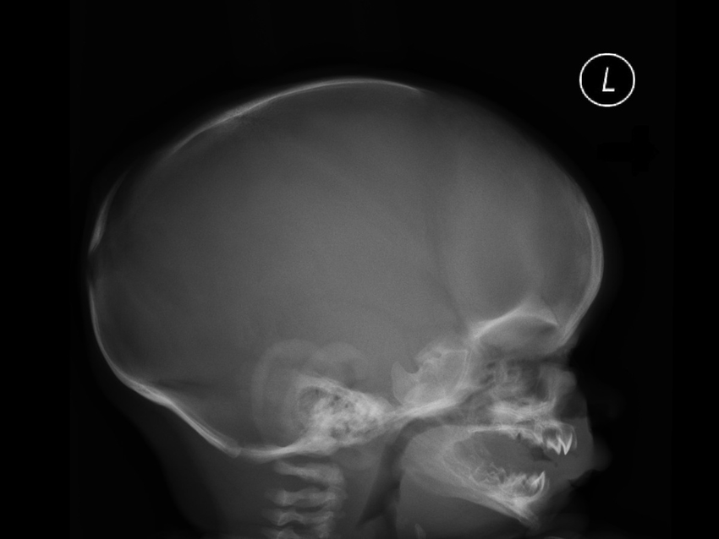
Hydrocephalus
Vertical integration
Notes:
Increased head size
Widened sutures
Can have copper beaten appearance

Slide 29
Hydrocephalus treated with VP shunt
Copper beaten skull,
also known as
refers to the prominence
of convolutional markings
(gyral impressions on the
inner table of the skull)
seen throughout the
skull vault.
Vertical integration

Slide 30
Fractures
Skull fractures can be broadly divided in a variety of ways:
anatomically
base of skull
skull vault (calvaria)
associated with overlying wound
open (compound)
closed
degree of displacement
undisplaced
depressed (5-10 mm)
number of fracture lines/fragments
linear
Comminuted
Vertical integration

Slide 31
Fracture parietal bone
Vertical integration
Notes:
Remember anatomical location of suture
Suture has serrated edges

Slide 32
Fracture frontal bone
Vertical integration

Slide 33
Depressed fracture
Vertical integration

Slide 34
Ping pong fracture
Ping pong skull fracture or pond skull fracture refers to a depressed skull fracture of the infant skull caused by inner buckling of the calvarium. It is seen in newborns because of the soft and resilient nature of their bones (like greenstick fractures of long bones) and the fracture line is not visualized radiologically.
Usually, it is not associated with significant neurological injury
Vertical integration

Slide 35
Ping pong fracture(depressed)
Vertical integration

Slide 36
Fracture frontal bone
Vertical integration

Slide 37
Calcifications in skull Xray
Normal
Basal ganglia
etc
Abnormal
Masses like meningioma
Metabolic cause
Falx
Choroid plexus
Pineal gland
etc
Vertical integration

Slide 38
Calcified meningioma
Vertical integration
Notes:
Calcified meningioma

Slide 39
Hair on end appearance
Vertical integration

Slide 40
Vertical integration

Slide 41
Multiple lytic lesions
Vertical integration
Notes:
Multiple myeloma
mets

Slide 42
Take home messages
Follow a systematic approach to see any diagnostic examination
Either from center to periphery, make a checklist to assess.
Try not to rush and miss any other second/third abnormality after reaching at 1st diagnosis.

Slide 43
Thank you.

