Slide 1
EYE MODULE
RESEARCH ETHICS

Slide 3
Vision & Mission of RMU
Wisdom
Truth
Service
Vision
Highly recognized and accredited center of excellence in Medical Education, using evidence-based training techniques for development of highly competent health professionals, who are lifelong experiential learner and are socially accountable.
Mission Statement
To impart evidence-based research-oriented health professional education in order to provide best possible patient care and inculcate the values of mutual respect, ethical practice of healthcare and social accountability.

Slide 4
Prof Umar’s Model

Slide 5
Sequence of the Session
Statement of learning outcomes (01 slide)
Order & Components of the session
Core subject ( contains throughout relevant clinical contents) ( 39 slides)
Vertical Integration( 6 slide)
Research pertinent to enhance understanding o the subjects (02 slides)
Bioethics : pertinent discussion (01 slides)
End of the session relevant assessments ( 01 slides)
Suggested additional readings ( 01 slide)

Slide 6
Learning Objectives
• Demonstrate understanding of different types of “Plagiarism” and “scientific misconduct” as ways of lying, stealing or Cheating related to research and publication
• Describe the concept of intellectual property” in reference to research ideas, medical writing, proposals, data, publication Identify issues related to authorship criteria for scientific journals
• Describe the Authorship criteria according to ICMJE Guidelines
• Identify potential sources of unethical conduct in dissemination of research such as plagiarism, fabrication of data, duplicate publication and gift authorships.

Slide 7
Research Ethics
Core Content
Involves the application of fundamental ethical principles to planning, conducting & publishing of research

Slide 8
Scientific Integrity
Core Content
➢ All scientists should be committed to the responsible use of the process known as the scientific method to seek new knowledge
➢ All researchers should maintain exemplary standards of intellectual honesty in formulating, conducting and presenting research

Slide 9
Why is Scientific Integrity So Important?
Core Content
The scientific community and the general public rightly expect adherence to exemplary standards of intellectual honesty in the formulation, conduct, and reporting of scientific research
Without a high standard of Scientific Integrity, the scientific community and general public may become victims of Research Misconduct

Slide 10
Intellectual property
Core Content
Intangible creation of human intellect
Highest standard of professionalism and rigor to ensure accuracy and truth in research

Slide 11
What is Research Misconduct?
Core Content
Fabrication – making up data or results and recording or reporting them
Falsification – manipulating research materials, equipment, or processes, or changing or omitting data or results such that the research is not accurately represented in the research record
Plagiarism – the appropriation of another person’s ideas, processes, results, or words, without giving appropriate credit

Slide 12
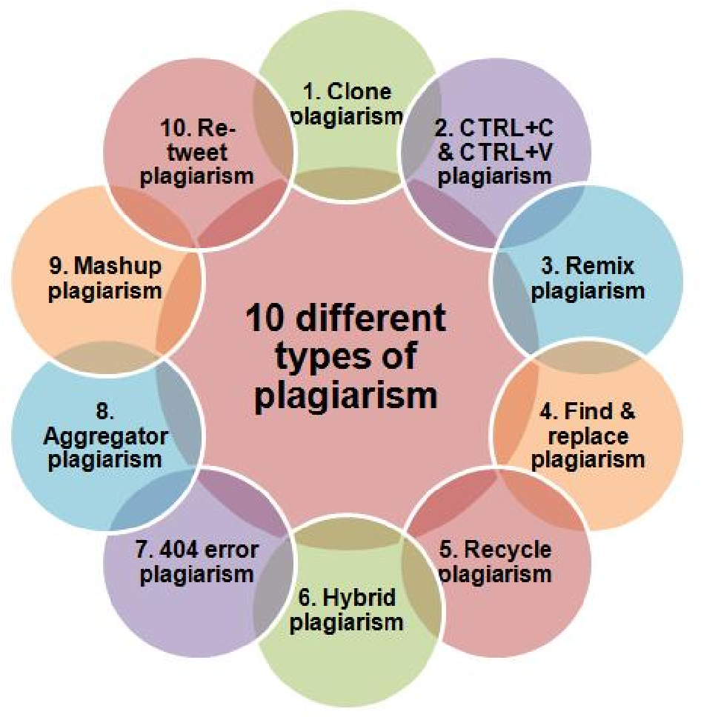
Core Content

Slide 14
What is Research Misconduct?
Core Content
Fabrication – making up data or results and recording or reporting them
Falsification – manipulating research materials, equipment, or processes, or changing or omitting data or results such that the research is not accurately represented in the research record
Plagiarism – the appropriation of another person’s ideas, processes, results, or words, without giving appropriate credit

Slide 15
Plagiarism
Core Content
According to the Merriam-Webster OnLine Dictionary, to “plagiarize” means
• To steal and pass off (the ideas or words of another) as one's own
• To use (another's production) without crediting the source
• To commit literary theft
• To present as new and original an idea or product derived from an existing source.

Slide 16
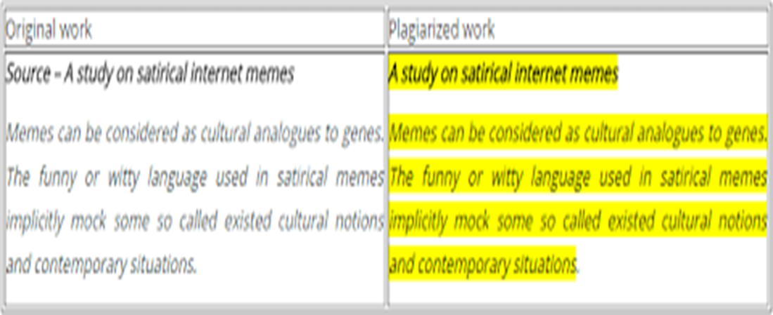
Submitting someone else’s work, word-for-word, as your own
Core Content
CLONE
Cloning is intentional plagiarism and includes: using a friend’s paper from a previous class, purchasing a paper from a paper-mill, downloading a paper you found online, and other instances in which you turn in someone else’s work, unaltered, and claim it as your own.

Slide 17
#2 CTRL-C Containing significant portions of text from a single source with alterations
Core Content
Ctrl-c is a common process in which although you have written some of the assignment and included your own thoughts, there are still significant portions that match up word-for-word to another person’s writing, without citation.

Slide 18
Core Content

Slide 19
Core Content

Slide 20
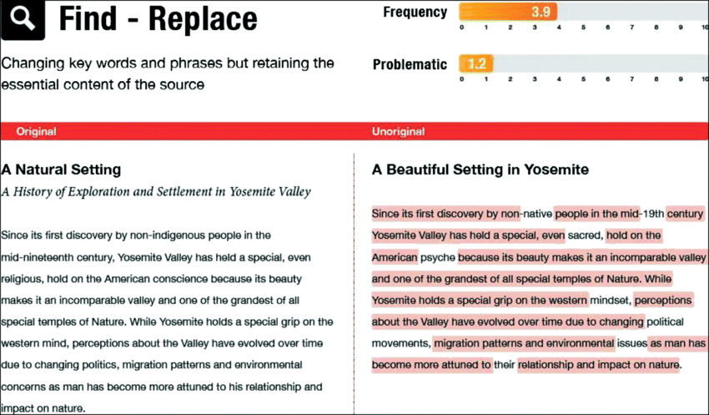
#3 FIND-REPLACE Changing key words and phrases but retaining the essential content of the source
Find-Replace occurs when you copy a sentence from a source, but change a few key words to alter it and attempt to make it your own

Slide 21
MASHUP Mixing copied material from multiple sources
Core Content
Mashup occurs when you pull copied information from multiple sources and mix them up together to create sentences and paragraphs

Slide 22
404 ERROR Citing non-existent sources or including inaccurate information about sources
Core Content
404 Error, or File Not Found, is when you attribute your information to a reference that does not exist

Slide 23
REMIX Mixing paraphrased material from multiple sources
Core Content
Remixing occurs when you attempt to paraphrase multiple sentences from multiple sources. This is similar to Find-Replace in your attempt to alter the original information, but still, if you use ideas that are not your own, and information that is not your own, no matter how much you changed the wording, you still need to cite your sources

Slide 24
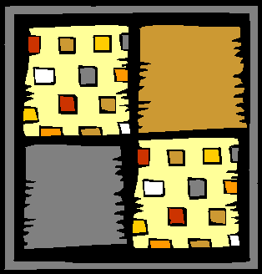
Unethical publishing
Core Content
Patch working
Using words & phrases from a source (which may or may not be acknowledged) & patching them together into new sentences
Remix Version

Slide 25
Self plagiarism
Core Content
Self plagiarism
plagiarism
Reuse of significant, identical, or nearly identical portions of one's own work without acknowledging that one is doing so or without citing the original work
Debatable !
Duplicating Publications
Reuse/recycle your own paper (paid twice for the same job)
SALAMI publication
Republishing the same material in successive papers (in different format and content)
Damaging because of its economic implications for publishers, readers, libraries, and indexes
It can also affect the results of meta-analyses

Slide 26
How to avoid Plagiarism
Core Content
• Don’t be anxious – All research is derivative
• NEVER copy paste – Instead paraphrase
• Read extensively do develop a flow / idea before you start
to write
• If something needs to be copies ALWAYS use “inverted
commas” and give reference

Slide 27
Real-life Examples of Research Misconduct
Core Content
This case involved questionable data management: 9 of 11 cell lines fabricated, images of cells were manipulated
One result is that major journals are changing their review processes to incorporate analyses of images that are submitted for publication.

Slide 28
Fabrication
Core Content

Slide 29
Core Content
Notes:
CUTTING AND PASTING

Slide 30
Vertical integration
BMJ 2011; 342:c5347
Notes:
Researcher claim 9 out of 12 pts has autism
Actually 6 out 12 has it
Further exploration and review revealed that actually 3 out of 12 had autism
When they investigated whether they has symptoms b4 n after
It revealed 2 had before and 1 had after vaccination

Slide 31
https://doi.org/10.1136/bmj.c5347
Vertical integration
https://doi.org/10.1136/bmj.c5347

Slide 32
Vertical integration
Notes:
There was significant decrease in vaccinated children which can also lead to drop in herd immunity

Slide 33
Vertical integration

Slide 34
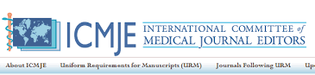
Authorship Criteria
Core Content
Who can be the Author?
1. Substantial contributions to the conception or design of the work; or the acquisition, analysis, or interpretation of data for
the work; AND
2. Drafting the work or revising it critically for important intellectual content; AND
3. Final approval of the version to be published; AND
4. Agreement to be accountable for all aspects of the work in ensuring that questions related to the accuracy or integrity of any part of the work are appropriately investigated and resolved

Slide 35
Who can be an Author?
Core Content
• In addition to being accountable for the parts of the work he or she has done, an author should be able to identify which coauthors are responsible for specific other parts of the work
• In addition, authors should have confidence in the integrity of the contributions of their co-authors

Slide 36
Who can be an Author?
Core Content
All those designated as authors should meet all four criteria
for authorship
• and all who meet the four criteria should be identified as
authors
• Those who do not meet all four criteria should be
acknowledged

Slide 37
Who can be an Author?
Core Content
• It is the collective responsibility of the authors, not the
journal to which the work is submitted, to determine that
all people named as authors meet all four criteria
• corresponding author is the one individual who takes
primary responsibility for communication with the
journal during the manuscript submission, peer review, and
publication process

Slide 38
Implications
Core Content
Retraction
Corrigendum
Banned form receiving funding , publication
Discharge from Job
Blacklist

Slide 39
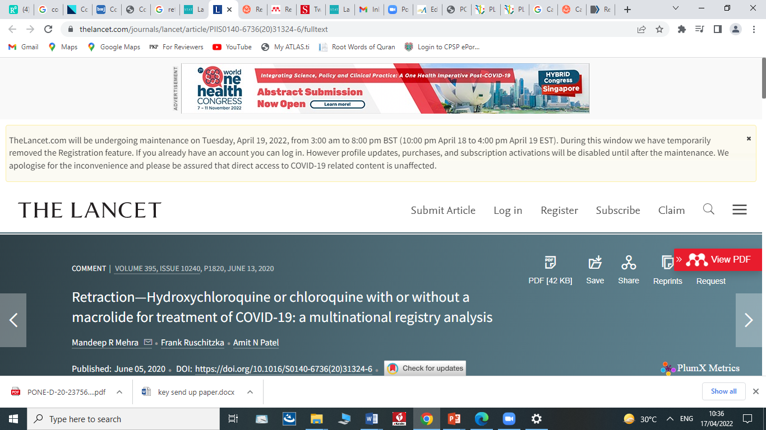
Research
RETRACTED

Slide 40
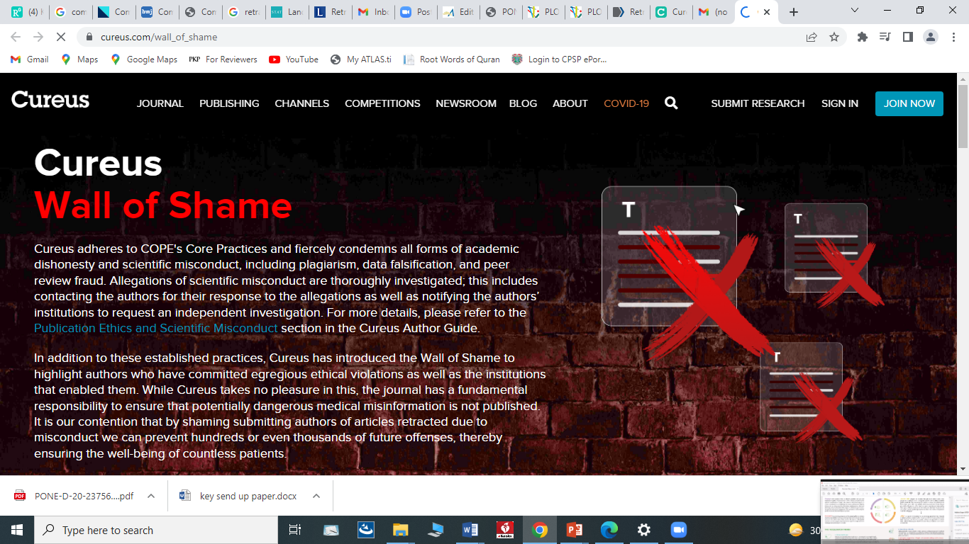

Slide 41
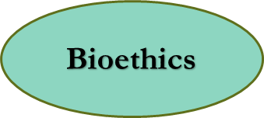
Ethical conduct of Medical Research

Slide 42
End of Lecture Assessment
In order to avoid plagiarism, when you are quoting the author verbatim. You should always use which of the following modality;
Para-pharsing
Direct Quotation
Use synonyms
Use different forms of words
Change the voice or perspective
Key : b

Slide 43
References
Casebook on Ethical Issues in International Health Research, Editors: Richard Cash, Daniel Wikler, Abha Saxena, Alexander Capron, WHO, 2009
Standards and Operational Guidance for Ethics Review of Health-Related Research with Human Participants, WHO, 2011
Guidance on ethics of tuberculosis prevention, care and control, WHO, 2010
The ethics of research related to healthcare in developing countries, Nuffield Council on Bioethics, 2002; follow-up paper, 2005

