Slide 2
Droplet infections (Diphtheria, Meningococcal meningitis) Otorhinolaryngology Block-X Module-II
Dr Bushra Farooq
Dr Saba Maryam

Slide 3
Vision & Mission of RMU
Wisdom
Truth
Service
To impart evidence based research oriented medical education
To provide best possible patient care
To inculcate the values of mutual respect and ethical practice of medicine

Slide 4
Prof Umar Model

Slide 5
Sequence Of Lecture
Statement of learning outcomes (01 slide)
Core Subject( 08 slides)
Horizontal Integration(01 slides)
Vertical integration( 06 slides)
EOLA(End of lecture assessment) (03 slides)
Digital Library References
( Research, Bioethics) (02 slides)

Slide 6
Learning Objectives
At the end of session students will be able to
Describe public health importance of Meningitis, diphtheria in global and local context. Describe the epidemiological determinants of Meningitis, diphtheria. Enlist the modes of transmission and incubation period of Meningitis, diphtheria. Identify the high-risk individuals to get these diseases. Diagnose the cases based on signs/symptoms. Enlist the complications of Meningitis, diphtheria Recommend prevention and control measures of Meningitis, diphtheria in community.

Slide 7
Diphtheria
CORE CONCEPTS
Diphtheria is a contagious disease which is vaccine preventable as well.Before the introduction of diphtheria vaccine and widespread vaccination in the 1930s, cases occurred throughout the world.
Recently, as a result of under vaccination, outbreaks have been occurring with increasing frequency despite the availability of a safe and effective vaccine.
Number of reported diphtheria cases in Pakistan has increased by 50%, in 2023, compared to the previous year. The majority of cases are being reported from the Sindh and Punjab provinces.

Slide 8
Diphtheria (introduction)
CORE CONCEPTS
Acute infectious disease caused by toxigenic strains of Corynebacterium diphtheriae
Types of Diphtheriae
Pharyngeal and tonsillar diphtheriae
Laryngeal diphtheriae
Anterior nasal diphtheriae
Cutaneous diphtheriae

Slide 9
Epidemiological Determinants
CORE CONCEPTS
Agent
Corynebacterium Diptheriae ( Gram + ve), non motile
Source Of infection
Case or carriers (nasopharyngeal secretions, discharges from lesions and contaminated fomites are infective materials)
Infectivity
14 to 28 days from the onset of disease
Incubation period :
2to 6 days

Slide 10
Epidemiological Determinants
CORE CONCEPTS
Host factors:
affects children 1-5 years of age, both gender affected equally
Environmental factors:
can occur in all seasons
Mode of transmission:
droplet infection or directly from infected cutaneous lesions
case-fatality rate is 5–10%, with higher death rates (up to 20%) in those younger than 5 years of age.
Portal of entry:
respiratory route, skin cuts wounds and ulcers

Slide 11
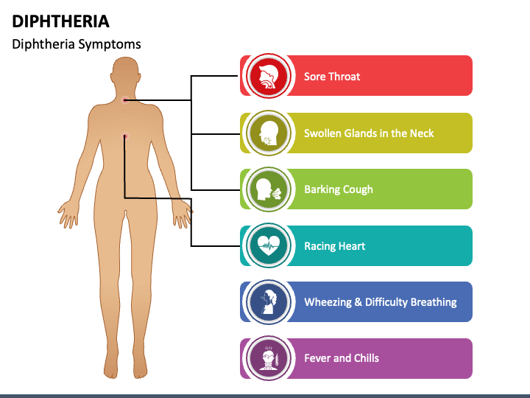
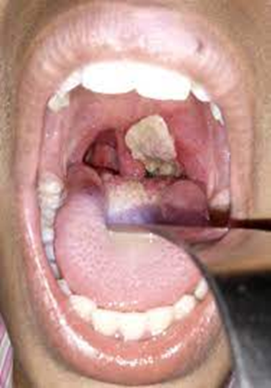
Clinical Features
Pseudo membrane at pharynx

Slide 12
Complications of Diphtheria
Airway blockage is a deadly complication from respiratory diphtheria. If the toxin gets into the blood stream, it can kill the tissue of other organs and cause:
Kidney failure
Myocarditis (damage to the heart muscle)
Polyneuropathy (nerve damage)
Even with treatment, about 1 in 10 people with respiratory diphtheria will die. Without treatment, up to half of people die from the disease.

Slide 13
SCHICK TEST
HORIZONTAL INTEGRATION
Skin test used to determine whether or not a person is susceptible to diphtheria.
Inject 0.1 ml of Schick test toxin (diphtheria toxin) intradermal on one forearm while on opposite forearm inactivated Schick toxin is injected.
If a person is immune no reaction is seen

Slide 14
Treatment
When diphtheria is suspected diphtheria antitoxin is given i/m or i/v in doses ranging from 20,000 to 100,000 depending on severity
In addition to antitoxin every case should be treated with penicillin or erythromycin for 5 to 6 days.

Slide 15
Prevention & Control Of Diphtheriae
Early detection
Isolation
Vaccination as pentavalent in EPI schedule

Slide 16
Meningococcal Meningitis
Meningitis is a devastating disease with a high case fatality rate, which can lead to serious long-term complications (sequelae).
Meningitis remains a major global public-health challenge.
Epidemics of meningitis are seen across the world, particularly in sub-Saharan Africa.
Recent outbreak in Rahim Yar Khan in April 2024, a severe form of meningitis, resulted in 12 deaths, including six children.

Slide 17
Epidemiological determinants
Agent:
Nesseria Meningitidis ( gram –ve)
Host :
Children & young adults, both genders
Environmental factors:
Cold & dry months of the year, overcrowding
Source of infection
Nasopharynx of cases & carriers
Incubation period
3-4 days
Mode of transmission
Direct or droplet route

Slide 18
Clinical features
VERTICAL INTEGRATION

Slide 19
Complications and sequelae
VERTICAL INTEGRATION
One in 5 people surviving an episode of bacterial meningitis may have long lasting after-effects. These after-effects include hearing loss, seizures, limb weakness, difficulties with vision, speech, language, memory, and communication, as well as scarring and limb amputations after sepsis.

Slide 20
Treatment Of Cases
VERTICAL INTEGRATION
Antibiotics : can saved 95 per cent of patients provided that it is started during the first 2 days of illness.
Penicillin is the drug of choice.
In penicillin-allergic patient-- ceftriaxone and cephalosporins should be substituted.
In case of epidemic --A single dose of long-acting chloramphenicol or ceftriaxone is used for treatment in subSaharan Africa

Slide 21
Prevention & Control
Early detection
Isolation
MASS CHEMOPROPHYLAXIS :
causes an immediate drop in the disease incidence and in the proportion of carriers.
drugs of choice-- ciprofloxacin, minocycline, spiramycin and ceftriaxone.

Slide 22
Research
The recent meningitis outbreak in Rahim Yar Khan led to 12 deaths including six children. This event highlights the urgent need for Pakistan's public health system to improve its readiness and efficiency to prevent future outbreaks. After reports of the outbreak, authorities dispatched emergency response teams to the affected area. According to the Dawn News, meningoencephalitis, a severe form of meningitis, was responsible for the deaths, revealing this as an underlying health issue that must be addressed.
https://pmc.ncbi.nlm.nih.gov/articles/PMC10985216/

Slide 23
Ethics
Epidemics, emergencies and disasters raise many ethical issues for the people involved, who include responders, public health specialists and policy-makers. This training manual provides material on ethical issues in research, surveillance and patient care in these difficult contexts, as well as related issues to reduce risks before, during and after events.
https://www.who.int/publications/i/item/ethics-in-epidemics-emergencies-and-disasters-research-surveillance-and-patient-care-training-manual

Slide 24
EOLA (End of lecture assessment)
During an outbreak of meningococcal meningitis in a densely populated refugee camp, public health officials aim to control the spread. Which of the following is the most effective immediate intervention to prevent further cases?
a) Implementing universal antibiotic prophylaxis for all residents of the camp b) Initiating mass vaccination with a conjugate meningococcal vaccine in high-risk groups c) Quarantining all individuals who had any contact with confirmed cases d) Conducting serological testing to identify asymptomatic carriers before treatment e) Focusing on improving nutrition and sanitation to reduce disease susceptibility

Slide 25
EOLA (End of lecture assessment)
Which of the following factors is the most significant contributor to diphtheria resurgence in low-income and conflict-affected areas?
a) Rapid mutation of Corynebacterium diphtheriae leading to vaccine escape variants b) Increased reliance on antibiotics rather than vaccination c) Declining herd immunity due to disruptions in routine immunization programs d) The emergence of an environmental reservoir maintaining bacterial transmission e) Lack of effective diphtheria treatment options beyond vaccination

Slide 26
OSPE
Identify disease
What type of vaccine is available for its prevention?
What is its vaccination schedule in EPI Pakistan?

Slide 27
References
K.Park
https://www.who.int/news-room/fact-sheets/detail/diphtheria#:~:text=Diphtheria%20is%20a%20disease%20caused,variation%20between%20and%20within%20countries.
https://www.who.int/news-room/fact-sheets/detail/meningitis#:~:text=Meningitis%20is%20a%20devastating%20disease,affect%20people%20of%20any%20age.

