Slide 1
Research Data analysis
Block : II Ophthalmology
Prof Syed Arshad Sabir

Slide 3
Vision & Mission of RMU
Wisdom
Truth
Service
Vision
Highly recognized and accredited center of excellence in Medical Education, using evidence-based training techniques for development of highly competent health professionals, who are lifelong experiential learner and are socially accountable.
Mission Statement
To impart evidence-based research-oriented health professional education in order to provide best possible patient care and inculcate the values of mutual respect, ethical practice of healthcare and social accountability.

Slide 4
Prof Umar’s Model

Slide 5
Learning Objective
● Comprehend the relevance of descriptive biostatistics to epidemiological research
● Explain principles of descriptive analysis of data.
● Perform simple data analysis including quantitative & qualitative data
● Perform cross-tabulation between two categorical binomial variables
● Calculate of “Standard Error” for the given data
● Calculate “ Confidence interval” for the given data
● Conceptualize hypothesis testing, types of error and p-value in data anlysis

Slide 6
Sequence of the Session
Statement of learning outcomes (01 slide)
Order & Components of the session
Core subject ( contains throughout relevant clinical contents) ( 35 slides)
Research pertinent to enhance understanding of the subjects (01 slides)
Vertical integration (01 slides)
Horizontal integration (01 slide)
End of the session relevant assessments ( 01 slides)
Suggested additional readings ( 01 slide)

Slide 7
Research Data analysis
It is treating the information collected in one’s research under predetermined conditions towards a conclusion in the research.
Fundamental to any research study.
Simply it is to process the raw research information to answer the research question
Prerequisite. Some capacity in;
Research data analysis Specific Software (SPSS) etc.
Biostatistical Principles & Methods
Computer soft skills (MS office Word, Excel)

Slide 8
Research Data analysis
Core content
It is based on
Conceptual framework of study
study objective
It is needed to focus the information generating effort to obtain the relevant information to;
- to describe health problem (Descriptive studies – descriptive analysis)
- Test a hypothesis (analytical studies-inferential statistics)
- to develop a data collection tool like Questionnaire ( Pilot study)
Work prior to Data Analysis:
Data coding
Data editing
Data completing
Data cleaning

Slide 9
Core content
3. What is purpose of this categorization ?
2. What dose it indicate ?
4. Is it primary or raw data, OR secondary or processed data???
1. How was the primary data ?

Slide 10
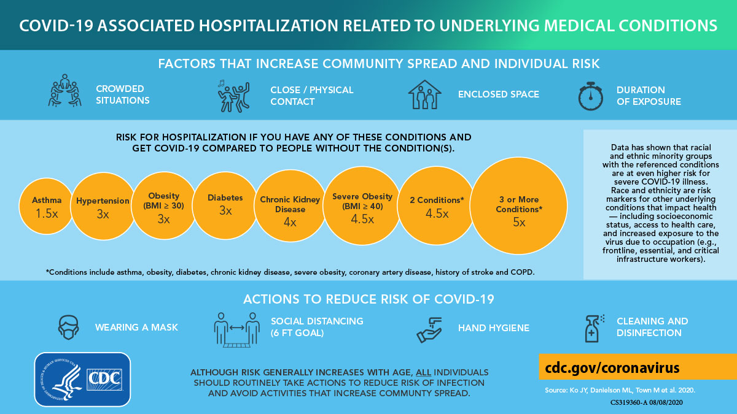
Core content
1, How known ?
2,What type of study was undertaken ?

Slide 11
Core content
What statistical process is done ?

Slide 12
Core content
How known ?

Slide 13
Identification of study variables
Core content
Needed for results presentation and data analysis scheme to answer research question.
Volume / number is determined by the nature of research question, the objectives and sub-objectives of study.
Only selected variables are used for analysis .
Analysis plan, whether simple description or looking for associations is conceived at the time selecting a research idea.
It is needed to quantitatively describe the problem and also to identify possible explanations of the problem
Dummy tables

Slide 14
Identification of study variables
Core content
Prevalence of anemia in a village population.
Factors affecting compliance in DM-Type-II / asthma patients.
Factors affecting receive of antenatal care in women living in rural area
Effectiveness of a new drug in controlling HTN.
Effectiveness of nutritional education to mothers in preventing malnutrition in their children

Slide 15
Identification of study variables
Core content
Prevalence of “anemia” in a village of 10,000 population. (n=900) Conceptual Framework of Research ?
Information collected
Background variables | Age in Years | Gender | Economic status | Profession
Research question / var | Level of Hb in gm% | Presence of pallor | Types of anemia present
Factors /Linked variables | Profession | Education level | Dietary preferences | Physiological health states
 | Use of IUCDs in females of CBA | Living place | Weight in kg (BMI) | Ht in msq (BMI)
 | Life styles variables | Affect on working capacity | Disease diagnosis | Presence of other morbidities

Slide 16
Types of variables
Core content
Variable type | Subtypes | Examples | Explanation | Summary measures
Categorical var. (qualitative) | Ordered categorical var. (Ordinal var.) | Social class PEM types Level of know. | Upper Middle Lower | Proportion, Rate, Ratio | Percentages, Actual number
 | Unordered categorical var. (Nominal var.) | Gender Blood groups Food types | Male Female or Female Male
Numeric var. (Quantitative) | Discrete var. | 1,2,3 Family size | Whole number No fractions | MCT | Mean Median
 | Continuous var. | 1.20, 1.55, 1.78 | Age Weight Systolic BP | MOV | SD Range Co-efficient of variation

Slide 17
Descriptive statistics
Core content
Total population accessed 1000 and assessed & tested for status of anemia (n=900)
Anemic = 300 (33.33%)
Mean age of anemic = 20Y SD= 8Y
Non-anemic = 600 (66.66%)
Mean age of study participants = 30Y SD=10Y
Gender distribution
Male = 400 …%
Female= 500…%
Use of footwear. (n=850*)
Yes = 650
No = 200
Use of IUCDs (n=500, eligible respondents* 230)
Yes = 70
No = 430

Slide 18
Descriptive cross-tabulation -I (age towards anemia)
Core content
Age groups | frequency | Distribution of Anemia status (n=900)
 |  | Anemic | No anemia
1-5Y | 100 | 60 | 40
6-12Y | 70 ?? | 10 | 60
13-18Y | 150 | 50 | 100
19-24Y | 100 | 10 | 90
25-45Y | 230 | 100 | 130
46-60Y | 100 | 10 | 90
61-65Y | 100 | 20 | 80
>65Y | 50 | 40 | 10
 | 900 | 300 (33%) | 600

Slide 19
Descriptive cross tabulation to analytical cross-tabulation (anemia in relation to gender and use footwear, using IUCD )---differences ???
Core content
attributes | Anemic status |  |  | issues
Gender (900) | Anemic (300) | Non-anemic (600) | Total | Proportion of female in anemic and in non-anemic gps 67 vs 50%
female | 200 (67%) | 300 (50%) | 500
male | 100 | 300 | 400
Use of footwear* (n=850) | anemic | Non-anemic | Total | Difference b/w 30% and 25% ?
Not use FWs | 60 (30%) | 150 (25%) | 200
Use FWs | 200 | 450 | 650
Use of IUCD (n=230*) | Anemic (130) | Non-anemic (100) | Total | Difference b/w 31%and 20% ?
Yes | 40 (31%) | 20 (20%) | 60
No | 90 | 80 | 170

Slide 20
Analytical Cross tabulation using 2x2 table
Core content
Independent variable |  | Dependent variable
 | Mothers literacy | Nutritional status of the children |  | Total Children
 |  | PEM present (cases) 65 | Normal (controls) 65
 | Low | 45 (69%) | 10 (15%) | 55
 | High | 20 | 55 | 75
 |  |  |  | 130
Measure associations |  | Odds ratio SE of the diff b/w two proportions X² test

Slide 21
Statistical debate on study results
Core content
Anemia is present in 33% population(300).
Mean age of the anemic pop is 20Y.
Proportion of anemia is high in female (40%) than in male population (25%)
Results are based on sample study not the total population.
Variations may arise from many sources like
Observer varai-, instruments faults, sampling varia..
Variations / estimates or results may have occurred due to chance or sampling ….
Results reliability tools for point estimates and analyzing associations
95% CLs
Tests of significance

Slide 22
Confidence Limits and Confidence Interval
Core content
In reality we take only one sample (X is not equal to µ)
According to CLT, SE is a tool to measure “ sampling variations”.
A sample mean (X) is not exactly equal to pop. mean but with help of SE we can construct a range of values around sample mean within which pop. mean would fall with certain degree of confidence. (Point estimate)
These limits calculated on both sides of sample mean are called “confidence limits” {CL}.
Range between these limits is known as “confidence interval” {CI}.
Formula for Pop. Mean (95% CI) µ_{ci} = X ± 2SE
= X ± 2 ( SD)
√ n

Slide 23
Exercise
Core content
Researcher want to assess wt. of 5 years old children of a village with total child population of 110. A sample of size n= 11 was drawn, its mean wt. was 16Kg & SD =2kg. Pop.
How close is this estimate to true value?
SE = 2/ √ 11 = 0.6 Kg
95% CI (µ_{ci}) = 16 ± 2 x 0.6
14.8kg---------17.2kg
Role of sample size:
If n= 20, SE= 2/ √ 20 = 0.45kg
95%CI = 16 ± 2 x 0.45 = 15.1------16.9kg (more precise)

Slide 24
Standard error of proportion (SEP)
Core content
To estimate a population proportion (P), sample proportion (p) can be used accordingly (CLT)
Distribution of samples proportions around the pop. proportions is “Normal” and may be expressed arithmetically in term of SE of proportion with confidence limits.
95% of sample proportions will lie within limits of population proportion as P ± 2 SEP {95% CLs}.
Samples with larger or smaller than this range will be rare or only 5%. And such values will taken as statistically significant at 5% level of significance.
[ Central limit theorem ]

Slide 25
95% CI for a pop. proportion ( in percentage) ( categorical variable)
Core content
In sample of 120 T.B pts. drawn from country, 23.3%(28) had compliance with treatment.
Is this finding holds true for whole population ?
Standard Error for Proportion (in %)/ (SEP)
if p probability of occurrence of one proportion in percentage (23.3%)
100-p will be probability of its non occurrence (q) = 100-23.3 = 76.7% (q)
SEP = √ p x q / n = √ 23.3-76.7/ 120 =3.8
95% CI for SEP = p ± 2 x SEP = 23.3 ± (2 x 3.8)
95% CI for SEP = 15.5%----31.1%
In population compliance rate will be b/w 15.5%----31.1%

Slide 26
Research portal Testing a statistical Hypothesis.
Core content
“Hypothesis” is a statement which is to be tested
under the assumption of being true . Research Hypothesis
In research 02 statistical Hypothesis are formulated:
Null Hypothesis ( H_{o} )- a certain characteristic don't differ between two groups in the population. The observed differences are due to sampling variability. {No difference Hypothesis}
2. Alternate Hypothesis (H_{A}). Significant difference do exist b/w two groups in the population…due to some factor (Hypo. of significant difference)

Slide 27
Hypothesis testing……
Core content
H_{o} is against the claim of the researcher.
Researcher desires to reject H_{o} and in doing so he may commit two types error- due to various sources of variability .. like bias or sampling variability
1.Type-I error or alpha –error (α-error) Rejects H_{o} when it was true.
(Actually, differences were not significant but are taken significant) OR
2.Type-II error or Beta-error (β-error)
Accepting H_{o} when it was not true.
(Actually, Significant difference do exist but are taken insignificant)

Slide 28
Hypothesis testing
Core content
Decision based on study results | True situation Difference Difference not Exist Exist
Difference exist: H_{0 Rejected} | Correct decision | Type-I error {α error} LOS (5% or 0.05)
Difference don't exist: H_{0 Accepted} | Type –II error {β-error} 0.2 | Correct decision

Slide 29
Statistical Hypothesis testing ….
Core content
Data is collected under probability Sampling
Large sample (more than 30)
Pre-deciding cut-off point (LOS) for declaring “ normal/chance variation”. (Prior-probability)
Finding probability of occurring observed differences by chance..P-value. Test statistic provide it (posterior probability )
Obtained P-value is compared with pre-decided limit of occurrence of differences by chance.
Drawing inference on the basis of comparison b/w two P-values.

Slide 30
Probability (P-value in Hypothesis testing)
Core content
P-value is probability of committing α error.
This probability is set before the start of study and is conventionally set at 5% or 0.05 which means that we will accept maximally up to 5% chance of taking differences significant when actually were no differences i.e. chances of wrongly rejecting null-hypothesis or getting the results by chance or due to sampling..
Probability at this stage is called as
“ level of significance (LOS)” or “level of Alpha”
means this experiment will let the chance to be operated up to a limit of (0.05) 5% and we will be (0.95) 95% confident upon the results.

Slide 31
Probability (P-value in Hypothesis testing)
Core content
level of α is set before start of experiment like 0.05, 0.02 or even may be 0.01.
But P-value is calculated after competing experiment and it may assume any value like 0.5 or 0.05 or even less like 0.01.
The obtained P-value is compared with pre-decided level of α (0.05)
if comes equal or less then level of α , reject null hypothesis and accept Alternate hypothesis.
If it is higher than level of α (LOS), we cannot reject null hypothesis
Tests of significance provide us P-value or basis of rejecting or accepting research hypothesis

Slide 32
Statistical tools choices in decision making in Health
Core content
Variable type | Statistical methods
Quantitative (age, HB% level, B.P, Weights, Heights etc ) | Standard error for Mean
 | Standard error of difference b/w two means
 | Students t-test / Z-test
Qualitative (Gender, anemic status, maternal literacy etc ) | Standard Error for Proportion.
 | Standard Error of the difference b/w two proportions
 | Chi – square test

Slide 33
Tests of significance
Core content
Issues:
Whether a study result can be considered as result which indeed exist in population from where sample was drawn ?
Whether the differences observed are due to chance variation(normal) or are true due to play some external factor (significantly different).
Tests of significance” are mathematical procedures by which Probability (p-value) of getting study results by chance can be found .
On the basis obtained P-value we reject or not reject Null Hypothesis…and draw inference
POWRE OF THE TEST: is its ability to detect differences between groups if such differences actually exist. (1-β error) ……conventionally taken 80%

Slide 34
Tests of significance
Core content
Tests provide P-value which forms the basis of rejecting or accepting null hypothesis…drawing inference from the data.
PRINCIPLE: These tests will calculating differences between the groups. More the difference is, more we would be confident in saying that there is real difference and the chances of being at wrong are very small.
POWRE OF THE TEST: is its ability to detect differences between groups if such differences actually exist.

Slide 35
Tests of significance
Core content
Power of the tests:
Ability of a statistical test to reject a null hypothesis when it is actually wrong.
Ability to avoid type-II (β) error.
It is equal to 1- β which is the probability of rejecting null hypothesis when it not true. (probability of not committing β error).
Conventionally,
a study is required to have power of ≥ 0.8 or more than 80% chance of rejecting a false Null-hypothesis.
Probability of β-error of 0.2 i.e. less than 20% chances of accepting a false null hypothesis, is acceptable in research.

Slide 36
Power of the test
Core content
Power of the test increases;
Observed differences are high
As level of alpha (LOS) increases
Sampling error decreases (SE)
Sample size increases ( SE is reduced)

Slide 37
Level of significance
Core content
Study results are sample based, not the total pop.
We can never 100% sure about study result ( sampling )
By convention we accept results if we have 95% confidence upon results (diff. exist) or if chances of having results by chance (actually no diff.) are less than 5%.
We allow 5% level/chance of accepting results (differences) as significant that might have occurred by chance. And will not let chance to operate more than 5%. This is called level of significance (LOS) or level of alpha.

Slide 38
Chi-square test (x²)
Core content
It was developed by Karl Pearson
x² -test is a “non-parametric test”.
x² -test is used to find out whether the observed differences in distribution of the two variables (into their classes) may have occurred by chance or are real or present in total population.
This test is based on measuring diff b/w observed frequencies and expected frequencies.

Slide 39
Chi-square test (x²)
Core content
Frequency of the classes of variables are expressed in actual observed numbers ( not in proportions or percentages like 0.3 or 30%).
Parallel frequencies (Expected Frequencies) for each observed frequency is calculated under H₀
Expected frequency in any cell should not be less than 5 and total of all should be less than 20.
Data should based Probability sampling

Slide 40
Steps of applying Chi-square test (x²)
Core content
An assumption of f no difference is made which is then proved or disproved with the x² test. (Null hypothesis)
Steps:
Fix a LOS (.05) beyond which chance will not be accepted
Enter study data in 2X2 table (obs. Freq.(O)
Calculate expected frequency for each cell (E)
Expected freq. = (RT x CT / GT)
Formula for x ² value of each cell = (O-E) ²/E
Add up results of all cells ∑ (O-E) ²/E = X ²_{cal}
Df = (C-1) x ( R-1) ( it is 1 in 2X2 table)
Compare X ²_{cal} value with value X ²_{tab} for predefined LOS in the table for given DF , it may be lesser, equal or larger than it ,. then corresponding P-value will be used to reject or not reject H₀ / accept the H_{A} accordingly.

Slide 41
Chi-square distribution
Core content
 | Percentage points of chi-distribution (P-values)
DF | 0.99 | .1 | .05 | 0.025 | 0.01 | .005 | .001
1 | 0.04393 | 2.71 | 3.84 | 5.02 | 6.63 | 7.88 | 10.83
2 | 0.0100 | 4.61 | 5.99 | 7.38 | 9.21 | 10.60 | 13.82
3 | …… | …. | …… | …… | ….. | …… | …..
4 | …… | …… | ……. | ….. | …. | …. | ….
5 | …… | …… | …… | …… | …… | ……. | …...

Slide 42
R.Q: Is the use of Antenatal Services is associated with shorter distance from the Health Facility ?
Core content
Distance from ANS Used ANS Not Used ANS Total
Less than 10 Km (O) 51(E= 44.4) (O)29 (E= 35.6) 80
10Km or more (O)35 (E = 41.6) (O)40 (E= 33.4) 75
86 69 155
E or Expected values are calculated on the basis of supposition
(H₀ )of no difference b/w proportions of the two groups.
X ²_{cal} = ( 51-44.4)² +(29- 35.6)²+(35-41.6)²+(40-33.4)² = 4.55
44.4 35.6 41.6 33.4
X ²_{cal} at 1DF = 4.55 while X ²_{tab} at P-value 0.05 at 1DF is 3.84, as the cal- value is larger than tab value that means Probability of occurring differences by chance is less than 0.05 hence the diff observed is sig. and H₀ is rejected.

Slide 43
Student’s t-test
Core content
Numerical data (measured values…Mean),
Normal Variable, Compare 02 groups
Random sampling
Steps:
Chose a level of Significance (LOS) usually .05 which means pre-decided cut off probability of accepting the difference by chance .
Calculate t-value (from study data)….test statistic
Determine DF (= sum of two sample sizes minus 2)
Locate table t-value corresponding to LOS at the given degree or freedom. If cal-t value is equal to or larger than table value of t, means P-value for that table t-value will used. Statistically significant. Hence H₀ is rejected and otherwise not.

Slide 44
How to calculate t-value
Core content
Summarize the data from the two groups to be compared in terms of means. (x₁ and x₂ )
Calculate difference b/w means of the two groups. (x₁ – x₂ ).
Calculate standard Deviation of each study group (SD₁ & SD₂ )
Calculate the Standard Error for the both groups (SE₁ & SE₂)
SE = SD / √ n.
Formula for t- test: x₁ – x₂
t = ----------------- √ SD₁² /n₁ + SD₂² /n₂

Slide 45
Applying t-test
Core content
Delivery outcome n Mother mean Ht. SD
Normal B wt 60 156cm 3.1
LBW 52 152cm 2.8
H₀ : there is no difference in mean hts. of the two gp?
Diff. may be by chance but acceptable LOS is 0.05 (p < .05)
x₁ – x₂ 2 2
t = ----------------- = -------------------------- = ------ = 3.6
√ SD₁² /n₁ + SD₂² /n₂ √ 3.1 ² /60 + 2.8 ² /52 0.56
Calculated value of t = 3.6, Tab value of t at DF 110 at .05 LOS is 1.98 . Hence Cal- t value is larger than tab value of t hence the difference is sig. and H_{o} is rejected.

Slide 46
Student’s t-test distribution
Core content
DF | Percentage points of students t-distributions (P-values)
DF | .4 | .1 | .05 | .01 | .005 | .001
1 | .325 | 3.07 | 6.31 | 31.82 | 63.66 | 318.3
50 | .255 | 1.296 | 1.67 | 2.40 | 2.67 | 3.26
100 | .254 | 1.290 | 1.66 | 2.36 | 2.62 | 3.17
500 | .253 | 1.28 | 1.64 | 2.33 | 2.86 | 3.10

Slide 47
Reflections and recommendations on research ethics in developing countries https://doi.org/10.1016/S0277-9536(01)00327-6
Bioethics

Slide 48
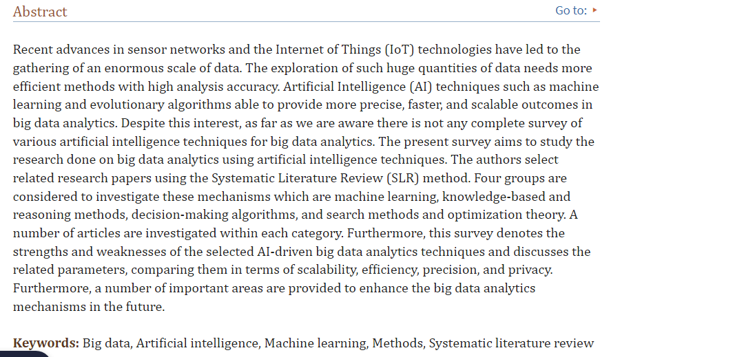
Artificial Intelligence

Slide 49
End of lecture assessment
A randomized control trial is conducted to compare the efficacy of new intervention versus placebo. The control group showed 40% response in placebo and the group with new intervention showed 60% response. The two results can be statistically compared for significance by:
Chi-square test
Paired t-test
T-test
Man Whitney Test
Fischer test

