Slide 1
Fundamental Concepts Of Preventive Medicine (health & Disease) Otorhinolaryngology Module I block X
Dr Imrana Saeed (APMO),Dr Mahjabeen Qureshi (Sr. Demonstrator)

Slide 4
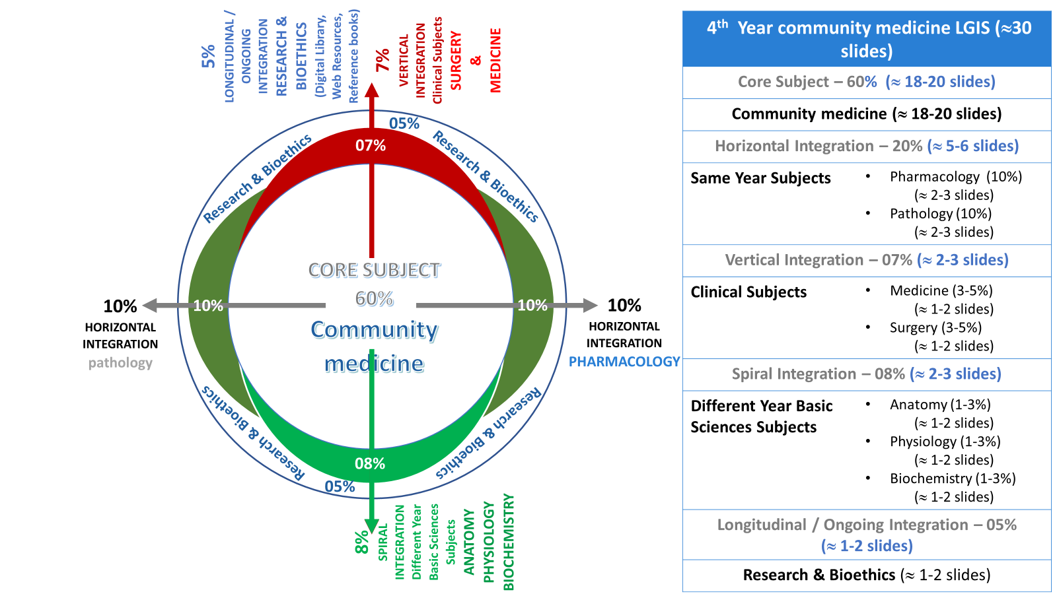
Prof Umar model

Slide 5
Sequence Of Lecture
Introduction 05
Core concept 25
Brain storming 02
Vertical integration with ENT 02
Digital Library References 02
( Research, Bioethics)
EOLA(End of lecture assessment) 01
Suggested readings 01

Slide 6
Learning Objectives
At the end of large group interactive session students will be able to
Differentiate b/w community medicine and clinical medicine
Comprehend public health aspects of Health & disease
Explain well being and positive health
Appraise different dimensions of health
Relate dimensions of health with its determinants
Able to read relevant research articles

Slide 7
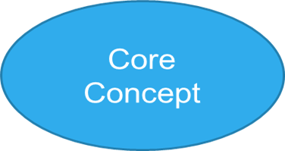
Evolution Of Community Medicine (History Of Medicine) : Introduction
Stages seen in the history of medicine:
Stone age
5000 BC: Indian medicine
2700 BC: Chinese medicine (system of barefoot doctor, System of acupuncture)
2000 BC: Egyptian medicine (manuscript of papyrus)

Slide 8
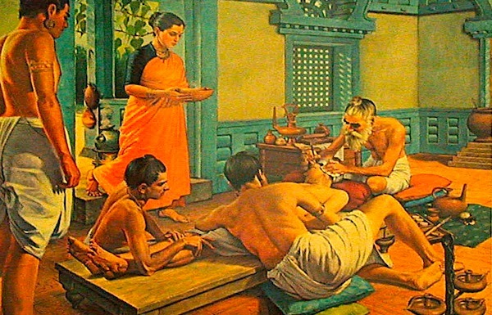
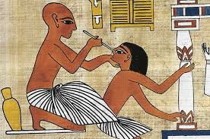
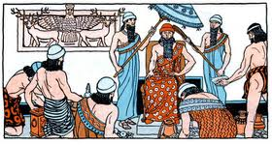
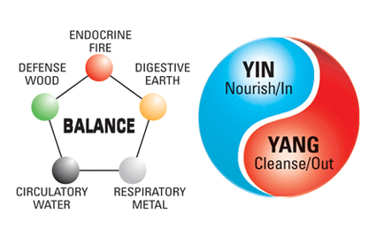
Egyptian Medicine
Indian Medicine
Mesopotamian Medicine
Chinese Medicine

Slide 9
Evolution Of Community Medicine(History Of Medicine)
History of Bioethics
Stages seen in the history of medicine:
2000 BC: Mesopotamian medicine (Babylonian code of Hammurabi)
460 BC: Greek medicine (Hippocrates oath) “father of medicine”
Arabo-Persian Medicine (Alexandria school of medical education )
130 AD: Roman medicine inspired by Greek (Galen)
500 to 1500 AD: Middle ages (Dark ages of medicine, fall of Roman empire)

Slide 10
What Is Community Medicine????
DEFINITION (WHO)
A system of delivery of comprehensive health care to the people by a health team in order to improve the health of the community.
Notes:
comprehensive care treats the whole person, including their physical, emotional, psychological, educational, financial, and vocational factors.
It involves timely diagnosis, personalized treatment plans, and continuity of care.
It also refers to the Delivery of personal as well as impersonal (sanitation, water supply, good waste disposal, town planning) health services. so it’s a team work

Slide 13
Public Health
The science & art of preventing disease, prolonging life and promoting health through organized community measures.
Changing Concepts In Public Health
1. Disease control Phase (1880-1920) sanitary reforms and legislation
2. Health Promotional Phase (1920-1960) through organized efforts
3. Social engineering Phase ( 1960-1980) controlling risk factors
4. “Health for All” phase (1981-2000) remove health inequalities
Notes:
(Viva question)Science
Public health professionals use scientific methods to study the causes of disease and how to prevent them. This includes using epidemiology, a statistical science, to describe the spread of disease.
Art
Public health professionals use artistic skills to promote health and improve the quality of life for people. This includes educating people about personal hygiene and organizing medical services

Slide 14
Changing Concepts Of Health
Biomedical Concept. based on germ theory of disease
Ecological Concept. role of environmental factors in disease
Psychosocial Concept. psychological factors influencing health
Holistic Concept

Slide 15
What Is Health ?? Interactive Session
WHO Definition
“ Health is a state of complete physical, mental and social well-being and not merely the absence of disease or infirmity.”
Criticism:
Health is not a “state”.
More idealistic than realistic.
Other dimensions
Spiritual, emotional, vocational, cultural, philosophical, curative, preventive

Slide 16
What Is Disease? (Brainstorming) Interactive Session
Disease: (dis-ease) physiological state
“ A condition in which body health is impaired, a departure from a state of health, an alteration of the human body interrupting the performance of vital functions.” (Webster’s Dictionary).
Illness (socio-psychological state)
“ A subjective state in which the person perceives himself of being unwell”
Sickness
“ A state of social dysfunction” (a role which a person performs when one is well)

Slide 17
Spectrum Of Health
Health is not static rather a dynamic phenomena.
Health and disease lie along a continuum and there is no single cut-off point.
The lowest point on the health-disease spectrum is death and the highest point corresponds to the WHO definition of “Positive Health.”

Slide 18
Spectrum Of Health
Positive health
Better health
Freedom from sickness
Unrecognized sickness
Mild sickness
Severe sickness
Death

Slide 19
Positive Health
The perfect functioning of the body and mind:
Biologically
Psychologically
Socially
Is it possible?????
New concept ………???? Of health by WHO …???

Slide 20
Concept Of Wellbeing
Mainly Two components: Objective and Subjective.
objective health components are related to ‘Standard of Living’ or ‘Level of Living’
subjective health components are related to ‘Quality of Life’.
3rd one functional health component, based on how well a person is able to function in ones life in given circumstances(operational definition of health)

Slide 21
Standard Of Living---Objective Component Of Well Being
The following services (effect health) may all be used individually as measures of socioeconomic status and collectively as an index of the ‘Standard of Living’.
Income and occupation
standards of housing,
sanitation and nutrition,
level of provision of health,educational, recreational services
Gross difference in diff countries. Measured by GNP per capita
Notes:
GNP is the value of all goods produced by country's citizens both domestically and abroad. GDP value of domestic goods produced within nations borders

Slide 22
Level Of Living---Objective Component Cont..
1. Health
2. Food consumption
3. Education
4. Occupation
5. Housing
6. Social security
7. Clothing
8. Recreation and Leisure
9. Human Rights
Parallel term for standard of living.
9 components

Slide 23
Quality Of Life Subjective Component
A composite measure of physical, mental and social well-being as perceived by each individual or by a group of individuals that is to say, happiness, satisfaction and gratification

Slide 24
Measurement Of Subjective Component Physical Quality Of Life Index (PQLI)
Three Indicators
1. Infant mortality
2. Life expectancy at age one
3. Literacy
A scale of 0-100.
Per capita GNP is not included.

Slide 25
Measurement Of Subjective Component Cont… Human Development Index (HDI)
Geometric mean of Three Indicators
1.Life Expectancy (at birth): minimum value 20 years
2. Education (adult literacy rate and mean years of schooling) : minimum value 0 %
3. Income (real GDP per capita, purchasing power parity in US dollars):minimum value $100
Maximum values are highest observed values at that time
The HDI values range between 0 to 1.

Slide 26
Dimensions Of Health
1. Physical Dimension.
2. Mental Dimension.
3. Social Dimension.
4. Spiritual Dimension.
5. Emotional Dimension.
6. Vocational Dimension.
7. Others.

Slide 27
Dimensions Of Health Cont.. Physical Dimension
Perfect functioning of the body.
A state in which every cell and every organ is functioning at optimum capacity and in perfect harmony with the rest of the body.
Signs of Physical Health in an individual:
Evaluation of Physical Health
At Individual Level
At Community Level.

Slide 28
Mental Dimension Of Health
“A state of balance between the individual and the surrounding world, a state of harmony between oneself and others, a coexistence between the realities of the self, other people and that of the environment.”
Ability to recognize realities of life, taking sound decisions, dealing with conflicts

Slide 29
Social Dimension Of Health
Social well-being has been defined as “ the quantity and quality of an individual’s interpersonal ties and the extent of involvement with the community.”
sound relationships with family, friends and community as a whole.

Slide 31
Others/ Non-medical Dimensions Of Health
Cultural dimension
Socioeconomic dimension.
Environmental dimension
Educational dimension.
Nutritional dimension.
Curative dimension.
Preventive dimension.

Slide 32
Determinants Of Health
1-Biological Determinants
Genetic makeup of an individual.
6-Aging of the population
7-Gender

Slide 33
Modifiable Determinants Of Health (Cont)
4-Environment
Internal ,External (micro or macro) Biological, physical and psychosocial
5-Behavioral and socio-cultural conditions (Lifestyle)
Developed countries ( obesity, drug addiction)
Developing Countries (lack of sanitation, poor nutrition, personal hygienic habits, cultural customs).
6-Socio-economic conditions
7-Health Services
8-Other Factors e.g. food, industry, occupation, social welfare etc.

Slide 35
Relationship Of Different Determinants with ones Health (Rainbow Model)

Slide 37
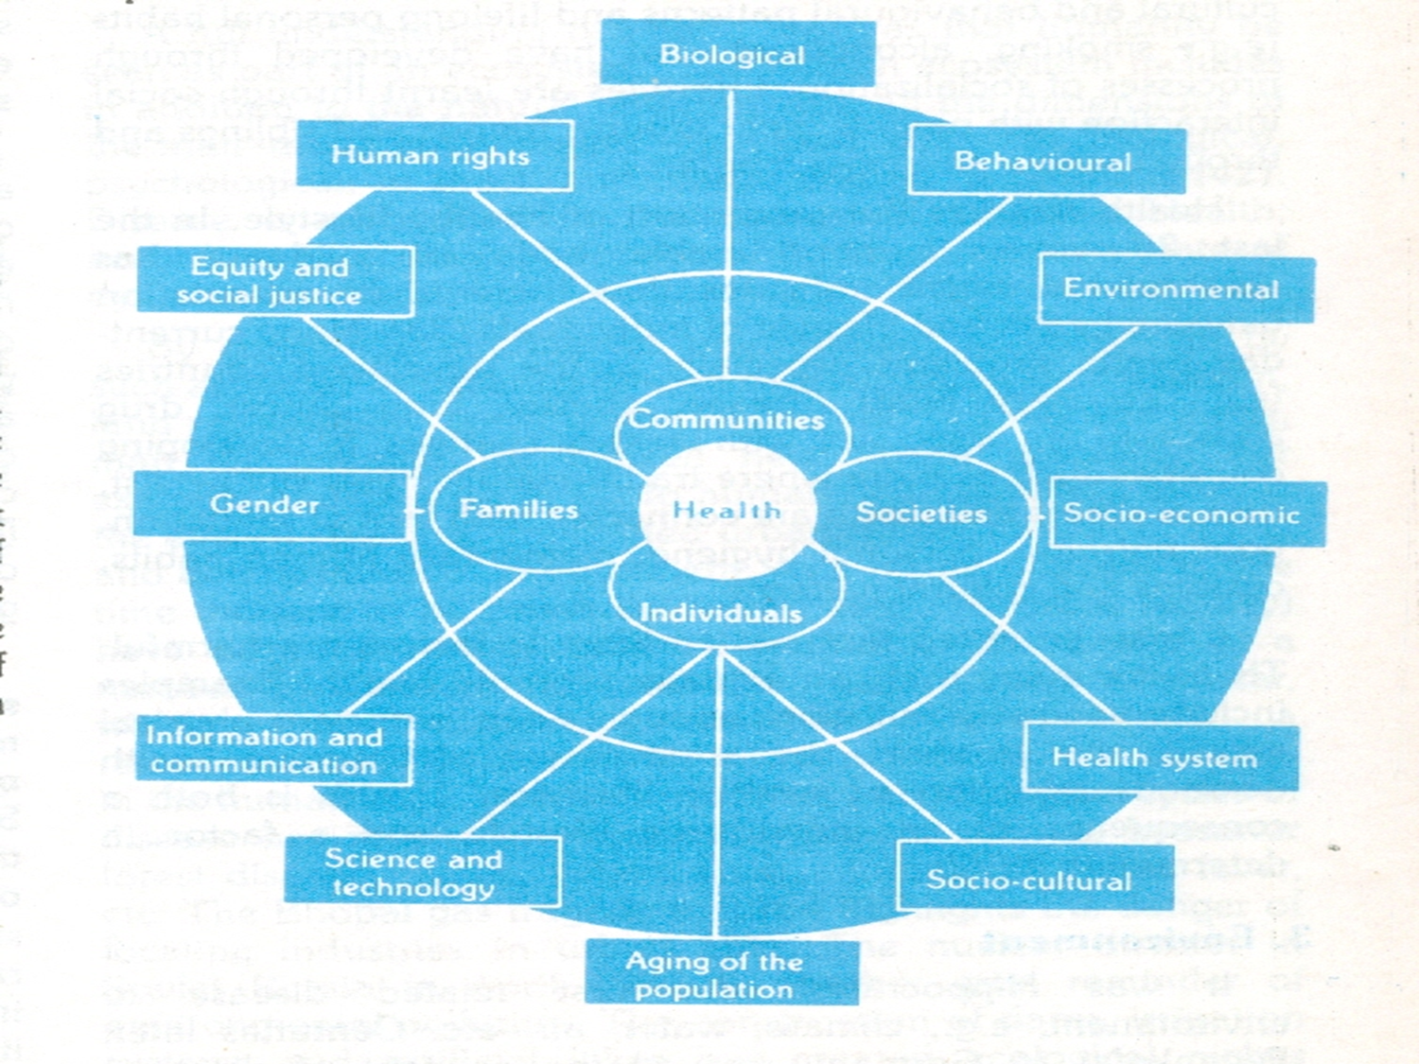

Slide 38
Let’s check out the epidemiological determinants of acute otitis media that you just covered in the lecture of ENT………
Vertical
Integration with ENT
Peak incidence in the first two years of life. Estimated to affect 20% of the children.
Boys are affected more than girls
One of the most common diseases of childhood

Slide 39
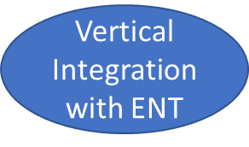
Strategies to prevent acute otitis media
Environmental factors:
Discourage
Childcare in large group setting
Environmental smoke exposure
Pacifier use
Encourage
Breast feeding
Immunization
Passive immunization
RSVIG-IV (selected infants)
Active immunization
Influenza vaccine
pneumococcal vaccine
Antibiotic prophylaxis

Slide 40
Health and illness in history, science and society
Research
That is to say, the concept of health is indeed relative and it is the result of an interesting evolution of the concept of illness. From the first approaches - dealing with the mere treatment of the symptoms - to the promise of a free-from-pain society, science and economics have played a significant role in redefining the dualism health/ illness. The article reflects on these two concepts, health and illness, in history and nowadays, and discusses the future of the medical science.
https://www.ncbi.nlm.nih.gov/pmc/articles/PMC5816293/

Slide 41
End Of Lecture Assessment (MCQ)
Illness is subjective state of a person who feels that he is not well, while sickness is a state of
a) Impaired psychological function
b) Social dysfunction
c) Impaired physiological dysfunction
d) Appearance of signs and symptoms
e) Appearance of complications
Notes:
KEY B

Slide 42
Suggested Readings
K. Park textbook, chapter 1( Man and Medicine ) chapter 2 (Concept of disease and health)
K. Park textbook of preventive and social medicine
27th edition,
Textbook of Public health and community medicine
8th edition by Ilyas Ansari

