Slide 2
COMMON MEDICAL ISSUES
DR. SEEMAB ABID
MBBS, FCPS Medicine
Senior Registrar
Medical Unit 1 HFH

Slide 4
LEARNING OUTCOMES
Difference between syncope, dizziness and vertigo.
How to approach a patient with hypertension
How to approach a patient with lymphadenopathy.
How to approach a patient with splenomegaly

Slide 7
VERTIGO
CORE CONCEPT
It is a symptom ,not a disease.
Feeling in which external world seems to revolve around the individual or individual itself seems to revolve in space.

Slide 8
DIZZINESS
CORE CONCEPT
Abnormal perception of movement(vertigo) with feeling of faintness or unsteadiness.
Anxiety is most common cause of dizziness in under 65 years age people.

Slide 9
LOSS OF CONSCIOUSNESS
CORE CONCEPT
Consciousness is the awareness of environment and ability to respond it.
Loss of consciousness is the global dysfunction of brain.

Slide 11
PRESYNCOPE AND SYNCOPE
CORE CONCEPT
Pre syncope is episode of lost consciousness with or without falling down due to reduced cerebral perfusion.
Syncope is loss of consciousness due to loss of cerebral perfusion.

Slide 12
Differentials of syncope
CORE CONCEPT

Slide 14
SYNCOPE VS SEIZURES
CORE CONCEPT
FEATURE | SEIZURE | SYNCOPE
AURA ( for example olfactory) | + | _
CYANOSIS | + | _
TONGUE BITING | + | - / +
POST ICTAL CONFUSION | + | _
POST ICTAL AMNESIA | + | _
POST ICTAL HEADACHE | + | _
RAPID RECOVERY | _ | +

Slide 15
RESEARCH

Slide 16
HYPERTENSION
HYPERTENSION

Slide 17
HORIZONTAL INTEGRATION

Slide 18
VERTICAL INTEGRATION

Slide 19
VERTICAL INTEGRATION

Slide 20
HORIZONTAL INTEGRATION

Slide 21
RESEARCH

Slide 22
SPLEENOMEGALY

Slide 23
CAUSES OF MASS IN LEFT HYPOCHONDRIUM
HORIZONTAL INTEGRATION
Splenomegaly
Enlarged left kidney
Mass in splenic flexure of colon (carcinoma)
Carcinoma of stomach
Mass in tail of pancreas (carcinoma)
Omental mass

Slide 26
VERTICAL INTEGRATION

Slide 27
SPLEEN CONSISTENCY
VERTICAL INTEGRATION
SOFT SPLEEN
Enteric fever
Infective endocarditis
Viral infection
Acute leukemia

Slide 28
VERTICAL INTEGRATION
FIRM SPLEEN
Liver cirrhosis with portal hypertension
CML
HARD SPLEEN
Malaria
leishmaniasis

Slide 29
RELEVENT EXAMINATION IN CASE OF SPLENOMEGALY
VERTICAL INTEGRATION
Lymph nodes(lymphoma, leukemia ,SLE, viral infection)
Anemia, jaundice, frontal, parietal bossing( hereditary hemolytic anemia)
Signs of CLD
Cardiac auscultation for murmur(infective endocarditis)
Bony tenderness(leukemia)
Pigmentation (kala-azar)

Slide 30
HYPERSPLENISM
CORE CONCEPT
It is syndrome characterized by
Splenomegaly
Pancytopenia
Increase bone marrow cellularity
Improvement of blood picture after splenectomy

Slide 31
VERTICAL INTEGRATION
Any cause of splenomegaly can cause hypersplenism but commonly found in
Haematological disease
Portal hypertension
Felty syndrome
Lymphoma

Slide 32
RESEARCH

Slide 33
LYMPHADENOPATHY

Slide 36
LYMPHADENOPATHY
VERTICAL INTEGRATION
Once lymph node is palpable examine following points.
Site (anterior, posterior chain, supraclavicular, submental, submandibular in right or left or both sites)
Number (single/multiple)

Slide 37
VERTICAL INTEGRATION
Size
Consistency
Tenderness
Discrete or matted
Fixation
Skin(sinus, ulcer, acute inflammation signs, skin tethering)

Slide 39
VERTICAL INTEGRATION
MATTED CERVICAL LYMPHADENOPATHY
Tuberculous lymphadenitis (most common)
Actinomycosis
Infection by atypical mycobacteria
LYMPHADENOPATHY WITH SINUS
Tuberculous lymphadenitis
actinomycosis

Slide 40
VERTICAL INTEGRATION
HARD IMMOBILE LYMPH NODE
Metastatic malignancy
TENDER CERVICAL LYMPH NODES
Acute infection
LYMPHADENOPATHY WITH GOITRE
Papillary carcinoma of thyroid with metastasis

Slide 41
LYMPH NODE CONSISTENCY
VERTICAL INTEGRATION
Rubbery: lymphoma
Firm and matted: tuberculosis
Hard: malignancy
Stony hard: calcified lymph node
Soft, cystic: cold abscess

Slide 42
GENERALIZED LYMPHADENOPATHY CAUSES
VERTICAL INTEGRATION
Lymphoma
Acute lymphoblastic leukemia
Viral infection
Disseminated T.B
Chronic lymphatic leukemia
HIV
Sarcoidosis

Slide 43
HOW TO INVESTIGATE
VERTICAL INTEGRATION
a) CBC with ESR , peripheral film
b) Chest x.ray
c) Ultrasound or C.T scan abdomen
d) FNAC or biopsy of lymph node
e) Bone marrow biopsy
f) Mantoux test
g)HIV screening test
h) ANA

Slide 44
RESEARCH

Slide 45
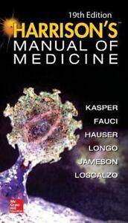
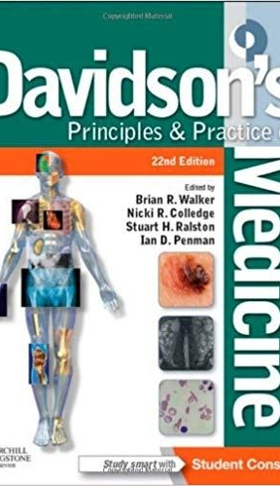
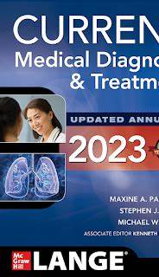
STUDY RESOURCES
VERTICAL INTEGRATION

Slide 48
MCQs
1)Firm and matted lymph nodes are found in
A) Tuberculosis
B) Malignancy
C) Infective lymphadenitis
D) Lymphoma

Slide 49
Answer: Tuberculosis

Slide 50
2) Massive splenomegaly is found in all of following except
a)CML
b)Visceral leishmaniasis
c)Chronic malaria
d)Enteric fever

Slide 51
Answer: Enteric fever

Slide 52
3) Post ictal confusion and amnesia is a feature of
a) Presyncope
b) Syncope
c) Seizure
d) Vertigo

Slide 53
Answer: seizure

Slide 54
4) Stage 2 hypertension is characterized by blood pressure reading of
> 130/80mmHg
> 140/90mmHg
>120/90mmHg
>150/100mmHg

Slide 55
Answer: >140/90mmHg

Slide 56
5) A Young female with anemia, jaundice, frontal bossing and splenomegaly. Most likely diagnosis is
Non cirrhotic portal hypertension
Hereditary hemolytic anemia
De compensated chronic liver disease
Iron deficiency anemia

Slide 57
Answer:
Hereditary hemolytic anemia

Slide 58
THANKYOU

