Slide 1
Causation of disease Concept of Health and Disease Otorhinolaryngology Block X module -I
Dr Imrana Saeed APMO,Dr Mehjabeen Qureshi

Slide 2
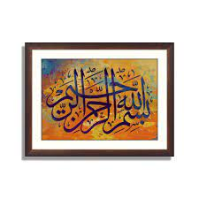

Slide 4
Prof Umar Model

Slide 5
Sequence Of Lecture
Introduction 01
Core concepts 24
Horizontal integration 06
vertical integration 02
Digital Library References 01
( Research, Bioethics)
End of lecture assessment 02
Suggested readings 01

Slide 6
Learning Objectives
By the end of lecture students will be able to;
Explain the concept of Causation of disease through different models
Epidemiological Triad
Wheel model
Multifactorial Causation
Web of Causation
Appraise concept of disease prevention
Categorize the Levels of prevention & types of intervention
Search relevant research articles

Slide 7
Theories of Disease causation
Introduction
1-Germ Theory of disease
One-to-one relationship between causal agent and disease.
Disease Agent Man Disease
Objections: single agent is not responsible in most cases.

Slide 8
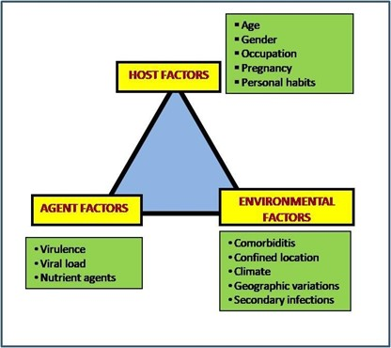
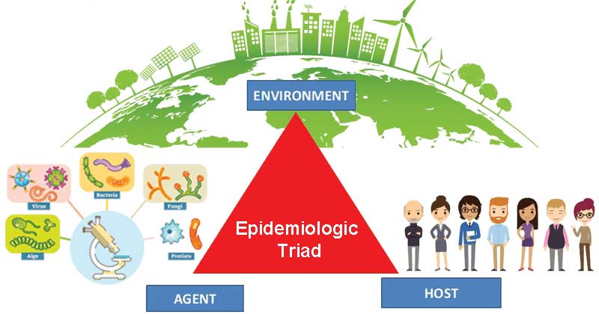
2-Epidemiological Triad
CORE CONCEPTS
Focus on different classes of factors especially with regard to infectious diseases.
Environment
Host
Agent

Slide 9
Epidemiological Triad
CORE CONCEPTS
vector

Slide 10
3-The wheel model
CORE CONCEPTS
Wheel model presents the interaction b/w host & environment.
Agent is not mentioned as it is considered part of biological environment.
The size varies with disease
E.g., in Down’s Syndrome (hereditary condition) the genetic core would be large
Physical Environment
Genetic core
Social
Environment
Biological
Environment

Slide 11
Multifactorial Causation
CORE CONCEPTS
Multiple factors involved in causation of chronic diseases
Linked to lifestyle and human behavior.
Purpose of knowing multiple factors of disease
To quantify and arrange them in sequence of priority (prioritization)
To prevent or control disease.

Slide 12
Web of Causation
Vertical integration
Model of disease causation suggested by McMahon and Pugh
This model is ideally suited for chronic diseases considers all the predisposing factors and their complex interrelationships with each other. e.g., Myocardial Infarction.
Sometimes removal of just only one link or chain may be sufficient to control disease

Slide 13
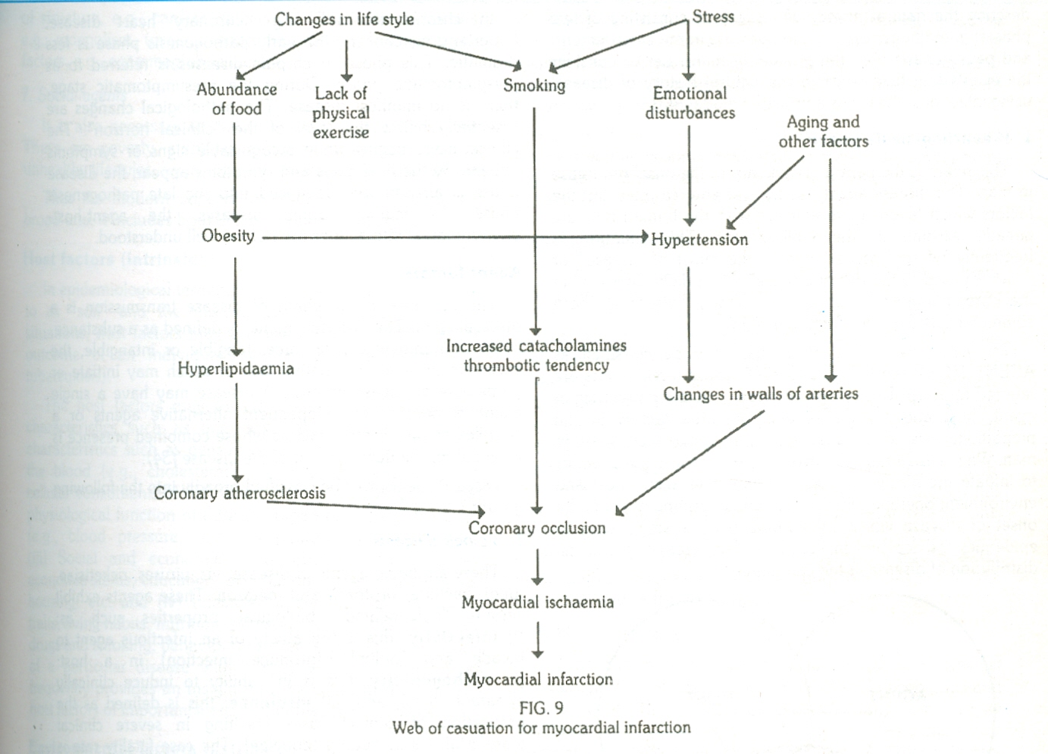
Web of causation cont….
Vertical integration

Slide 14
Natural History of Disease
Horizontal Integration
The way in which a disease evolves over time from the earliest stage of its pathogenesis phase to its termination as recovery, disability or death, in the absence of treatment or prevention.
Best established by cohort studies.
Consists of two phases: Pre-pathogenesis phase and Pathogenesis phase.

Slide 15
Pre-pathogenesis Phase
The period preliminary to the onset of disease in man.
Disease agent has not yet entered man/ has not been able to initiate disease.
The factors which favors the interaction of disease agent with human host are already existing in the environment.
Horizontal integration

Slide 16
Pathogenesis Phase
Horizontal integration
Characterized by entry of the disease agent in the susceptible human host.
Incubation Period Early and late pathogenesis phases Outcome (recovery, disability or death).
Pathogenesis modified by intervention measures such as immunization or chemotherapy.

Slide 17
Pathogenesis Phase
Horizontal Integration
Infection may be clinical or subclinical/ typical or atypical or may become a carrier with or without having developed clinical disease.
In Chronic Diseases (e.g. coronary heart disease, hypertension, cancer) early pathogenesis phase is less dramatic.
In late pathogenesis phase, the symptoms become manifest.

Slide 18
Spectrum of Disease
A graphic representation of variations in the manifestations of disease.
At one end are subclinical infections and at the other end are fatal illnesses. In the middle lie illnesses ranging from mild to severe.
For almost all diseases, there exists a spectrum of severity with few exceptions such as Rabies.
In infectious diseases, the spectrum of disease is also referred to as the “gradient of infection”.

Slide 19
Horizontal integration
Natural History of Disease /spectrum of disease (Completing the clinical picture of the disease)
Death
Good health
Sub clinical
Changes
Clinical
disease
Recovery

Slide 20
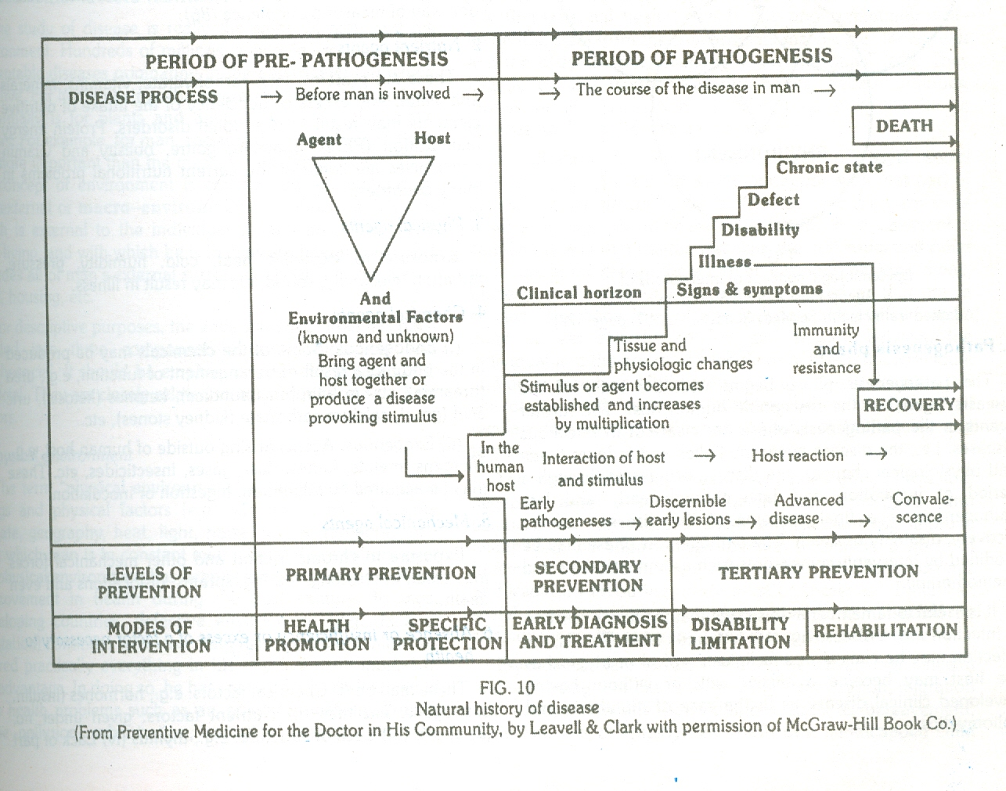
Horizontal integration

Slide 21
Agent Factors
Core concepts
Agent : A substance, living or non-living, or a force, tangible or intangible, the excessive presence or the relative lack of which may initiate or perpetuate a disease process.
Single agent/ independent alternative agents or factors.

Slide 22
Agent Factors
Core concepts
1. Biological agents:
Infectivity, pathogenicity, virulence.
2. Nutrient agents: fats, vitamins, minerals, water etc.
3. Physical agents: heat, cold, humidity, etc.
4. Chemical agents:
i) Endogenous: eg urea, bilirubin, ketones, uric acid,etc.
ii) Exogenous: allergens, metals, fumes, dust, insecticides.

Slide 23
Agent Factors (Cont..)
Core concepts
5. Mechanical agents:
crushing, tearing, sprains, dislocations.
Absence or insufficiency or excess of a factor necessary to health.
E.g. poverty, smoking, abuse of drugs and alcohol, unhealthy lifestyles, social isolation.
6.Social agents

Slide 24
Host Factors (Intrinsic)
Core concepts
“Soil” and “Seed”.
Host Factors:
Demographic characteristics: age, sex
Biological characteristics: genetic factors
Social and economic characteristics: education, occupation
Lifestyle factors: living habits, smoking, alcohol consumption

Slide 25
Environmental Factors (Extrinsic)
Core concepts
Macro-environment : “All that which is external to the individual human host, living or non-living, and with which he is in constant interaction”.
Includes air, water, food and housing, etc.
Micro- environment??????

Slide 26
Environmental Factors
Core concepts
Physical Environment:
Non-living things & physical factors. New health problems due to pollution, urbanization, radiation hazard.
Biological environment:
Living things around man including man himself. These act as disease-producing agents, reservoirs of infection, intermediate hosts and vectors of disease.
Psychosocial environment:
Cultural values, customs, habits, religion, education, lifestyles, community life, health services, social and political organization

Slide 27
Risk factors
An attribute or exposure that is significantly associated with the development of a disease.
A determinant that increases the like hood of developing a disease
Risk factors maybe additive or synergistic.
May be truly causative/ contributory/ predictive only in a statistical sense.
May be Modifiable/ Non-modifiable or immutable.

Slide 28
Levels of prevention with Modes of Interventions
Core Concepts
Primary Prevention
Health Promotion
Specific Protection
Secondary Prevention
Early Diagnosis & Treatment
Tertiary Prevention
Disability Limitation
Rehabilitation
Primordial prevention
Relatively new concept
Esp. for prevention of chronic diseases
Prevention of emergence of risk factors responsible for disease causation e.g. to childhood obesity efforts directed to promote healthy lifestyles
Main focus is on health education of masses

Slide 29
Primary prevention (Reduces incidence of disease)
Action taken prior to disease onset (in pre pathogeneses period)
Health promotion through health education
Mass strategy
High risk strategy
Specific protection by
Immunization , chemoprophylaxis
Use of Specific nutrients e.g. Vit A drops, iodized salt
Protection against occupational hazards
Wearing seat belt for protection from accidents

Slide 30
Secondary prevention (Reduces prevalence of disease)
Action (taken in early stage of disease) which halts the progress of disease & prevent complications
Early diagnosis by
Screening tests
case finding
Prompt treatment with medication( Mainly domain of clinical medicine)

Slide 31
Tertiary prevention (Reduces the number & impact of complications)
Actions taken if patient comes in late stage of disease
Disability limitation
Rehabilitation
Medical…. Restoration of function
Social…… Restoration of family & social relationships
Vocational….. Restoration of capacity to earn a livelihood
Psychological…..Restoration of personal dignity & confidence

Slide 32
31

Slide 34
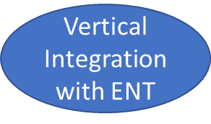
Strategies to prevent acute otitis media
Environmental factors:
Discourage
Childcare in large group setting
Environmental smoke exposure
Pacifier use
Encourage
Breast feeding
Immunization
Passive immunization
RSVIG-IV (selected infants)
Active immunization
Influenza vaccine
pneumococcal vaccine
Antibiotic prophylaxis

Slide 35
Public health approach to problem(disease)

Slide 36
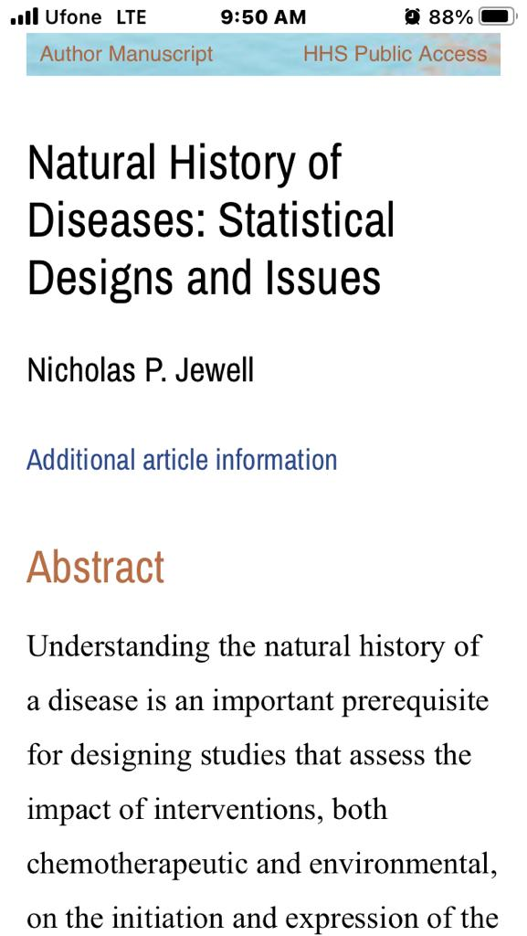
Relevant research article
https://www.ncbi.nlm.nih.gov/pmc/articles/PMC5017909/

Slide 37
End Of Session Assessment
A study was conducted to observe etiology, pathogenesis, duration and outcome of the HIV / AIDS. It means that the study was collectively focused on disease:
Epidemiology
Natural history
Severity
Prognosis
Infectivity

Slide 38
End Of Session Assessment
A researcher wanted to study how cholera evolves over time from the earliest state of its causation to its extinction as recovery, disability or death, without treatment or any intervention. This means that the researcher is interested in disease:
Pathogenesis
Natural history
Etiology
Prognosis
Severity

Slide 39
Further readings
Suggested readings parks text book 27th edition chapter 2 (concept of disease)
THANK YOU

